Slide 1
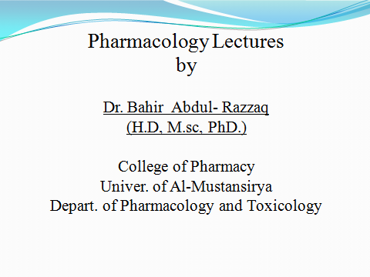
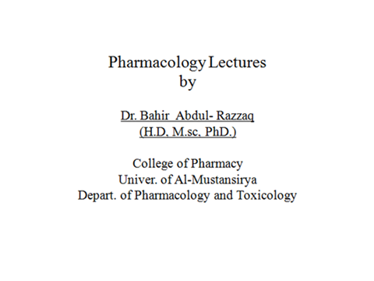

Slide 2
Immune Response
Cellular and Humoral Immunity

Slide 3
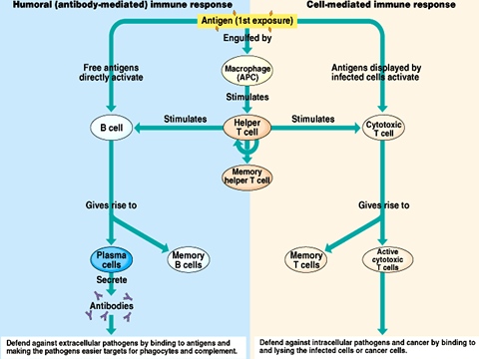

Slide 4
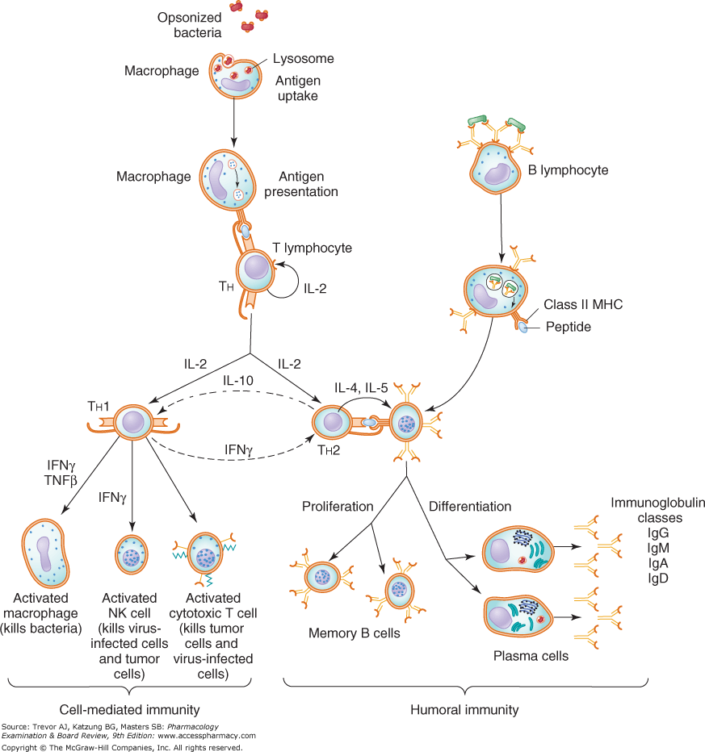

Slide 5
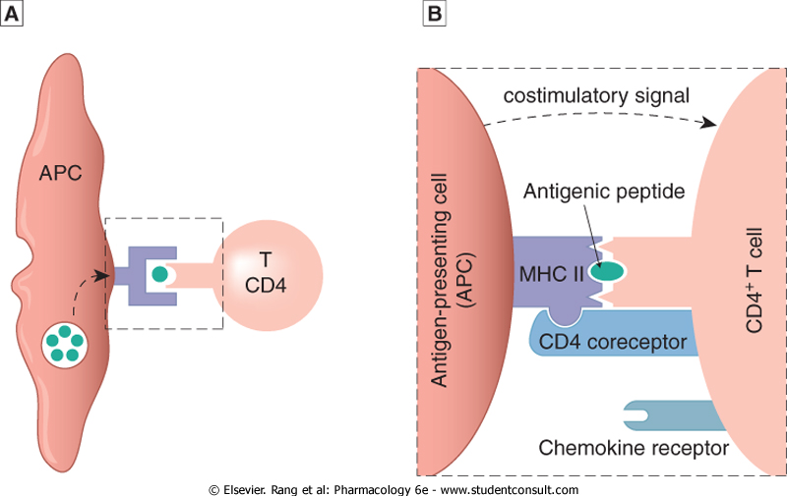

Slide 6
Complications of Immune Response Over Stimulation

Slide 7
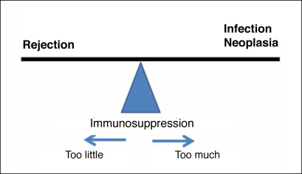

Slide 8
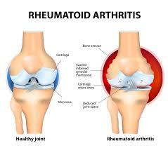

Slide 9
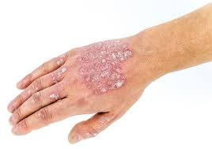

Slide 10
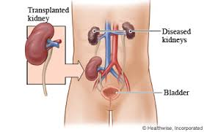

Slide 11
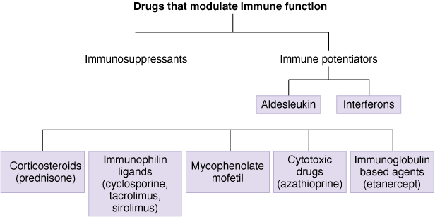

Slide 12
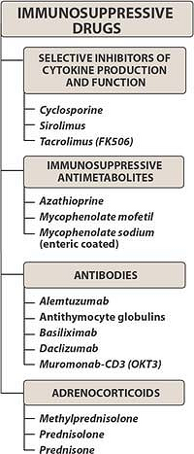

Slide 13
Cytokine-Production Inhibitors
(Calcineurin Inhibitors)
Signal 1-blockers

Slide 14
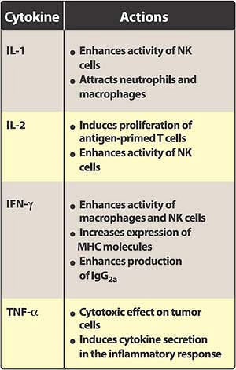

Slide 15
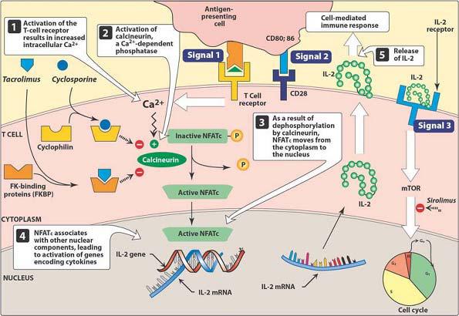

Slide 16
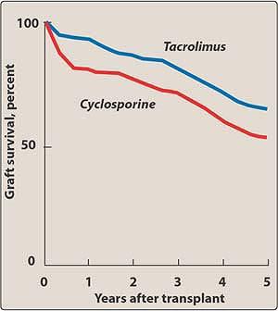

Slide 17
Co-stimulation Blockers
(CD28-blockers)
Signal 2-blockers

Slide 18
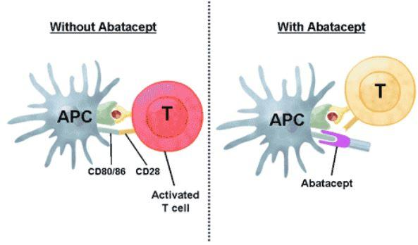

Slide 19
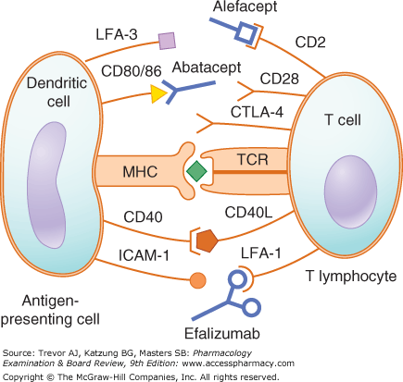

Slide 20
Cytokine-Function Inhibitors
(mTOR inhibitors)
Signal 3-blockers

Slide 21
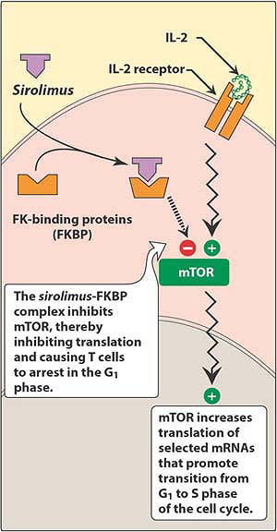

Slide 22
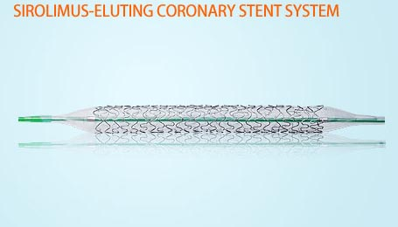

Slide 23
Antimetabolities

Slide 24
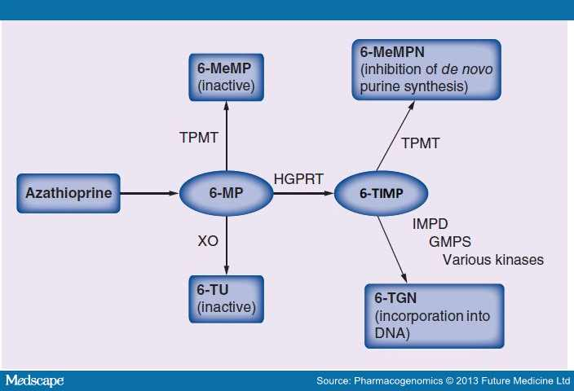

Slide 25
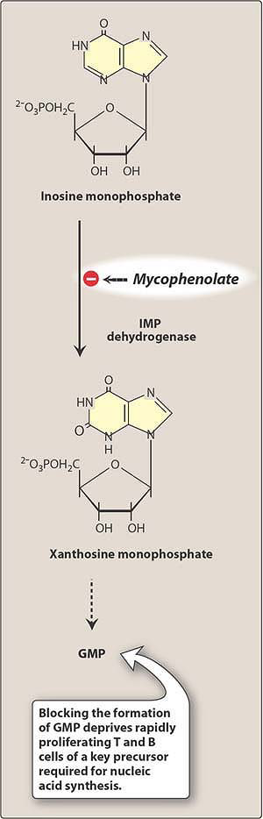

Slide 26
Antibodies

Slide 27
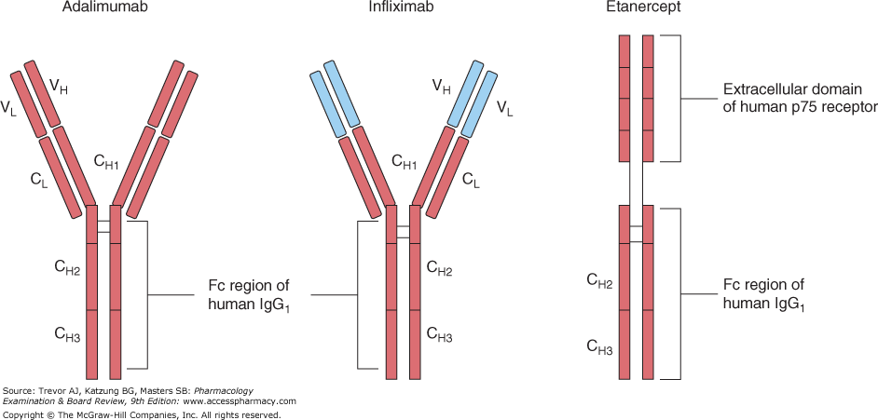

Slide 28
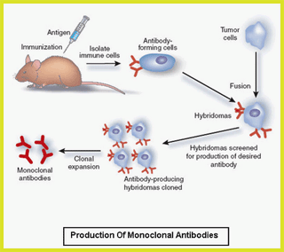

Slide 29
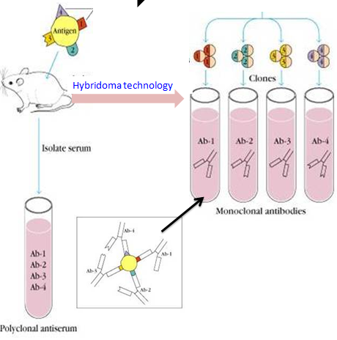

Slide 30
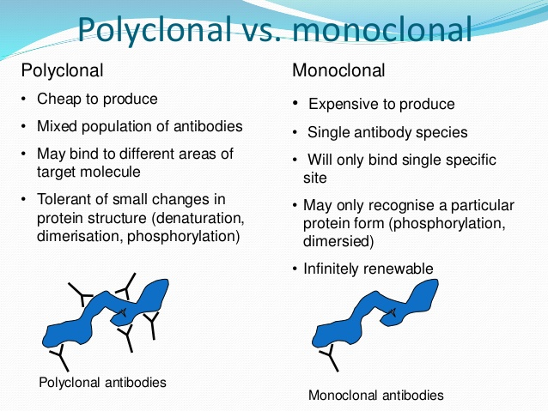

Slide 31
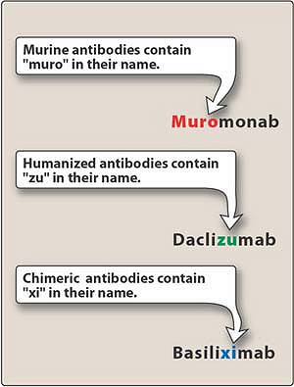

Slide 32
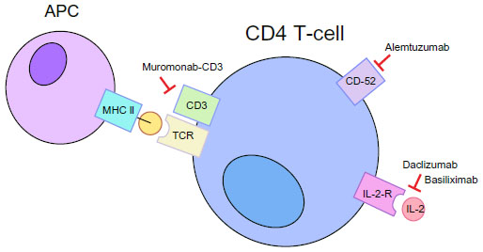

Slide 33
Corticosteroids

Slide 34
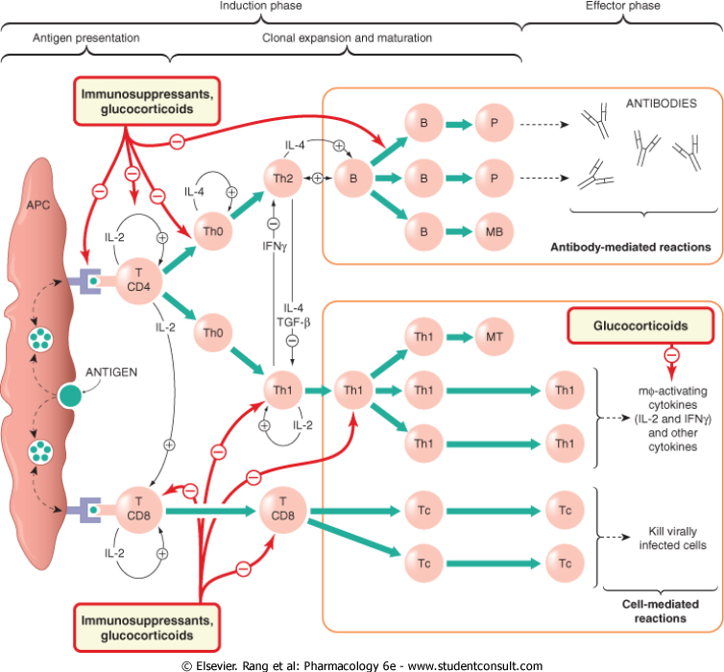

Slide 35
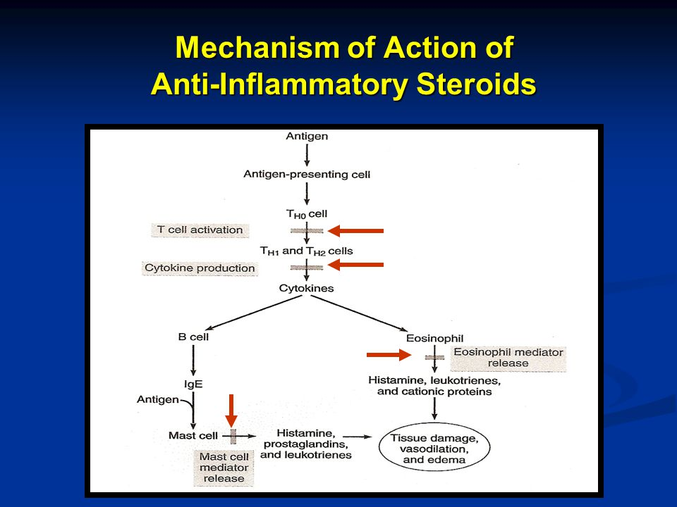

Slide 36
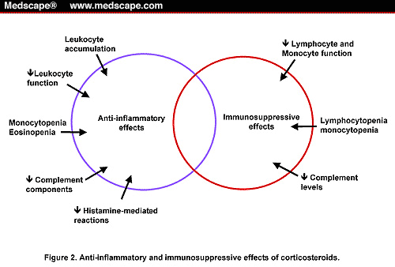

Slide 37
Sites of Action of Immunosuppressants

Slide 38
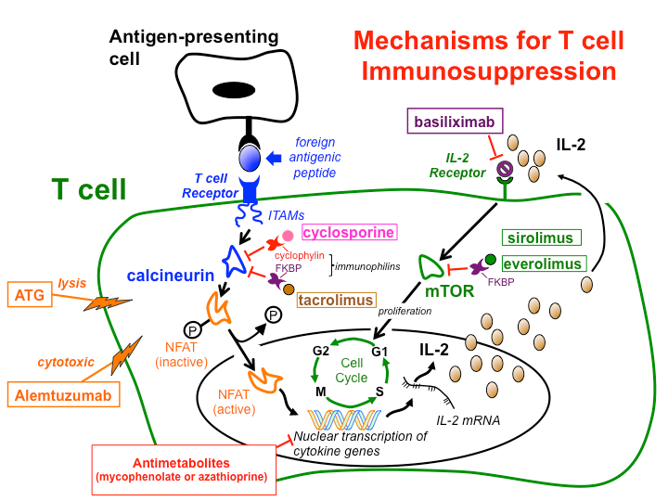

Slide 39
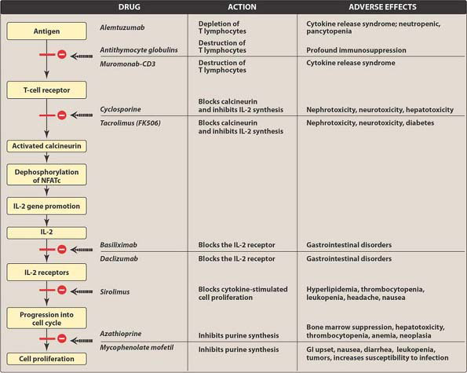

Slide 40
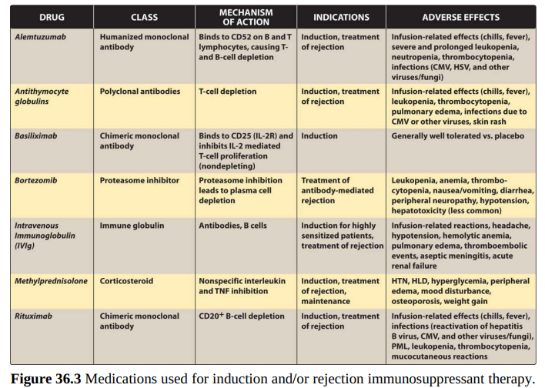

Slide 41
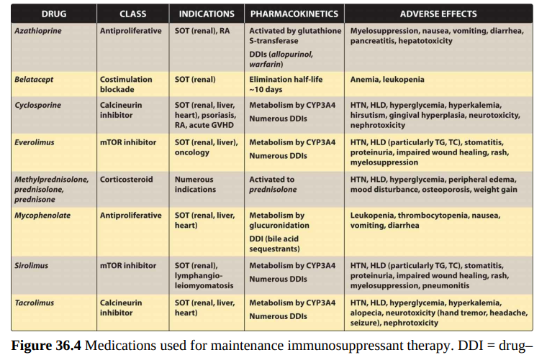

Slide 42
Checklist:
Describe the primary features of cell-mediated and humoral immunity.
Name 7 immunosuppressants and, for each, describe the mechanism of action, clinical uses, and toxicities.
Describe the mechanisms of action, clinical uses, and toxicities of antibodies used as immunosuppressants.
Identify the major cytokines and other immunomodulating agents and know their clinical applications.
Describe the different types of allergic reactions to drugs.

Slide 43
Which of the following drugs specifically inhibit calcineurin in the activated
T -lymphocytes?
A. Daclizumab.
B. Tacrolimus.
C. Prednisone.
D. Sirolimus.
E. Mycophenolate mofetil.

Slide 44
