Slide 2
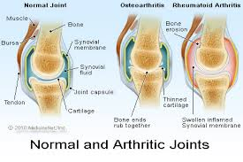

Slide 3
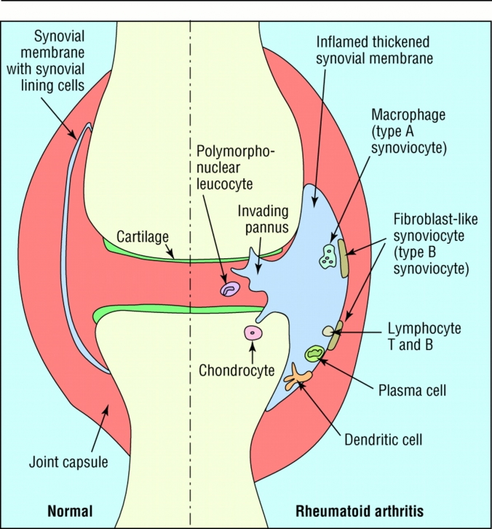

Slide 5
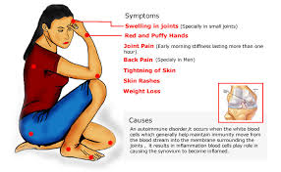

Slide 10
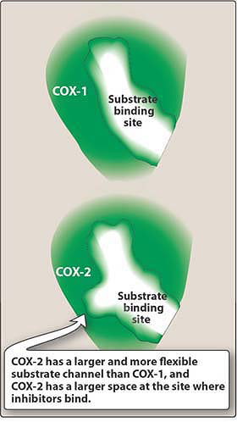

Slide 11
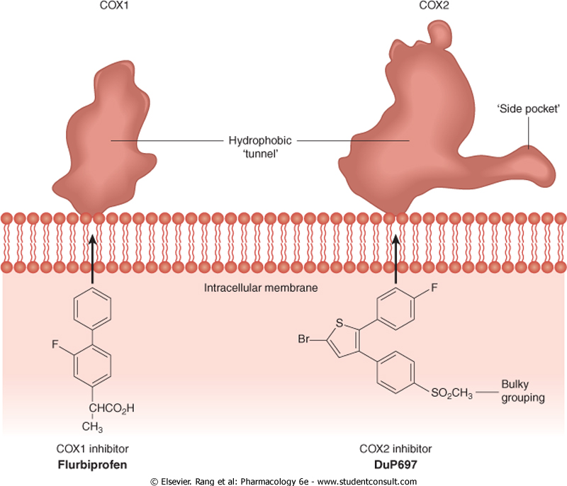

Slide 13
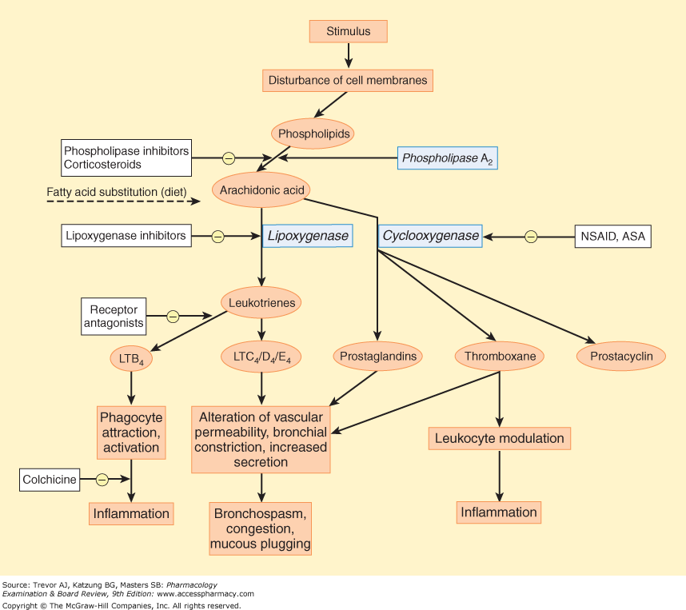

Slide 14
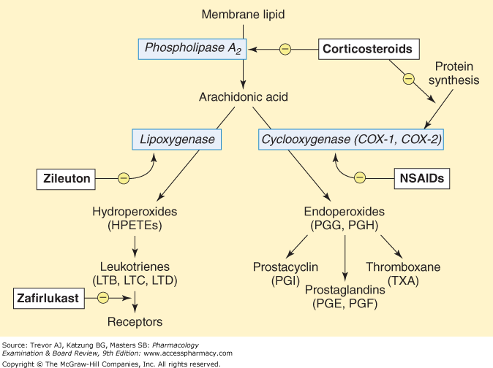

Slide 16
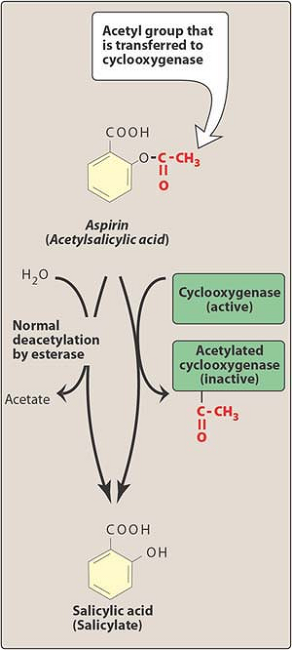

Slide 17
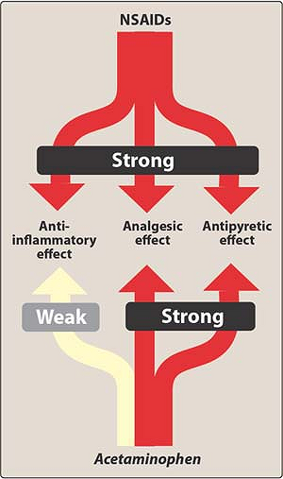

Slide 18
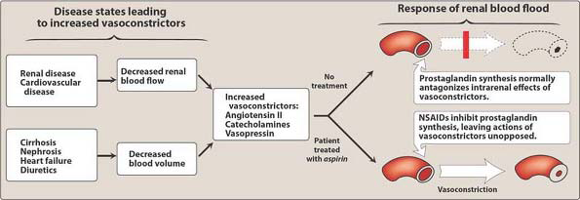

Slide 19
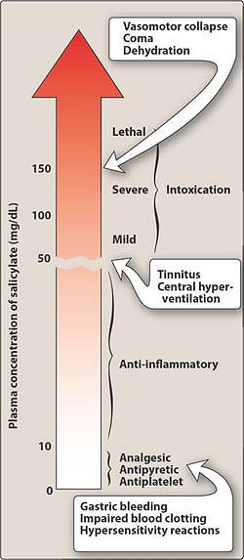

Slide 20
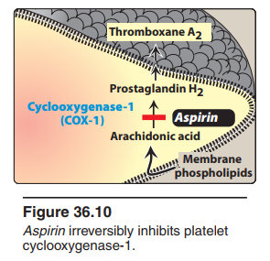

Slide 21
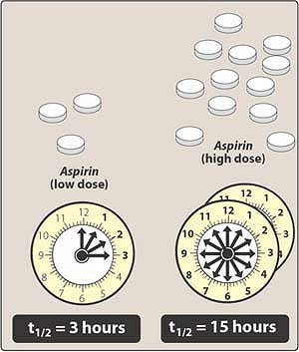

Slide 22
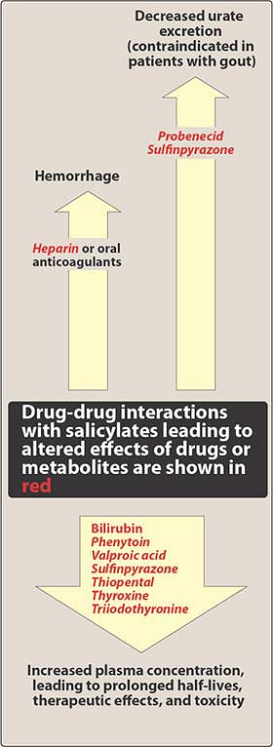

Slide 23
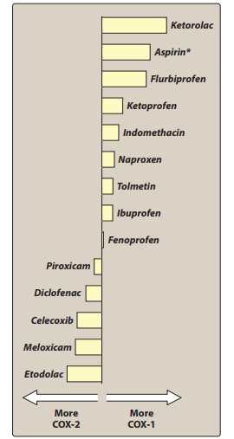

Slide 24
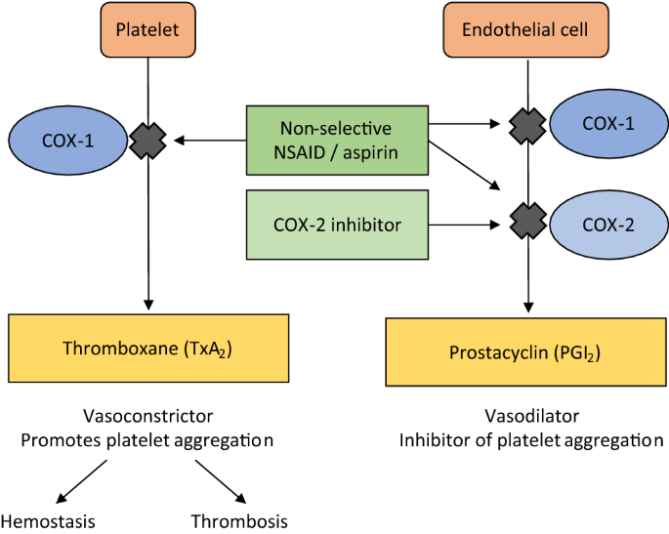

Slide 27
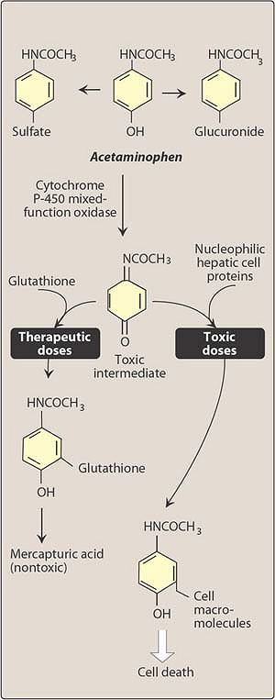

Slide 28
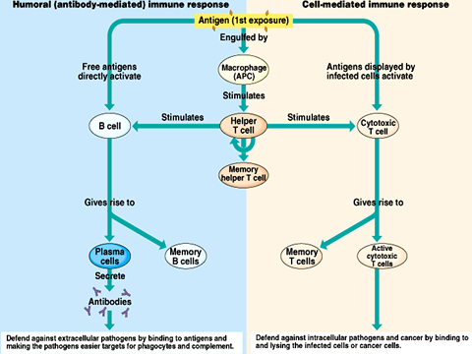

Slide 30
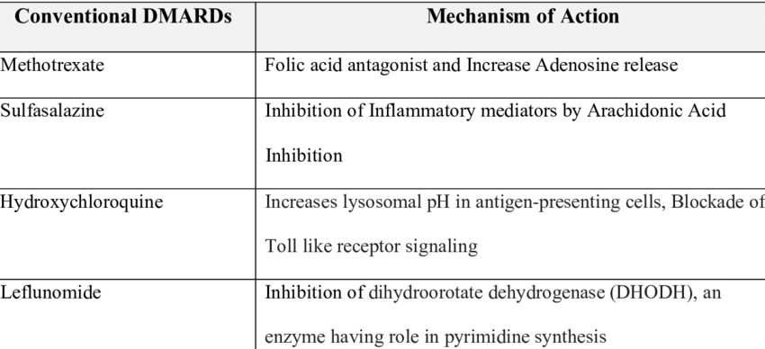

Slide 31
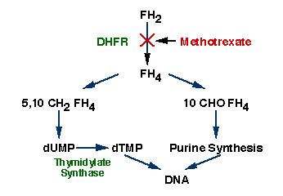

Slide 32
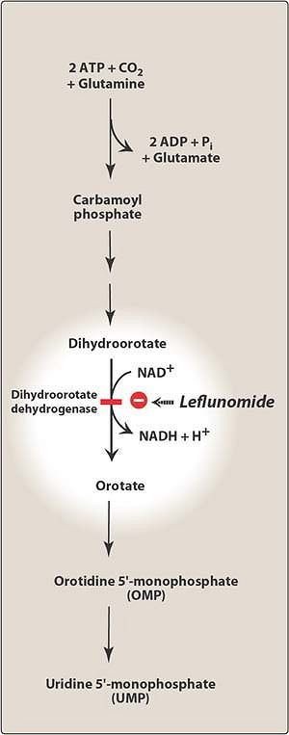

Slide 33
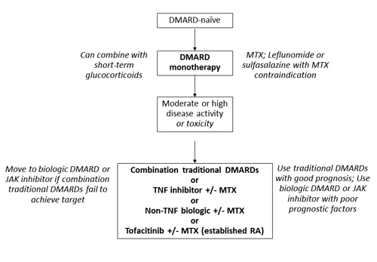

Slide 34
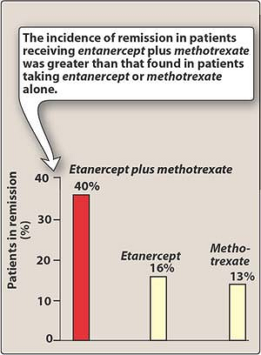

Slide 37
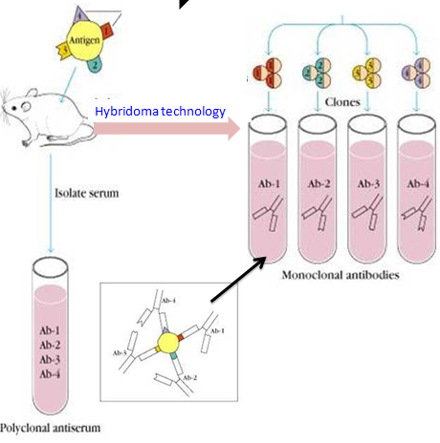

Slide 39
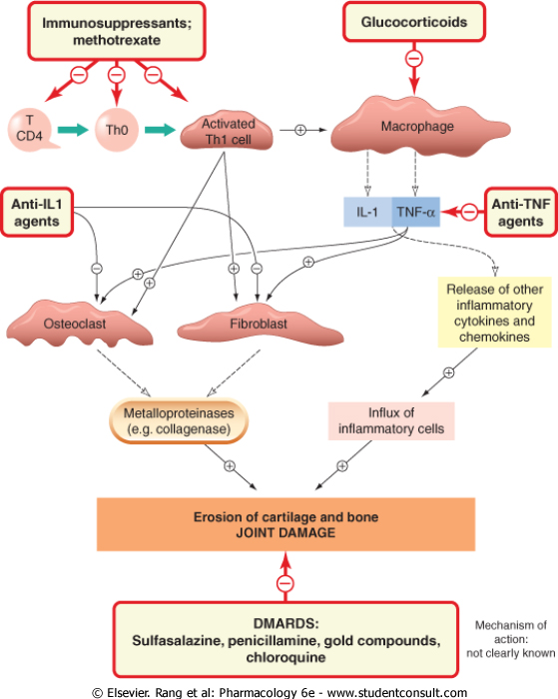

Slide 40
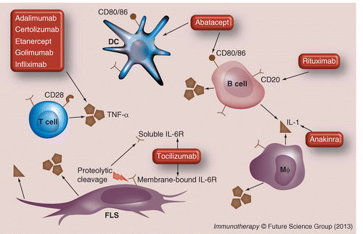

Slide 41
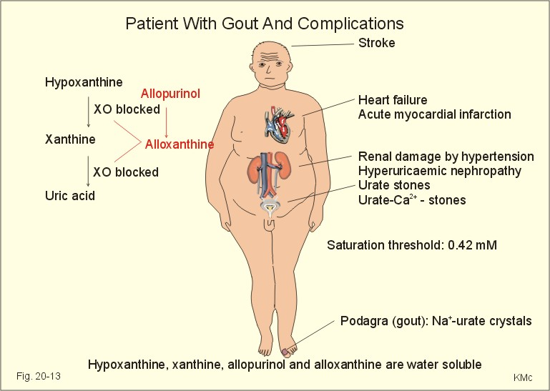

Slide 42
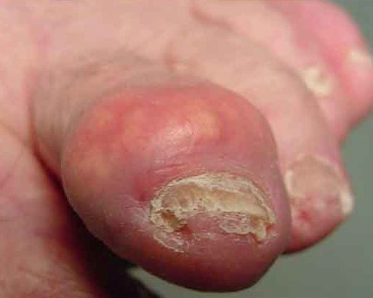

Slide 43
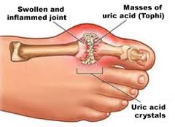

Slide 44
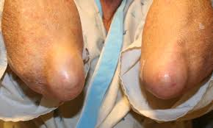

Slide 46
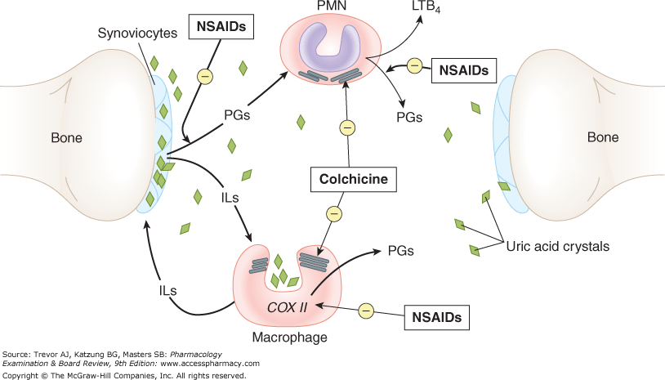

Slide 48
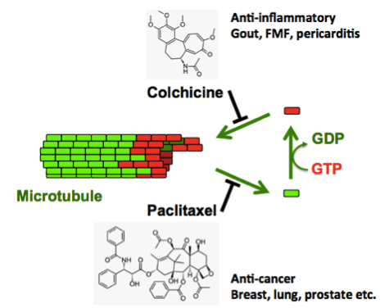

Slide 49
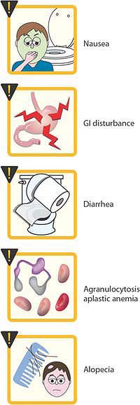

Slide 50
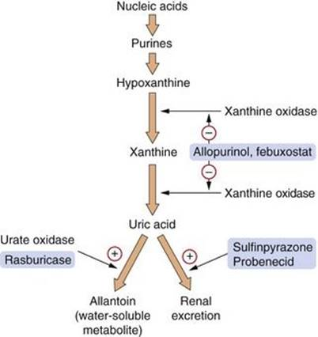

Slide 51
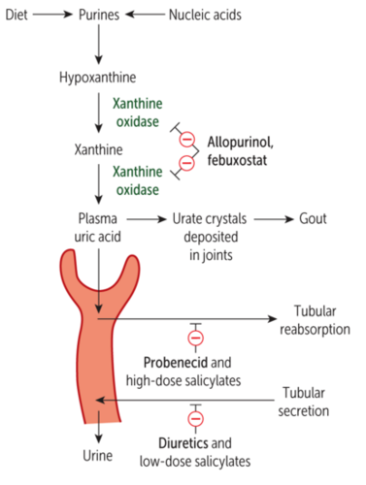

Slide 52
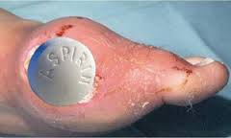

Slide 54
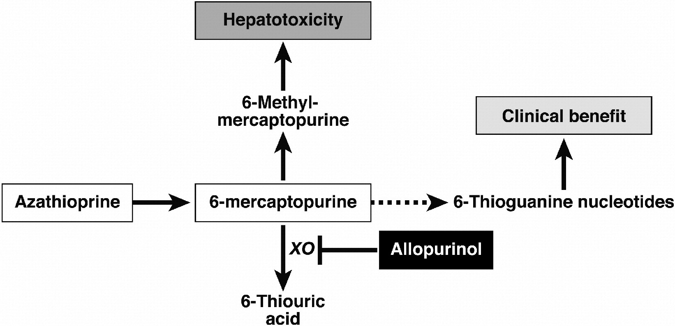

Slide 55
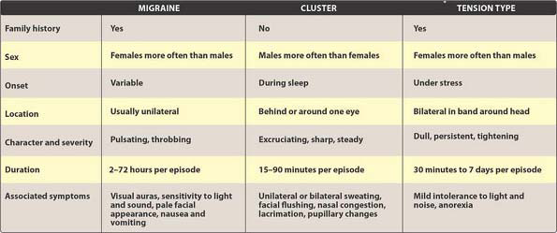

Slide 58
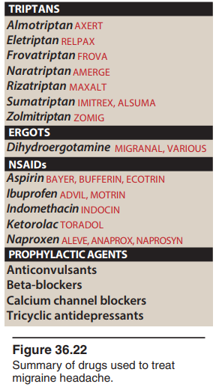

Slide 59
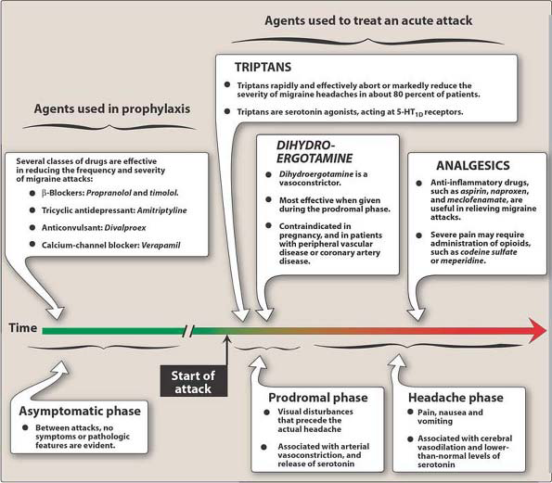

Slide 60
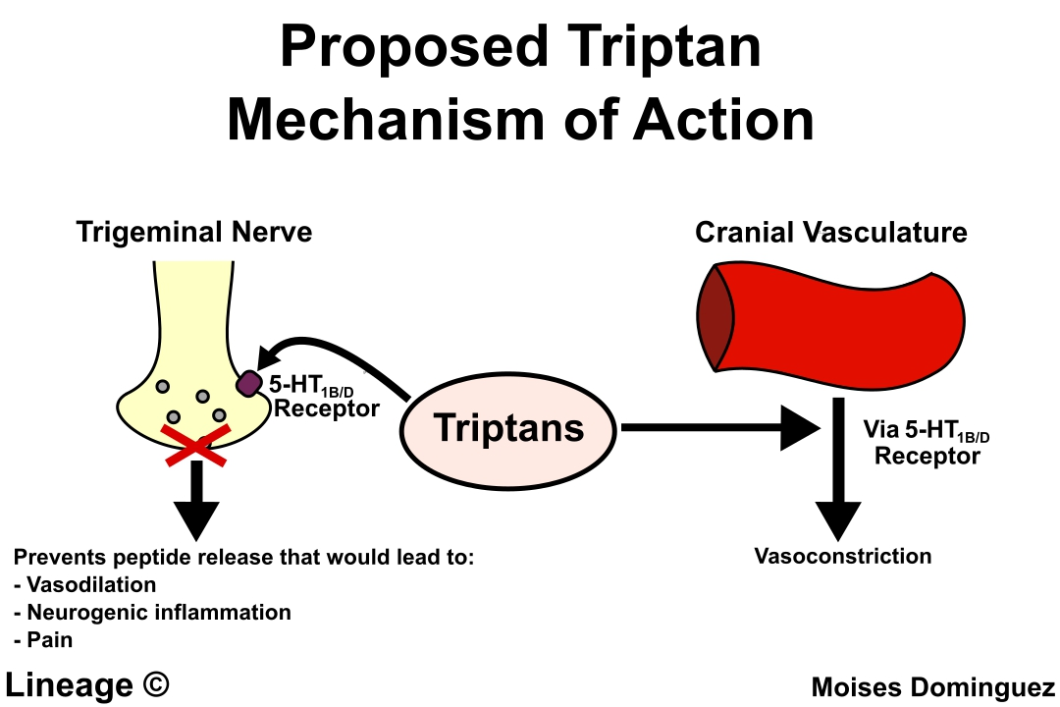

Slide 63
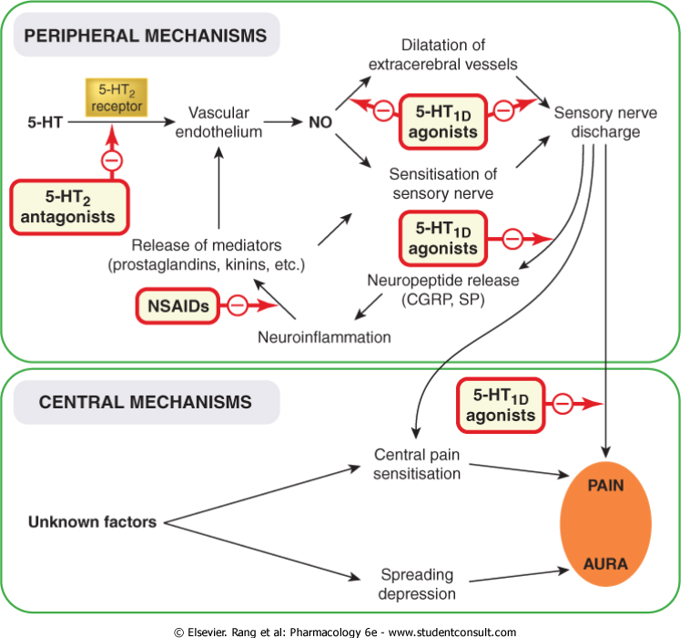

Slide 64
Checklist
When you complete this chapter, you should be able to:
List the major effects of PGE₂, PGF₂, PGI₂, LTB₄, LTC₄, and LTD₄.
List the cellular sites of synthesis and the effects of thromboxane and prostacyclin in the vascular system.
List the currently available therapeutic antagonists of leukotrienes and prostaglandins and their targets (receptors or enzymes).
Explain the different effects of aspirin on prostaglandin synthesis and on leukotriene synthesis.

Slide 65
When you complete this chapter, you should be able to:
Describe the effects of NSAIDs on prostaglandin synthesis.
Contrast the functions of COX-1 and COX-2.
Compare the actions and toxicity of aspirin, the older nonselective NSAIDs, and the COX-2-selective drugs.
Explain why several of the highly selective COX-2 inhibitors have been withdrawn from the market.
Describe the toxic effects of aspirin.
Describe the effects and the major toxicity of acetaminophen.
Name 5 disease-modifying antirheumatic drugs (DMARDs) and describe their toxicity.
Contrast the pharmacologic treatment of acute and chronic gout.
Describe the mechanisms of action and toxicity of 3 different drug groups used in gout.

Slide 66
Checklist
When you complete this chapter, you should be able to:
List the major organ system effects of histamine and serotonin.
Describe the pharmacology of the 2 generations and 3 subgroups of H₁ antihistamines; list prototypical agents for each subgroup.
Describe the pharmacology of the H₂ antihistamines; name 2 members of this group.
Describe the action and indication for the use of sumatriptan.
Describe one 5-HT₂ and one 5-HT₃ antagonist and their major applications.
List the major organ system effects of the ergot alkaloids.
Describe the major clinical applications and toxicities of the ergot drugs.

Slide 67
Which one of the following statements concerning
COX-2 inhibitors is correct?
A. The COX-2 inhibitors show greater analgesic
activity than traditional NSAIDs.
B. The COX-2 inhibitors decrease platelet function.
C. The COX-2 inhibitors do not affect the kidney.
D. The COX-2 inhibitors show anti-inflammatory
activity similar to that of the traditional NSAIDs.
E. The COX-2 inhibitors are cardioprotective

