Slide 1
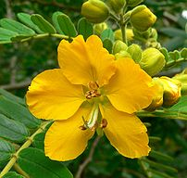
ANTHRAQUINONE GLYCOSIDES
Pharmacognosy
3rd Class, 1st Semester
Lab.4

Slide 2
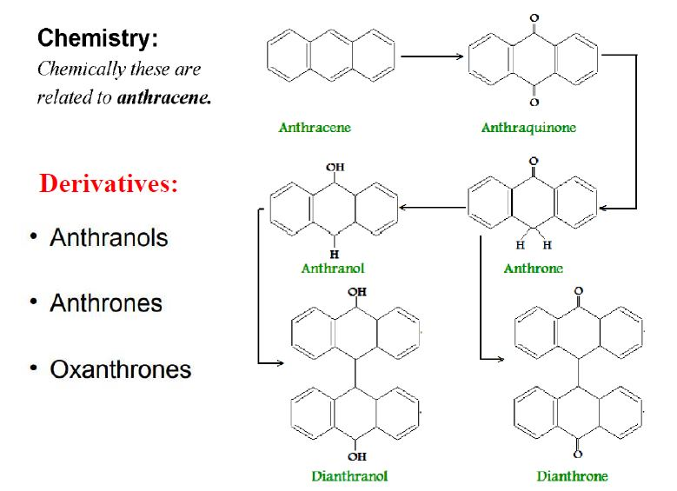
Anthraquinone glycosides are anthracene derivatives most of them contain anthraquinone skeleton.

Slide 3
Glycosides of anthranols, dianthrones, and oxanthrones have significant therapeutic action.
The glycosides, upon hydrolysis, yield aglycones that are di-, tri-, or tetrahydroxyanthraquinones or modifications of these compounds.
Mechanism of action
They employed as stimulant cathartic which exert their action by increasing the tone of the smooth muscle in the wall of the colon and stimulate the secretion of water and electrolytes into the large intestine (bulk laxatives).

Slide 4
Medicinal plants that contain Anthraquinone glycoside :
1-Senna
2-Cascara
3-Frangula
4- Aloe
5-Rhubarb
Drug of choice
not recommended due to their irritating action.
Aloe use in the treatment of minor burns

Slide 5
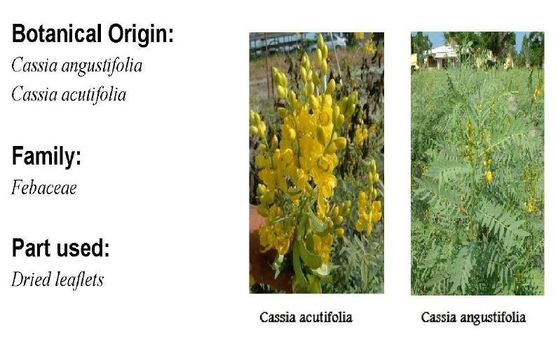
Senna

Slide 6
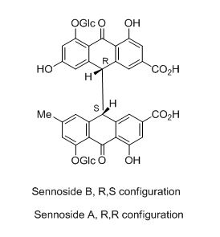
Sennoside :anthraquinone glycoside of senna plant in which the aglycone part is dimer of anthrone (dianthrone) .

Slide 7
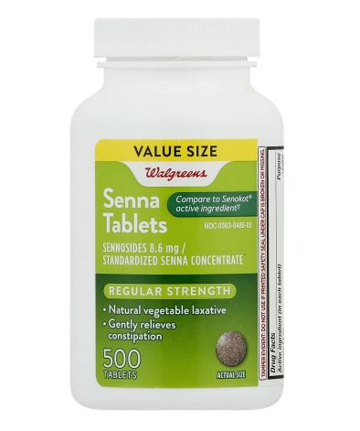
Market formulation

Slide 8
Extraction OF Anthraquinone glycosides (Senna)
Macerate the powdered plant material with 70% ethanol
After filtration
Place the filtrate in separatory funnel and shaking with same quantity of
chloroform 1x2
Fraction(A)
Organic layer
Fraction(B)
aqueous layer
mix few amount of fraction B then add FeCL₃ and dilute HCL on water bath for about10 min.
Partion with chloroform
Fraction(c)
Organic layer
Fraction(d)
aqueous layer

Slide 9
Discussion
The chloroform layer will contain the free aglycone (fraction B) , while the aqueous layer will contain the glycoside as a whole , since sugar is water soluble (fraction A) .
The use of ferric chloride and HCL and reflux is to break the C-C bond in the dimmer, which is very strong bond so need strong conditions.

Slide 10
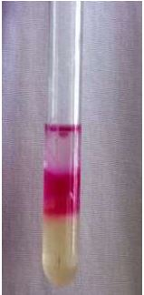
Borntragers test for anthroquinone
Hydrolysis the glycoside with acid and heating to form free aglycone and sugar parts
mix with chloroform in separatory funnel to take free aglycone(free anthraquinone)
Then in test tube mix 5ml of chloroform layer with aqueous KOH or dilute ammonia to form two immiscible layers
A pink to red color produced in the alkaline layer indicate the presence of free anthraquinone

Slide 11
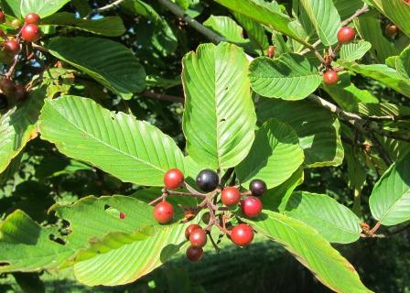
Thank You

