Slide 1
Cell Contents
Cytology is the science that deal with cell
Cell theory
1) The cell is the unit of the structure and function
2) All organisms consist of one or more cells

Slide 2
Plant cell
Cell wall
protoplast
Non-living substance
Living substance
Metabolic products
Like, protein ,
, alkaloids, tannins
Glycoside, ca-oxalate
Food storage
like, starch,
Plasma membrane
mitochondria
nucleus
plastids
chlorophyll
Golgi body
ribosome's

Slide 3
starch
Starch = carbohydrate consisting of a large number of glucose units joined together by glycoside bonds.
Pure starch
white, tasteless and odorless powder that is insoluble in cold water or alcohol
Blue color with iodine(identification)
starch generally contains 20 to 25% amylose and 75 to 80% amylopectin

Slide 4
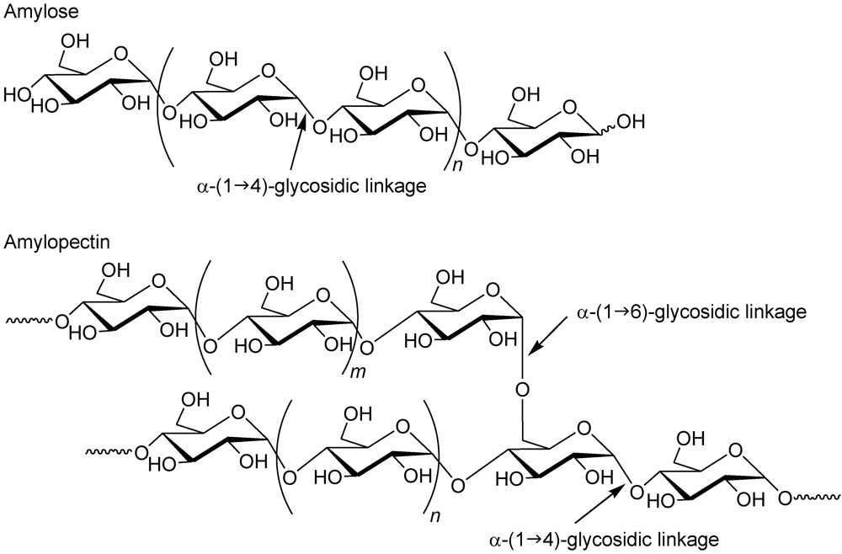

Slide 5
Starch type in plant
Primary starch = from photosynthesis in chloroplast
Secondary starch = store in tubers
Convert to glucose

Slide 6
Unheated starch granule
Heated starch granule

Slide 7
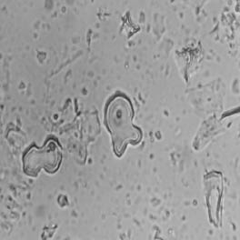
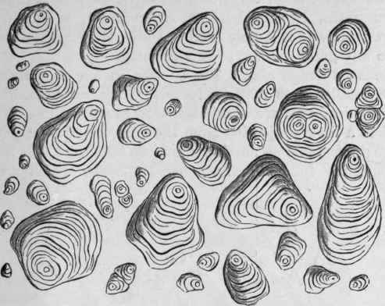
STARCH
starch occurs in granules of varying size in almost all organs of plants, found in roots, fruits, rhizomes and seeds. Starch granules may simple or compound, compound granules formed by aggregation of a large numbers of simple granules

Slide 8
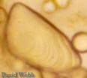
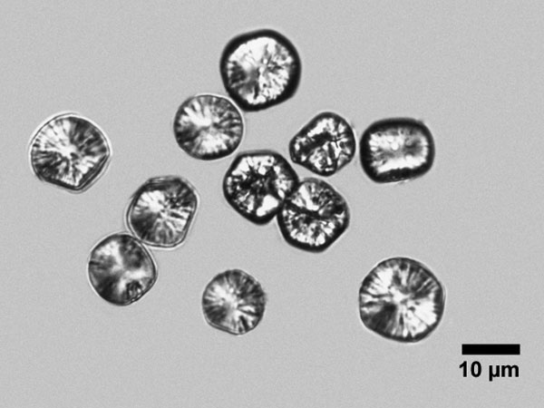
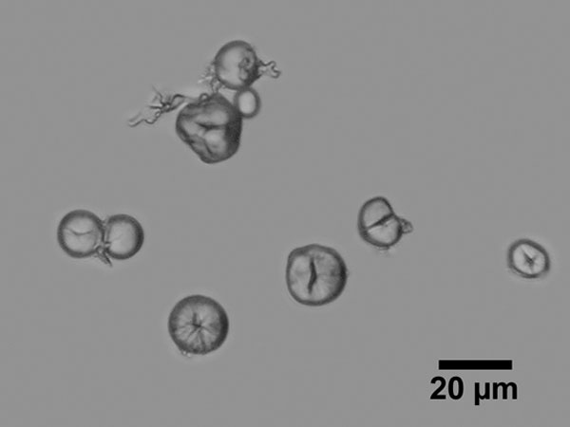
Hilum: is the starting point of formation of starch granules, the position of the Hilum either central or ecentric. There are different shapes of Hilum (dot, curved, multiple clefts).
Concentric rings : (deposition of the layers around the Hilum)

Slide 9
Hilum | Shape | Type of starch
Central triangles or 2-5 satellite cleft without striation | Simple, polyhedral or sub spherical | Maize starch
Central point without striations | Compound granules, polyhedral with sharp angles | Rice starch
Point, eccentric with well marked striations | Simple granules, mussel shapes | Potato starch

Slide 10
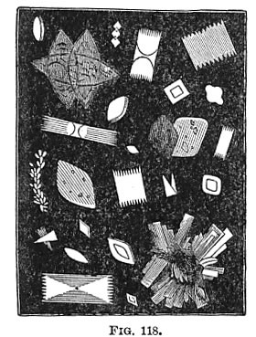
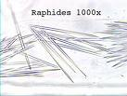
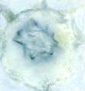
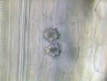
CRYSTALS
Crystals are inorganic salt(waste material). Most crystals are composed of calcium oxalate. Calcium oxalate is a dimorphous salt.
Prismatic
Allium cepa
Raphides
Druses
Nerium olender

Slide 11
Slide no. 1 potato starch (Solanum tuberosum) .you has to differentiate the size, shape, Hilum,

Slide 12
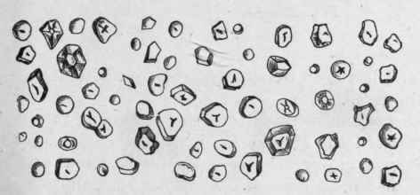
Slide no. 2 Maize starch ( Zea mays )

Slide 13
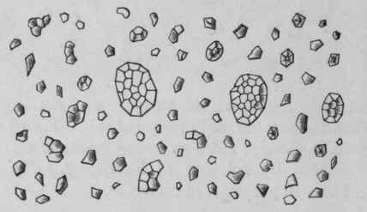
Slide no. 3 Rice starch

