Slide 1
Principles of pharmacy practice
Lec 5
Lecturer Dr Athmar Dhahir Habeeb Al-Shohani
PhD in industrial pharmacy and pharmaceutical formulations
athmar1978@uomustansiriyah.edu.iq
athmar1978@yahoo.com
athmar.habeeb.12@ucl.ac.uk

Slide 2
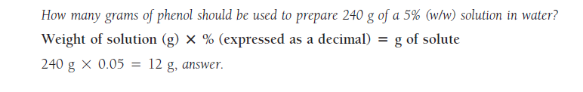
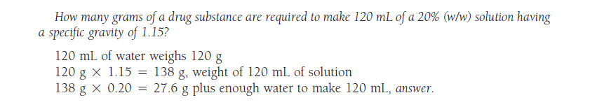
Percent weight in weight

Slide 3
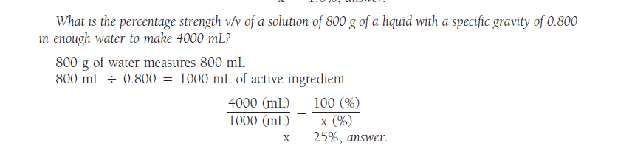
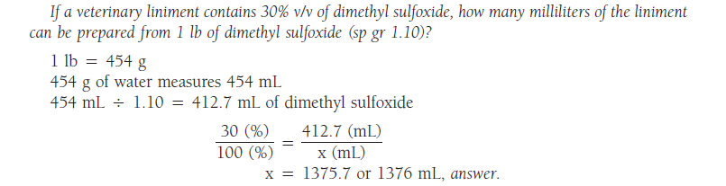

Slide 4
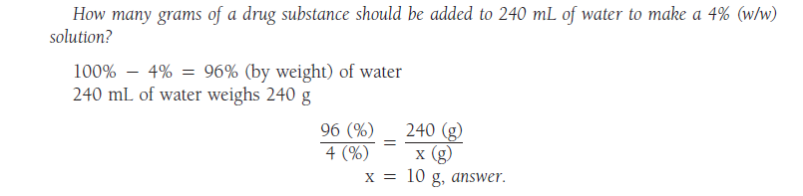
Sometimes in a weight-in-weight calculation, the weight of one component is known but not the total weight of the intended preparation. This type of calculation is performed as demonstrated by the following example.

Slide 5
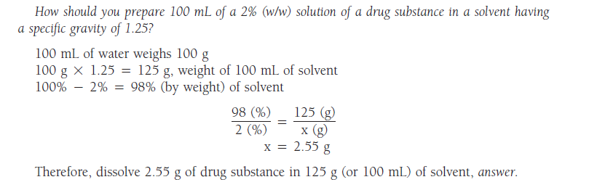

Slide 6

Calculating Percentage Strength Weight-in-Weight
If the weight of the finished solution or liquid preparation is not given when calculating its percentage strength, other data must be supplied from which it may be calculated: the weights of both ingredients, for instance, or the volume and specific gravity of the solution or liquid preparation.
If 1500 g of a solution contains 75 g of a drug substance, what is the percentage strength (w/w) of the solution?

Slide 7
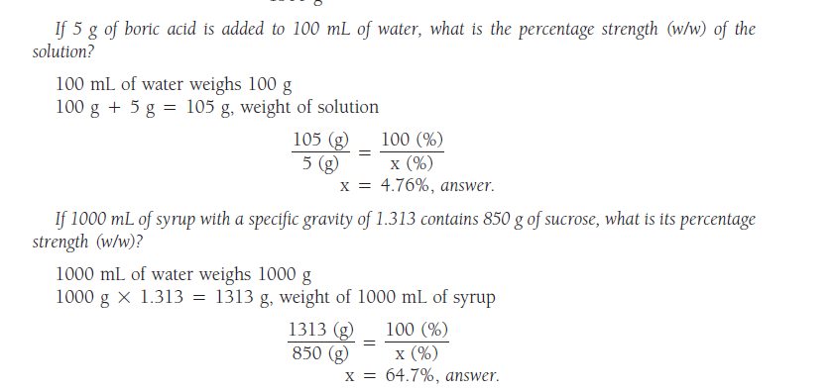

Slide 8
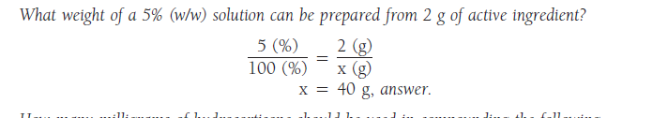
Weight-in-Weight Calculations in Compounding
Weight-in-weight calculations are used in the following types of manufacturing and compounding problems

Slide 9
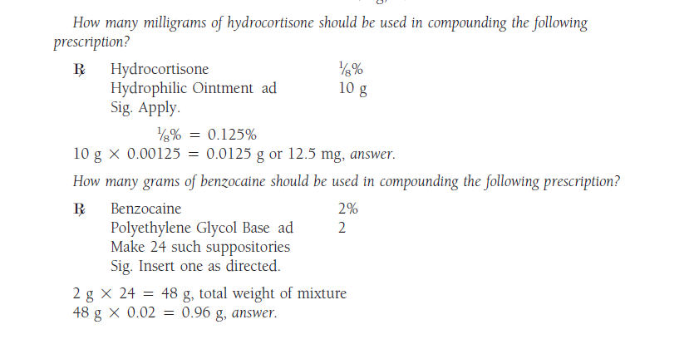

Slide 10
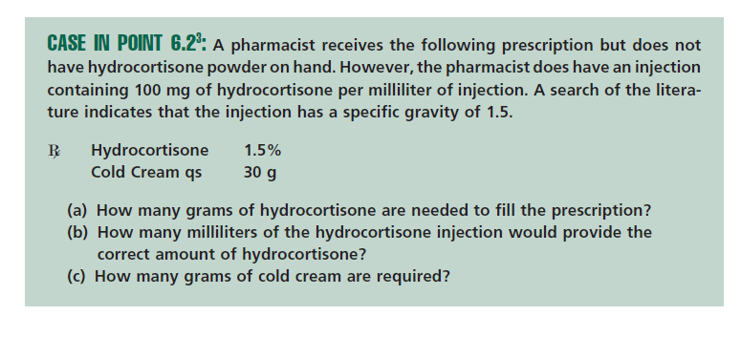

Slide 11
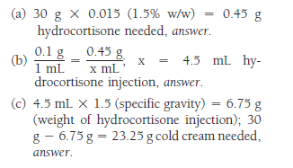

Slide 12

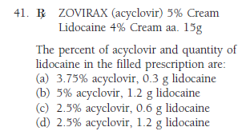

Slide 13
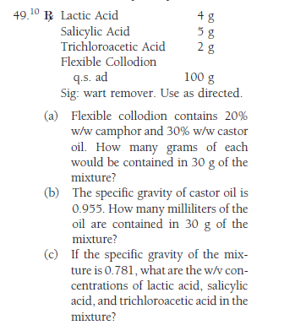

Slide 14
Ratio strength
The concentrations of weak solutions are frequently expressed in terms of ratio strength. Because all percentages are a ratio of parts per hundred When a ratio strength, for example, 1:1000, is used to designate a concentration, it is to be interpreted as follows:
For solids in liquids 1g of solute or constituent in 1000 mL of solution or liquid preparation.
• For liquids in liquids 1 mL of constituent in 1000 mL of solution or liquid preparation.
• For solids in solids 1g of constituent in 1000 g of mixture.
The ratio and percentage strengths of any solution or mixture of solids are proportional, and either is easily converted to the other by the use of proportion.

Slide 15
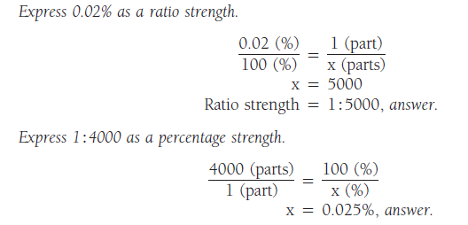
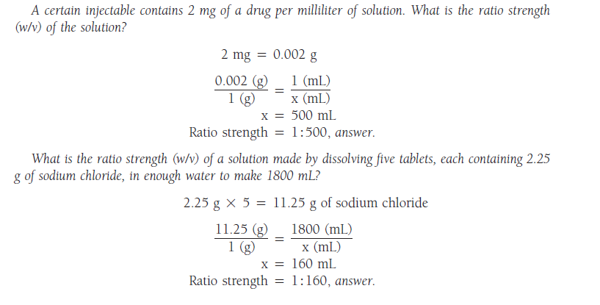

Slide 16
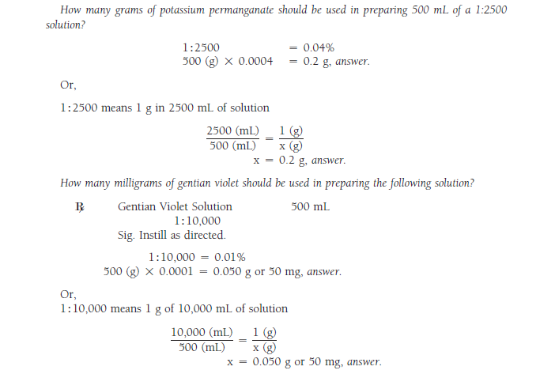

Slide 17
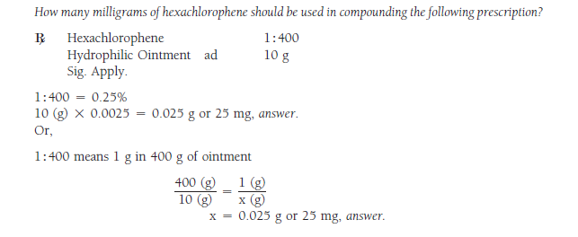

Slide 18
Mg/mL
Occasionally, pharmacists, particularly those practicing in patient care settings, need to convert rapidly product concentrations expressed as percentage strength, ratio strength, or as grams per liter (as in IV infusions) to milligrams per milliliter (mg/mL)

Slide 19
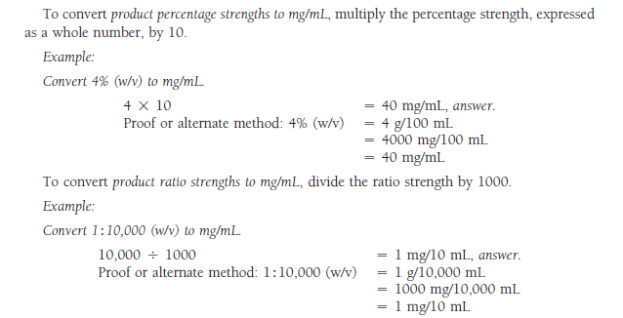

Slide 20
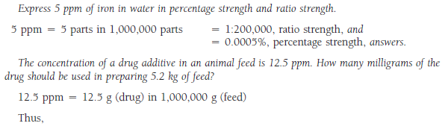
Part per million (ppm)
Part per billion (ppb)
The strengths of very dilute solutions are commonly expressed in terms of parts per million (ppm) or parts per billion (ppb), i.e., the number of parts of the agent per 1 million or 1 billion parts of the whole

Slide 21
