Slide 1
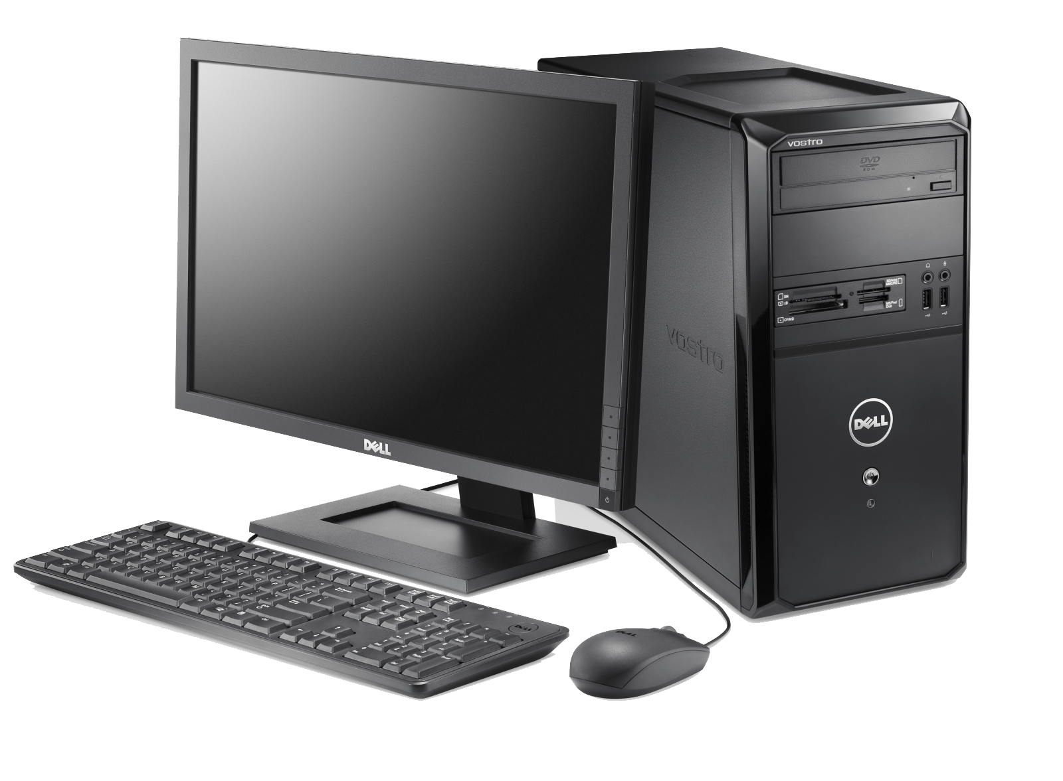
Lesson 2
Main Parts of a PC
Case
Monitor
Keyboard
Mouse

Slide 2
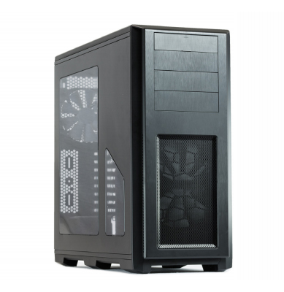
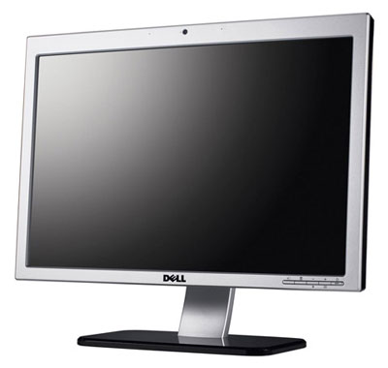
Lesson 2 – Main Parts of a PC
System Unit/Case/Box
It is a plastic or metal box.
Box has many other parts of the computer like CPU, Motherboard, Hard disk, CD-ROM.
Box may be Tower-top or Desk-top.
Monitor / VDU (Video Display Unit)
It is used to view information or results from the computer.
Monitors are of many sizes and qualities.
LCDs are new shapes of monitors.

Slide 3
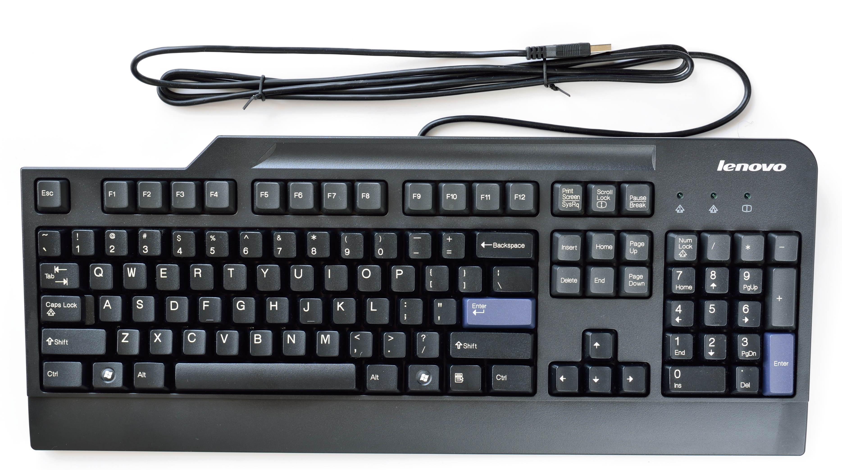

Lesson 2 – Main Parts of a PC
Keyboard
It is used to enter information in the computer.
Its like a board having Keys (buttons)
Mouse
It is used to operate or control the computer.
When mouse is moved then a cursor is moved on the computer screen.
With mouse we can select menu options,
drag & drop and point & click.

Slide 4
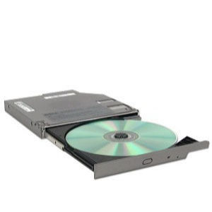
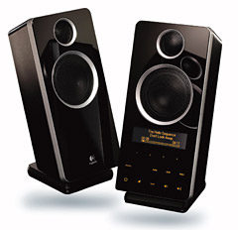
Lesson 2 – Main Parts of a PC
DVD / CD-ROM Drive (CD-ROM)
In CD-ROM, a CD is used to read information.
CD may contain computer software, data or music.
We can also write data/information on Writeable CDs.
Speakers
Speakers are used to play music or any audio.
There are many types of speakers.

Slide 5

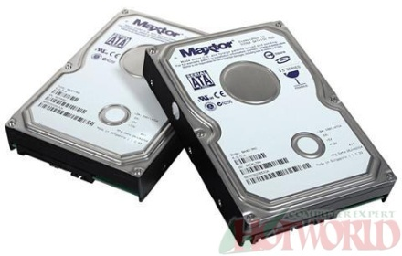
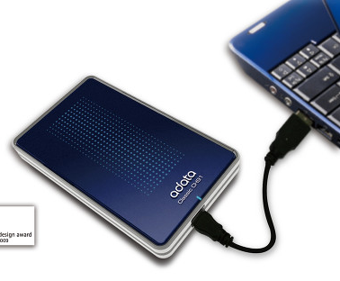

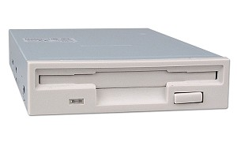
Lesson 2 – Main Parts of a PC
Hard Disk Drive (HDD)
Hard disk is inside the computer box.
It is used to store data and programs.
Hard disk may be external or internal.
Floppy Disk Drive (FDD)
Floppy disk is used to transfer the data from one computer to other computer.
New computers don’t have Floppy drives. Now we have Memory sticks/Flash drive.

Slide 6
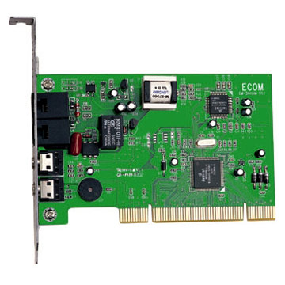
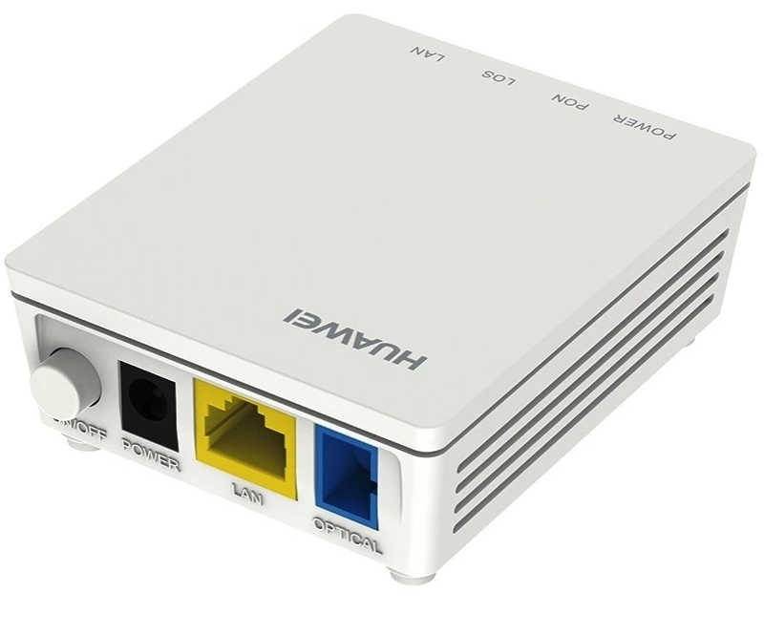
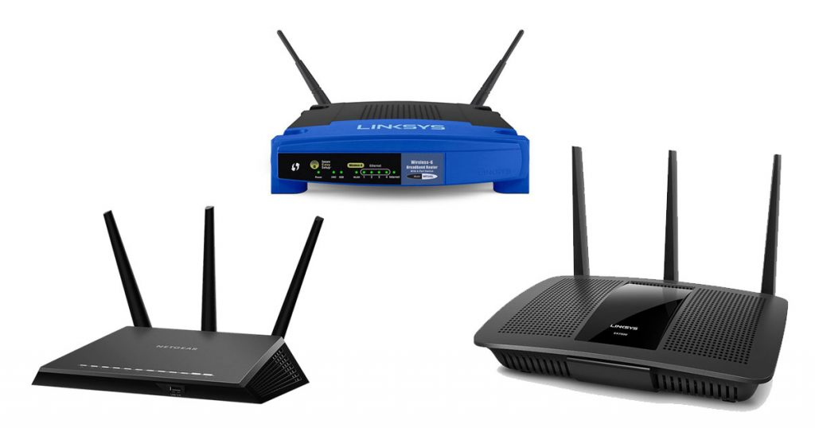
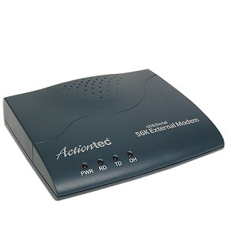
Lesson 2 – Main Parts of a PC
Modem or Routers
Modem is used to connect to internet via a telephone line.
Modem can be internal or external.

Slide 7
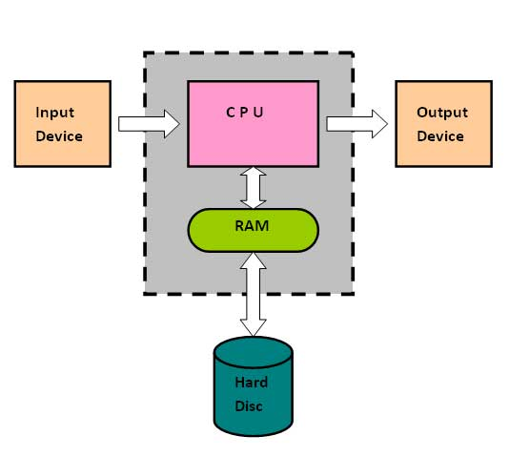
Lesson 2 – Main Parts of a PC
Logical Parts of a PC
CPU
Memory (RAM) (Primary Memory)
Storage (Secondary Memory)
  Hard Disk Drive
  DVD Drives
  Floppy Drives
Input Devices
  Keyboard
  Mouse
Output Devices
  Monitor
  Printer
  Speakers
Storage

Slide 8
A computer can be viewed as made from:-
CPU
Input Devices
Storage (Secondary Memory)
Output Devices
Memory (Primary Memory)

Slide 9
Types of Memory based on Functionality
Memory
Secondary Memory
Primary Memory
Hard Disk
RAM
ROM
DVD/CD Drives
Cache
Floppy Drives

Slide 10
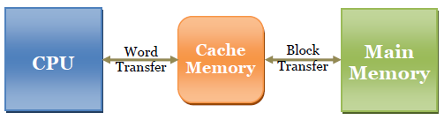
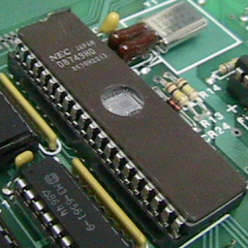
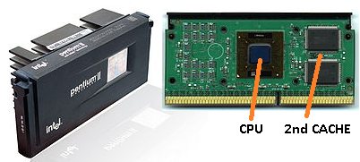
ROM, Cache Memory
This Photo by Unknown Author is licensed under CC BY
ROM (Read Only Memory)
Cache Memory

Slide 11
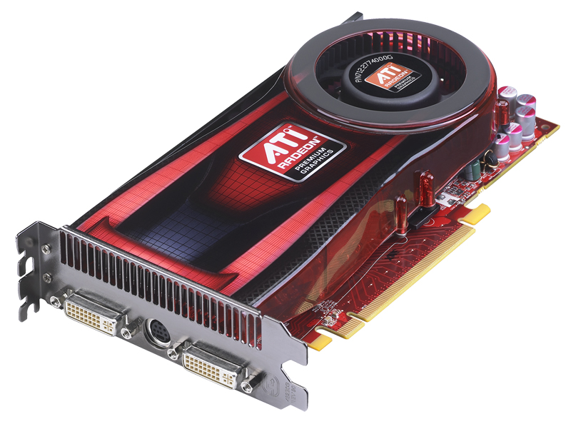
Computer Performance
Factors affecting performance are
CPU
RAM
Graphics cards
Applications running and their number

