Slide 1
Basic Concepts of Information Technology
Lecture 1

Slide 2
Lesson 1 : Basic Terms, types of computers
Hardware, Software, IT

Slide 3
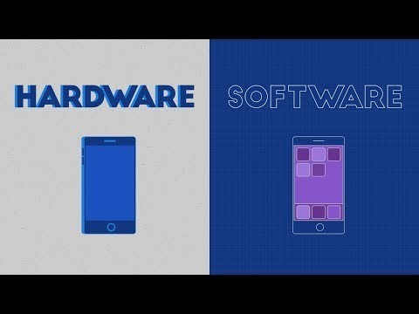
General Concepts

Slide 4
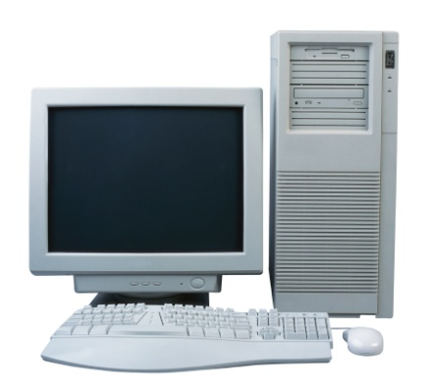
Computer
A computer is an electronic device used to process data, converting data into information that is useful to people.
A computer is a machine that is used to store and process data electronically.
A computer is an electronic device which is used to store, retrieve and process data according to a set of instructions (program) given to it.
Input
Output

Slide 5
Types of Computers
Computers are of following types:
  Super-computer
  Mainframe computer
  Server
  Networked computer
  Personal Computer (PC)
  Laptop computer
  Handheld Devices
    PDA
    Mobile Phones & Smart phones
  Multimedia Players

Slide 6
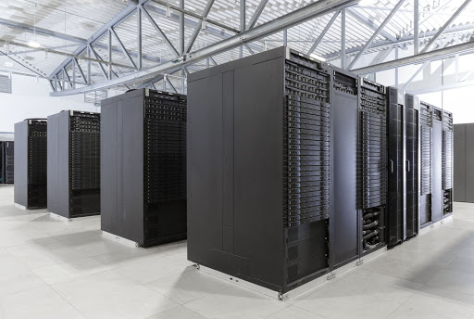
Supercomputer
A computer that was the fastest in the world at the time it was constructed.
Can tackle tasks that would not be practical for other computers.
Typical uses
  Breaking codes
  Modeling weather systems
  Computing structures and properties of
  chemical compounds
Notes:
quantum mechanics, weather forecasting, climate research, oil and gas exploration, molecular modeling (computing the structures and properties of chemical compounds, biological macromolecules, polymers, and crystals), and physical simulations (such as simulations of the early moments of the universe, airplane and spacecraft aerodynamics, the detonation of nuclear weapons, and nuclear fusion)

Slide 7
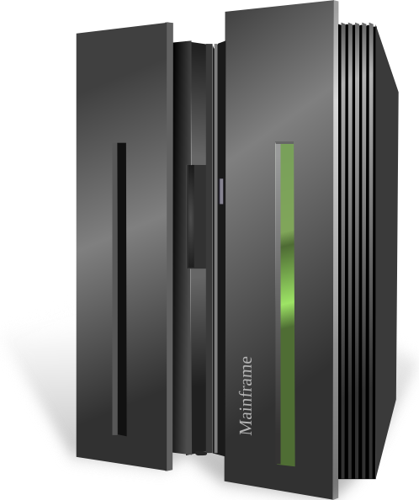
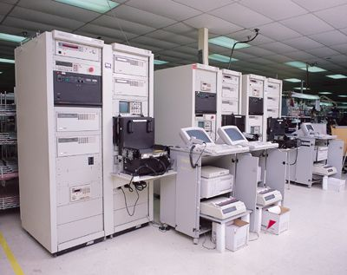
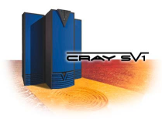
Mainframe Computers
  These are very big, powerful and very high speed computers.
  They can do multiple tasks at high speed.
  These are used by large organisations such an banks to control the entire business operation.
  These are very expensive.
  They are placed in a big room.
Notes:
Big iron from the 60s used as servers

Slide 8
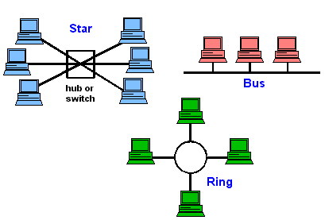
Network Computers
  A network is a collection or group of computers connected with each other via cables or wireless.
  A network is used to share resources and information.
  Network is used in large organisations, schools, hotels and offices.

Slide 9
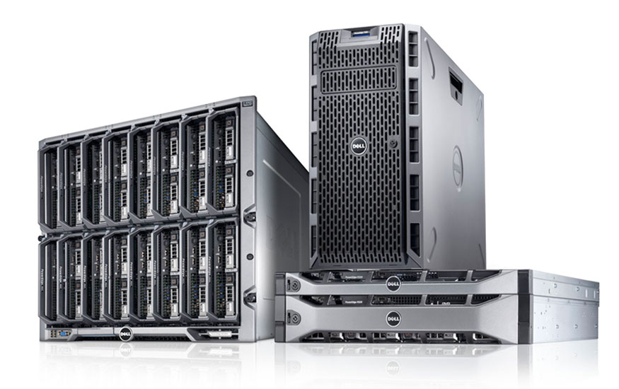
Server
Purpose is to “serve.”
A computer that has the purpose of supplying its users with data; usually through the use of a LAN (local area network).

Slide 10
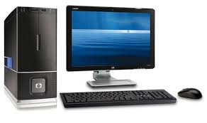
Personal Computer
  In General, the term Personal Computer PC is used for any small computer.
  Standard PC comprises a Casing/Box, a monitor, a keyboard and a mouse.
  PC is cheap and easy to use.
  PC is normally used by students, families and in small businesses.

Slide 11
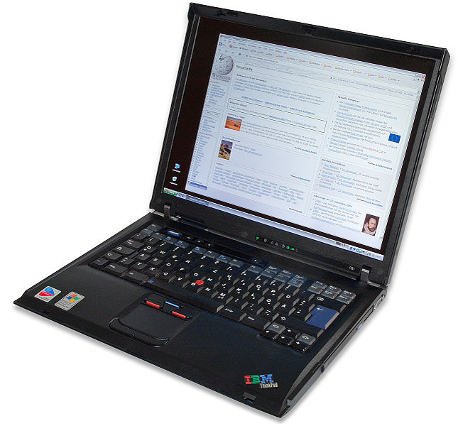
Lesson 1 - Types of Computers
Laptop Computer
  A laptop is a small computer which can be easily carried in a small bag/case.
  In laptop, batteries are used for power.
  Laptop has keyboard and a touchpad.
  It is expensive than PC.
  Laptop is almost equal in speed of a PC.
  It is normally used by business people.

Slide 12
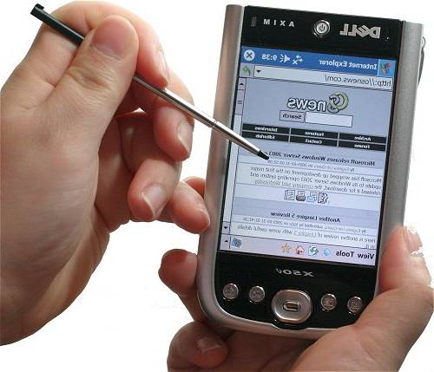
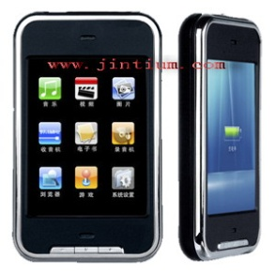
Lesson 1 - Types of Computers
Handheld Devices
  Personal Digital Assistant (PDA)
    It is a small computer which can be placed on the palm of hand.
    It has touch screen where we can use finger or digital pen.
    It can be used as a phone, Media Player, for internet.
    It is also used by businessmen.
  Mobile phones & Smart Phones
    These are advanced phones with latest functions.
    We can use them as a phone and as a computer to use some software.

Slide 13
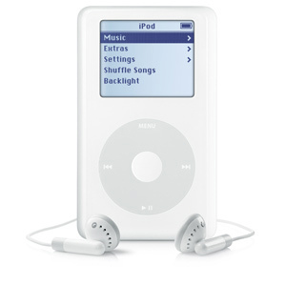
Lesson 1 - Types of Computers
Multimedia Players
  These players can play and view many types of media files e.g. video, music and photos.
  Example is Apple iPod
  We can connect these players to internet or other network.

