Slide 1
Buffer solutions
Lab.6
Done By:
Lecturer Zeina Dawood Assistant Lecturer Hiba Sabah

Slide 2
Buffers: are compounds or mixtures of compounds that, by their presence in solution, resist changes in pH upon the addition of small quantities of acid or alkali.
buffer action : The resistance to a change in pH .

Slide 3
What is a Buffer?
A combination of a weak acid and its conjugate base (i.e., its salt) or
a weak base and its conjugate acid .

Slide 4
Consider a buffer solution that includes of a weak acid and its salt such as the acetate buffer:
CH3COOH ↔ H3O⁺ + CH3COO⁻ (incomplete
dissociation)
CH3COOK → K⁺ + CH3COO⁻ (complete
dissociation)

Slide 5
How can you differentiate between buffer system & non-buffer system?
If 1ml of 0.1 N HCl solution is added to 100ml of pure water the pH is reduced from 7 to 3.
When strong acid is added to 0.01 M solution containing equal quantities of acetic acid & sodium acetate the pH change only by 0.09 units bec. The base AC‾ ties up the H⁺ ion according to the following equation
AC‾ + H₃O → HAC + H₂O

Slide 6
To illustrate the way that buffer resist pH change lets take acetate buffer as example:
HAC + H₂O ↔ AC⁻ + H₃O⁺
NaAC → AC⁻ + Na⁺
if strong acid added → H₃O⁺ → shifts the equation to the left so ties up the H₃O⁺ ion.
If strong base added → OH⁻ → shifts the equation to the right so ties up OH⁻ ion .

Slide 7
When a strong base, such as KOH is added, the following occurs:
KOH → OH⁻ + K⁺
CH3COOH ↔ H3O⁺ + CH3COO⁻ (shifts to the right)
CH3COOK → K⁺ + CH3COO⁻
The added OH⁻ ions react with the H3O⁺ ions to form H2O
The decrease in [H3O⁺] causes a shift to the right and more CH3COO⁻ is formed.

Slide 8
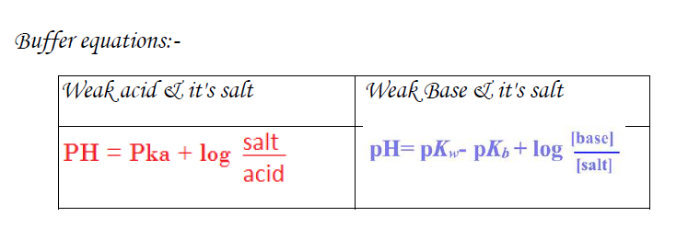

Slide 9
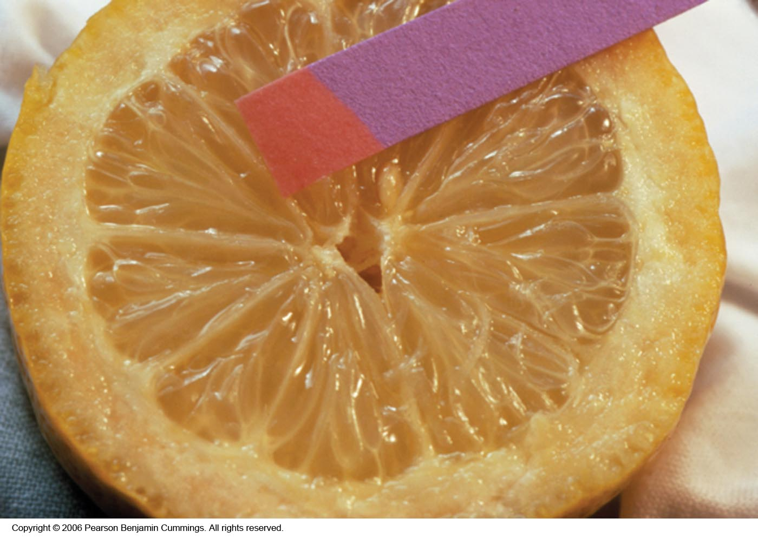
PH Indicators

Slide 10
PH- indicators
the PH of the buffer solution can be measured by:
1- Colorimetric method:
a)chemical indicator
b) paper indicators
2- Electrometric method (PH meter).

Slide 11
PH Indicators
Colorimetric method (chemical indicator):
may be considered as weak acids or weak bases that act like buffers and also exhibit color changes as their degree of dissociation varies with pH.
For example, methyl red shows its full alkaline color, yellow, at a pH of about 6 and its full acid color, red, at about pH 3.

Slide 12
Range and Color Changes of Some
Common Acid-Base Indicators
pH Scale
1
2
3
4
5
6
7
8
9
10
11
12
13
14
Indicators
Methyl orange red 3.1 – 4.4 yellow
Methyl red red 4.4 6.2 yellow
Bromthymol blue yellow 6.2 7.6 blue
Neutral red red 6.8 8.0 yellow
Phenolphthalein colorless 8.0 10.0 red colorless beyond 13.0
Bromthymol blue indicator would be used in titrating a strong acid with a strong base.
Phenolpthalein indicator would be used in titrating a weak acid with a strong base.
Methyl orange indicator would be used in titrating a strong acid with a weak base.
Notes:
From F. Brescia et al., Chemistry: A Modern Introduction, W. B. Saunders Co., 1978.
Adapted from R. Bates, Determination of pH, Theory and Practice, John Wiley & Sons, Inc., New York, 1964.
Choosing the correct indicator for an acid-base titration
1. For titrations of strong acids and strong bases (and vice versa), any indicator with a pK_{in} between 4 and 10 will do
2. For the titration of a weak acid, the pH at the equivalence point is greater than 7, and an indicator such as phenolphthalein or thymol blue, with pK_{in} > 7, should be used
3. For the titration of a weak base, where the pH at the equivalence point is less than 7, an indicator such as methyl red or bromcresol blue, with pK_{in} < 7, should be used

Slide 13

The colour of an indicator is a function of the pH of the solution.
The dissociation of an acidic indicator is given in simplified form as:

Slide 14
HIn is the un-ionized form of the indicator, which gives the acid color, and In- is the ionized form, which produces the basic color.
If an acid is added to a solution of the indicator, the hydrogen ion concentration term on the right-hand side of equation is increased, and the ionization is repressed by the common ion effect. The indicator is then predominantly in the form of HIn, the acid color.

Slide 15
If base is added, [H3O+] is reduced by reaction of the acid with the base, reaction proceeds to the right, yielding more ionized indicator In-, and the base color is predominate.
Several indicators can be combined to yield so-called universal indicators just as buffers can be mixed to cover a wide pH range(1-12) .
Example of universal indicator is a mixture of methyl yellow, methyl red, bromothymol blue ,thymol blue & phenolphthalein which covers PH range 1-11.

Slide 16
Range and Color Changes of Some
Common Acid-Base Indicators
pH Scale
1
2
3
4
5
6
7
8
9
10
11
12
13
14
Indicators
Methyl orange red 3.1 – 4.4 yellow
Methyl red red 4.4 6.2 yellow
Bromthymol blue yellow 6.2 7.6 blue
Neutral red red 6.8 8.0 yellow
Phenolphthalein colorless 8.0 10.0 red colorless beyond 13.0
Bromthymol blue indicator would be used in titrating a strong acid with a strong base.
Phenolpthalein indicator would be used in titrating a weak acid with a strong base.
Methyl orange indicator would be used in titrating a strong acid with a weak base.
Notes:
From F. Brescia et al., Chemistry: A Modern Introduction, W. B. Saunders Co., 1978.
Adapted from R. Bates, Determination of pH, Theory and Practice, John Wiley & Sons, Inc., New York, 1964.
Choosing the correct indicator for an acid-base titration
1. For titrations of strong acids and strong bases (and vice versa), any indicator with a pK_{in} between 4 and 10 will do
2. For the titration of a weak acid, the pH at the equivalence point is greater than 7, and an indicator such as phenolphthalein or thymol blue, with pK_{in} > 7, should be used
3. For the titration of a weak base, where the pH at the equivalence point is less than 7, an indicator such as methyl red or bromcresol blue, with pK_{in} < 7, should be used

Slide 17
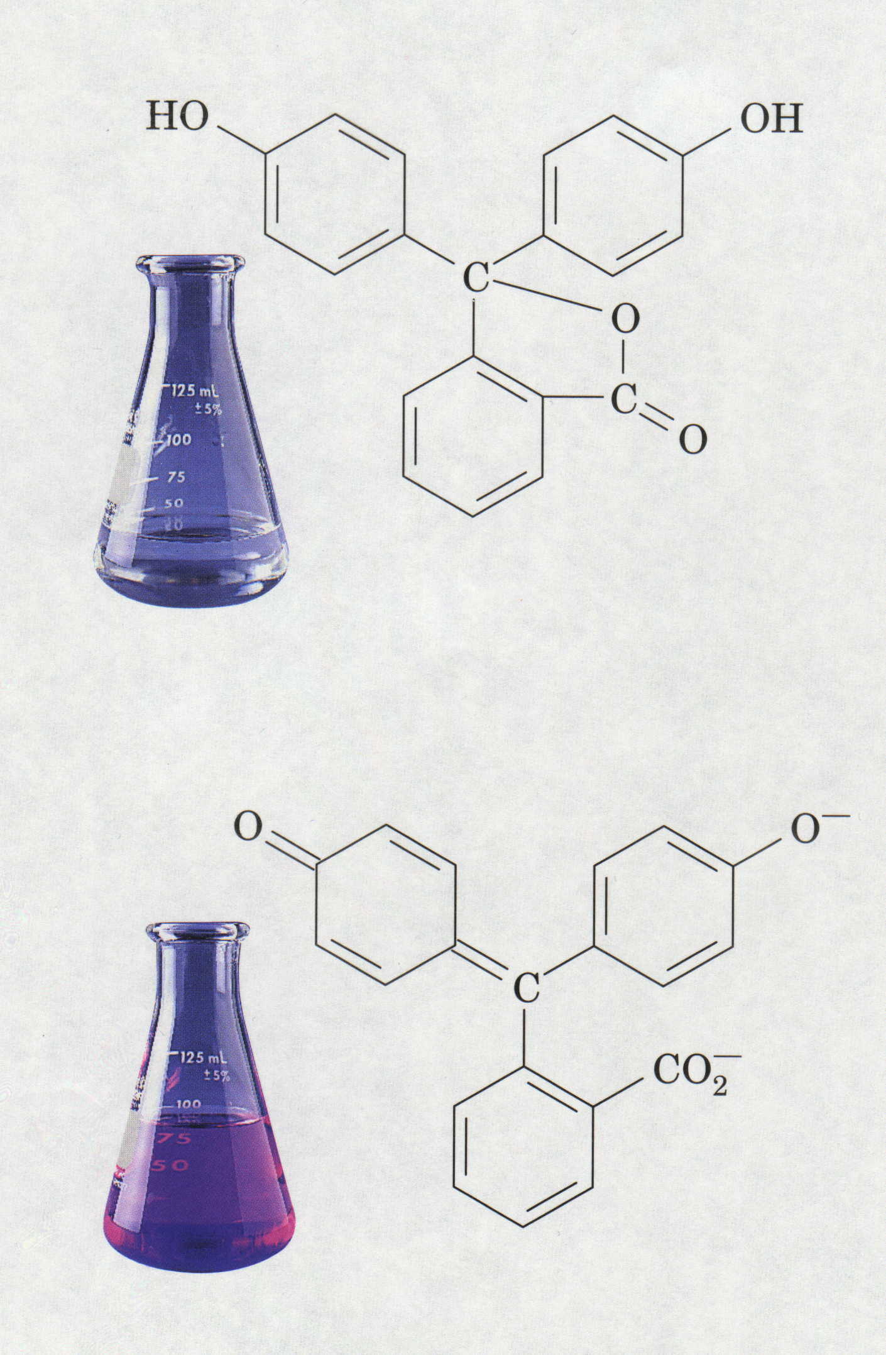
Phenolphthalein Indicator
H⁺
Colorless = Acidic pH
Pink = Basic pH

Slide 18
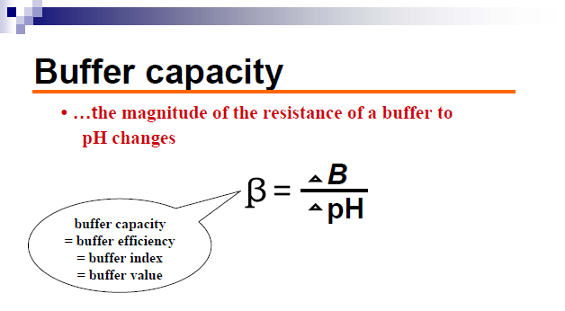
ΔB : small increment in gram equivalents/Liter of strong(base ) added to the buffer soln. to produce a pH change of ΔpH

Slide 20
Factors affecting on buffer capacity:-
1- value of the ratio salt / acid increasing as the value approaches unity .
2-the magnitude of individual conc. of the buffer component , the buffer becoming more efficient as the salt & acid conc. Increased bec. of greater acid & alkaline reserve.
3- depends on the amount of strong base added , with addition of more base buffer capacity decreases rapidly& when sufficient base is added the acid converts completely to sodium & acetate ions, the solution is no longer act as acid reserve.( i.e. max. β before any base is added )

Slide 21
Various buffer systems have been suggested for different pharmaceutical solutions:
Sorensen phosphate
Acetate buffer

Slide 22
Experimental work
Part l: prepare
0.2 M HAC, ( solution A)
0.2 M NaAC (Solution B)
0.1 M NaOH.

Slide 23
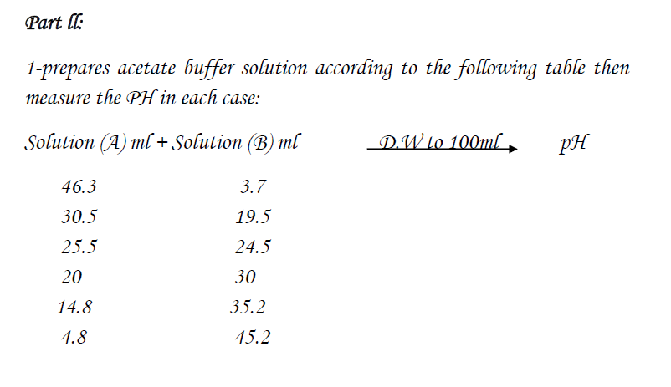

Slide 24
Part III
measuring the pH, using PH meter: Put the electrode of the PH meter in the buffer solution & read the PH.
Take a certain volume of acetate buffer solution; add 0.0004 M sodium hydroxide portions (0.1 ml of 0.1 M) to it. Then, measure the PH and calculate the buffer capacity.

Slide 25


