Slide 1
Gynecology ward -Placental problems -Female infertelity
Done by assistant lecturer Zahraa Abdul Ghani
2020

Slide 2
Placental problems
Role of placenta
The placenta is an organ that develops in the uterus during pregnancy. This structure provides oxygen and nutrients to the growing baby and removes waste products from the baby's blood. The placenta attaches to the wall of the uterus, and the baby's umbilical cord arises from it. In most pregnancies, the placenta attaches at the top or side of the uterus.

Slide 3
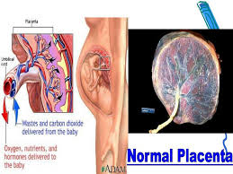
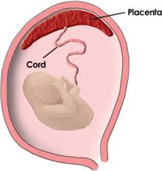

Slide 4
Factors affect placental health
Various factors can affect the health of the placenta during pregnancy, some modifiable and some not. For example:
- Maternal age. Certain placental problems are more common in older women, especially after age 40.
- Premature rupture of the membranes. During pregnancy, baby is surrounded and cushioned by a fluid-filled membrane called the amniotic sac. If the sac leaks or breaks before labor begins, the risk of certain placental problems increases.
- High blood pressure. High blood pressure can affect the placenta.
-Twin or other multiple pregnancy. pregnant with more than one baby, might be at increased risk of certain placental problems.
- Blood-clotting disorders. Any condition that either impairs blood's ability to clot or increases its likelihood of clotting increases the risk of certain placental problems.

Slide 5
- Previous uterine surgery. If woman had a previous surgery on her uterus, such as a C-section or surgery to remove fibroids, she at increased risk of certain placental problems.
- Previous placental problems. A placental problem during a previous pregnancy might be at increased risk of experiencing it again.
- Substance abuse. Certain placental problems are more common in women who smoke or use illegal drugs, such as cocaine, during pregnancy.
-Abdominal trauma. Trauma to the abdomen — such as from a fall or other type of blow to the abdomen — increases the risk of certain placental problems.

Slide 6
The most common placental problems
During pregnancy, the most common placental problems include placental abruption, placenta previa and placenta accreta. These conditions can cause potentially heavy vaginal bleeding. After delivery, retained placenta is also sometimes a concern.
- Placental abruption (abruptio placentae). If the placenta peels away from the inner wall of the uterus before delivery — either partially or completely — it's known as placental abruption. Placental abruption can cause varying degrees of vaginal bleeding and pain or cramping. It might also deprive the baby of oxygen and nutrients. In some cases, early delivery is needed.

Slide 7
Placenta Previa. This condition occurs when the placenta partially or totally covers the cervix — the outlet for the uterus. Placenta previa is more common early in pregnancy and might resolve as the uterus grows. Placenta previa can cause severe vaginal bleeding before or during delivery. A C-section delivery usually is required if the placenta previa is present at the time of delivery.
-Placenta accreta. This condition occurs when the blood vessels of the placenta grow too deeply into the uterine wall. Placenta accreta can cause vaginal bleeding during the third trimester of pregnancy and severe blood loss after delivery. Treatment might require a C-section delivery followed by surgical removal of the uterus (abdominal hysterectomy). More-aggressive forms of this problem can also occur if the placenta invades the muscles of the uterus (placenta increta) or if the placenta grows through the uterine wall (placenta percreta).

Slide 8
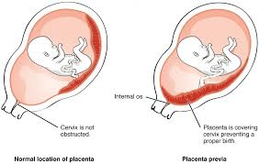

Slide 9
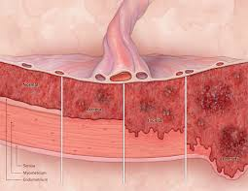
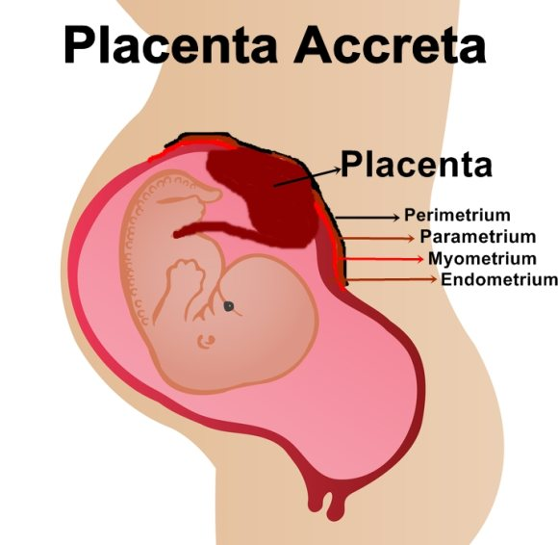

Slide 10
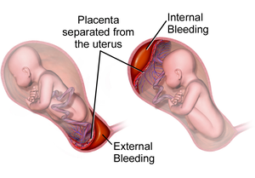

Slide 11
Retained placenta. If the placenta isn't delivered within 30 to 60 minutes after childbirth, it's known as retained placenta. Retained placenta might occur because the placenta becomes trapped behind a partially closed cervix or because the placenta is still attached to the uterine wall — either loosely (adherent placenta) or deeply (placenta accreta). Left untreated, a retained placenta can cause severe infection or life-threatening

Slide 12
Female infertility
According to the World Health Organization (WHO), infertility can be described as the inability to become pregnant, maintain a pregnancy, or carry a pregnancy to live birth.[3] A clinical definition of infertility by the WHO is “a disease of the reproductive system defined by the failure to achieve a clinical pregnancy after 12 months or more of regular unprotected sexual intercourse.”
Infertility can further be broken down into primary and secondary infertility. Primary infertility refers to the inability to give birth either because of not being able to become pregnant, or carry a child to live birth, which may include miscarriage or a stillborn child. Secondary infertility refers to the inability to conceive or give birth when there was a previous pregnancy or live birth.

Slide 13
Factors Affect Fertility:
Hypothalamic-pituitary factors
-Hypothalamic dysfunction
- Hyperprolactinemia
Ovarian factors
- Chemotherapy with certain agents has a high risk of toxicity on the ovaries.
- Polycystic ovary syndrome
- Anovulation. Female infertility caused by anovulation is called "anovulatory infertility", as opposed to "ovulatory infertility" in which ovulation is present.
-Premature menopause
-Menopause
- Luteal dysfunction
- Gonadal dysgenesis (Turner syndrome)
- Ovarian cancer

Slide 14
Tubal (ectopic)/peritoneal factors
- Endometriosis
- Pelvic adhesions
- Pelvic inflammatory disease (PID, usually due to chlamydia)
- Tubal occlusion
-Tubal dysfunction
-Previous ectopic pregnancy
Uterine factors
- Uterine malformations
- Uterine fibroids
-Asherman's Syndrome
-Implantation failure without any known primary cause. It results in negative pregnancy test despite having performed e.g. embryo transfer.
Previously, a bicornuate uterus was thought to be associated with infertility, but recent studies have not confirmed such an association.

Slide 15
Cervical factors
-Cervical stenosis
-Antisperm antibodies
-Non-receptive cervical mucus
Vaginal factors
-Vaginismus
-Vaginal obstruction

Slide 16


