Slide 1

Clinical pharmacy lab
(first course)
4th stage students skin part 1
Lecturers
lubab Tareq Nafea
Zahraa Abdul-Ghani
MSc in clinical pharmacy

Slide 2

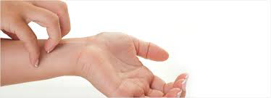
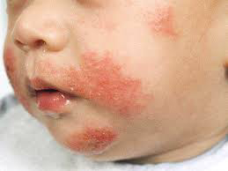

Slide 3
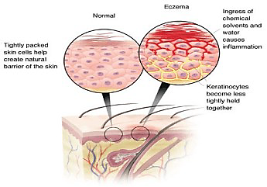

Slide 4
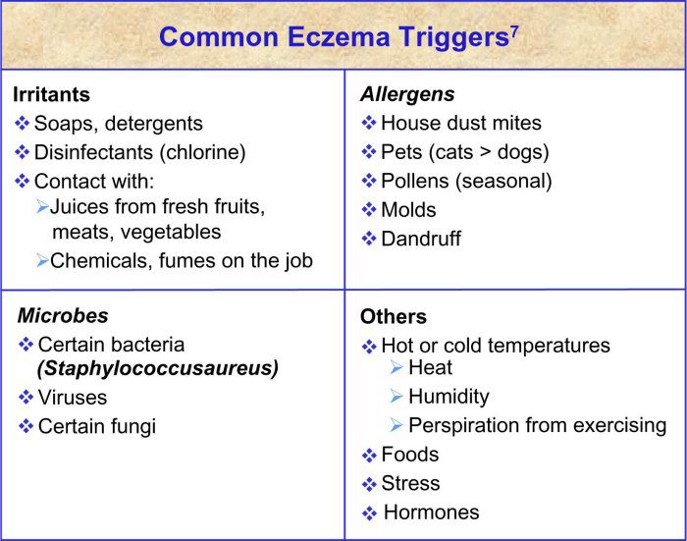

Slide 5
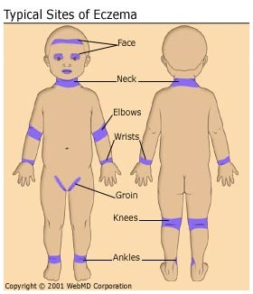

Slide 6
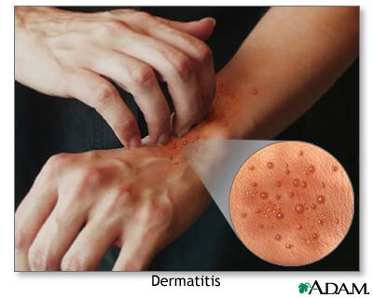
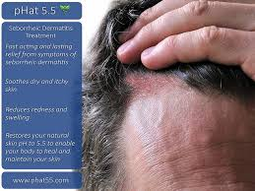
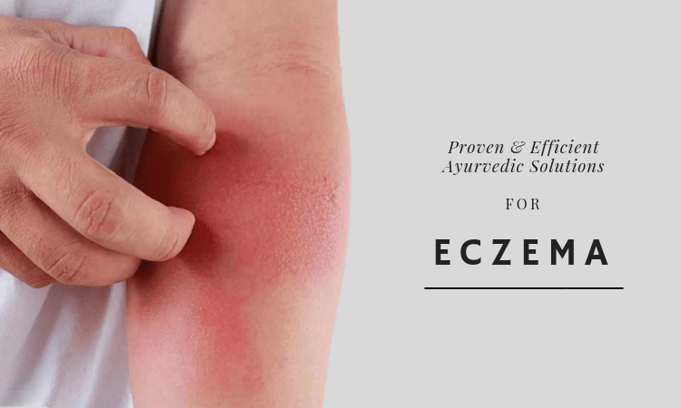
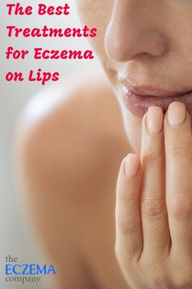
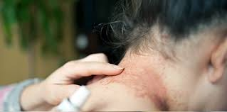
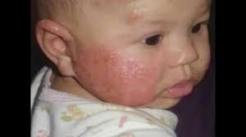
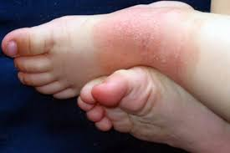
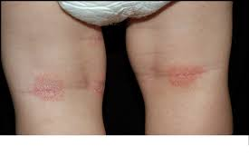

Slide 7
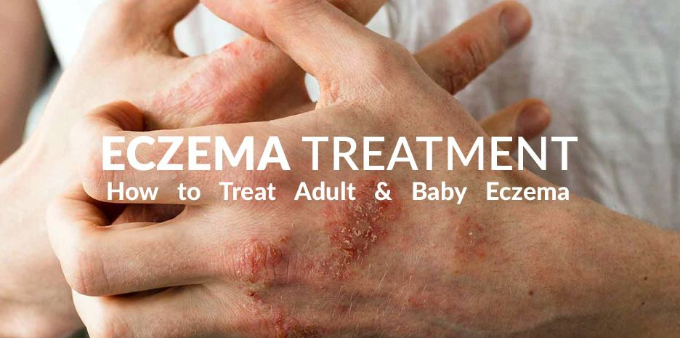
1- Emollient
2- Topical Corticosteroid
3- Antipruritics
Treatment

Slide 8
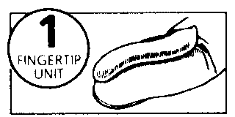
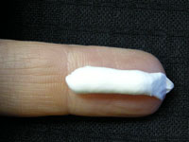
Topical CS

Slide 9
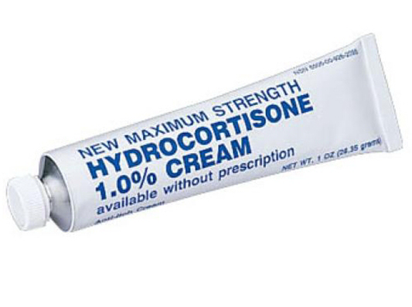
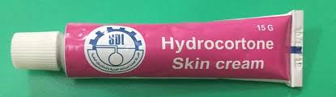

Slide 10
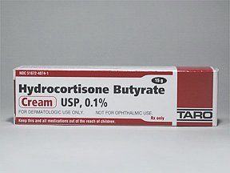

Slide 11
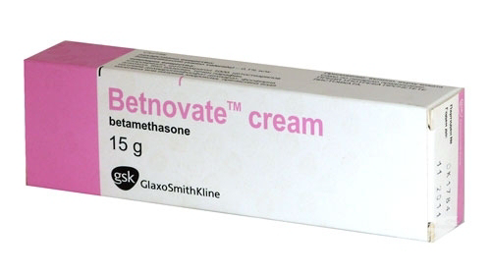
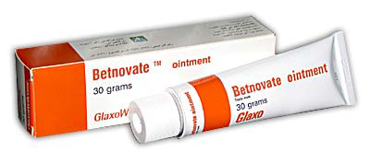

Slide 12
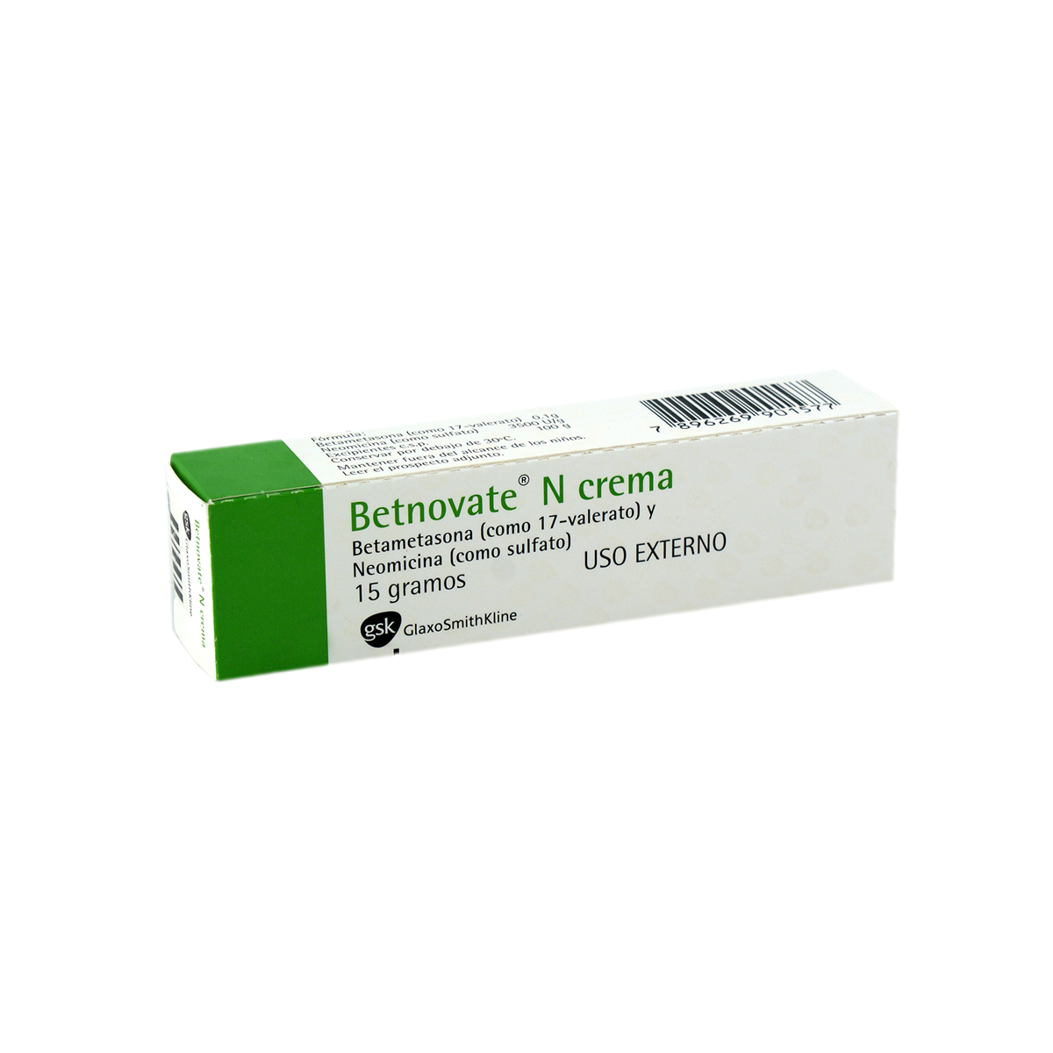
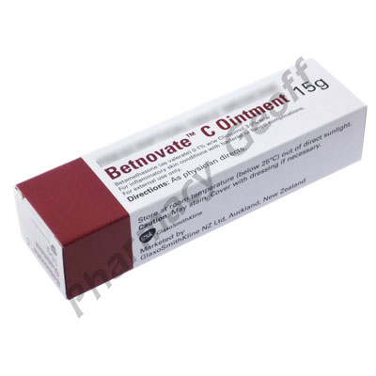

Slide 13
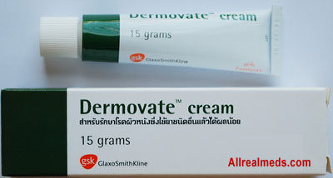
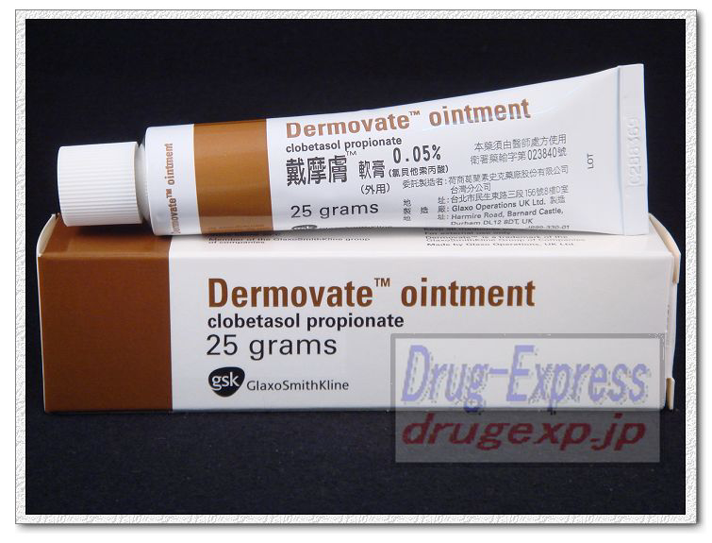

Slide 14
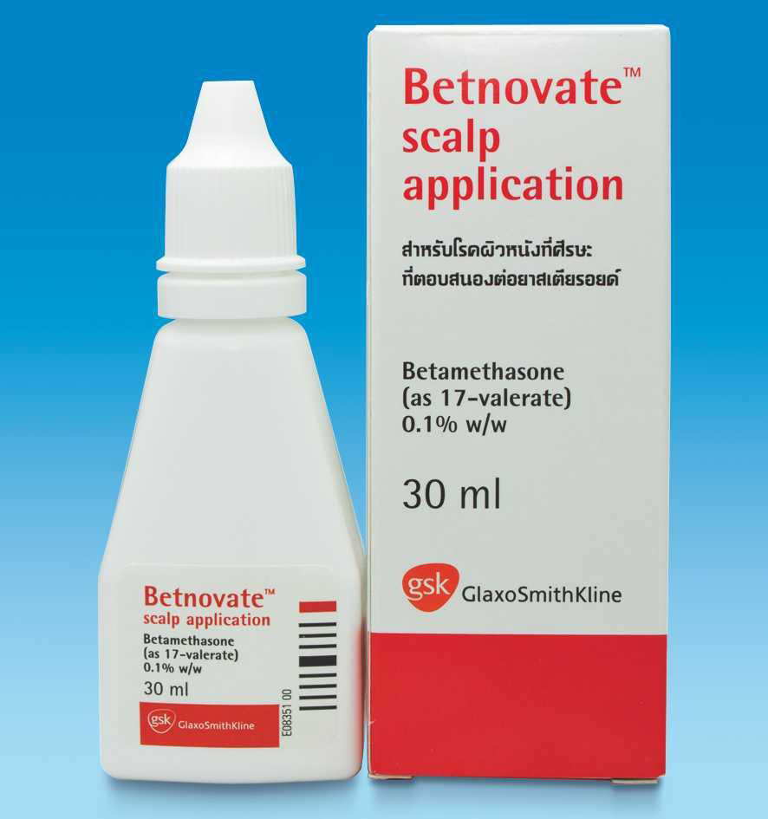
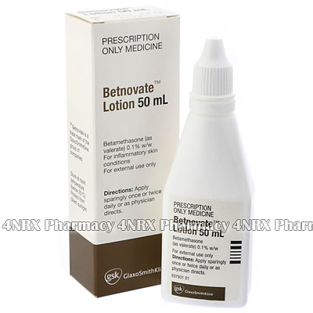

Slide 15
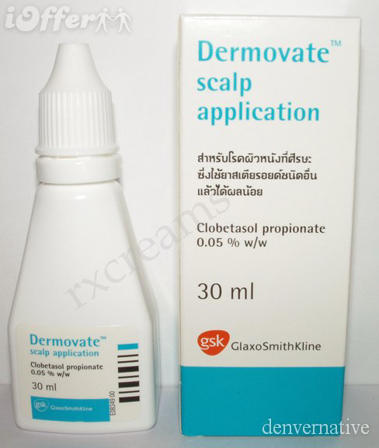

Slide 16
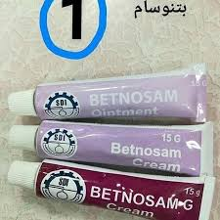
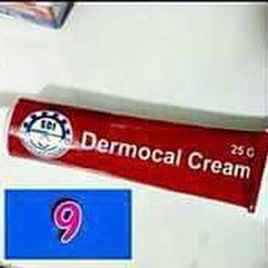

Slide 17
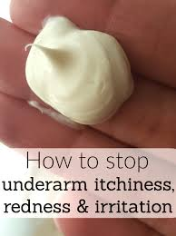
Anti-pruritis

Slide 18
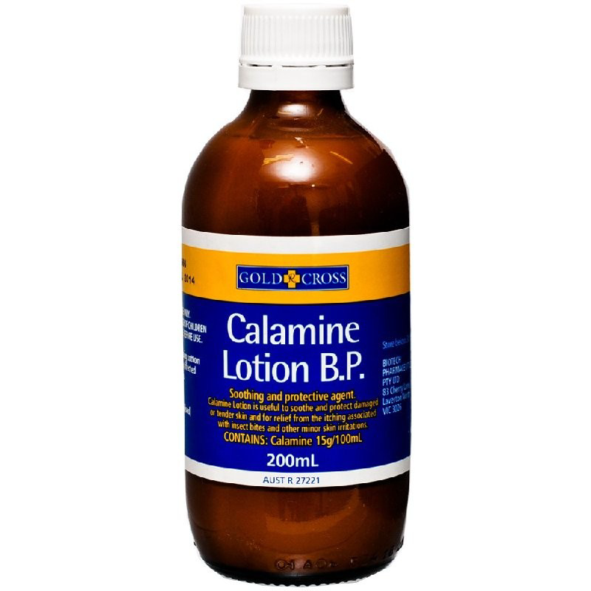

Slide 19
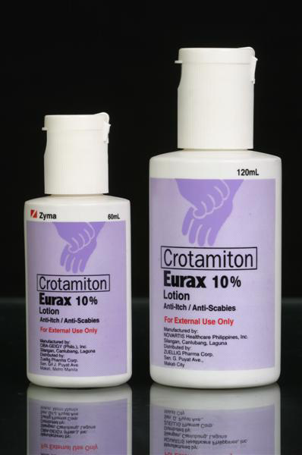
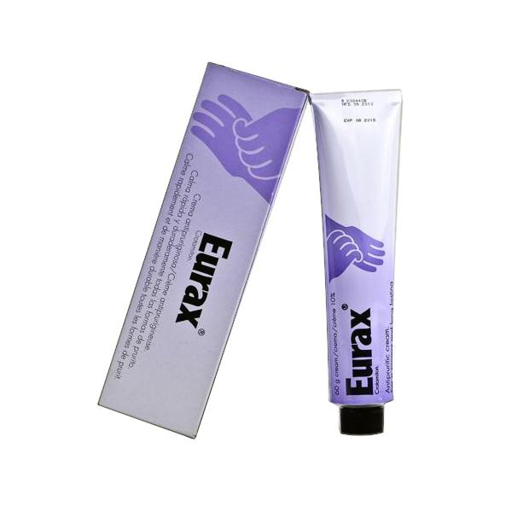

Slide 20
Acne

Slide 21
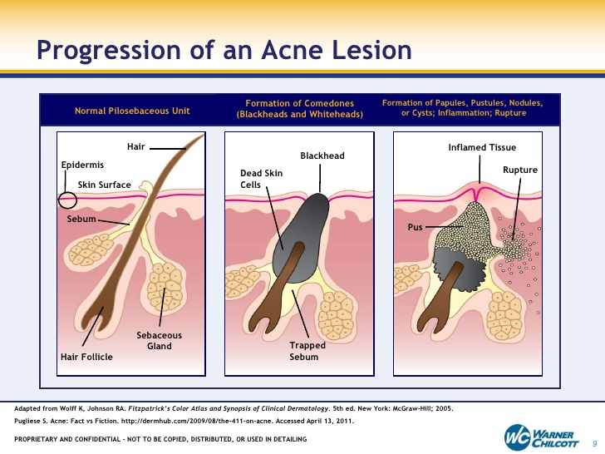

Slide 22
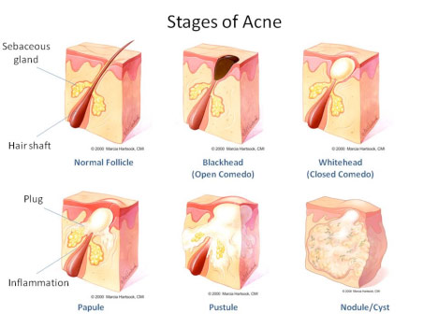

Slide 23
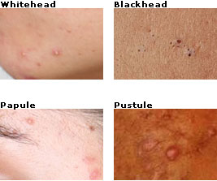

Slide 24
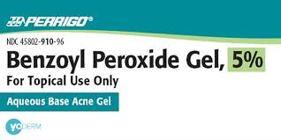

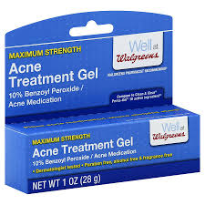
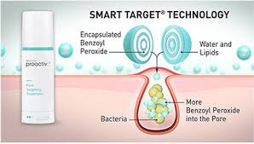
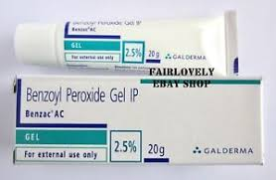

Slide 25
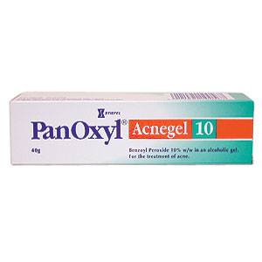
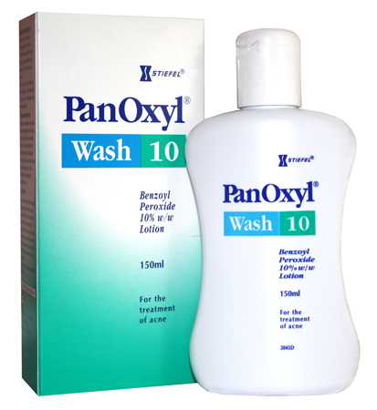

Slide 26
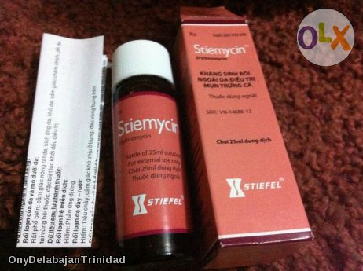
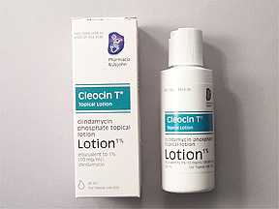

Slide 27
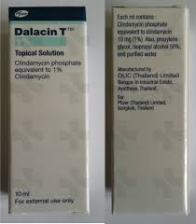
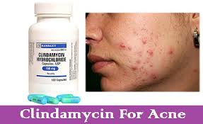
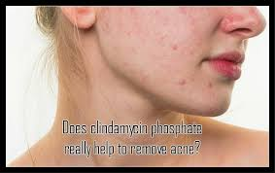
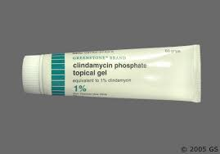
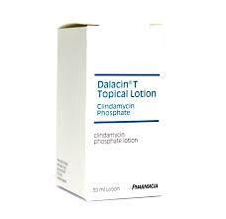

Slide 28





Slide 29

CHILDHOOD CONDITIONS

Slide 30


Slide 31
Thrush(candidosis) is a fungal infection caused by Candida albicans which occurs commonly in the mouth (oral thrush).It may also occurs in the nappy area in the babies and in the vagina.
patient assessment with oral thrush:
1-Age:
oral thrush is most common in babies .
In older children and adults it is rarer.-------it may be a sign of immunosuppressant and referral to the Dr. is advisable.
2-Affected area:
oral thrush can occurs anywhere in oral cavity (mainly on the surface of the tongue and insides of the cheeks).
3-Appeareance:
oral thrush occurs as a creamy white soft elevated patches which resemble milk curds( but oral thrush differ from milk curds in that it is not so easily removed and when it is scraped , a sore and reddened area will be seen).
4-Previous history:
patients who experience recurrent infections should be referred for further investigations.
5-Medications:
A- Broad –spectrum antibiotics can predispose to oral thrush .
B-Immunosuppressive Agents: like cytotoxic and steroids( oral or inhaled) can predispose to oral thrush .
Note: Rinsing the mouth with water after the use of inhaled steroid may be helpful.
Treatment timescale
If symptoms are not cleared within a week -------patient should see a Dr.

Slide 32




Slide 33
Management
Miconazole Oral Gel:
It the only (till now)products available as an OTC to treat oral thrush and its appear to have superior cure rate than the POM Nystatin.
Dose for infants and children under 2 years is:
2.5 ml of the gel twice daily after food.
Duration of treatment: for 2 clear days after the symptoms have apparently gone.
Practical points
1- Patients should be advised to hold the gel in the mouth for as long as possible.
2-For young babies , the gel can be applied directly to lesion using a cotton bud or the handle of a teaspoon.
3-treatment may be enhanced by cleaning the white plug off with a cotton bud prior to the application of the gel.
4- The pharmacist should check whether nappy rash is also presents
(in the napkin area , candidal infection present as red papules on the outer edge of the area of napkin rash (satellite papules), another feature is that the skin in the skin folds is nearly always affected).
In this case an antifungal cream containing miconazole or clotrimazole can be used for the nappy area--------see napkin rash later.
5-Where the mother is Breast feeding, a small amount of miconazole gel applied to the nipple will eradicated any fungus present.

Slide 34







Slide 35


SCABIES

Slide 36


Slide 37


Slide 38


Slide 39


Slide 40


Slide 41

Cold Sore

Slide 42


Slide 43


Slide 44


Slide 45


