Slide 1
Clinical biochemistry
Hypothalamus and pituitary gland
Dr. Huda Jaber

Slide 2
GENERAL PRINCIPLES OF ENDOCRINE
A hormone can be defined as a substance secreted by an endocrine gland that is transported in the blood, there by regulating the function of another tissue(s).
Ex.GH,T4,INSULIN and rout of secretion from glands
Conversely, trophic hormones from the pituitary gland stimulate target endocrine glands to synthesize and secrete further hormones, which in turn partly control trophic hormone release, usually by negative feedback inhibition
example, hypercalcaemia and parathyroid hormone (PTH), (inversely proportional)and plasma T4 concentration inhibits the secretion of thyroid stimulating hormone(TSH)
Endocrine glands may secrete excessive or deficient amounts of hormone
Abnormalities of target glands may be primary or secondary to dysfunction of the controlling mechanism, usually located in the hypothalamus or anterior pituitary gland.
DIAGNOSIS
.
•
•

Slide 3
dynamic’ tests
Suppression tests are used mainly for the differential diagnosis of excessive hormone secretion
The substance (or an analogue) that normally suppresses secretion by negative feedback is administered and the response is measured
Failure to suppress implies that secretion is not under normal feedback control .
.

Slide 4
Stimulation tests are used mainly for the differential diagnosis of deficient hormone secretion. The trophic hormone that normally stimulates secretion is administered and the response is measured.
A normal response excludes an abnormality of the
target gland, whereas failure to respond confirms it.

Slide 5
HYPOTHALAMUS AND PITUITARY
GLAND
There are two lobes of pituitary gland anterior and
posterior lobes. Both depend on hormones synthesized in the hypothalamus for normal function
The hypothalamus also has extensive neural connections with the rest of the brain. Stress and some psychological disorders affect the secretion of pituitary hormones and of the hormones from other endocrine glands
.

Slide 6
Control of posterior pituitary hormones
Two structurally similar peptide hormones
antidiuretic hormone (ADH) –– and oxytocin, are
synthesized in the hypothalamus and transported to pituitary stalk attached to specific carrier proteins – neurophysins.
Then stored in the posterior pituitary gland and are
released into the bloodstream under hypothalamic
control, together with neurophysin
Neurophysin has no apparent biological function and
is rapidly cleared from plasma.
.
.

Slide 7
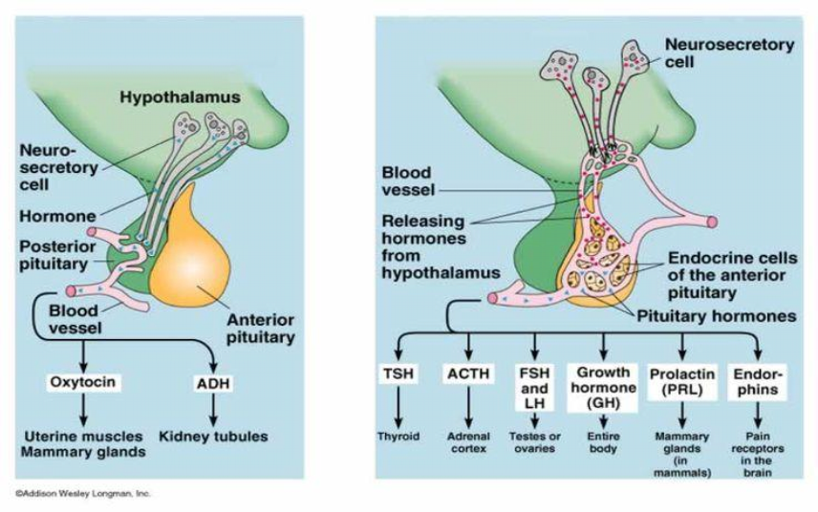

Slide 8
Antidiuretic hormone (arginine vasopressin) is
mainly synthesized in the hypothalamus and enhances water reabsorption from the collecting ducts in the kidneys
. Oxytocin is synthesized in the the hypothalamus. It controls the ejection of milk from the lactating breast and may have a role in initiating uterine contractions It may be used therapeutically to induce labour
.

Slide 9
Anterior pituitary hormones
There is no direct neural connection between the hypothalamus and the anterior pituitary gland
The hypothalamus synthesizes small molecules (regulating hormones or factors) that are carried to the cells of the anterior pituitary lobe by the hypothalamic portal system
This network of capillary loops, which, after passing down the pituitary stalk, divide into a second capillary network in the anterior pituitary gland, from where hypothalamic hormones stimulate or inhibit pituitary hormone secretion into the systemic circulation.
.

Slide 10
The cells of the anterior pituitary lobe can be classified simply by their staining reactions as acidophils, basophils or chromophobes
.
Acidophils are of two cell types:
lactotrophs, which secrete prolactin
somatotrophs, which secrete GH (somatotrophin).
These hormones, which are simple polypeptides with
similar amino acid sequences, mainly affect peripheral tissues directly.
Stimulation and inhibition of secretion via the
hypothalamus is influenced by neural stimuli.

Slide 11
Basophils secrete hormones that affect other endocrine
glands.
The hypothalamic control is mainly stimulatory. There are three cell types:
Corticotrophs synthesize a large polypeptide (pro-opiomelanocortin), which is a precursor of both adrenocorticotrophic hormone (ACTH; corticotrophin) and β-lipotrophin
Secretion of these hormones occurs in parallel
Adrenocorticotrophic hormone stimulates the synthesis and secretion of steroids, and maintains adrenal cortical growth.
Gonadotrophs secrete the gonadotrophins, folliclestimulating hormone (FSH) and luteinizing hormone (LH), which act on the gonads
Thyrotrophs secrete TSH (thyrotrophin), which acts on the thyroid gland
These hormones are structurally similar glycoproteins consisting of two subunits, α and β.
The α -subunit is common to all three hormones; the β -subunit is important for receptor recognition.
Chromophobes, once thought to be inactive, do contain secretory granules
.

Slide 12
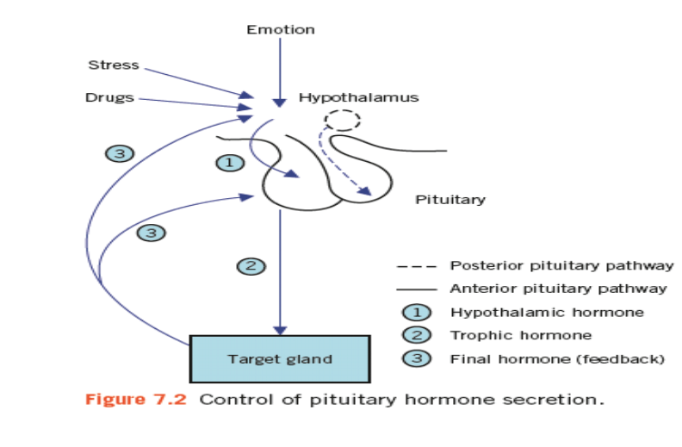

Slide 13
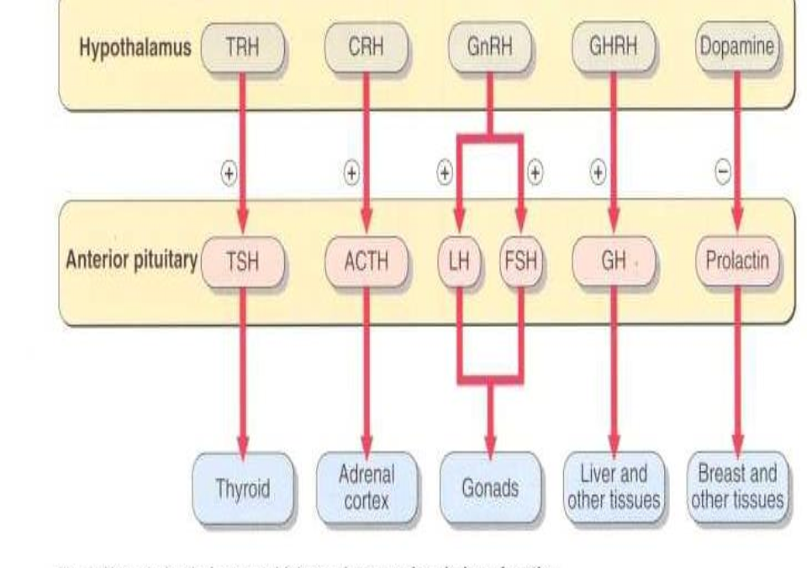

Slide 14
Extra hypothalamic neural stimuli modify, and at times over-ride, other control mechanisms Physical or emotional stress and mental illness
may give similar findings to, and even precipitate, endocrine disease.
The stress caused by insulin-induce hypoglycaemia is used to test anterior pituitary
function.
Stress may also stimulate the secretion of ADH
from the posterior pituitary

Slide 15
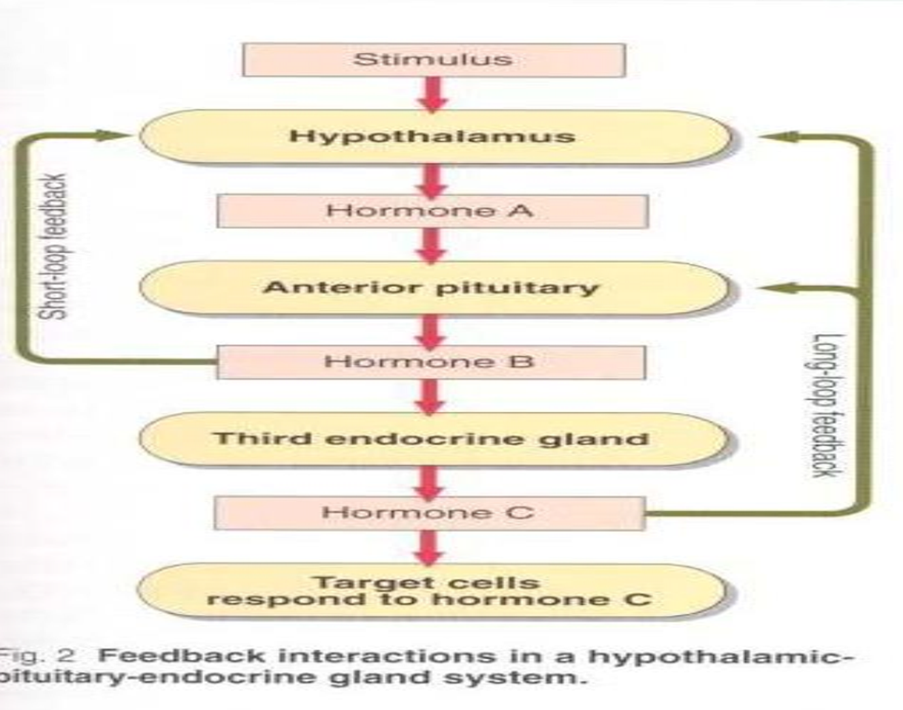
Feedback control is mediated by the concentrations of
circulating target-cell hormones; a rising concentration usually suppresses trophic hormone secretion
This negative feedback may directly suppress
hypothalamic hormone secretion or may modify its effect on pituitary cells (long feedback loop
The secretion of hypothalamic hormones may also be
suppressed by rising concentrations of pituitary hormone
in a short feedback loop.

Slide 16
Evaluation of anterior pituitary
function
The diagnosis of suspected hypopituitarism is best excluded by the direct measurement of pituitary hormones after stimulation or by demonstrating target gland hyposecretion after the administration of the relevant trophic hormone.
However, prolonged hypopituitarism may result in secondary failure of the target gland with diminished response to stimulation.
Laboratory tests establish only the presence or absence of hypopituitarism, and the cause must be sought by other clinical means such as radiological imaging

Slide 17
DISORDERS OF ANTERIOR PITUITARY
HORMONE SECRETION
The main clinical syndromes associated with
excessive or deficient anterior pituitary
hormone secretion are shown in Table bellow.
Excessive secretion usually involves a single
hormone, but deficiencies are often multiple.
However, many pituitary tumours are non-
secretory and may present clinically with eye
signs or headaches.

Slide 18
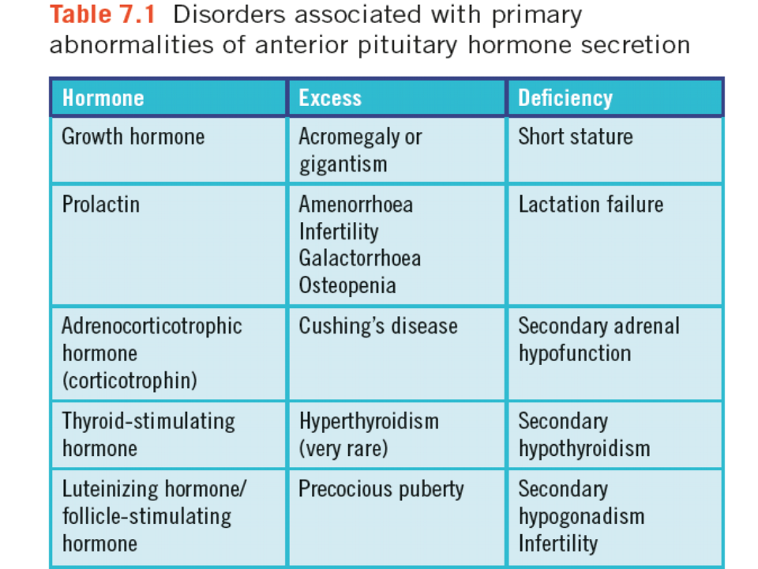

Slide 19
Growth hormone
Growth hormone secretion from the anterior pituitary gland is mainly controlled by hypothalamic GH releasing hormone (GHR( After synthesis by the hypothalamus, this is transported via the hypothalamic portal system to the somatotrophs of the anterior pituitary.
Secretion of GHRH, and therefore of GH, is pulsatile, occurring about seven or eight times a day, usually associated with
exercise, onset of deep sleep, in response to the falling plasma glucose concentration about an hour after meals.
At other times, plasma concentrations are usually very low or undetectable, especially in children.
Growth hormone release is inhibited in a negative feedback pathway by another hypothalamic hormone, somatostatin (GH-release inhibiting hormone).
Insulin like growth factor 1 (IGF-1) acts by feedback to inhibit GHRH action.

Slide 20
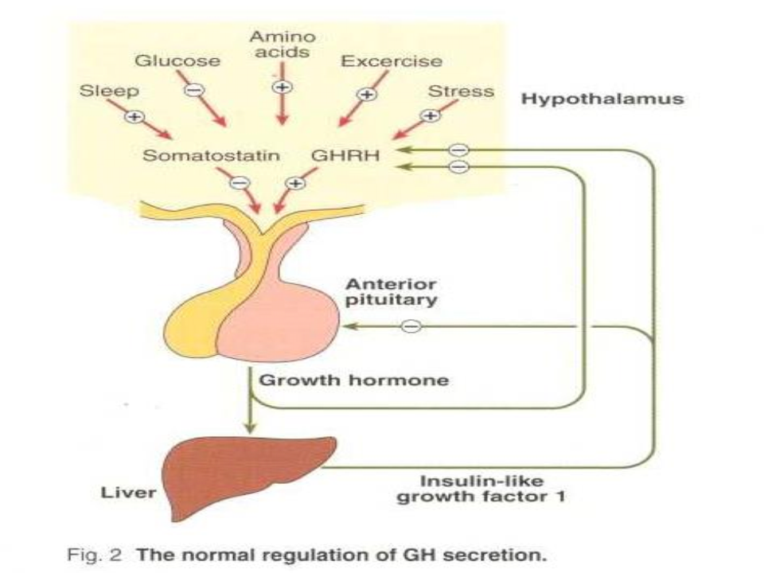

Slide 21
Growth hormone secretion may be stimulated by:
stress, one cause of which is hypoglycaemia,
glucagon,
some amino acids, for example arginine,
drugs such as levodopa and clonidine.
All these stimuli have been used to assess GH secretory capacity, which may also be impaired in
obese patients, in hypothyroidism and hypogonadism, in some cases of Cushing’s syndrome and in patients receiving large doses of steroids.

Slide 22
Actions of growth hormone
The main function of GH is to promote growth. Its action is primarily mediated by IGFs, polypeptides that are synthesized in many tissues, where they act locally. Plasma concentrations of one of these, IGF-1 (also known as somatomedin C), correlate with GH secretion.
Carbohydrate metabolism is affected by GH: GH antagonizes the insulin-mediated cell uptake of glucose, and excess secretion may produce glucose intolerance.
Fat metabolism is stimulated by GH: lipolysis is stimulated, with a consequent increase in the
concentration of circulating free fatty acids. Free fatty acid antagonizes insulin release and action. Growth hormone enhances protein synthesis, in conjunction with insulin, to stimulate amino acid uptake by cells.
The production of IGF-1 is also influenced by other factors, the most important of which is nutritional status. In undernutrition, plasma concentrations are low, whereas GH concentrations are elevated, suggesting that plasma IGF-1 may influence GH secretion by negative feedback. Other factors, such as adequate nutrition and T4, are also needed for normal growth.
The growth spurt during puberty may be enhanced by androgens.

Slide 23
Growth hormone excess: gigantism and acromegaly
Growth hormone excess causes gigantism during childhood and acromegaly in adults.
Most patients with GH excess have acidophil adenomas of the anterior pituitary gland, which may be secondary to excessive hypothalamic stimulation.
Rarely, malignant tumours may release GH or GHRH.
The clinical manifestations of GH excess depend on whether the condition develops before or after fusion of the bony epiphyses. Gigantism is caused by excess GH secretion in childhood before fusion of the epiphyseal plates, which may be delayed by accompanying
hypogonadism. Heights of up to about 2 metres may be reached.
Acromegalic features may develop after bony fusion, but these patients may die in early adult life from infection or cardiac failure or as a consequence of progressive pituitary tumour growth

Slide 24
The features of acromegaly
An increase in the bulk of bone and soft tissues with enlargement of, for example, the hands, tongue, jaw and heart. Changes in facial appearance are often marked, due to the increasing size of the jaw and sinuses; the gradual coarsening of the features may pass unnoticed for many years.
Thyroid gland enlargement may be clinically detectable, but the patient is usually euthyroid.
Excessive hair growth, hyperhidrosis and sebaceous gland secretion are common.
Menstrual disturbances are common in females.
Impaired glucose tolerance is present in about 25 per cent of patients, about half of whom develop symptomatic diabetes mellitus. In most cases the pancreas can secrete enough insulin to overcome the antagonistic effect of GH.
There is a predisposition to multiple pre-malignant colon polyposis and hypertension.
Hyperphosphataemia, hypercalcaemia and hypertriglyceridaemia may also be present.

Slide 25
Diagnosis
Magnetic resonance imaging (MRI) is more sensitive than computerized tomograph (CT) scanning.
Plasma GH concentrations are usually higher than normal.
The diagnosis is confirmed by demonstrating a raised plasma GH conc. that is not suppressed by a rise in plasma glucose concentration. In normal subjects, plasma GH concentrations fall to very low levels – to below 1 mg/L after a 75 g oral glucose load.
In acromegaly, the secretion of GH is autonomous and this fall may not occur or be only slight, or there may even be a paradoxical rise. Growth hormone secretion is inhibited by hyperglycaemia in the normal subject.
Glucose suppression test for suspected acromegaly
Procedure: After an overnight fast, insert an indwelling intravenous cannula. After at least 30 min, take basal samples for plasma glucose and GH estimation. The patient should drink 75 g of glucose dissolved in about 300 mL of water, or an equivalent glucose load. Take samples for glucose and GH assays at 30, 60, 90 and 120 min after
the glucose load has been taken.

Slide 26
Treatment
surgery to remove the adenoma,
medical therapy, usually with either bromocriptine or cabergoline (dopamine receptor agonists) or somatostatin analogues (somatostatin itself has too short a half-life for effective therapeutic use).
Octreotide or lanreotide, which bind to somatostatin receptors, can be used or pegvisomant (GH receptor antagonist)
Radiation therapy.
The aim of treatment is to ameliorate symptoms and to obtain an oral glucose suppressed GH
concentration of less than 1 mg/L (this cut-off can be GH assay dependent – conversion factor for units:
mU/L = 2.4 ¥ mg/L) and normalization of plasma IGF-
1 concentrations.

Slide 27
Growth hormone deficiency
In adults, GH deficiency may cause clinical symptoms, such as tiredness, dyslipidaemia and increased cardiovascular disease.
Growth hormone deficiency can cause short stature in children.
It is important to investigate children with reduced growth rate to identify those who may
benefit from recombinant human GH replacement treatment.
Isolated GH deficiency is most commonly secondary to idiopathic deficiency of hypothalamic GHRH

Slide 28
Diagnosis
It is, important to exclude hypothyroidism, chronic diseases and malabsorption states, poor nutritional state and failure to thrive
Clinical examination should assess for obvious syndromes, pubertal status, bone age, growth or growth velocity .
• Karyotyping may be indicated if a chromosomal disorder such as Turner’s syndrome (45,X0) is suspected.
There is a physiological reduction in GH secretion at the end of pre-puberty. Thus, in children with bone age more than 10 years, priming with sex hormones before
investigation may be necessary.
• For example, ethinyloestradiol may be given to girls and testosterone to boys prior to testing.

Slide 29
Plasma GH concentrations in normal children are often low and assays under basal conditions rarely exclude the diagnosis.
A low plasma IGF-1 concentration may be a useful screening test
Urinary GH excretion, either in 24-h collections or timed overnight, may offer a relatively safe screening test.
If blood is taken at a time when physiologically high concentrations are expected, the need for stimulation tests may be avoided, for example 60–90 min after the onset of
sleep and about 20 min after vigorous exercise.
If GH deficiency is not excluded by the above measurements, it is necessary to perform one or more stimulation tests
The response of GH to insulin may be the most reliable to detect GH deficiency, but it is not without the risk of fatal hypoglycaemia
Glucagon could also be used as an alternative.
A GH absolute response of greater than 20 mU/L (7 μg/L)makes GH deficiency unlikely.
.

Slide 30
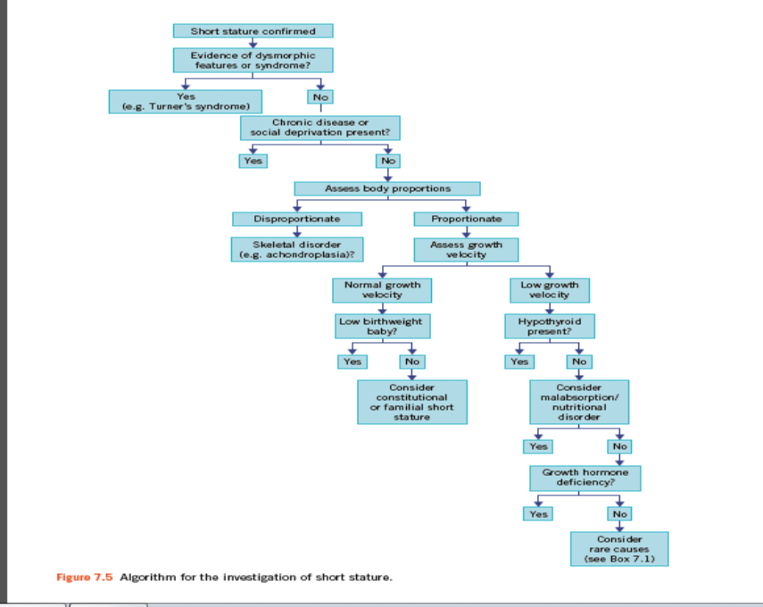
•
Figure
shows an algorithm
for the investigation
of short stature.

Slide 32
DISORDERS OF POSTERIOR PITUITARY HORMONE SECRETION
Disorders of the posterior pituitary are rare compared with those of the anterior pituitary.
Deficiency of ADH in diabetes insipidus may present as polyuria.
HYPOPITUITARISM
Hypopituitarism is a syndrome of deficiency of pituitary hormone production that may result from disorders of the hypothalamus, pituitary or surrounding structures
Clinical features of deficiency are usually absent until about 70 % of the gland has been destroyed, unless there is associated hyperprolactinaemia, when amenorrhoea and infertility may be early symptoms
Panhypopituitarism alludes to the involvement of all pituitary hormones; alternatively, only one or more may be involved, as in partial hypopituitarism
Panhypopituitarism with the full clinical picture described is usually arises in patients presenting with various features such as clinical and radiological evidence of a pituitary or localized brain tumor.
hypopituitarism and it is unusual for the post- pituitary hormones such as ADH and oxytocin to
be affected

Slide 33
Consequences of pituitary hormone
deficiencies
Progressive pituitary damage usually presents
with evidence of deficiencies of gonadotrophins and GH.
•
Plasma ACTH and/or TSH concentrations may
remain normal or become deficient months or even years later
•
.

Slide 34
The clinical and biochemical consequences of the
target-gland failure include the following:
Growth retardation in children This may be due to deficiency of GH;
deficiency of TSH, and therefore of thyroid hormone, may contribute
Secondary hypogonadism This is due to gonadotrophin deficiency,
presenting as amenorrhoea, infertility and atrophy of secondary sexual characteristics. Puberty is delayed in children.
Secondary adrenocortical hypofunction (ACTH deficiency) In
contrast to the primary form (Addison’s disease), patients are not
hyperpigmented because ACTH secretion is not raised.
The sodium and water deficiency and hyperkalaemia characteristic
of Addison’s disease do not usually occur because aldosterone secretion (which is controlled by angiotensin and not by ACTH) is normal.
.
•
•

Slide 35
However, cortisol is needed for normal free water excretion, and consequently there may be a dilutional hyponatraemia due to cortisol deficiency.
Cortisol is also necessary for the maintenance of normal blood pressure. Hypotension may be associated with ACTH deficiency
Cortisol and/or GH deficiency may cause increased insulin sensitivity with fasting hypoglycaemia
•
.

Slide 36
Secondary hypothyroidism (TSH deficiency) This may sometimes be
clinically indistinguishable from primary hypothyroidism.
Prolactin deficiency Associated with failure to lactate, this may occur after post-partum pituitary infarction (Sheehan’s syndrome).
However, in hypopituitarism due to a tumour, plasma prolactin
concentrations are often raised and may cause galactorrhoea (secretion of breast fluid)
Patients with hypopituitarism, like those with Addison’s disease, may die because of an inability to secrete an adequate amount of cortisol in response to stress caused by, for example, infection or Surgery.
Other life-threatening complications are hypoglycaemia.

Slide 37
Pituitary tumours
The clinical presentation of pituitary tumours depends on the type
of cells involved and on the size of the tumour (microadenomas less
than 10 mm and macroadenomas more than 10 mm(
Tumours of secretory cells may produce the clinical effects of excess hormone secretion:
excess prolactin causes infertility, amenorrhoea and varying
degrees of galactorrhoea .
•
•
•
•
excess GH causes acromegaly or gigantism,
excess ACTH causes Cushing’s syndrome
Large pituitary tumours may present with:
visual disturbances caused by pressure on the optic chiasma or
headache due to raised intracranial pressure,
•
deficiency of some or all of the pituitary hormones due to
destruction of secretory cells in the gland.

Slide 38
• Non-secreting tumours are difficult to diagnose using biochemical tests, although the combined pituitary stimulation test may indicate subclinical impairment of function.
Hyperprolactinaemia, which may be asymptomatic, is a valuable biochemical marker of the presence of a pituitary tumour
Prolactin may be secreted by the tumour cells or
by unaffected lactotrophs if tumour growth interferes with the normal inhibition of prolactin secretion

Slide 39
Investigation of suspected
hypopituitarism
•
Deficiency of pituitary hormones causes hypofunction of
the target endocrine glands.
•
Investigation aims to confirm such deficiency, to exclude
disease of the target gland and then to test pituitary
hormone secretion after maximal stimulation of the gland
Measurement should be made of the plasma concentrations of LH, FSH and oestradiol (female) or testosterone (male), total or free T4 and TSH prolactin, to test for hypothalamic or pituitary stalk involvement cortisol at 09.00 h, to assess the risk of adrenocorticalinsufficiency during later testing.
•
•
•
•

Slide 40
If the plasma concentration of the target gland hormone is low and
the concentration of trophic hormone is raised, the affected target
gland should be investigated.
Conversely, if the plasma concentrations of both the target gland
and trophic hormones are low or low-normal, consider a pituitary
stimulation test
Investigation of the pituitary region using radiological techniques
such as CT or MRI scanning may help elucidate a cause of the Hypopituitarism the combined pituitary stimulation test (insulin or glucagon plus TRH and GnRH given as one test), this is rarely required, as useful information can be obtained from the basal pituitary hormones and, if indicated, an insulin stimulation/ hypoglycaemia test,although this is not without risk

Slide 41
Insulin tolerance or insulin stimulation
test
•
This test is potentially dangerous and must be done under direct medical supervision due to severe hypoglycaemia and the test should be carried out only in specialist units by experienced staff.
It is contraindicated in the following patient
groups: the elderly, patients with ischaemic heart
disease, epilepsy or severe panhypopituitarism,
and patients in whom plasma cortisol at 09.00 h
is less than 100 nmol/L.
•

Slide 42
A resting electrocardiogram should be normal.
Hypothyroidism should be treated before hand as this can impair the cortisol and
GH responses.
• However, note that treatment with thyroxine can precipitate an adrenal crisis in
•
•
such patients and thus corticosteroid replacement is also necessary.
• Indications of the insulin stimulation test may include:
•
•
assessment of GH in growth deficiency, assessment of ACTH/cortisol reserve
differentiation of Cushing’s syndrome from pseudo- Cushing’s syndrome, for
example depression or alcohol excess. Both ACTH and GH are released in response
to the stress of hypoglycaemia.
• Fifty millilitres of 20 per cent glucose for intravenous administration must be
immediately available in case severe symptomatic hypoglycaemia develops.
• Care should be taken not to induce severe hyperglycaemia during infusion, as it
•
may cause hyperosmolality, which can be dangerous.
• Plasma cortisol is usually measured as an index of ACTH secretion.
If glucose needs to be given, continue with the sampling.

Slide 43
Procedure
• After an overnight fast, fter at least 30 min, take basal samples at time 0
min for cortisol, GH and glucose.
• Inject soluble insulin in a dose sufficient to lower plasma glucose
concentrations to less than 2.5 mmol/L and evoke symptomatic
hypoglycaemia.
• The recommended dose of insulin must be adjusted for the patient’s body
weight and for the suspected clinical condition under investigation.
• The usual dose is 0.15 U/kg body weight.
•
If either pituitary or adrenocortical hypofunction is suspected, or if a low
fasting glucose concentration has been found, reduce the dose to 0.1 or
0.05 U/kg.
• If there is likely to be resistance to the action of insulin because of
Cushing’s syndrome, acromegaly or obesity, 0.2 or 0.3 U/kg may be
needed.
• Take blood samples at 30, 45, 60, 90 and 120 min after the injections for
cortisol, GH and glucose assays.

Slide 44
Interpretation
Interpretation is not possible if hypoglycaemia is not
attained, and the dose of insulin can cautiously be repeated
if this is not attained in the 45-min blood sample.
•
If hypoglycaemia has been adequate, plasma cortisol
concentrations should rise by more than 200 nmol/L and
exceed 580 nmol/L, and an adequate GH response occurs
with an absolute response of greater than 20 mU/L (7
μg/L).
•
•
In Cushing’s syndrome, neither plasma cortisol nor GH
concentrations rise signifi cantly, although they usually do
in cases of pseudo-Cushing’s syndrome.
•
After the test, a supervised meal should be given and the
patient should not drive for at least 2 hours.

Slide 45
Glucagon stimulation test of the
hypothalamus–
pituitary axis
•
This test is useful if the insulin hypoglycaemic test is
contraindicated.
• However, it is essential that the test is carried out in a
specialist unit by experienced staff.
•
The basic principle is that glucagon stimulates GH and
ACTH release probably via a hypothalamic route.
•
The test is contraindicated if there is severe adrenal
failure, for example if cortisol at 09.00 h is less than
100 nmol/L or in hypothyroidism.
•
It is also unreliable in the presence of diabetes mellitus.

Slide 46
• Procedure
•
Patients should fast overnight, although they
can drink water.
•
For adults, 1 mg of glucagon is injected
subcutaneously at 09.00 h.
•
Blood samples are taken at 0, 90, 120, 150,
180, 210 and 240 min for cortisol and GH.

Slide 47
• Interpretation
•
Plasma cortisol should normally rise by at
least 200 nmol/L to more than 580 nmol/L,
and an adequate GH response occurs with an
absolute response of greater than 20 mU/L (7
μg/L).

Slide 48
•
•
Treatment of hypopituitarism
This consists of specific therapy depending on its cause and
may include surgical removal of a large adenoma.
•
If the ACTH axis is impaired, it is essential to prescribe a
glucocorticoid, for example hydrocortisone in the acute
situation or prednisolone for maintenance.
•
Secondary hypothyroidism will need thyroid replacement.
Adrenal replacement should precede T4 therapy to avoid
an Addisonian crisis Gonadotrophin deficiency may require
testosterone in males and oestrogen replacement in
women, with or without progesterone as appropriate.
•
In children and sometimes in adults, GH may be indicated.

