Slide 2
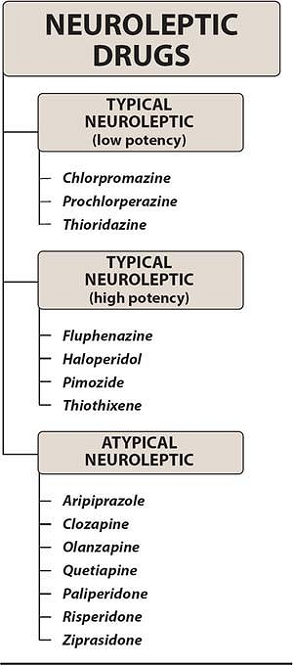

Slide 6
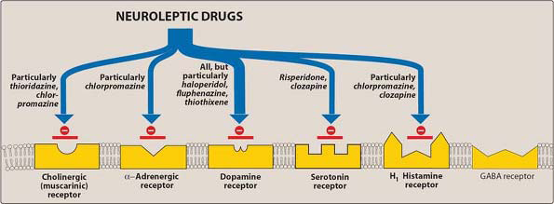

Slide 12
Checklist
When you complete this chapter, you should be able to:
Describe the "dopamine hypothesis" of schizophrenia.
Identify 4 receptors blocked by antipsychotic drugs.
Describe the relationship of receptor-blocking actions to the pharmacodynamics of both the older and the newer (atypical) antipsychotics.
Identify the established toxicities of each of the following drugs: chlorpromazine, clozapine, haloperidol, thioridazine, ziprasidone.
Describe tardive dyskinesia and the neuroleptic malignant syndrome.
Identify the distinctive pharmacokinetic features of lithium, and list its adverse effects and toxicities.
List the "alternative" drugs used in bipolar disorder.

Slide 13
A 28-year-old woman with schizoid affective disorder and difficulty sleeping would be most benefited by
which of the following drugs?
A. Aripiprazole.
B. Chlorpromazine.
C. Haloperidol.
D. Risperidone.
E. Ziprasidone.

