Slide 3
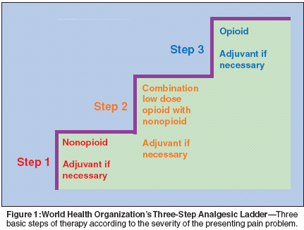

Slide 4
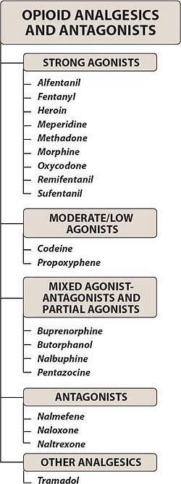

Slide 6
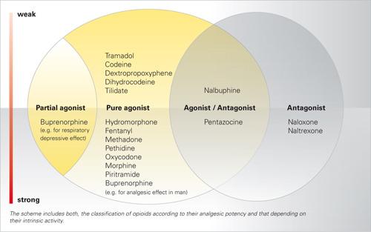

Slide 7
Opiate A drug derived from alkaloids of the opium poppy
Opioid The class of drugs that includes opiates, opiopeptins, and all synthetic and semisynthetic drugs that mimic the actions of the opiates
Opioid peptides Endogenous peptides that act on opioid receptors
Opioid agonist A drug that activates some or all opioid receptor subtypes and does not block any
Partial agonist A drug that can activate an opioid receptor to effect a submaximal response
Opioid antagonist A drug that blocks some or all opioid receptor subtypes
Mixed agonist-antagonist A drug that activates some opioid receptor subtypes and blocks other opioid receptor subtypes

Slide 8
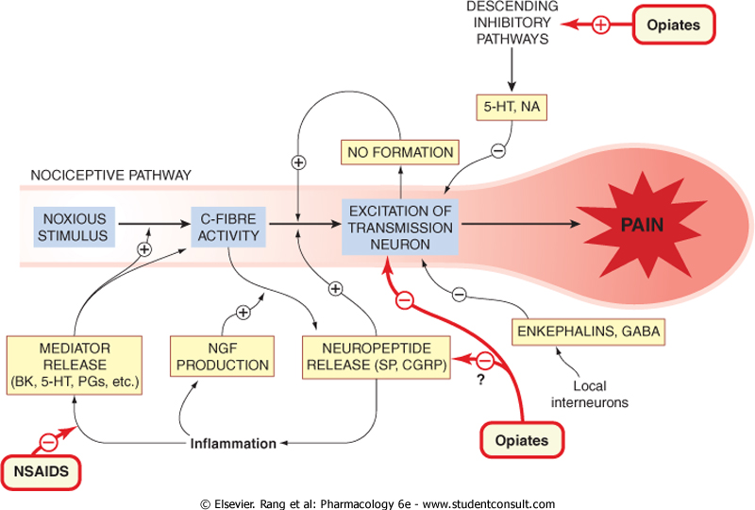

Slide 10
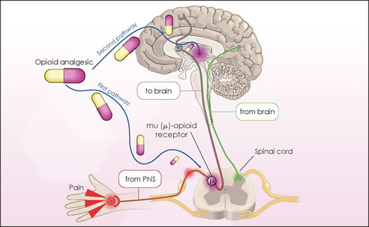

Slide 12
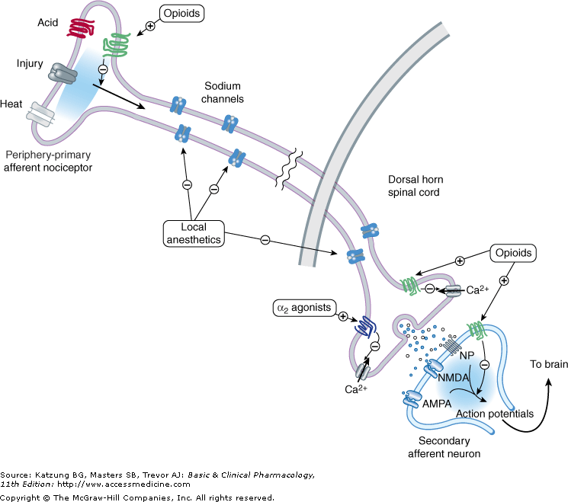

Slide 14
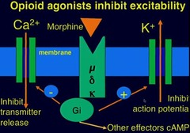

Slide 17
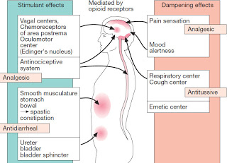

Slide 22
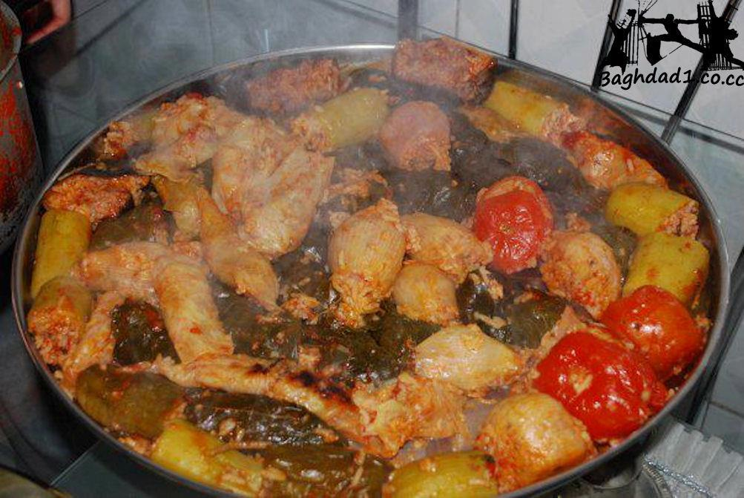

Slide 29
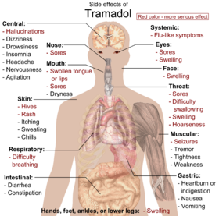

Slide 35
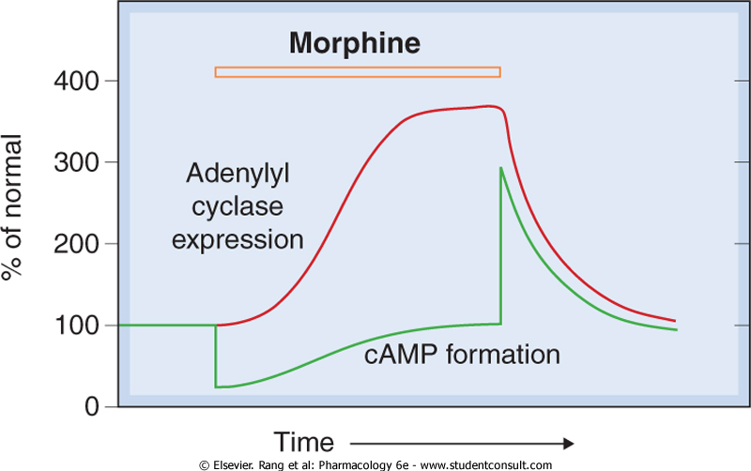

Slide 36
Checklist
When you complete this chapter, you should be able to:
Identify 3 opioid receptor subtypes and describe 2 ionic mechanisms that result from such activation.
Name the major opioid agonists, rank them in terms of analgesic efficacy, and identify specific dynamic or kinetic characteristics.
Describe the cardinal signs and treatment of opioid drug "overdose" and of the "withdrawal" syndrome.
List acute and chronic adverse effects of opioid analgesics.
Identify an opioid receptor antagonist and a mixed agonist-antagonist.
Identify opioids used for antitussive effects and for antidiarrheal effects.

Slide 37
Which of the following statements about morphine is correct?
A. It is used therapeutically to relieve pain caused by severe head injury.
B. Its withdrawal symptoms can be relieved by naloxone.
C. It causes diarrhea.
D. It is most effective by oral administration.
E. It rapidly enters all body tissues, including the fetus.

