Slide 1
Estimation of Hemoglobin lab-5 2020-2021

Slide 2
Hemoglobin
Found in the RBC.
Responsible for carrying oxygen to all cells in the body.
Also binds to carbon dioxide and carries it to the lungs from the cells to be released.
Buffer against change in [H⁺]
Hemoglobin detection can also gives the health care worker an idea about:-
Patient’s oxygen carrying capacity
Current blood loss and recovery from blood loss
Treatment of RBC disorders, like anemia.

Slide 3
Hemoglobin
Makes up 98% of the protein found in the RBC and Gives blood its red color.
Composed of two parts….
Heme , 4 iron atoms in the ferrous state (Fe2+) and porphyrin ring
Globin , 4 protein chains
The most common globin forms are alpha and beta chains.
Hemoglobin's are named based on the structure of the protein chain that is present.
Hemoglobin A , 95-98% of adult hemoglobin
Hemoglobin A2 , 3-5% of adult hemoglobin
Hemoglobin F , normal fetal hemoglobin, <1% of adult hemoglobin
Hemoglobin S , abnormal hemoglobin found in sickle cell anemia

Slide 5
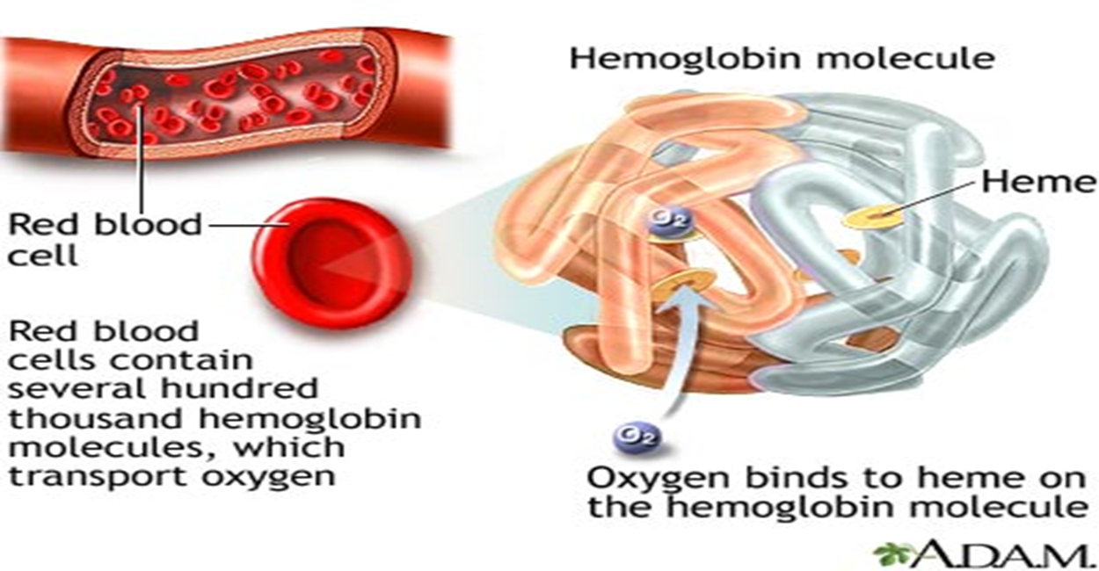
Normal value
Male 13.5-17.5 gm/dl
Female 11.5-15.5 gm/dl
Newborn 21 gm/dl

Slide 6
Medical application
The body will respond for the decrease in haemoglobin level (for slightly lower than normal haemoglobin levels) as a compensatory mechanism:-
The heart will beat faster and more forcefully.
The lungs increase the amount of air they move each minute to increase the amount of oxygen they deliver to the blood.
when the level drops too low for us, we start to feel tired, breathless and may start to run into problems with too little oxygen getting to important organs like the heart and brain.
This can cause palpitations, angina (chest pains), headache or dizzy spells.

Slide 7
Haemoglobin and High Altitudes
People living at high altitudes have developed unique and often different ways to cope with the reduced amount of oxygen available at higher altitudes.
Natives of the Andes Mountains in South America have a higher concentration of haemoglobin in their blood, allowing more oxygen to be carried by the same volume of blood. However, there are other means of coping with high altitudes.
For instance, the people living in the Tibetan Plateau have doubled their nitric oxide levels. Nitric oxide is a blood vessel dilator, which is thought to boost the uptake of oxygen.

Slide 8
Variant forms of hemoglobin
Oxyhemoglobin: hemoglobin combined with oxygen.
Carbaminohemoglobin: hemoglobin combined with CO2.
Methemoglobin: Ferrous iron in converted into ferric iron.

Slide 9
Medical conditions
anemia :- is a decrease of hemoglobin concentration.
Polycythemia :- is an increase of Hb oncentration.

Slide 10
Types of anemia:
Iron deficiency anemia: commonest cause of anemia in most parts of the world cause either due to loss of iron due to bleeding or an inadequate diet or mal-absorption.
Megaloblastic anemia: caused by deficiency of vitamin B12 or folate deficiency or both of them.
Pernicious anemia :- an autoimmune destruction of gastric parietal cells (and autoantibody inactivation of intrinsic factor) leading to a lack of intrinsic factor which important for vitamin B₁₂ absorption in the gut.

Slide 11
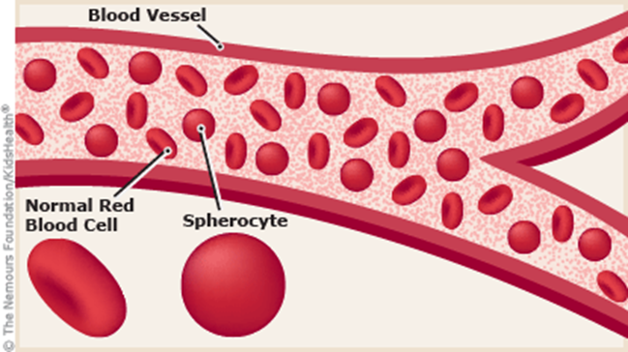
Hemolytic anemia includes
1- Hereditary spherocytosis:-Deficiency of spectrin (red cell membrane protein) leading to abnormal shape of RBC (spherical) instead of biconcave shape leading to their destruction in spleen. & they will become more susceptible to osmotic lysis.

Slide 12
2-Acquired hemolytic anemia:
Autoimmune hemolytic anemia
Hemolytic disease of newborn
ABO incompatibility
Rhesus (Rh) incompatibility
3- Glucose 6 Phosphate dehydrogenase deficiency
Favism (hemolytic anemia from the ingestion of the broad beans)

Slide 13
4- Hemoglobinopathies : Sickle cell anemia: there in alteration in amino acid sequence of polypeptide chains of the globin fraction of hemoglobin e.g. hemoglobin S found in sickle cell anemia

Slide 14
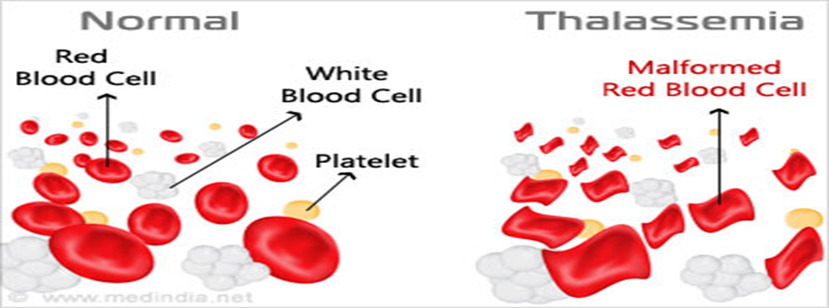
Thalassaemia: it is an inherited impairment of hemoglobin production, in which there is partial or complete failure to synthesize a specific type of globin chain.
5-Anemia of chronic disease.

Slide 15
Hgb estimatiom
(SAHLI’S METHOD)
All Hb is converted into acid hematine and the intensity of the color is measured by comparing it with the standered
Sahli Haemometer consists of:
A color standard
Pipette marked to contain 20 microliter of blood.
Graduated tube
Distilled water (D.W.)
0.1 normal HCl
Anticoagulated whole blood or capillary blood can be used.

Slide 16
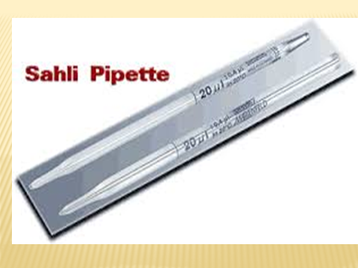

Slide 17
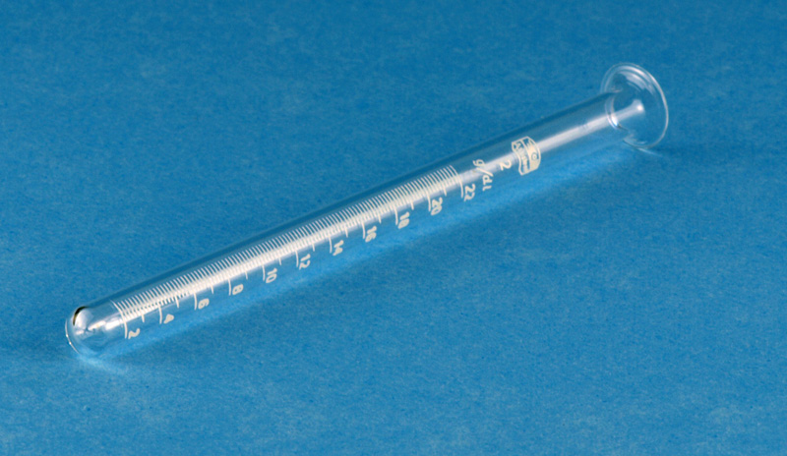

Slide 18
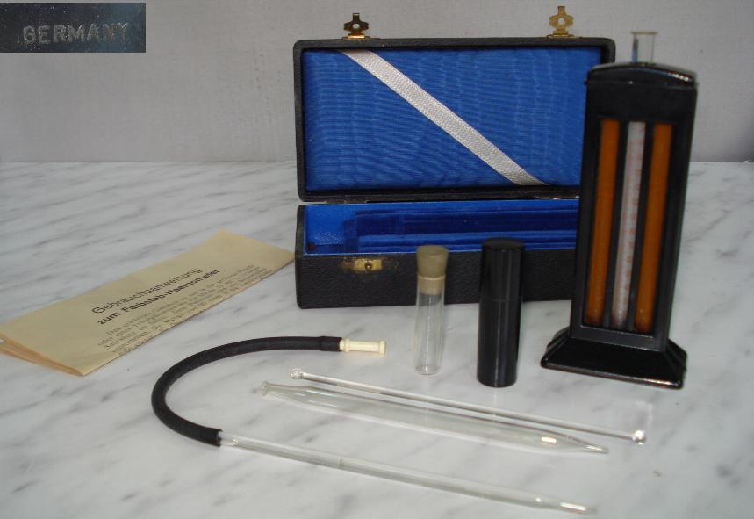

Slide 19
Procedure
Fill the graduated tube to mark (2 or 10) with 0.1 normal HCl.
Draw blood by hemoglobin pipette to mark 20Ml
Dip the tip of the pipette in the graduated tube to blow the blood into the tube, mix content with stirrer.
Place the tube in the hemoglobinometer for 10 minutes for complete reaction
Add drop by drop D.W. until the color in the graduated tube is identical to the color of the standard.
Read the result in gm/dl.

