Slide 1
ECG (Electrocardiography)
Lab -8
Pharmacology and toxicology department
Febreuary, 2021

Slide 2
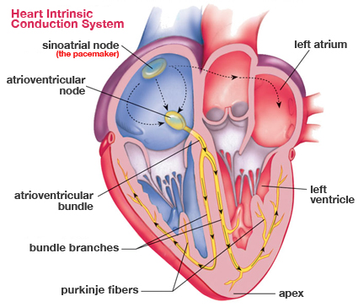
The intrinsic conduction system
The intrinsic conduction system composed of
Sinoatrial node(SA-node)
Atrioventricular node (AV-node)
Bundle of His
Purkinje fiber

Slide 3
The intrinsic conduction system
the intrinsic conduction system (nodal system) of the heart sets its basic rhythm as a result of polarization and depolarization events of specialized cells in the heart tissue.

Slide 4
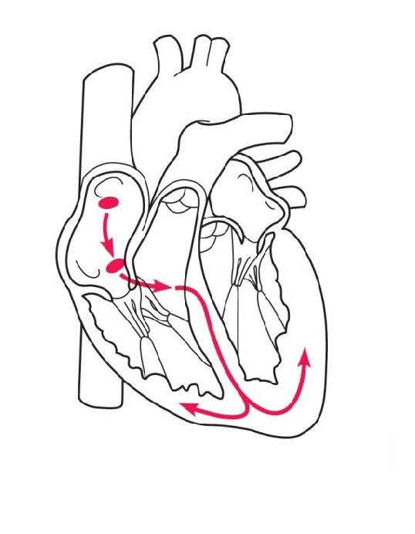
This system causes heart muscle depolarization in only one direction—from the atria to the ventricles.
It also enforces a heart rate of approximately 75 beats per minute on the heart and ensures that the heart beats as a coordinated unit.

Slide 5
Electrical impulses from the myocardium cause the heart to contract ("beat"). The electrical signal begins in the sinoatrial node (the SA node).
The SA node is located at the top of the right atrium. Because the SA node has the highest rate of depolarization in the whole system, it starts each heartbeat and sets the pace for the whole heart. Consequently, the SA node is often called the pacemaker of the heart

Slide 7
The impulse from the SA node spreads through the atria to the atrioventricular or AV node and the atria contract.
At the AV node, the impulse is delayed briefly as the atria finish contracting.
It then passes rapidly through the AV bundle, the bundle branches and fibers, resulting in contraction of the ventricles.
This contraction effectively ejects blood into the large arteries leaving the heart

Slide 8
Because the atria and ventricles are separated from one another by connective tissue that insulates the chambers, the depolarization waves can reach the ventricles only by traveling through the AV node.

Slide 9
Impulse conduction
Sinoatrial node (SA) node
↓
Atrioventricle node (AV) node
↓
Bundle of His
↓
Bundle branches
↓
Purkinje fibers

Slide 10
ECG
Electrocardiography (ECG or EKG) is the process of recording the electrical activity of the heart over a period of time using electrodes placed on a patient's body. These electrodes detect the tiny electrical changes on the skin that arise from the heart muscle depolarizing during each heartbeat.

Slide 11
How does the ECG work?
ECG electrodes (electrical sensing device) are attached to the body while the patient lies flat on a bed or table. Electrodes are attached to each extremity (4 totals) and to 6 pre-defined positions on the front of the chest.
A small amount of gel is applied to the skin, which allows the electrical impulses of the heart to be more easily transmitted to the ECG electrodes.
The electrodes are attached by small suction cups or by small adhesive patches attached loosely to the skin.
The test takes about 5 minutes and is painless.

Slide 13
Electrodes and leads
There is a careful distinction between "electrode" and "lead.“
Electrode:- electrical sensing device placed on the body.
Leads:- the electrical activity or (voltage differences) between electrodes.

Slide 14
Types of leads
1- limbs leads (3 standared+3 augmented)
2-chest leads (6 leads)

Slide 15
Types of limb Leads
1. ( Standard Limb Leads)
(Bipolar leads) l , l l , l l l Leads :- record the electrical activity between electrode placed on the wrists and left ankle (with right ankle acting as the earth).
2. (augmented limb lead)
(Unipolar leads) aVL , aVR , aVF record the electrical activity between a single electrode placed on the body surface and an electrode that is maintained at zero potential(earth) that is a combination of readings from other leads.

Slide 16
Standard limb leads (bipolar)
Lead I is formed using the right arm electrode as the negative electrode and the left arm electrode as the positive.
Lead II is formed using the right arm electrode as the negative electrode and the left leg electrode as the positive.
Lead III is formed using the left arm electrode as the negative electrode and the left leg electrode as the positive.

Slide 17
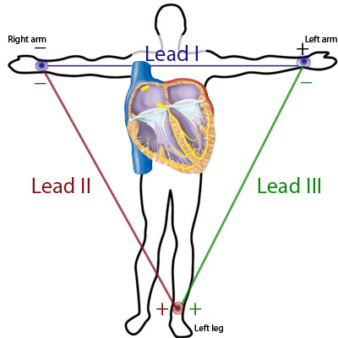
Einthoven's triangle

Slide 18
Augmented limb leads(unipolar leads)
aVL, aVF and aVR are composite leads, computed using the information from the other leads.
Each lead can be thought of as ‘looking at’ an area of myocardium

Slide 19
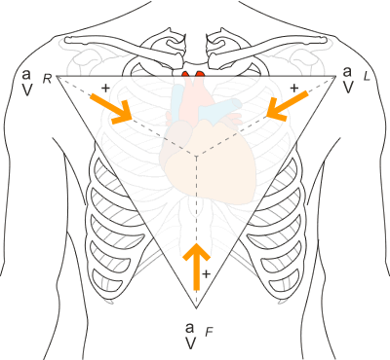
Augmented limb leads (unipolar leads)

Slide 20
Chest leads (unipolar leads)
The precordial leads, V1 to V6, also called C1-C6 are also unipolar leads but instead of recording between limbs they are placed directly on the chest so the sensing electrode is sensing the heart from a very close and particular angle.

Slide 21
Placement of chest electrodes
V1 : in the 4th intercostal space right sternal edge.
V2: in the 4th intercostal space left sternal edge.
V4 :over the apex ( 5th ICS mid-clavicular line)
V3: halfway between V2 and V4.
V5: at the same level as V4 but on the anterior axillary line.
V6: at the same level as V4 and V5 but on the mid-axillary line.

Slide 22
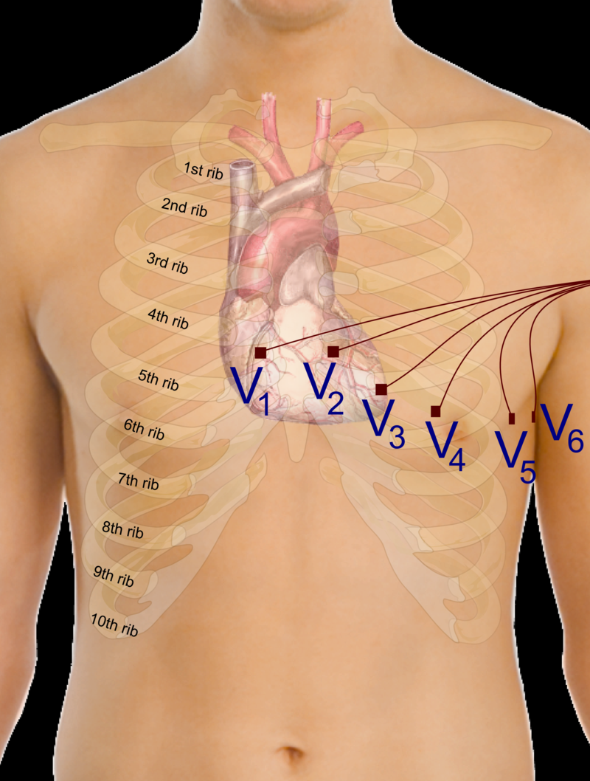
Placement of chest electrodes

Slide 23
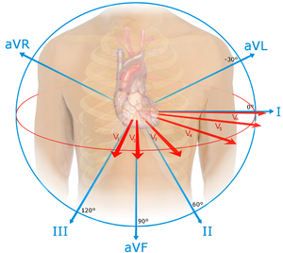

Slide 24
Elements of the trace
An ECG will give a trace of a healthy heart that looks like the graph below. Each trace is a single heartbeat and therefore lasts about 0.8 seconds.
The main features of the trace are labeled as P, Q, R, S and T according to convention.

Slide 27
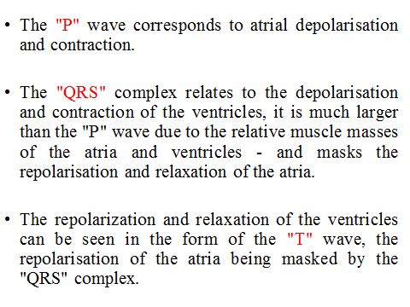

Slide 28
The voltage change is sensed by measuring the current change across 2 electrodes – a positive electrode and a negative electrode.
If the electrical impulse travels towards the positive electrode this results in a positive deflection. If the impulse travels away from the positive electrode this results in a negative deflection.

Slide 29
Away from the electrode = negative deflection

Slide 31
Heart rate= 300/no. of large squares between two consecutive R waves.

Slide 32
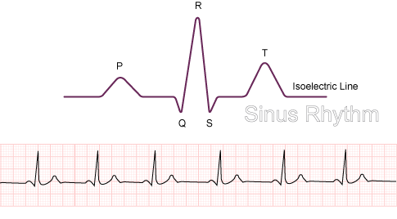
Rhythm
Sinus Rhythm can be defined as cardiac impulse originates from the sinus node. Every QRS must be preceded by a P wave.
In 2nd degree heart block where some P waves are not followed by a QRS, It could be said that it is not a normal sinus rhythm)

Slide 33
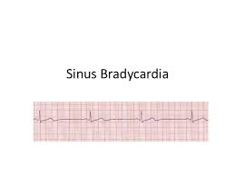
Sinus bradycardia
Rhythm originates in the sinus node
Rate of less than 60 beats per minute.

Slide 34
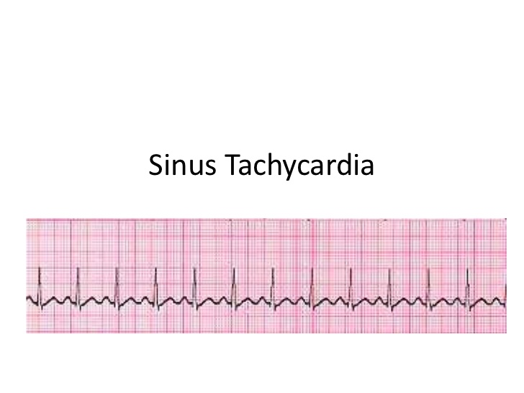
Rhythm
Sinus tachycardia
Rhythm originates in the sinus node
Rate of greater than 100 beats per minute.

Slide 35
Thank you

