Slide 1
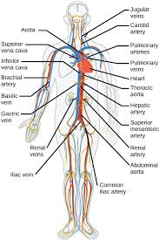
Histology
Circulatory System
Part -2-
2020-2021

Slide 2
VenaCava
The inferior vena cava is the largest vein in the human body. It collects blood from veins serving the tissues inferior to the heart and returns this blood to the right atrium of the heart. There are two in humans, the inferior vena cava (carrying blood from the lower body) and the superior vena cava (carrying blood from the head, arms, and upper body). Although the vena cava is very large in diameter, its walls are incredibly thin due to the low pressure exerted by venous blood.

Slide 3
Comparison between a vein and artery
Artery | Vein
Thick wall shape less deformed tunica intina crinkled three distinct layers tunica media prominent | Thin wall shape flatted Smooth layering indistinct Weak

Slide 4
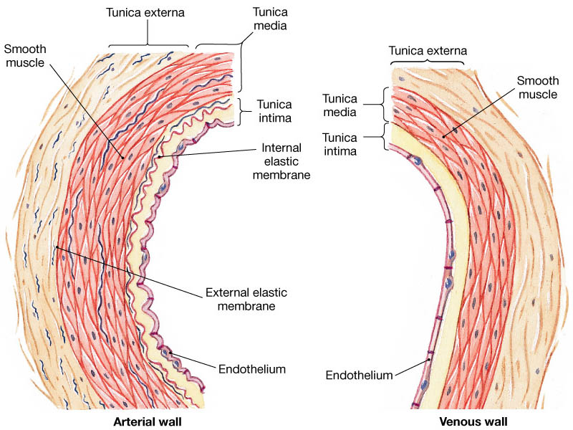

Slide 5
Capillaries are small, normally around 3-4µm, but some capillaries can be 30-40 µm in diameter. The largest capillaries are found in the liver.
Capillaries connect arterioles to venules. They allow the exchange of nutrients and wastes between the blood and the tissue cells, together with the interstitial fluid. This exchange occurs by passive diffusion and by pinocytosis which means 'cell drinking.

Slide 6
Types of capillaries
1-Fenestratedcappillaries: Have the same structure of non fenestrated but several circular opening in their endothelium cell are closed by diaphragm.This type capillary found in kidney and endocrine gland.

Slide 7
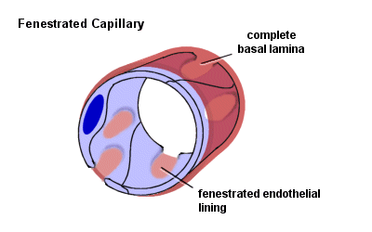

Slide 8
2-Sinusoid or discontinuous capillary
A large capillaries with diameter of (30-40)pm or more. It consists of cells which are irregular in shape and discontinuous basal membrane. The endothelium is not connected by desmosome and associated with macrophagocytic or (Kupffer cells). This type is found in spleen, bone marrow, and liver.

Slide 9
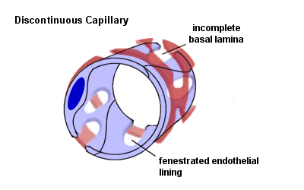

Slide 10
3-Non fenestrated (Continuous capillaries)
Are most common in body consist the wall endothelial cell resting on basal membrane and contain pericyte and pinocytotic vessel. This type capillary found in skin and muscle.Are formed by "continuous" endothelial cells and basal lamina. The endothelial cell and the basal lamina do not form openings, which would allow substances to pass the capillary wall without passing through both the endothelial cell and the basal lamina. Both endothelial cells and the basal lamina can act as selective filters in continuous capillaries.

Slide 11
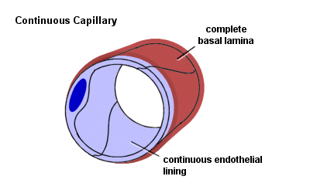

Slide 12
Heart
The heart is a muscular organ in humans and other animals, which pumps blood through the blood vessels of the circulatory system. Blood provides the body with oxygen and nutrients, and also assists in the removal of metabolic wastes. The heart is located in the middle compartment of the mediastinum in the chest, the heart is a pump with four chambers and valves that maintain a one-way flow of blood. The wall of heart consists of three layers that are homologous to the three tunic of blood vessels.

Slide 13
Tunica Intima: ( Endocardium)
The Endocardium is composed of a continuous endothelial lining, with attendant basement membrane, that lies on top of a layer of collagen. The endothelium of the heart is continuous with that of the aorta, vena cava, pulmonary artery, and pulmonary veins, Purkinje Fibers ( impulse conducting fibers ,it is large modified of muscle cell).

Slide 14
Tunica Media: ( Myocardium)
The myocardium is a variably-sized layer of cardiomyocytes that lies between the endocardium and epicardium and makes up the bulk of the heart's mass. Cardiomyocytes are arranged end to end, in a branching network of fibers and are attached to one another by specialized sections of membrane known as intercalated discs. The membrane at intercalated discs possess a large number of gap junctions which allow nearly free passage of ions between cardiomyocytes which is critical for cardiac action potential propagation.

Slide 15
Tunica Adventitia: (Epicardium)
The Epicardium of the heart is lined by a layer of flat mesothelial cells that lie on top of a layer of collagenous tissue. The epicardium makes up the visceral pericardium and serves as a lubricated surface which allows for the free movement of the heart within the pericardium. The outer, parietal pericardium also possesses a layer of mesothelium but is not considered a histological component of the heart itself.

Slide 16
Heart also have four valves composed of connective tissue layered with endothelium on each side, valves consist of three layes: Spongiosa (loose collagen),fibrosa(dense of connective tissue), Ventricularis

Slide 17
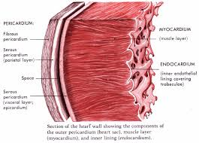

Slide 18



