Slide 1
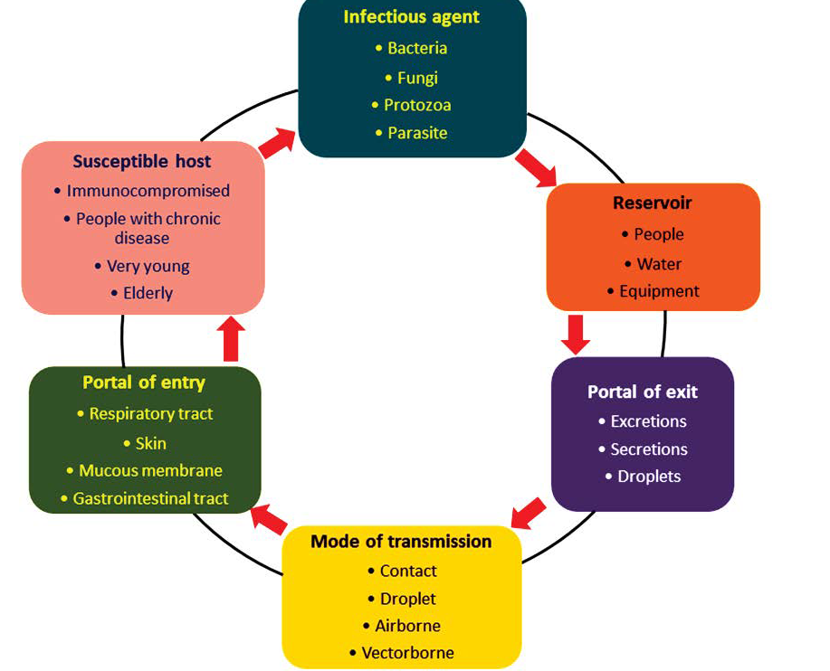
COMMUNICABLE DISEASES - II -
INFECTIONS THROUGH THE
GASTRO-INTESTINAL TRACT
Dr. Mayssaa Essam
2020-2021

Slide 2
HEAD LINES
■ Infective agents
■ Control of the infections acquired through the gastro-intestinal tract
■ Diarrhoeal diseases
■ Viral infections
■ Bacterial infections
■ Protozoal infections
■ Helminthic infections

Slide 3
POLIOMYELITIS
poliomyelitis was the most important enterovirus in the tropics but widespread immunization programmes have greatly reduced the incidence of the disease. the disease will be eradicated within the next 5 years .The incubation period varies from 3 to 21 days, with an average of about 10 days. It is characterized by fever and a flaccid asymmetrical paralysis.
Epidemiology
The disease is now limited to a few countries in the tropics. All of the known types of poliomyelitis (1, 2 and 3) are prevalent although the virus strains
responsible for paralytic illness in any area may vary, and at different periods in the same area one type or other may predominate. Large-scale epidemics
may result if virulent wild-type virus (commonly type 1) is reintroduced into a community with breakdown in vaccine delivery and poor economic and environmental conditions. In the tropics, a seasonal peak occurs in the hot
and rainy season.

Slide 4
RESERVOIR
Humans are the reservoir of infection. The poliovirus is excreted in the stools of infected cases.
TRANSMISSION
Poliomyelitis is a highly infectious disease. The virus is transmitted from person to person by the faecal–oral route or pharyngeal secretions, rarely by foodstuffs contaminated by faeces.
Virology
There are three distinct types of poliovirus, that invade the central nervous system: type 1 ,type 2 and type 3 . The viruses grow well in tissue culture, they resist desiccation but are killed in half an hour by heat (60°C). Most outbreaks are due to type 1 poliovirus.

Slide 5
Laboratory diagnosis
The virus is isolated from samples of faeces, throat swabs or from throat and nasopharyngeal washings. Clinically, the paralysis is usually symmetrical and progresses for longer periods – 10 days instead of 3–4 days as in poliomyelitis.
Control
High standards of hygiene and mass immunization are the two most important measures of control.
IMMUNIZATION
Immunization provides the most reliable method for the prevention of poliomyelitis and for controlling rapid spread during an epidemic. Two types of poliomyelitis vaccines are currently available: killed ‘Salk’ vaccine (IPV), which is given by injection, and the attenuated ‘Sabin’ vaccine, which is given by mouth (OPV).

Slide 6
ERADICATION
In 1988 WHO declared the goal of eliminating
poliomyelitis in the world due to wild-type virus
by the year 2000. The strategy is four-pronged
comprising: (i) high routine immunization coverage
with OPV. (ii) supplementary immunization
in the form of national immunization days (NIDs).
(iii) effective surveillance. (iv) in the final
stages, door-to-door immunization campaigns in
areas where the virus persists.

Slide 7
VIRAL HEPATITIS
There are six types of viral hepatitis – A and E, which are transmitted by the faeco-oral route, and B, C, D and G, which are blood-borne infections.
Viral hepatitis A (HAV)
The disease is characterized by loss of appetite, jaundice, enlargement of the liver and raised levels of liver enzymes. The incubation period varies from 15 to 40 days with an average of around 20 days.
EPIDEMIOLOGY
The disease is widespread but is more common in the tropics and subtropics; in these areas, most infections are acquired in childhood and many are subclinical.
Reservoir
Humans are the reservoir of infection, excreting the organism in the faeces and possibly urine, virus shed in the faeces continues until the onset of clinical symptoms.

Slide 8
Transmission
Faeco-oral spread is the most important mode of transmission by direct or indirect contact. Sporadic cases are probably caused by person to person contact, but explosive epidemics from water and food occur. The ingestion of shellfish grown in polluted waters is attended by a risk of acquiring hepatitis A.
Host factors
■ Age – children tolerate the infection and recover more rapidly than adults.
■ Sex – men take longer than women to recover from an equivalent degree of liver damage.
■ Pregnancy – exacerbates hepatitis.
■ Strenuous exercise – in the early stages of the disease.
■ Glucose-6-phospate deficiency – a high frequency of G6PD deficiency has been found among patients with hepatitis and those with this genetic enzyme defect have a longer and more severe course.

Slide 9
VIROLOGY AND LABORATORY DIAGNOSIS
HAV is in the range of 25–28 nm? and is identified by electron microscopy. Elevation of serum levels of liver enzymes? is invariably found. The diagnosis is confirmed by the demonstration of IgM antibodies to the virus measured by solid phase, IgM capture immunoassays.
CONTROL
Control depends on high standards of personal and environmental hygiene.
Immunizatio
Inactivated HAV vaccine is now available. A double-dose vaccine has been licensed which, if followed by a booster dose 6–12 months later, is expected to provide at least 10 years’ protection. It induces antibodies in over 90% of individuals within 2 weeks and protects against infection. The vaccine should be given intramuscularly in the deltoid region. Unfortunately, HAV vaccines are at present too expensive for use on a population-wide basis in most tropical countries. Passive immunity may be conferred using human immunoglobulin (IG). Even when it does not prevent infection it does modify the severity of the disease. It is useful in protecting family contacts during epidemics (0.2 ml/kg intramuscularly). For those going to the tropics a 0.2–0.5 ml/kg gives passive protection for about 6 months. Recovery from a clinical attack creates a lasting active immunity.

Slide 10
Viral hepatitis E (HEV)
Like HAV, HEV causes malaise, anorexia, jaundice and liver enzyme serum elevation. The incubation period is around 40 days, a case fatality rate of 20% occurred in pregnant women in India, while 60% of sporadic cases of fulminant hepatitis seen in the country are all due to HEV .
EPIDEMIOLOGY
Hepatitis E has been reported from a number of countries in the tropics ranging from China to Mexico. The source of infection has been contaminated drinking water. The peak age specific sero-prevalence in endemic countries is in the over-16 years group – unlike hepatitis A, which usually occurs before the age of 5 years. Clinical manifestations occur in persons 25–40 years of age.
CONTROL
As for HAV, provision of safe drinking water and sanitary disposal of faeces is required to prevent the infection. No vaccine is as yet available.

Slide 11
Hepatitis B (HBV)
Hepatitis B is not transmitted by the faeco-oral route but is a blood-borne agent, transmitted by inoculation. Hepatitis B virus causes long-incubation hepatitis. It also gives rise to one of the 10 most common cancers, heptocellular carcinoma. There is evidence that HBV is the aetiological agent in up to 80% of cases.
EPIDEMIOLOGY
The carrier state (defined as the presence of HbsAg for more than 6 months) rises from 0.1% in parts of Europe to 15% in several tropical countries, a large number of infections are acquired in the perinatal period, usually from a carrier mother. Transmission may occur by:
■ Transfusion of blood or blood products.
■ Accidental inoculation, e.g. repeated use of hypodermic needles without sterilization.
■ Insect bites.
■ Perinatally – from a carrier mother.
■ Sexual intercourse – hetero- and homosexual.
■ Injury-associated sports or jobs.

Slide 12
VIROLOGY
HBV possesses at least three separate antigens:
surface antigen (HbsAg); core antigen (HbcAg) and enzyme antigen (HbeAg). The HbcAg is a valuable marker of potential infectivity of HbsAg positive serum. Subdeterminants of both surface antigen and c antigen occur.
CONTROL
Control is carried out by a combination of: (i) counselling;
(ii) hygiene practices in high-risk areas; (iii)vaccination of at- risk individuals; and (iv) selective use of hepatitis B immunoglobin (HbIG). A recombinant HbsAg vaccine is now widely used. Three doses (at 0, 1 and 6 months).

Slide 13
Hepatitis C (HCV)
Hepatitis C virus was discovered in 1989, and contains six different genotypes (1–6) which vary in
their geographical destination. The incubation period from exposure to liver function abnormalities is usually 8 weeks. Chronic infection is generally asymptomatic at first, later a large proportion of cases progress to cirrhosis of the liver and some to hepatocellular carcinoma.
EPIDEMIOLOGY
HCV has a worldwide distribution. The route of
infection is parenteral (e.g. intravenous drug users, blood transfusion). Donor HCV sero-prevalence is high in Egypt. Transplanted organs may also transmit the infection. Unsterile needles in medical and dental procedures, tattooing and other perisubcutaneous procedures are also responsible.

Slide 14
CONTROL
■ For the individual, interferon is now generally prescribed for the treatment of chronic hepatitis.
■ Screening of blood donors has proved effective
in reducing transmission of HCV.
■ Education, greater availability of disposable needles.
■ No vaccine is currently available.
Hepatitis delta (HDV)
HDV is a small, incomplete virus incapable of independent replication, which can exist only in the presence of HBV. It gives rise to a more severe form of hepatitis. Two forms of infection have been recognized. Like HBV, HDV is a blood-borne pathogen. Delta hepatitis is endemic in the Eastern Mediterranean, the Middle East, North Africa, the Amazon
but occurs worldwide.
CONTROL
■ HBV vaccination also protects against HDV.
■ Screening of blood has reduced the risk of infection.

Slide 15
Hepatitis G (HGV)
HGV has a similar role to HCV and should be sought in haemophilia, thalassaemia, dialysis patients, intravenous drug addicts and those handling blood. Co-infection with HCV is frequent.
REFERENCES
Rowitz, Louis. 2008. Public Health Leadership: Putting Principles into Practice.

