Slide 1
POSITIVE INOTROPIC DRUGS
Assistant lecturer :
Noor Wafaa Hashim

Slide 2
Positive inotropic drugs
Cardiac glycosides : Digoxin.
+ve Inotropic sympathmimetics :
Dopamine , Dobutamine .

Slide 3
Digoxin
Digoxin increase the force of myocardial contraction and reduce conductivity within the atrioventricular (AV) node.
In patients with heart failure who are in sinus rhythm, a satisfactory plasma digoxin concentration can be achieved over a period of about a week.

Slide 4
Clinical Use
Cardiac glycosides are most useful in the treatment of supraventricular tachycardia, especially for controlling ventricular response in persistent atrial fibrillation.
Digoxin is now rarely used for rapid control of heart rate even with intravenous administration, response may take many hours; persistence of tachycardia is therefore not an indication for exceeding the recommended dose.

Slide 5
Digoxin dosing
Digoxin has a long half-life and maintenance doses need to be given only once daily (although higher doses may be divided to avoid nausea).
The intramuscular route is not recommended.
Digitoxin also has a long half-life and maintenance doses need to be given only once daily or on alternate days

Slide 6
Digoxin dosing
Renal function is the most important determinant of digoxin dosage, whereas elimination of digitoxin depends on metabolism by the liver.

Slide 7
Digitalization
Rapid digitalisation, for atrial fibrillation or flutter, by mouth, 0.75–1.5 mg over 24 hours in divided doses . Maintenance, for atrial fibrillation or flutter, by mouth, according to renal function and initial loading dose; usual range 125–250 micrograms Daily .
Slow digitalisation , for heart failure (for patients in sinus rhythm), by mouth, 62.5–125 micrograms once daily .

Slide 8
Emergency loading dose
Emergency loading dose, for atrial fibrillation or flutter, by intravenous infusion (but rarely necessary), 0.75–1 mg over at least 2 hours , then maintenance dose by mouth on the following day.
Reduce dose by half with concurrent use of: amiodarone, dronedarone and quinine

Slide 9
Cautions
Cardiac glycosides should be used with special care in the elderly who may be particularly susceptible to digitalis toxicity.
Hypokalaemia predisposes the patient to digitalis toxicity; it is managed by giving potassium sparing diuretic or, if necessary, potassium supplementation.

Slide 10
Cautions
Hypercalcaemia (risk of digitalis toxicity) .
hypokalaemia (risk of digitalis toxicity) .
hypomagnesaemia (risk of digitalis toxicity) . hypoxia (risk of digitalis toxicity) . recent myocardial infarction . Severe respiratory disease . sick sinus syndrome . thyroid disease.

Slide 11
PREGNANCY : May need dosage adjustment.
REBAST FEEDING :Amount too small to be harmful.
RENAL IMPAIRMENT:
Dose adjustments :Reduce dose.
Monitoring:Monitor plasma-digoxin concentration in renal impairment.

Slide 12
Unwanted effects depend both on the concentration of the cardiac glycoside in the plasma and on the sensitivity of the conducting system or of the myocardium, which is often increased in heart disease.
It can sometimes be difficult to distinguish between toxic effects and clinical deterioration because symptoms of both are similar. Also, the plasma concentration alone cannot indicate toxicity reliably but the likelihood of toxicity increases progressively through the range 1.5 to 3 micrograms/ litre for digoxin.

Slide 13
Regular monitoring of plasma-digoxin concentration during maintenance treatment is not necessary unless problems are suspected.
Toxicity can often be managed by discontinuing digoxin; serious manifestations require urgent specialist management.
Digoxin-specific antibody fragments are available for reversal of life-threatening over dosage.

Slide 14
SIDE-EFFECTS:
Common or very common :Arrhythmias . cardiac conduction disorder . cerebral impairment . diarrhoea . dizziness .eosinophilia . nausea . skin reactions . vision disorders .vomiting.
INTERACTIONS → Appendix 1: digoxin

Slide 15
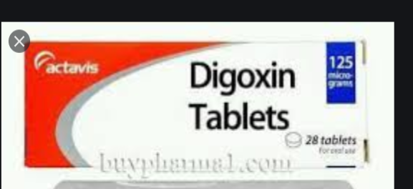
Digoxin tablets 125 mcg

Slide 16
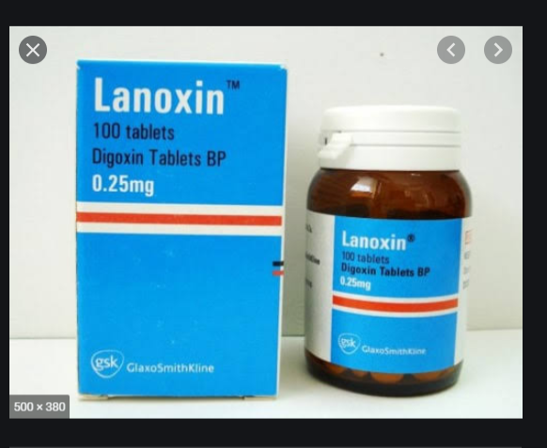
Digoxin tablet 250 mcg

Slide 17
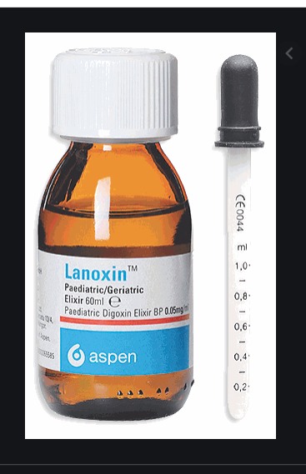
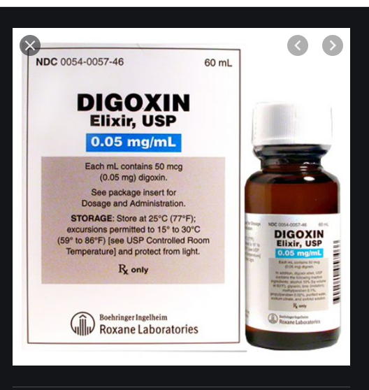
Digoxin Elixir 0,05 mg/ml

Slide 18
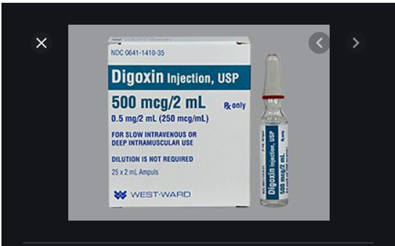
Digoxin injection (250mcg/ml)

Slide 19
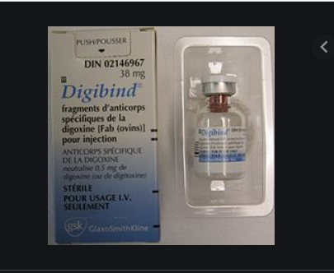
Digoxin specific antibody fragments

Slide 20
Sympathomimetic agents
Dopamine & Dobutamine

Slide 21
Dopamine hydrochloride
Dopamine is a cardiac stimulant which acts on beta1 receptors in cardiac muscle ,and increases contractility with little effect on rate.

Slide 22
INDICATIONS AND DOSE
Cardiogenic shock in infarction or cardiac surgery :
▶ BY INTRAVENOUS INFUSION:
▶ Adult: Initially 2–5 micrograms/kg/minute

Slide 23
CONTRA-INDICATIONS : Phaeochromocytoma , tachyarrhythmia.
CAUTIONS :Correct hypervolemia . hypertension (may raise blood pressure) . hyperthyroidism . low dose in shock due to acute myocardial infarction

Slide 24
SIDE-EFFECTS
Angina pectoris . anxiety . arrhythmias .azotaemia . cardiac conduction disorder . dyspnoea .gangrene . headache . hypertension . mydriasis . nausea .palpitations . piloerection . polyuria . tremor. vasoconstriction . vomiting

Slide 25
PREGNANCY: No evidence of harm in animal studies—manufacturer advises use only if potential benefit outweighs risk.
BREAST FEEDING: May suppress lactation—not known to be harmful.
INTERACTION: see Appendix 1 in BNF
(Sympathomimitics,inotropic)

Slide 26
DIRECTIONS FOR ADMINISTRATION
Dopamine concentrate for intravenous infusion to be diluted before use.
For intravenous infusion give continuously in Glucose 5%or Sodium chloride 0.9%.
Dilute to max. concentration of 3.2 mg/mL; incompatible with bicarbonate.

Slide 27
MEDICINAL FORMS
▶ Dopamine hydrochloride (Non-proprietary)
Dopamine hydrochloride 40 mg per 1 ml Dopamine 200mg/5ml solution for infusion ampoules.
Dopamine hydrochloride 160 mg per 1 ml Dopamine 800mg/5ml solution for infusion ampoules.

Slide 28
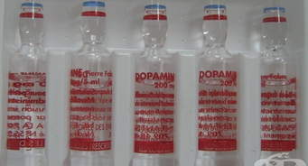
Dopamine

Slide 29
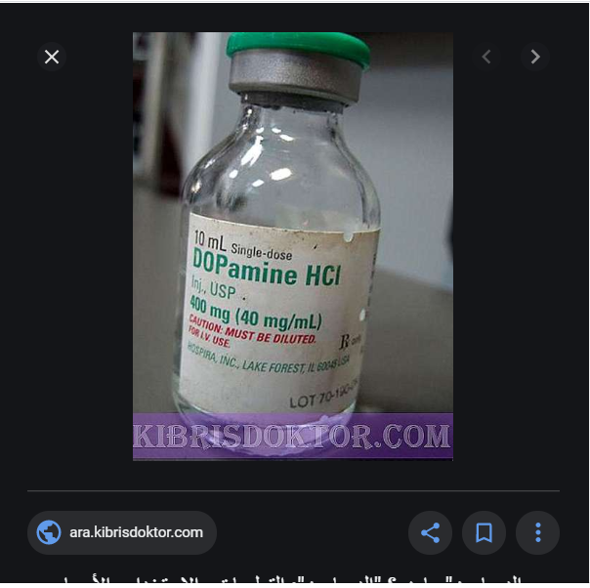
Dopamine

Slide 30
Dobutamine
DRUG ACTION : Dobutamine is a cardiac stimulant which acts on beta1 receptors in cardiac muscle, and increases contractility.
INDICATIONS AND DOSE: Inotropic support in infarction, cardiac surgery, cardiomyopathies, septic shock, cardiogenic shock, and during positive end expiratory pressure ventilation
▶ BY INTRAVENOUS INFUSION
▶ Adult: Usual dose 2.5–10 micrograms/kg/minute, adjusted according to response, alternatively
0.5–40 micrograms/kg/minute

Slide 31
Cardiac stress testing:
▶ BY INTRAVENOUS INFUSION
▶ Adult: (consult product literature).
CONTRA-INDICATIONS: Phaeochromocytoma.
INTERACTIONS → Appendix 1: sympathomimetics,inotropic

Slide 32
CAUTIONS
Acute heart failure . acute myocardial infarction. arrhythmias .
correct hypercapnia before starting and during treatment .
correct hypovolaemia before starting and during treatment .
correct hypoxia before starting and during treatment .
correct metabolic acidosis before starting and during treatment .
diabetes mellitus . elderly .

Slide 33
CAUTIONS
extravasation may cause tissue necrosis .
extreme caution or avoid in marked obstruction of cardiac ejection (such as idiopathic hypertrophic subaortic stenosis) .
hyperthyroidism . ischaemic heart disease . Occlusive vascular disease . severe hypotension .
susceptibility to angle-closure glaucoma . tachycardia .
tolerance may develop with continuous infusions longer than 72 hours.

Slide 34
SIDE-EFFECTS
▶ Common or very common :Arrhythmias bronchospasm .chest pain . dyspnoea . eosinophilia . fever . headache .inflammation localised . ischaemic heart disease . nausea .palpitations . platelet aggregation inhibition (on prolonged administration) . skin reactions . Urinary urgency . vasoconstriction

Slide 35
PREGNANCY : No evidence of harm in animal studies—manufacturers advise use only if potential benefit outweighs risk.
BREAST FEEDING :Manufacturers advise avoid—no information available.
MONITORING REQUIREMENTS :Monitor serum-potassium concentration.

Slide 36
DIRECTIONS FOR ADMINISTRATION :Dobutamine injection
should be diluted before use or given undiluted with
syringe pump.
For intravenous infusion, give continuously in Glucose 5%
or Sodium chloride 0.9%.
Dilute to a concentration of 0.5–1 mg/mL and give via an infusion pump; give higher concentration (max. 5 mg/mL) through central venous catheter.
Incompatible with bicarbonate and other strong alkaline solutions

Slide 37
MEDICINAL FORMS
Solution for infusion
EXCIPIENTS: May contain Sulfites
*Dobutamine (as Dobutamine hydrochloride)
5 mg per1 ml Dobutamine 250mg/50ml solution for infusion vials.
*Dobutamine (as Dobutamine hydrochloride)
12.5 mg per 1 ml Dobutamine 250mg/20ml concentrate for solution for infusion ampoules

Slide 38
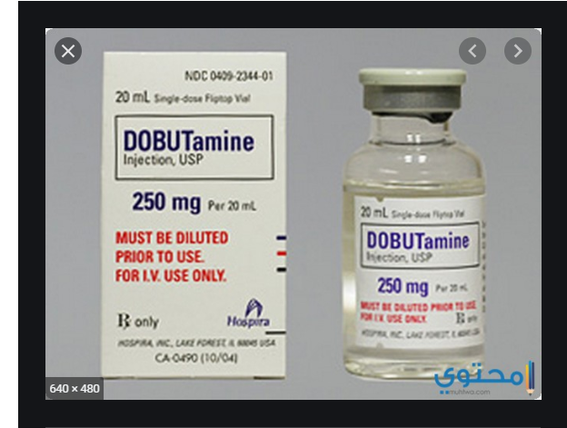
Dobutamine Vials 250 mg/20 ml

Slide 39
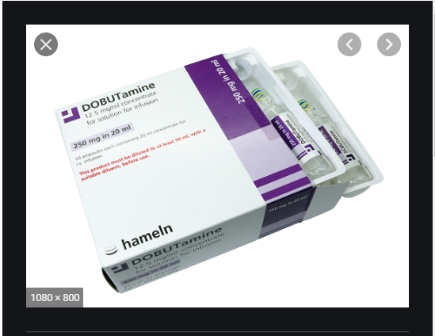
Dobutamine ampoules

Slide 40

Thank you

