Slide 1
Skin Part II
Athlete's foot & Warts
Assistant lecturer :
Noor Wafaa Hashim

Slide 2
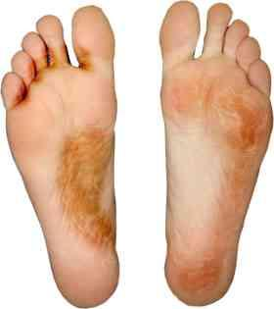
Athlete's foot
The incidence of athlete’s foot (tinea pedis) is not, as its name might suggest, limited to those of an athletic disposition. The fungus that causes the disease thrives in warm, moist conditions. The spaces between the toes can provide a good growth environment and the infection therefore has a high incidence. The problem is more common in men than in women and responds well to OTC treatment.

Slide 3
Patient assessment
1. Duration: A long-standing severe condition may need referral the patient. However, most cases of athlete’s foot are minor in nature and can be treated effectively with OTC products.
2. Appearance: It usually presents as itchy, flaky skin in the web spaces between the toes.
The flakes or scales of skin become white and macerated and begin to peel off. Underneath the scales, the skin is usually reddened and may be itchy and sore. The skin may be dry and scaly or moist and weeping.

Slide 4
3. Severity : It is usually a mild fungal infection, but the skin between the toes becomes more macerated and broken and deeper and painful fissures may develop which become inflamed and sore. Once the skin is broken, there is the potential for secondary bacterial infection to develop. If there are indications of bacterial involvement, such as weeping, pus or yellow crusts, then referral to the doctor is needed.

Slide 5
4. Location : Classically, the toes are involved, the web space between the fourth and fifth toes being the most commonly affected.
• More severe infections may spread to the sole of the foot and even to the upper surface in some cases. This type of spread can alter the appearance of the condition and severe cases are probably best referred to the doctor for further investigation. When other areas of the foot are involved, the appearance can be confused with that of allergic dermatitis.
• If the toenails appear to be involved, referral to the doctor may be necessary depending on how many toenails are affected and severity. Systemic antifungal treatment may be required to deal with infection of the nail bed where OTC treatment is not appropriate.

Slide 6
5. Previous history: Any diabetic patient who presents with athlete’s foot is best referred to the doctor. Diabetics may have impaired circulation or innervations of the feet and are more prone to secondary infections in addition to poorer healing of open wounds.

Slide 7
6. Medication: Treatment failure may occur simply because it was not continued for sufficiently long enough. However, if an appropriate antifungal product has been used correctly without remission of symptoms, the patient is best referred to the doctor, especially if the problem is of long duration (several weeks).
Treatment timescale :If athlete’s foot has not responded to treatment within 2 weeks, patients should see their doctor.

Slide 8
Drug groups
Allylamines: Terbinafine
Azole: Clotrimazole, Miconazole, Ketoconazole
Tolnafitate, HC cream.
Management
Many preparations are available for the treatment of athlete’s foot. Formulations include creams, powders, solutions, sprays and paints.
allylamines (e.g. terbinafine), azoles (e.g. clotrimazole, miconazole and ketoconazole), undecenoic acid and tolnaftate. All are more effective than placebo. terbinafine is more effective in preventing recurrence. Terbinafine and ketoconazole have a 1-week treatment period, which some patients may prefer. Regular application of the product to clean, dry feet is essential and treatment must be continued after symptoms have gone to ensure eradication of the fungus and advise use for 1–2 weeks after the disappearance of all signs of infection.

Slide 9
Azoles (e.g. clotrimazole, ketoconazole and miconazole)
They have a wide spectrum of action and have both antifungal and antibacterial activity. (The latter is useful as secondary infection can occur.) The treatment should be applied two or three times daily. Formulations include creams, powders and sprays. Miconazole, clotrimazole and ketoconazole have occasionally been reported to cause mild irritation of the skin. Ketoconazole has a 1-week treatment period.

Slide 10
Clotrimazole
INDICATIONS AND DOSE
Fungal skin infections
▶ TO THE SKIN
▶ Child: Apply 2–3 times a day
▶ Adult: Apply 2–3 times a day
CAUTIONS Contact with eyes and mucous membranes should be avoided
PREGNANCY :Minimal absorption from skin; not known to be harmful.
PRESCRIBING AND DISPENSING INFORMATION : Spray may
be useful for application of clotrimazole to large or hairy
areas of the skin.

Slide 11
Ketoconazole
INDICATIONS AND DOSE
Tinea pedis
▶ TO THE SKIN USING CREAM
▶ Adult: Apply twice daily
CONTRA-INDICATIONS Acute porphyrias
CAUTIONS Avoid contact with eyes . avoid contact with mucous membranes
SIDE-EFFECTS
▶ Common or very common: Skin reactions

Slide 12
Miconazole
INDICATIONS AND DOSE
Fungal skin infections
▶ TO THE SKIN
▶ Child: Apply twice daily continuing for 10 days after lesions have healed
▶ Adult: Apply twice daily continuing for 10 days after lesions have healed
PREGNANCY Absorbed from the skin in small amounts; manufacturer advises caution.

Slide 13
Terbinafine
Terbinafine is available as cream, solution, spray and gel formulations. terbinafine is better than the azoles in preventing recurrence, so it will be useful where frequent bouts of athlete’s foot are a problem. Terbinafine can cause redness, itching and stinging of the skin; contact with the eyes should be avoided. Terbinafine products are not recommended for use in children.

Slide 14
Terbinafine
INDICATIONS AND DOSE
Tinea pedis
▶ TO THE SKIN USING CREAM
▶ Adult: Apply 1–2 times a day for up to 1 week, to be applied thinly
▶ BY MOUTH USING TABLETS
▶ Adult: 250 mg once daily for 2-6 weeks

Slide 15
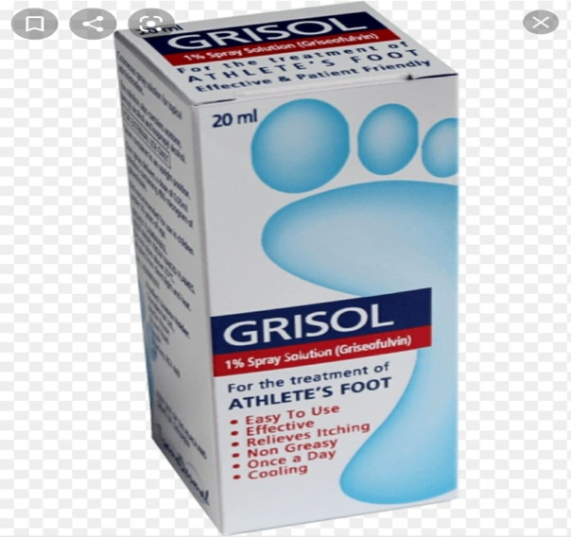
Griseofulvin
INDICATIONS AND DOSE
Tinea pedis
▶ TO THE SKIN
▶ Adult: Apply 400 micrograms once daily, apply to an area approximately 13cm2; increased if necessary to 1.2 mg once daily for maximum treatment duration of 4 weeks, allow each spray to dry between application

Slide 16
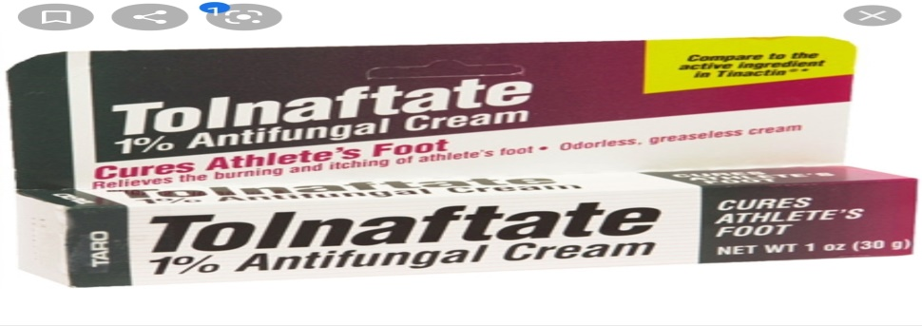
Tolnaftate
Tolnaftate is available in powder, cream, aerosol and solution formulations and is effective against athlete’s foot. It has antifungal, but not antibacterial, action. It should be applied twice daily and treatment should be continued for up to 6 weeks. tolnaftate may sting slightly when applied to infected skin.
Hydrocortisone cream or ointment
topical hydrocortisone in athlete’s foot is not recommended because, although it would reduce inflammation, it would not deal with the fungal infection, which might then worsen. Combination products containing hydrocortisone together with an antifungal agent are, , however, available OTC for use in athlete’s foot .Treatment is limited to 7 days.

Slide 17
Practical points
Footwear
Sweating of the feet can produce the kind of hot, moist environment in which the fungus is able to grow. Shoes that are too tight and that are made of synthetic materials make it impossible for moisture to evaporate. If possible, the patient should wear leather shoes, which will allow the skin to breathe. In summer, open-toed sandals can be helpful, and shoes should be left off where possible. The wearing of
cotton socks can facilitate the evaporation of moisture, whereas nylon socks will prevent this.
Foot hygiene
The feet should be washed and carefully and thoroughly dried, especially between the toes, before the antifungal preparation is applied.

Slide 18
Transmission of athlete’s foot
Athlete’s foot is easily transmitted and is acquired by walking barefoot, e.g. on changing-room floors in workplaces, schools and sports clubs. There is no need to avoid sports but wearing some form of footwear such as rubber sandals is advisable.
Prevention of re- infection
Shoes and socks are kept free of fungus. Socks should be changed and washed regularly. Shoes and feet can be dusted with a fungicidal powder to eradicate the fungus and absorb moisture and prevent maceration. Patients should be reminded to treat all shoes, since fungal spores may be present.

Slide 19
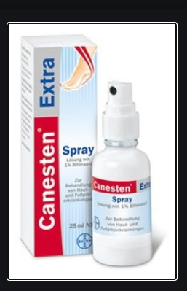
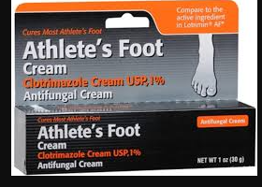
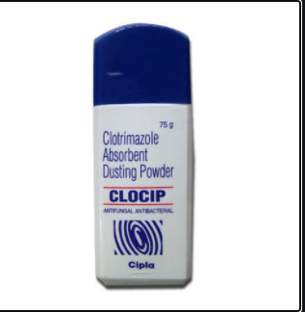
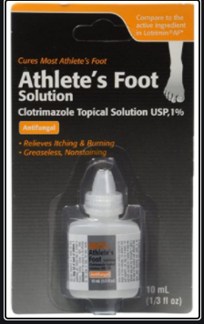

Slide 20
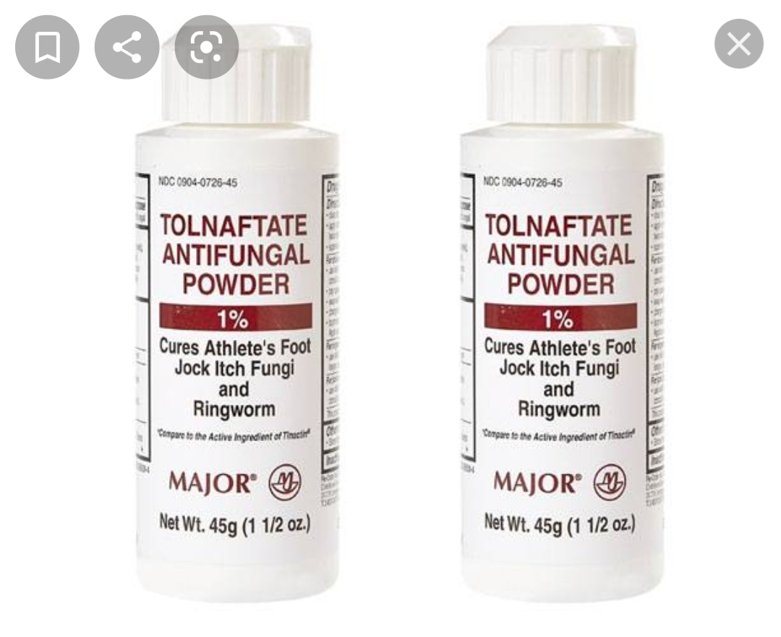
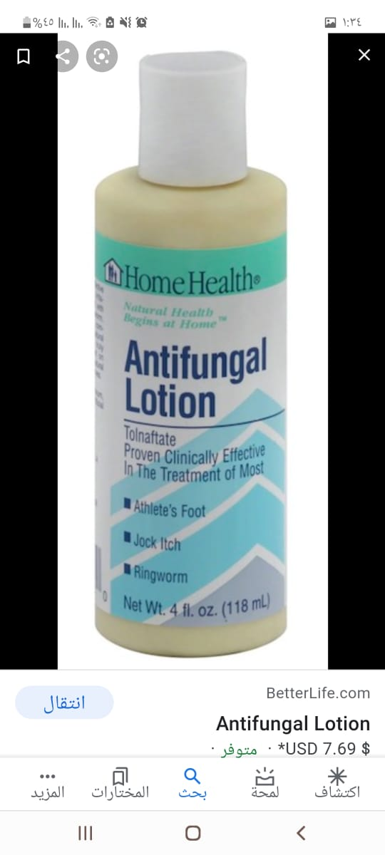


Slide 21
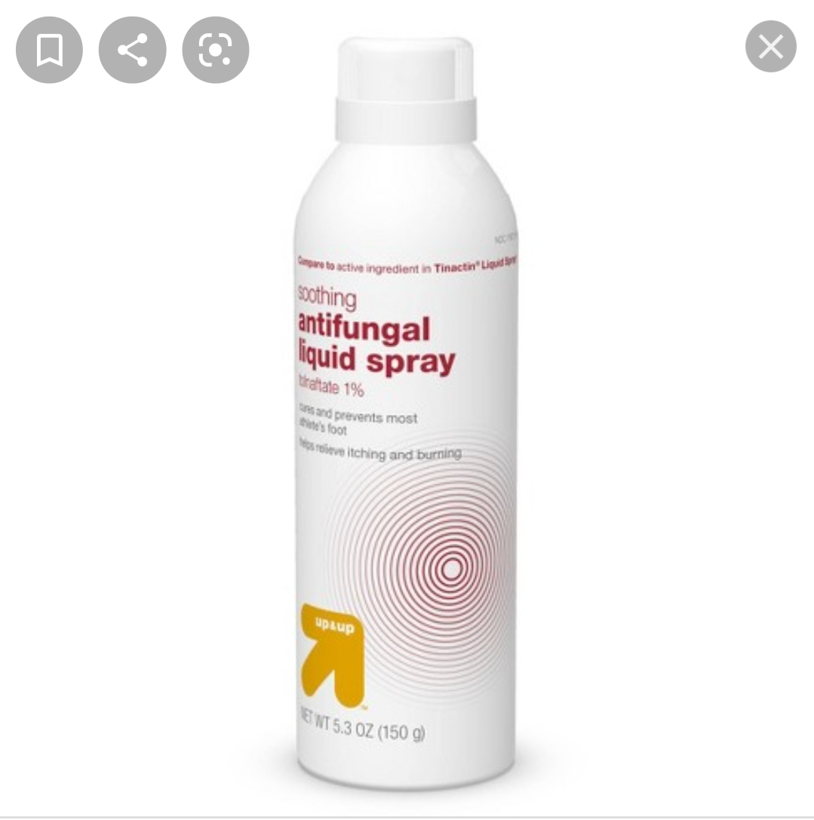
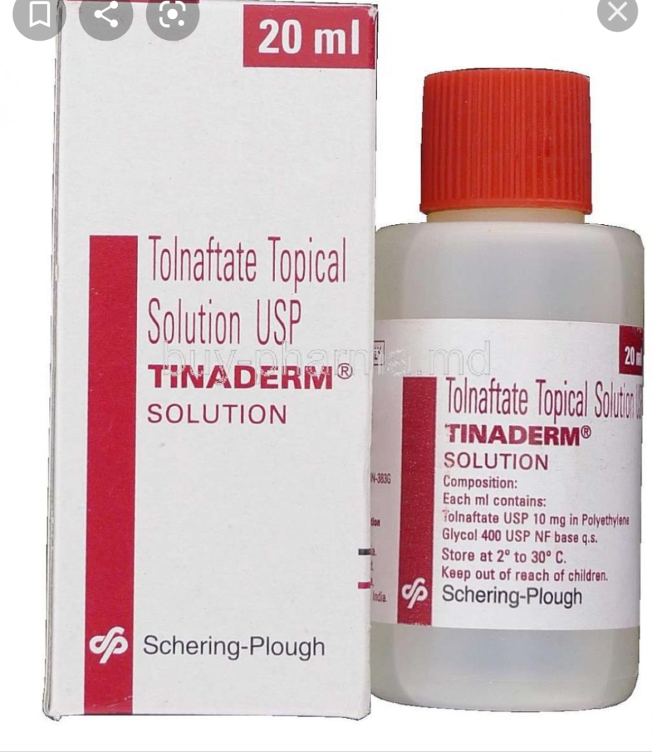

Slide 22
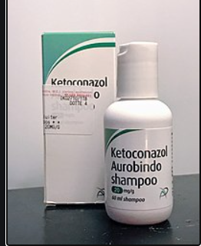

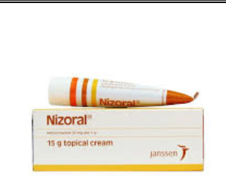

Slide 23
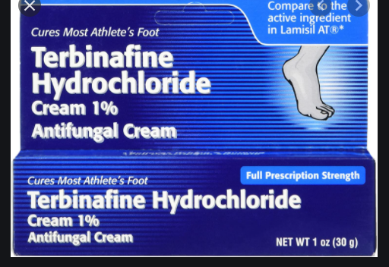

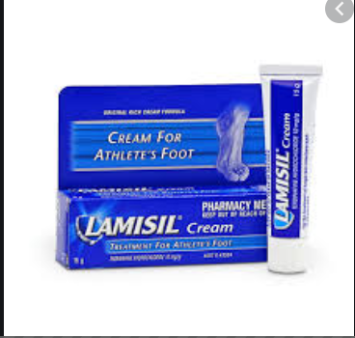
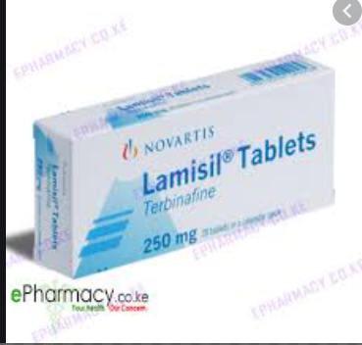

Slide 24
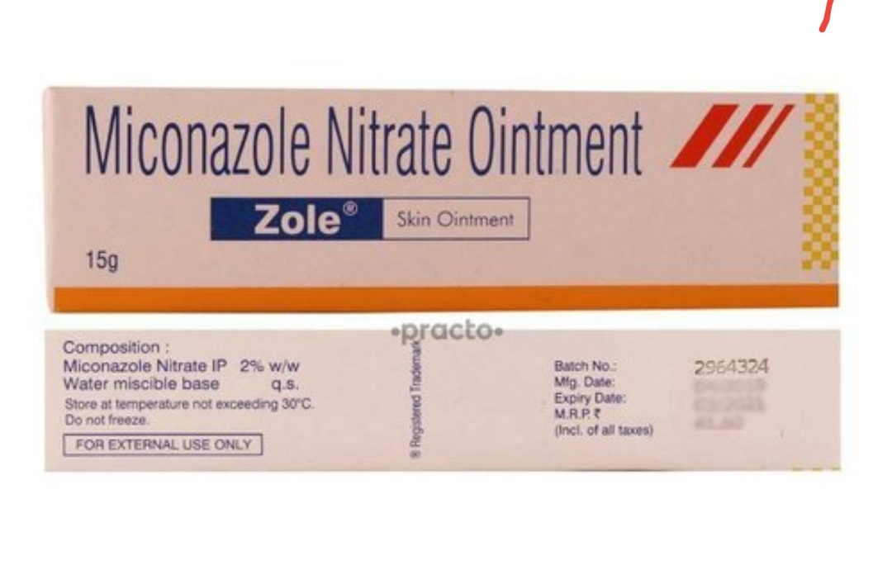
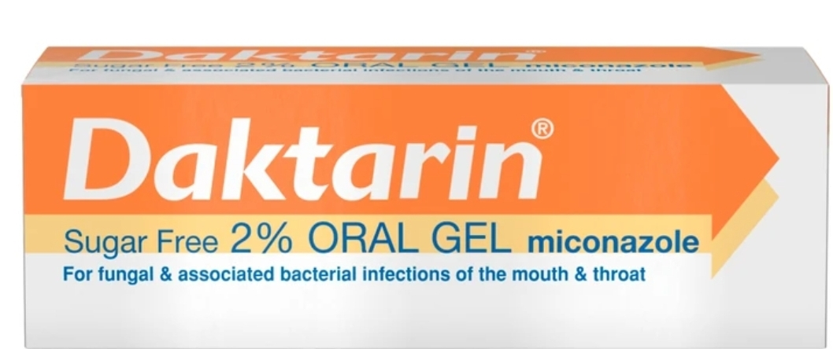

Slide 25
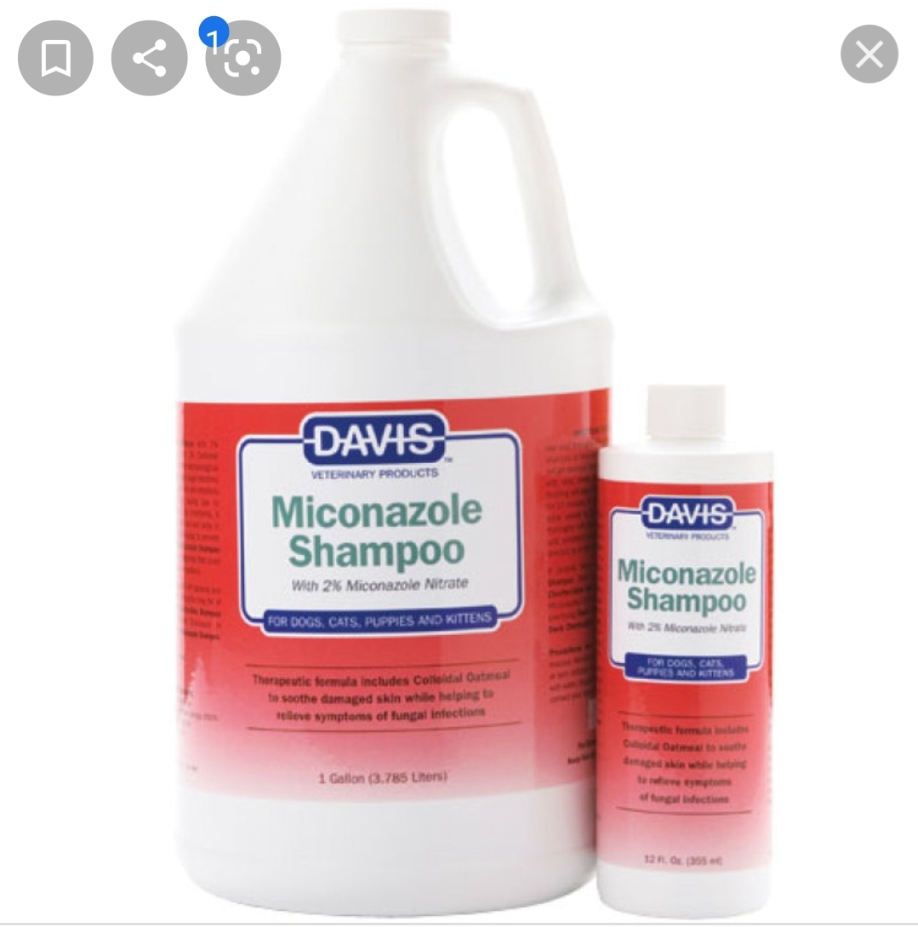
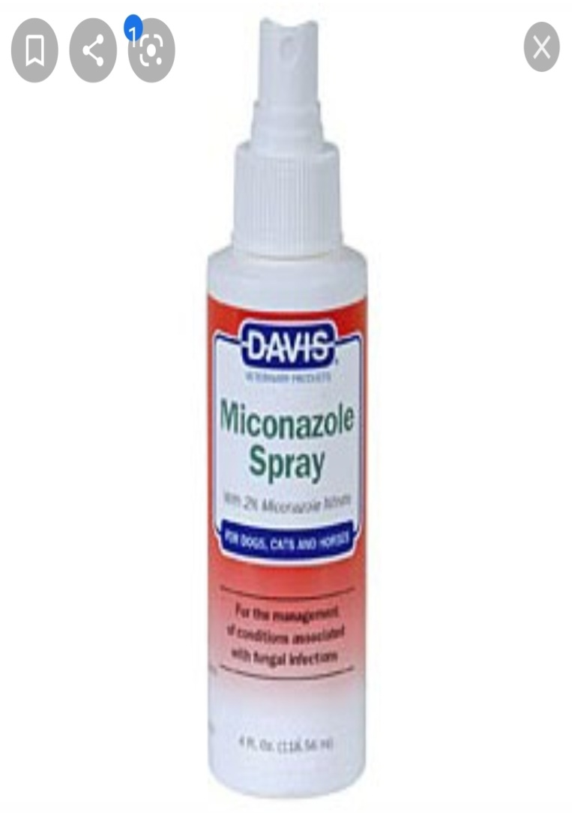
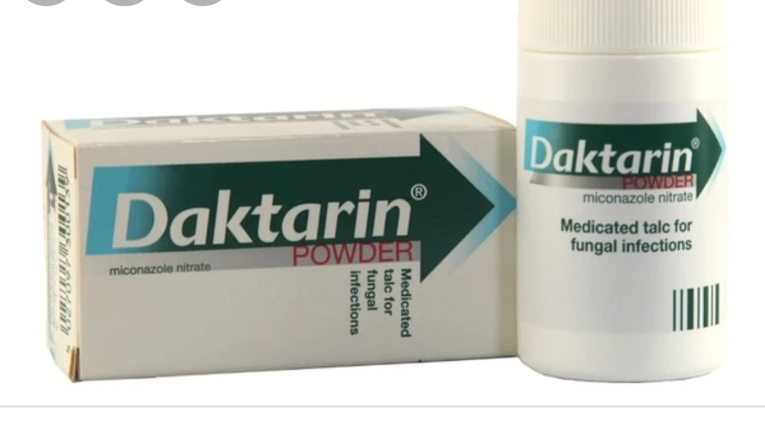

Slide 26
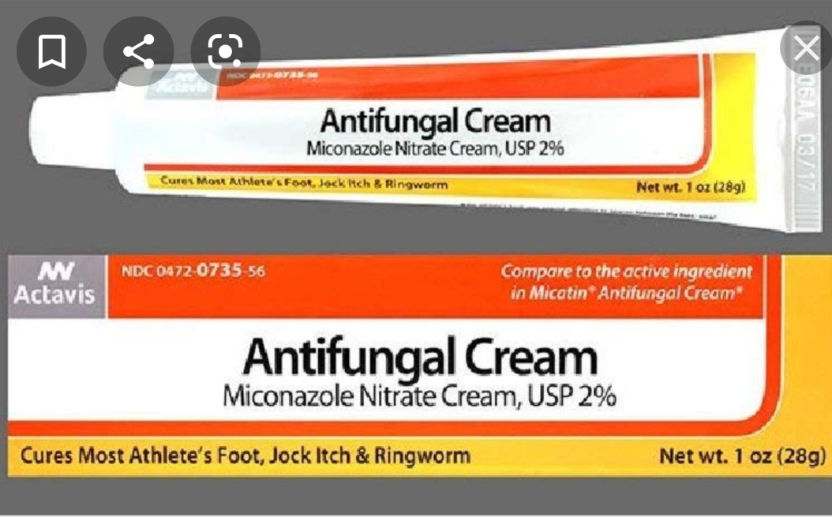

Slide 27
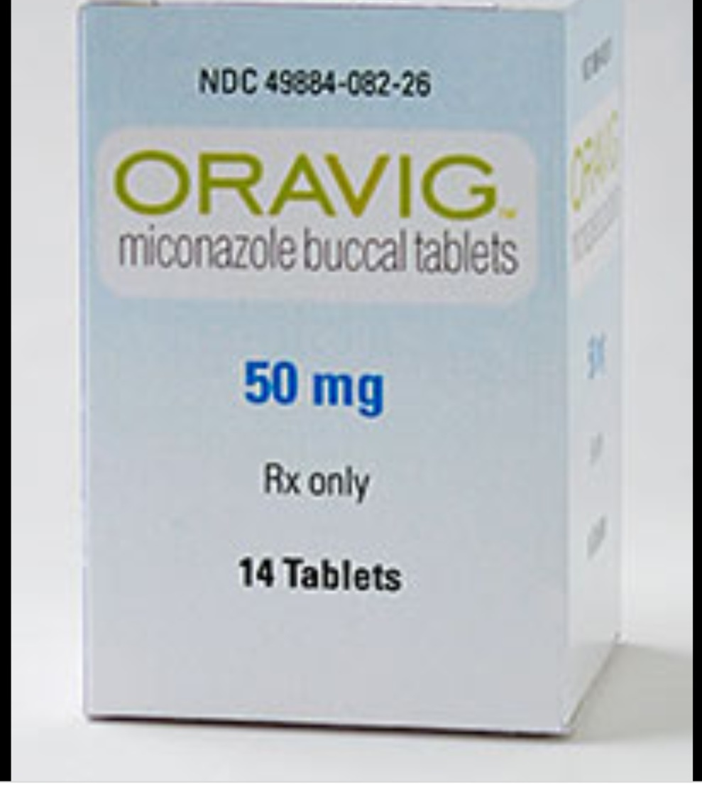
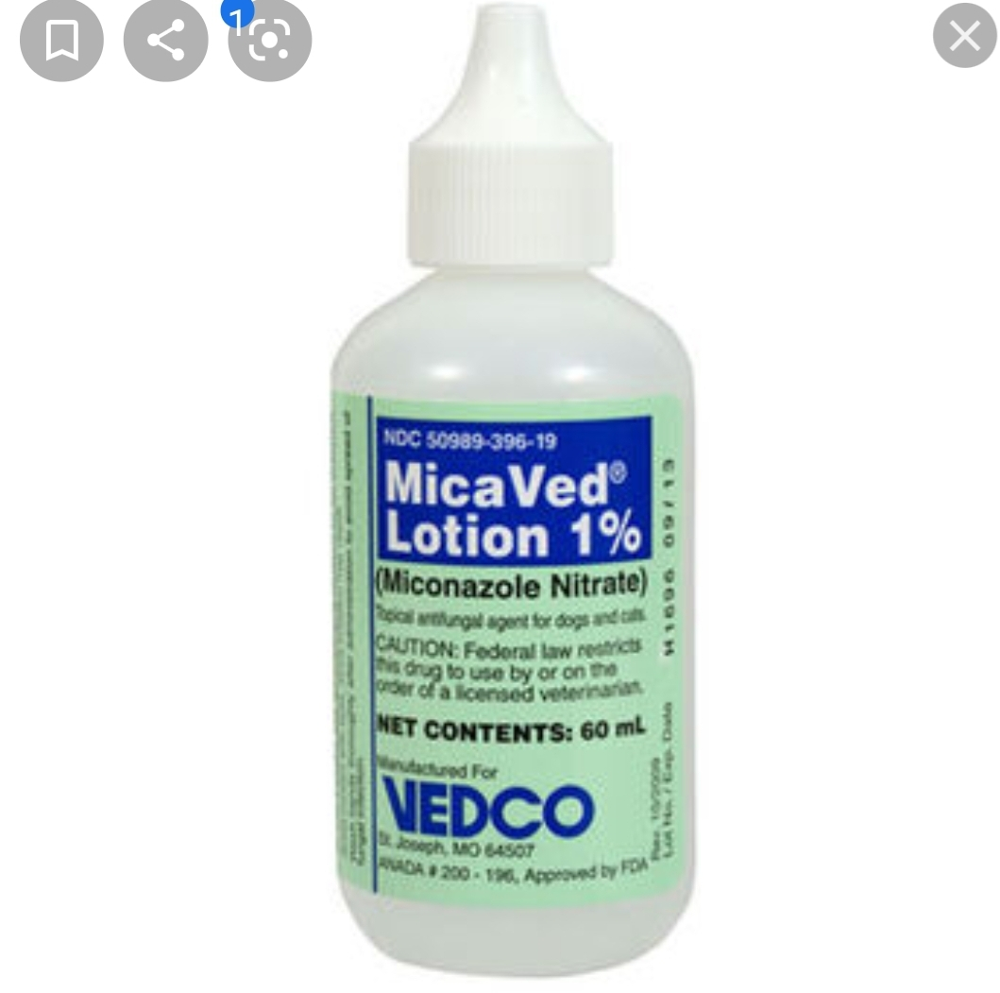

Slide 28
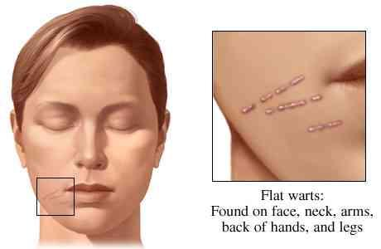
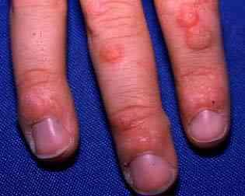
Warts

Slide 29
Warts
Warts is caused by the human papilloma virus to the skin and have a high incidence in schoolchildren. Once immunity to the infecting virus is sufficiently high, the lesions will disappear.
Patient assessment
Age
Warts can occur in children and adults; they are more common in children due to higher exposure to the virus in schools and sports facilities and the peak incidence is found between the ages of 12 and 16 years.

Slide 30
Appearance
Warts appear as raised lesions with a roughened surface that are usually flesh coloured. Warts have a network of capillaries and, if pared, thrombosed, blackened capillaries or bleeding points will be seen.
Multiple warts
Warts may occur singly or as several lesions. Molluscum contagiosum is a condition in which the lesions may resemble warts and where another type of viral infection is the cause. Closer examination shows that the lesions contain a central plug of material (consisting of viral particles), which can be removed by squeezing. The location of molluscum contagiosum tends to differ from that of warts – the eyelids, face, armpits and trunk may be involved. Such cases are best referred to the doctor, since self treatment would be inappropriate.

Slide 31
Location
The palms or backs of the hands are common sites for warts, as is the area around the fingernails. People who bite or pick their nails are more susceptible to warts around them. Warts sometimes occur on the face and referral to the doctor is the best option in such cases. Since treatment with OTC products is destructive in nature, self
treatment of facial warts can lead to scarring and should never be attempted. Parts of the skin that are subject to regular trauma or friction are more likely to be affected, since damage to the skin facilitates entry of the virus.

Slide 32
Anogenital
Anogenital warts are caused by a different type of human papilloma virus and require medical referral for examination, diagnosis and treatment. They are sexually transmitted and patients can self-refer to their local genitourinary clinic.
Duration and history
It is known that most warts will disappear spontaneously within a period of 6 months to 2 years. The younger the patient, the more quickly the lesions are likely to remit. Any change in the appearance of a wart should be treated with suspicion and referral to the doctor is advised.

Slide 33
Medication
Diabetic patients should not use OTC products to treat warts since impaired circulation can lead to delayed healing, ulceration or even gangrene. Peripheral neuropathy may mean that even extensive damage to the skin may not provoke a sensation of pain. Warts can be a major problem if the immune system is suppressed by either disease (e.g. HIV infection and lymphoma) or drugs (e.g. ciclosporin (cyclosporin) to prevent rejection of a transplant).
Treatment timescale
Treatment with OTC preparations should produce a successful outcome within 3 months; if not, referral is necessary.

Slide 34
Drug group
SalicylicAcid
Management
Treatment of warts aims to reduce the size of the lesion by gradual destruction of the skin. Continuous application of the selected preparation for several weeks or months may be needed.

Slide 35
Salicylic acid
It is the treatment of choice acts by softening and destroying the skin, thus mechanically removing infected tissue available in collodion-type bases that help to retain the salicylic acid in contact with the wart. Lactic acid is included in some preparations with the aim of enhancing availability of the salicylic acid. It is a keratolytic and has an antimicrobial effect. Ointments, gels and plasters containing salicylic acid provide a selection of methods of application. Preparations should be kept well away from the eyes and applied with an orange stick or other applicator, not with the fingers.
Duct tape
The tape is left in place for up to 6 days at a time after which the wart is soaked in warm water for 5 min and then gently abraded with an emery board. Treatment takes up to 8 weeks.

Slide 36
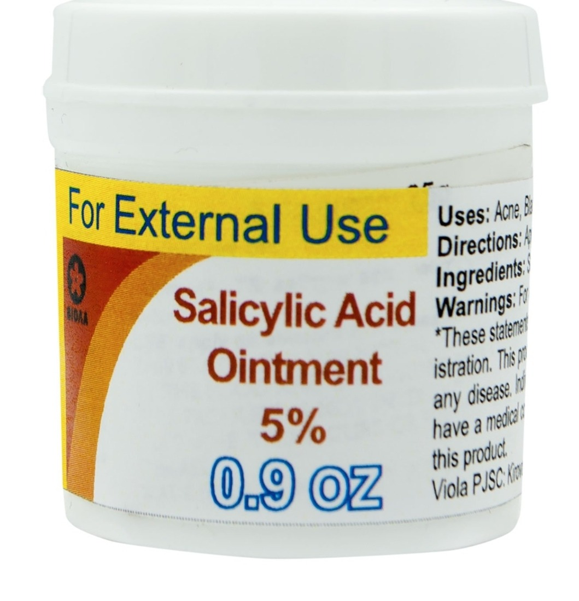
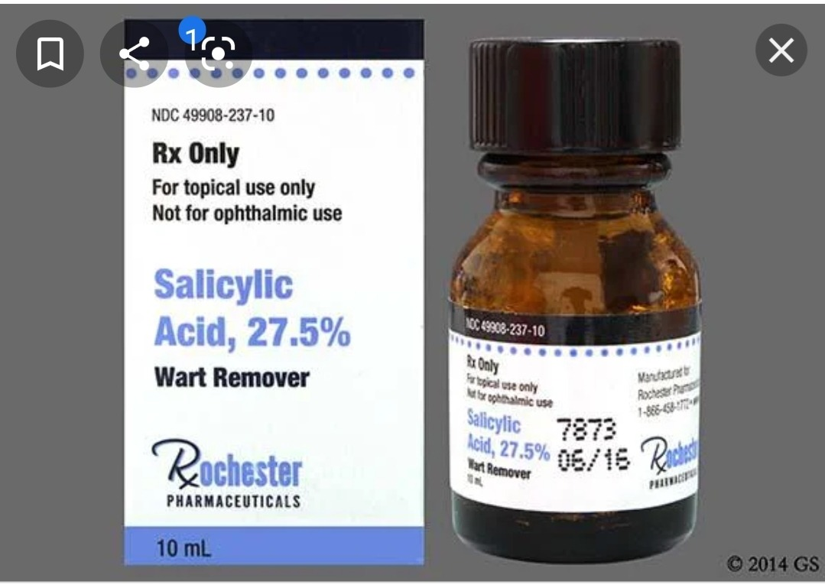

Slide 37
Glutaraldehyde
It is used in a 5 or 10% gel or solution to treat warts but not for anogenital warts. Patients should be warned that glutaraldehyde will stain the skin brown, although this will fade after treatment has stopped.
Practical points
Application of treatment
Treatments containing salicylic acid should be applied daily. The treatment is helped by prior soaking of the affected hand or foot in warm water for 5–10 min to soften and hydrate the skin, increasing the action of the salicylic acid. Removal of dead skin from the surface of the wart by gentle rubbing with a pumice stone or emery board ensures that the next application reaches the surface of the lesion. Occlusion of the wart using an adhesive plaster helps to keep the skin macerated, maximising the effectiveness of salicylic acid. Protection of the surrounding skin is important and can be achieved by applying a layer of petroleum jelly to prevent the treatment from making contact with healthy skin.

Slide 38
Salicylic acid
INDICATIONS AND DOSE
Common and plantar warts
▶ TO THE LESION
▶ Child& Adult: Apply daily, treatment may need to be continued for up to 3 months
CAUTIONS : Avoid broken skin . impaired peripheral
circulation . not suitable for application to anogenital
region . not suitable for application to face . not suitable
for application to large areas . patients with diabetes at risk
of neuropathic ulcers . significant peripheral neuropathy

Slide 39
Salicylic acid
SIDE-EFFECTS Skin irritation
PATIENT AND CARER ADVICE Advise patient to apply carefully to wart and to protect surrounding skin (e.g. with soft paraffin or specially designed plaster); rub wart surface gently with file or pumice stone once weekly
CAUTIONARY AND ADVISORY LABELS 15:
Flammable ,keep your body away from fire or flame after you put your medicine.

Slide 40

Thank you

