Slide 1
Thyroid disorders
Lec. Dr. Abeer Abdulhadi Rashid

Slide 2
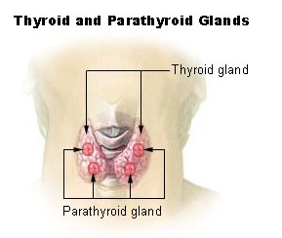

Slide 3
Introduction
The prevalence of hypothyroidism is higher in older age groups and in whites and Hispanics; blacks had a lower prevalence of hypothyroidism.
The prevalence of hypothyroidism correlated with age. Compared with the total population, people aged 50 to 79 years had an almost twofold higher prevalence, and those aged 80 years and older had a fivefold higher prevalence.
Overt hypothyroidism occur in 1.5 to 2% of women and 0.2% of men and incidence increases with age.
Pregnant women also had a higher prevalence of hypothyroidism.

Slide 4
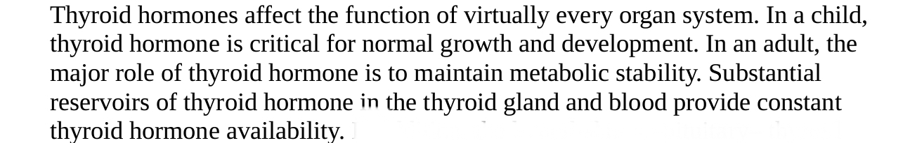
Overall prevalence of an abnormal TSH level was 11.7% of the study population, with 9.4% hypothyroid (9% subclinical) and 2.2% hyperthyroid (2.1% subclinical).

Slide 5
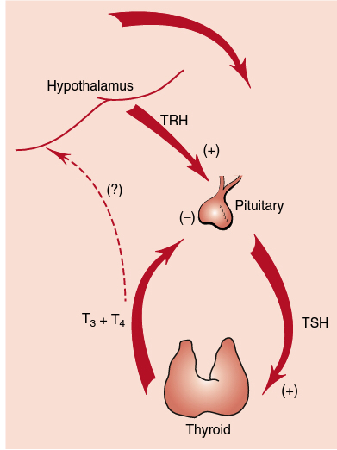
THYROID HORMONE PHYSIOLOGY AND BIOSYNTHESIS

Slide 6
T4 is 99.97% protein bound, and T3 is 99.7% protein bound, with only the unbound or free fractions physiologically active.
The high degree of protein binding results in a long half-life of these hormones: approximately 7 to 10 days for T4 and 24 hours for T3.
Eighty percent of needed T3 is derived from conversion of T4 to T3 in peripheral tissue under the influence of tissue deiodinases. These deiodinases allow end organs to produce the amount of T3 needed to control local metabolic functions.
Release of TRH is also inhibited by somatostatin and its analogs, and release of TSH can also be inhibited by dopamine, dopamine agonists, and high levels of glucocorticoids.

Slide 7
SPECTRUM OF THYROID DISEASE
There are two general modes of presentation for thyroid disorders: changes in the size or shape of the gland and changes in secretion of hormone from the gland.
Thyroid nodules and goiters in euthyroid patients are common problems.
Patients with a goiter who are biochemically euthyroid often require no specific pharmacotherapy unless the goiter is caused by iodine deficiency.
Thyroid nodules, seen in 4% to 7% of adults, may be malignant or may autonomously secrete thyroid hormones.
Changes in hormone secretion, often due to an underlying inflammatory disorder (thyroiditis), can result in hormone deficiency or excess.

Slide 8
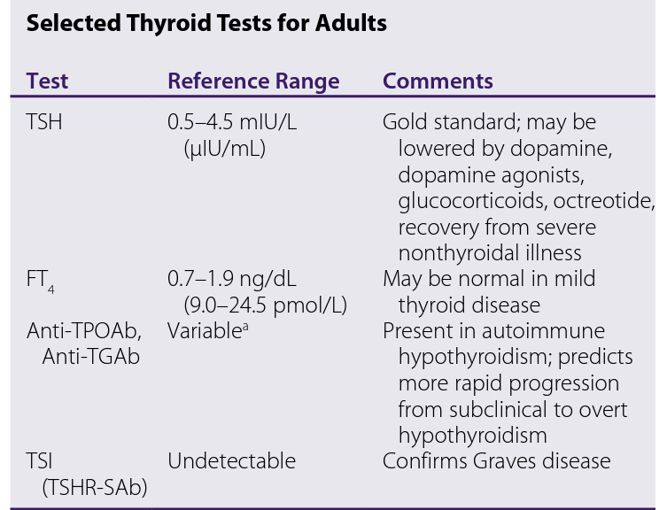
PATIENT ASSESSMENT AND MONITORING

Slide 9
TSH level is adequate for initial screening and diagnosis of hypothyroidism and hyperthyroidism.
Serum free thyroxine (FT4) and triiodothyronine (FT3) levels may be helpful in distinguishing mild (subclinical) thyroid disease from overt disease.
Since a number of factors can alter protein binding, these older assays are very insensitive and should no longer be used routinely even with protein-binding adjustment factors such as the free T4 index.
Free or unbound T4 (FT4) and T3 (FT3) assays Mild Overt Thyrotoxicosis are readily available and are more sensitive in identifying thyroid dysfunction than the older total assays.
The radioactive iodine uptake (RAIU) is elevated in those with hyperthyroidism and can aid in identifying thyrotoxicosis

Slide 10
Radionuclide thyroid scans are used in the evaluation of thyroid nodules.
Because many thyroid disorders are autoimmune, measurement of various serum antithyroid antibodies can be performed.
Antithyroid peroxidase antibodies (anti-TPOAb) and antithyroglobulin antibodies (anti-TGAb) are present in many patients with hypothyroidism.
Most patients with Graves disease have TSH receptor-stimulating antibodies (TSHR-SAb) as well as elevated anti-TPOAb and antimicrosomal antibodies.

Slide 11
HYPOTHYROIDISM
It is the clinical syndrome that results from inadequate secretion of thyroid hormones from the thyroid gland.
The vast majority of hypothyroid patients have primary gland failure, but occasional patients have pituitary or hypothalamic failure.
Most studies define hypothyroidism based on a serum TSH level above the upper limit of the laboratory reference range.
There is a strong correlation between the presence of anti-TPOAb or anti-TGAb and the risk of developing hypothyroidism.

Slide 12
Other risk factors for development of hypothyroidism include the postpartum state, family history of autoimmune thyroid disorders, a previous history of head and neck or thyroid surgery, head and neck irradiation,
other autoimmune endocrine disorders such as type 1 diabetes and Addison disease,
other nonendocrine autoimmune diseases such as celiac disease and pernicious anemia,
history of treatment for hyperthyroidism, treatment with amiodarone or lithium, and an iodine-deficient diet.

Slide 13
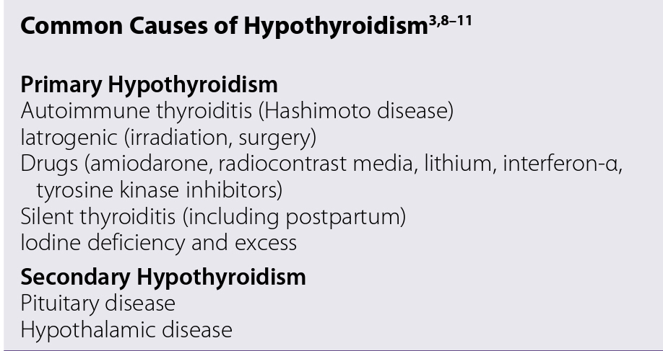
Causes of Hypothyroidism

Slide 14
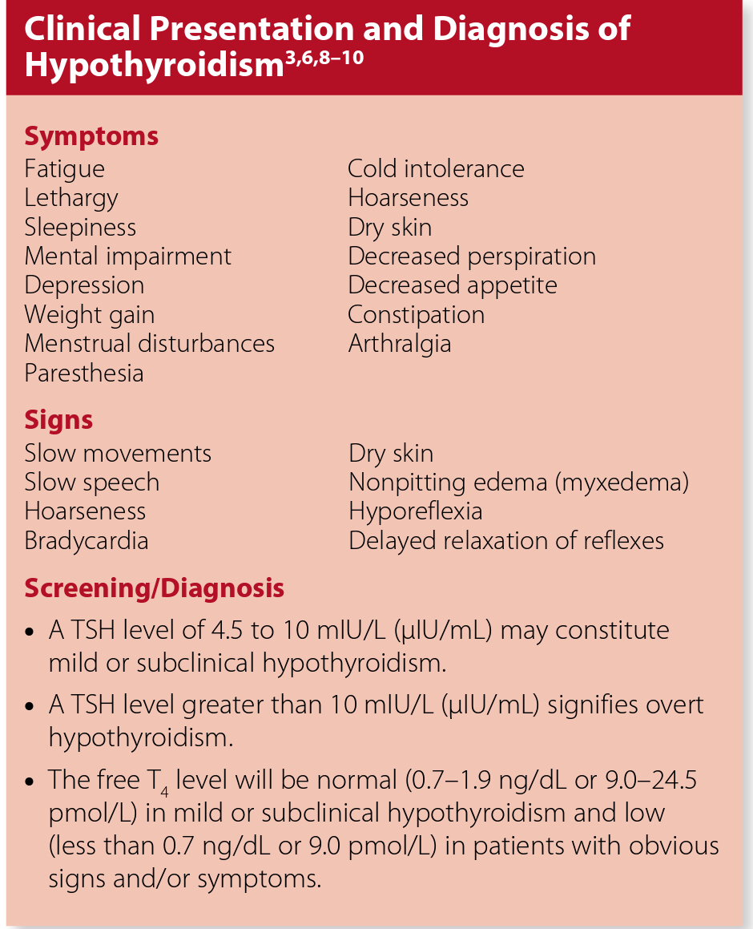

Slide 15
Mild (Subclinical) Hypothyroidism
Mild or subclinical hypothyroidism is present when a patient has a TSH above the upper limit of the laboratory reference range but usually below 10 mIU/L or μIU/mL, normal FT4, and no overt hypothyroid signs and symptoms.
Recent studies have shown subclinical hypothyroidism to be a risk factor for cardiovascular mortality and to be associated with decreased myocardial contractility, decreased exercise tolerance, elevated low-density lipoprotein (LDL) cholesterol, and neuropsychiatric symptoms.

Slide 16
Sequelae of Hypothyroidism
Hypercholesterolemia
increasing the long-term risk of cardiovascular disease and cardiovascular mortality
increased systemic vascular resistance, decreased cardiac output, and increased diastolic blood pressure.
cause significant neuropsychiatric problems, including a dementia-like state in the elderly.
Inadequately treated maternal hypothyroidism results in increased risk of miscarriage and developmental impairment in the child

Slide 17
Myxedema coma is seen in advanced hypothyroidism.
These patients develop CNS depression, respiratory depression, cardiovascular instability, and fluid and electrolyte disturbances.
Myxedema coma often is triggered by an underlying acute medical condition such as infection, stroke, trauma, or administration of CNS depressant drugs.

Slide 18
Treatment of Hypothyroidism
There are three major goals in the treatment of hypothyroidism:
replace the missing hormones
relieve signs and symptoms
and achieve a stable biochemical euthyroid state.

Slide 19
Levothyoxine
synthetic LT4 is the treatment of choice for almost all patients with hypothyroidism.
LT4 mimics the normal physiology of the thyroid gland, which secretes mostly T4 as a prohormone.
Peripheral tissues convert T4 to T3 as needed based on metabolic demands.
If T3 is used to treat hypothyroidism, the peripheral tissues lose their ability to control local metabolic rates.
LT4 also has distinct pharmacokinetic advantages over T3. With a 7- to 10-day half-life, LT4 provides a very smooth dose-response curve with little peak and trough effect.

Slide 20
There is no evidence that one LT4 product is better than another. However, given the evidence that these products do have differences in bioavailability, patients should be maintained on the same LT4 product.
Given the generic substitution regulations of most states, this is best accomplished by prescribing a brand-name product or otherwise ensuring the product remains constant and not allowing substitution.

Slide 21
Therapeutic Use of LT4

Slide 22
There are no prospective clinical trials that show an outcome benefit with treating these patients.
A retrospective study from the United Kingdom showed that LT4 therapy in patients with mild hypothyroidism reduced ischemic heart disease events in patients 70 years and younger.
In patients without symptoms who have underlying heart disease, high cardiovascular risk, goiter, positive antiTPOAb and/or are infertile or pregnant, LT4 replacement should be considered.
Patients with mild or subclinical hypothyroidism do not need to be started on the full LT4 replacement dose because they still have some endogenous hormone production.
Start these patients on 25 to 50 mcg/day and titrate every 6 to 8 weeks based on TSH levels. Over time, it is likely the LT4 dose will need to be increased slowly as the patient’s thyroid gland loses residual function.

Slide 23
In patients younger than age 65 years with overt hypothyroidism, the average LT4 replacement dose is 1.6 mcg/kg/day (use ideal body weight in obese patients).
However, there is wide interpatient variability in the optimal replacement dose, so individual dose titration is necessary.
If there is no history of cardiac disease, these patients may be started on the full replacement dose.
The full replacement dose in patients older than age 75 years is lower, about 1 mcg/kg/day.
In the elderly, the starting dose should be 25 to 50 mcg/day, and the dose should then be titrated to the target TSH value.
In patients with ischemic heart disease, start with 12.5 to 25 mcg/day and slowly titrate.

Slide 24
At the start of therapy and with each change in dose, recheck the TSH in 6- to 8-week intervals.
If the TSH is not in the target range (0.5–4 mIU/L or μIU/mL), change the dose by 10% to 20% and then recheck the TSH 6 to 8 weeks later.
As the dose is titrated, assess the patient’s symptoms.
Many patients will improve quickly, and younger patients will feel best if the TSH is titrated to low-normal to middle normal levels (0.5–1.5 mIU/L or μIU/mL).

Slide 25
Risk of over treatments and under treatment
In general, overtreatment and a suppressed TSH are more common than undertreatment with an elevated TSH.
Patients with long-term overtreatment are at higher risk for atrial fibrillation and other cardiovascular morbidities, depression or mental status changes, and osteoporosis.
Elderly patients being treated with LT4 have a dose-related risk of fractures even if the TSH is not suppressed below normal values.
Patients who are undertreated are at higher risk for hypercholesterolemia and other cardiovascular problems, depression or mental status changes, and obstetric complications.

Slide 26
Alterations in LT4 Dose Requirements
time of administration
drug–drug and drug–food interactions.
LT4 has the greatest and most consistent bioavailability when taken in the evening on an empty stomach.
The most common cause of increased dose requirement is coadministration of LT4 with calcium or iron supplements (including prenatal vitamins).
Counsel patients that they should take the LT4 dose at least 2 hours before or 6 hours after the calcium or iron dose.
The most common cause of decreased dose requirement is aging.

Slide 27
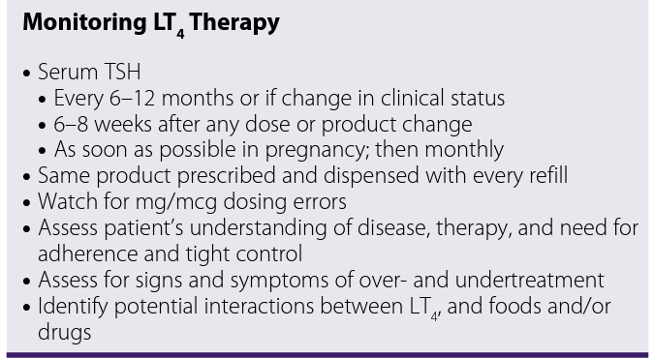

Slide 28
Special Populations and Conditions

Slide 29
Hypothyroidism and Pregnancy
During pregnancy, β-human chorionic gonadotropin (β-hCG) acts as a TSH receptor agonist, increasing the amount of thyroid hormone available for fetal growth and development.
Maternal hypothyroidism results in an increased rate of miscarriage and decreased intellectual capacity of the child.
Most hypothyroid women who become pregnant will quickly need an increased dose of LT4, typically 20% to 50% above the prepregnancy dose.

Slide 30
Myxedema coma
These patients are given 300 to 500 mcg LT4 intravenously initially, using caution in patients with underlying cardiac disease.
Although administration of T3 would provide a more rapid onset of action, there is no evidence that T3 improves outcomes in patients with myxedema coma.
Historically, glucocorticoids, such as hydrocortisone 50 to 100 mg every 6 hours, are administered owing to concern about simultaneous adrenal insufficiency.
As patients improve, the LT4 dose can be given orally in a typical full replacement dose.

Slide 31
HYPERTHYROIDISM AND THYROTOXICOSIS

Slide 32
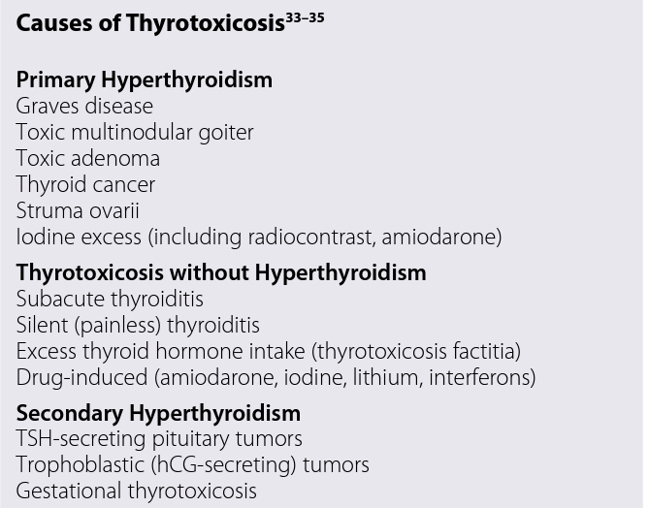

Slide 33
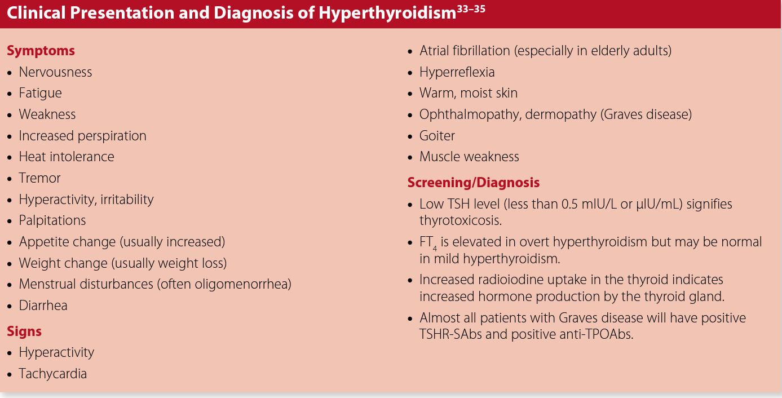

Slide 34
Mild (Subclinical) Hyperthyroidism
Mild (subclinical) hyperthyroidism is defined as a low TSH level with a normal FT4 level.
Patients with subclinical hyperthyroidism have been shown to experience long-term cardiovascular and bone sequelae.
Mild hyperthyroidism appears to increase cardiovascular morbidity and mortality.
Treatment of patients with mild hyperthyroidism is controversial but should be considered in patients with TSH levels less than 0.1 mIU/L (μIU/mL), Graves disease, postmenopausal women, and patients with underlying cardiovascular disease.
Patients who do not have a fully suppressed (below the lower limit of detection) TSH or other risk factors for hyperthyroid complications (eg, osteoporosis, cardiac arrhythmias) may just undergo observation, with TSH testing every 6 months to identify progression of the hyperthyroid state.

Slide 35
Graves Disease
Graves disease is an autoimmune syndrome that includes hyperthyroidism, diffuse thyroid enlargement, exophthalmos and other eye findings, and skin findings.
The peak age of incidence is 20 to 49 years, with a second peak after 80 years of age.
Hyperthyroidism results from the production of TSHR-SAbs in at least 80% of patients with clinical Graves disease.
These antibodies have TSH agonist activity, thereby stimulating hormone synthesis and release.

Slide 36
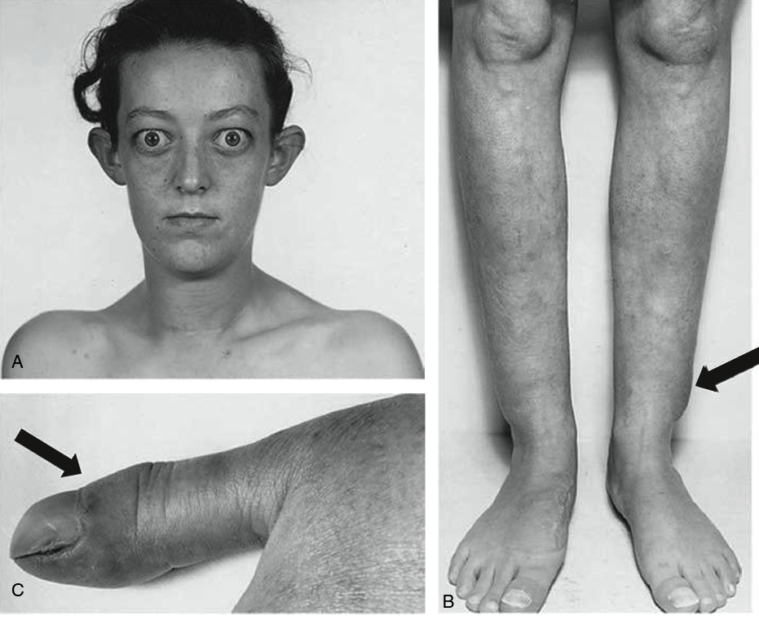

Slide 37
Treatment of Hyperthyroidism
The goals of treating hyperthyroidism are to
relieve signs and symptoms,
reduce thyroid hormone production to normal levels and achieve biochemical euthyroidism,
and prevent long-term adverse sequelae.

Slide 38
β-Blockers
used to rapidly relieve palpitations, tremor, anxiety, and heat intolerance.
Because β-blockers do not reduce the synthesis of thyroid hormones, they are used only until more specific antithyroid therapy is effective.
Because nonselective agents can impair the conversion of T4 to T3, propranolol and nadolol are preferred.
An initial propranolol dose of 20 to 40 mg four times daily should be titrated to relieve signs (target resting heart rate less than 90 beats/min) and symptoms.
β-Blockers should not be used in patients with decompensated heart failure or asthma.
A more β-1 specific blocker (eg, metoprolol, atenolol) may be used when a relative contraindication to a β-blocker exists; however, when an absolute contraindication to β-blockers exists, clonidine, verapamil or diltiazem may be used for rate control.

Slide 39
Methods to Reduce Thyroid Hormone Synthesis
Iodides
antithyroid drugs
radioactive iodine
surgery.

Slide 40
Iodide
Large doses of iodide inhibit the synthesis and release of thyroid hormones.
Serum T4 levels may be reduced within 24 hours, and the effects may last for 2 to 3 weeks. Iodides are used most commonly in Graves disease patients before surgery and to quickly reduce hormone release in patients with thyroid storm.
Iodide therapy should start 7 to 14 days before surgery.
Iodide should not be given before radioactive iodine treatment because the iodide will inhibit concentration of the radioactivity in the thyroid.
Iodides also are used to protect the thyroid from radioactive iodine fallout after a nuclear accident or attack.

Slide 41
Antithyroid Drugs
These drugs inhibit thyroid hormone synthesis by interfering with thyroid peroxidase–mediated iodination of tyrosine residues in thyroglobulin.
PTU has the added effect of inhibiting the conversion of T4 to T3. The thionamides also have immunosuppressant effects.
Both drugs are well absorbed from the gastrointestinal (GI) tract. PTU has a half-life of 1 to 2.5 hours, whereas the half-life of MMI is 6 to 9 hours.
MMI can be given as a single daily dose and may have a better overall safety profile, particularly less hepatotoxicity.

Slide 42
The usual starting dose of MMI is 10 to 20 mg/day, and the usual starting dose of PTU is 50 to 150 mg three times daily.
Thyroid hormone levels drop in 2 to 3 weeks, and after 6 weeks, 90% of patients with Graves disease will be euthyroid. Thyroid function testing should be performed every 4 to 6 weeks until stable.
Antithyroid therapy may be stopped or tapered after 12 to 24 months. Relapse usually occurs in the first 3 to 6 months after stopping antithyroid therapy.
Skin rash, arthralgias, and GI upset are seen in 5% of patients.
Agranulocytosis is one of the most serious adverse effects of antithyroid drug therapy. Agranulocytosis must be distinguished from a transient decrease in white blood cell count seen in up to 12% of adults and 25% of children with Graves disease.

Slide 43
Radioactive Iodine
Radioactive iodine, typically 131I, produces thyroid ablation without surgery. 131I is well absorbed after oral administration. The iodine is concentrated in the thyroid gland and has a half-life of 8 days.
Over a period of weeks, thyroid cells that have taken up the 131I begin to develop abnormalities and necrosis. Eventually, thyroid cells are destroyed, and hormone production is reduced.
Because 131I has a slow onset of action, most patients are treated initially with β-blockers and antithyroid drugs to prevent 131I-induced thyroid storm.
MMI is the preferred agent before the administration of 131I. MMI is discontinued 3 to 5 days before the administration of 131I and is restarted 3 to 7 days later.

Slide 44
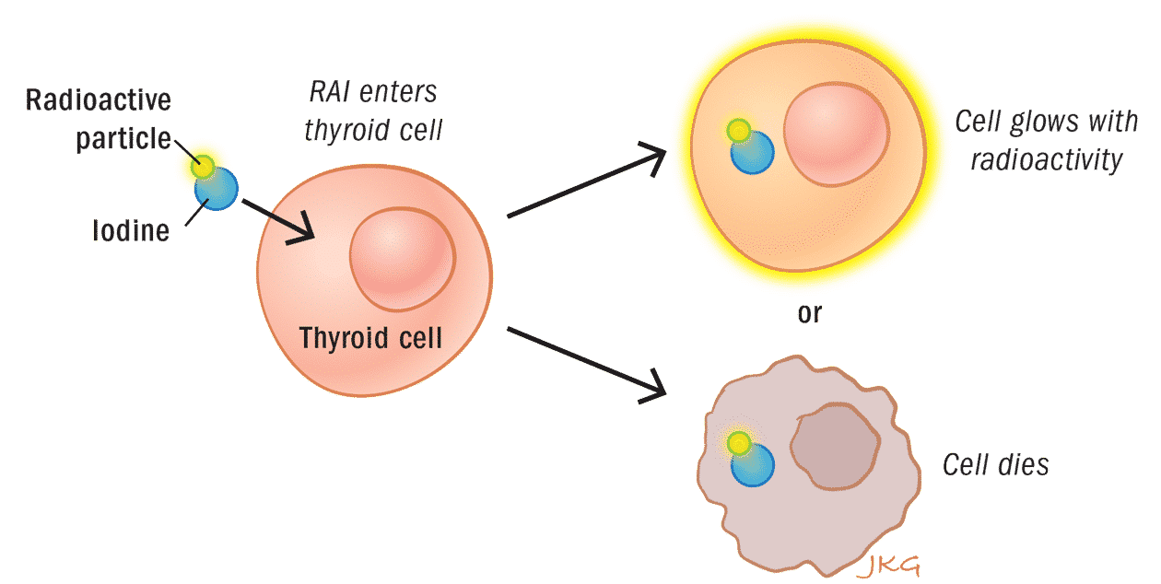

Slide 45
Surgery
Subtotal thyroidectomy is indicated in patients with very large goiters and thyroid malignancies and those who do not respond or cannot tolerate other therapies.
Patients must be euthyroid before surgery, and they are often administered iodide preoperatively to reduce gland vascularity.
After thyroidectomy, serum calcium and intact parathyroid hormone levels should be monitored for early identification of postoperative hypoparathyroidism.
Postoperative administration of 1250 to 2500 mg/day of calcium and 0.5 mcg/day of calcitriol may be given and then tapered over 1 to 2 weeks if the patient does not develop hypoparathyroidism.

Slide 46
Special Conditions and Populations

Slide 47
Graves Disease and Pregnancy
Pregnancy may worsen or precipitate thyrotoxicosis in women with underlying Graves disease owing to the TSH agonist effect of β-hCG.
Untreated maternal thyrotoxicosis may result in increased rates of miscarriage, premature delivery, eclampsia, and low-birth-weight infants.
Fetal and neonatal hyperthyroidism may occur as a result of transplacental passage of TSHR-SAbs.
Because radioactive iodine is contraindicated and surgery is best avoided during pregnancy, most patients are treated with antithyroid drugs.
PTU is considered the treatment of choice, particularly in the first trimester.
While MMI is thought to have greater teratogenic potential versus PTU, the relative safety of these medications in pregnancy is not clear.

Slide 48
Pediatric Hyperthyroidism
-Blockers are administered to children who are symptomatic or have a heart rate greater than 100 beats/min.
MMI is the preferred antithyroid drug therapy in children at a dose of 0.2 to 0.5 mg/kg/day.
Once a euthyroid state is achieved, the MMI dose can be reduced by 50% or more to maintain euthyroidism.
If remission does not occur in that time, long-term antithyroid drug therapy, radioactive iodine, or surgical therapy is offered.

Slide 49
Thyroid Storm
Thyroid storm is a life-threatening condition caused by severe thyrotoxicosis.
Signs and symptoms include high fever, tachycardia, tachypnea, dehydration, delirium, coma, and GI disturbances.
Thyroid storm is precipitated in a previously hyperthyroid patient by infection, trauma, surgery, radioactive iodine treatment, and sudden withdrawal from antithyroid drugs.
Patients are treated with a short-acting β-blocker such as intravenous (IV) esmolol, IV or oral iodide, and large doses ofPTU (500–1000 mg load; then 250 mg every 4 hours) or MMI (60–80 mg/day).
Supportive care with acetaminophen to suppress fever, fluid and electrolyte management, and antiarrhythmic agents are important components of therapy.
IV hydrocortisone 300 mg initially and then 100 mg every 8 hours is used often because of the potential presence of adrenal insufficiency.

Slide 50
