Slide 1
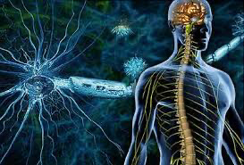
Multiple sclerosis

Slide 2
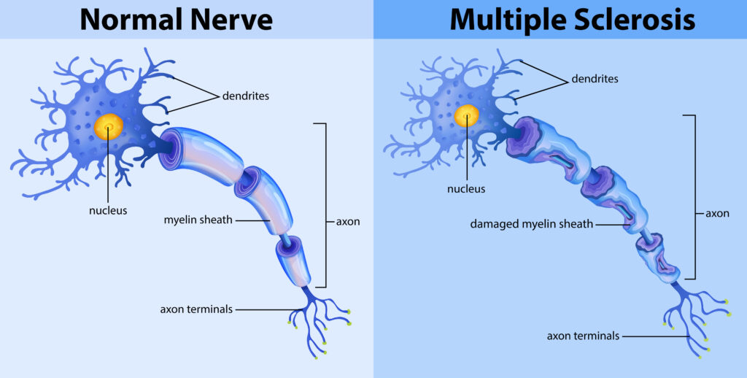
Multiple sclerosis (MS) is an inflammatory disease of the central nervous system (CNS), variable in symptoms and presentation. Multiple describes the number of CNS lesions, and sclerosis refers to the demyelinated lesions, today called plaques.

Slide 3
Etiology
Inheritance Theory
Family members of MS patients have a 5% risk; monozygotic twins have a concordance rate of 25% to 30%.
Environment Theory
Epstein-Barr virus is thought to be a possible infectious etiologic agent.

Slide 4
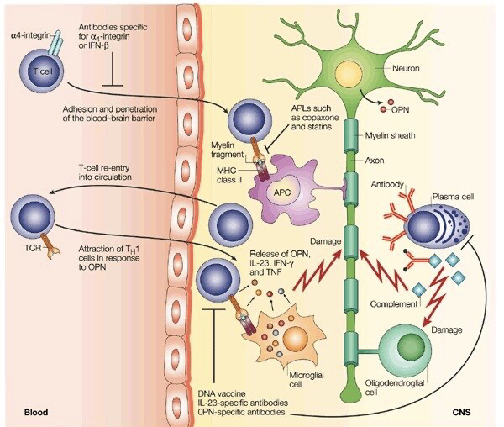
Pathophysiology
T- cells gain entry in to the brain
Via distribution in the BBB.
T-cells recognize myelin as foreign
And attack it.
Attack of myelin start inflammatory
Process which release cytokines and
Antibodies which interact
Macrophages.
B-cells make antibodies that mark
The myelin & macrophages
Will use these antibodies to engulf
The oligodendrocytes and the myelin.

Slide 5
Clinical Course
MS is classified into relapsing and progressive disease
These categories are subclassifed according to disease activity and progression.
Clinically isolated syndrome (CIS) is a first clinical presentation for which the criteria of dissemination in time has not been met to diagnose MS.
Relapsing-remitting MS is the most common form (85%), developing into progressive form in 50% of patients within 10 years.

Slide 7
CLINICAL PRESENTATION

Slide 9
Diagnosis

Slide 11
TREATMENT Desired Outcomes and General Approach to Treatment
The goal of treatment is preventing permanent neurologic damage. There are three approaches to treatment.
First, treat acute relapses with corticosteroids to speed recovery.
Second, disease-modifying therapies decrease the number of relapses, prevent permanent neurologic damage, and prevent disability.
Third, symptomatic treatments minimize quality of life impact of MS.

Slide 12
Treatment of Acute Relapses with Corticosteroids
The mechanism of action of corticosteroids may involve:
• Prevention of inflammatory cytokine activation
• Inhibition of T- and B-cell activation
• Prevention of immune cells from entering the CNS
Corticosteroids hasten functional recovery.

Slide 13
Dosing and Administration
Methylprednisolone is given 500 to 1000 mg/day IV as one dose or in divided doses.
Oral prednisone 1250 mg/day or oral methylprednisolone 1000 to 1250 mg/day provides an equivalent dose. These regimens are given for 3 to 7 days.
Outcome Evaluation
• Monitor for symptom improvement
• Educate regarding adverse effects

Slide 14
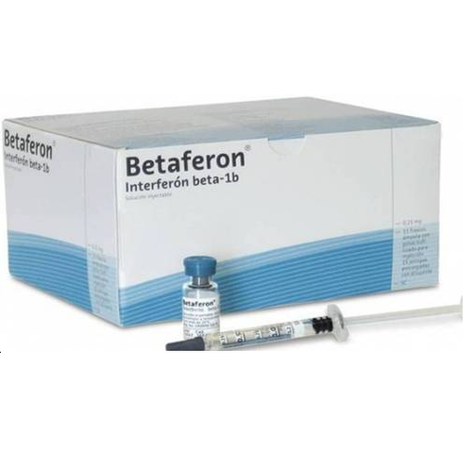
Disease-Modifying Therapies
β-Interferons
Decrease in T-cell activation, decreasing cytokine secretion
Prevention of upregulation of adhesion molecules on activated T-cells, limiting T-cells access to the CNS
Suppression of MMPs, Matrix metalloproteinases maintaining the integrity of the blood–brain barrier
Decrease in microglial proliferation, preserving myelin
Promotion of formation of Th2 cells rather than Th1 cells, decreasing inflammation
Increase in neural growth factor production, assisting in repair of the CNS

Slide 16
In Patients with Relapsing Remitting MSβ-Interferons reduce relapses by about one-third versus placebo.
In Patients with Secondary Progressive MS Who Experience Relapses β-Interferons reduce the risk of relapses, but do not slow progression.
Flu-like symptoms (fever, fatigue, muscle aches, malaise, and chills) begin a few hours postinjection and dissipate within 8 to 24 hours.
Tests for Responsiveness: increased expression of the type I interferon gene (interferonhigh) have more proinflammatory effects. Interferonhigh patients are less likely to respond to β-interferons than interferonlow
Neutralizing antibodies develop 6 to 18 months after initiation. Neutralizing antibodies can form against any β-interferon and are cross-reactive

Slide 17
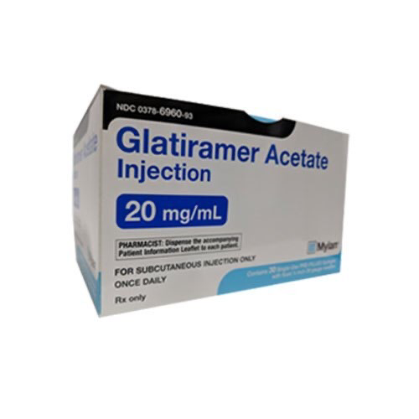
Glatiramer Acetate
Mechanism of action is unknown
but has the following properties:
Binds to MHC (major histocompatibility complex) class II, blocking the activation of T-cells
Activates Th2 cells, preventing inflammation
Activated Th2 cells secrete brain-derived neurotrophic factor, which may be neuroprotective.
reduces relapses by 28% compared with placebo, but does not prevent sustained progression of MS.
It is used in CIS to prevent conversion to clinically definite MS.

Slide 19
Patients report injection site reactions .
Icing the injection site preinjection and postinjection and/or topical anesthetics improve these reactions.
If a systemic reaction (flushing, chest tightness, palpitations, anxiety, and shortness of breath) occurs, it is usually within 30 minutes of the injection; recurrence is infrequent.
Doses may be reduced by 75% for the week following the reaction, then increased by 25% per week to the full dose.
Adherence to injectable medications is a significant problem, with 22% to 59% discontinuation.

Slide 20
Teriflunomide
MOA
Cytostatic effect on rapidly dividing B- and T-cells by inhibiting dihydro-orotate dehydrogenase
Inhibiting T-cell activation, entry to the CNS, and secretion of proinflammatory cytokines.
Half-life of teriflunomide is 2 weeks; taking 3 months to achieve steady-state concentrations.
It is contraindicated in hepatic failure.

Slide 22
Teriflunomide reduces relapse rate and progression of disease for relapsing forms of MS.It also prevents CIS from converting to clinically definite MS.
Teriflunomide is generally well tolerated.
If patients develop liver injury, teriflunomide must be stopped and accelerated elimination undertaken.
Patients should be screened for tuberculosis prior to initiating therapy

Slide 23
Dimethyl Fumarate
Dimethyl fumarate is thought to treat MS in the following ways:
Shift cytokine production from a proinflammatory state to an anti-inflammatory state
Prevent macrophage entry into the CNS by an unknown mechanism
Stabilization of transcription factor nuclear (erythroidderived 2) related factor which may reduce oxidative stress
reduced relapses approximately 50%. It slowed MS progression in some studies.

Slide 25
Dimethyl fumarate causes a transient, dosedependent flushing sometimes with itching.
Likely due to histamine release, incidence decreases after the first month and may be improved by slower dose titration, administration with food, and/or H2-blocking antihistamines.
Gastrointestinal adverse effects may be lessened with a slow dose increase and administration with food

Slide 26
Fingolimod
Fingolimod is a sphingosine 1-phosphate receptor modulator. It retains T-cells in lymphoid tissues, depleting peripheral blood and CNS lymphocytes.
Fingolimod also binds to sphingosine 1-phospate receptors in the brain where may reduce inflammatory cytokines.
It is highly protein bound with a long half-life of 8 to 9 days.
Treatment reduced the annualized relapse rate to 0.18 compared with 0.40 for placebo. It also slowed MS progression.

Slide 28
Fingolimod reduces circulating lymphocytes by about 75%; infections and malignancies are concerns.
Sphingosine 1-phosphate receptors elsewhere in the body are associated with first-dose bradycardia, macular edema, and reduced forced vital capacity.
Fingolimod is contraindicated in patients with myocardial infarctions, unstable angina, stroke, transient ischemic attacks, or some types of congestive heart failure within the past 6 months
In patients with many types of atrioventricular block, prolonged QT interval, or who are taking class Ia or III antiarrhythmic medicines.
Extensive monitoring is required at baseline and for the first dose; monitoring must be repeated if therapy is interrupted.

Slide 29
Natalizumab
is a α4-integrin antagonist; its postulated mechanism of action follows:
Binds to α4β1 and α4β7 integrins, preventing lymphocyte migration into the CNS and inflammation
Inhibits binding of α4-positive leukocytes to fibronectin and osteopontin, decreasing the activation of leukocytes already within the CNS24
Efficacy Treatment with natalizumab reduced relapses by 68% at 1 year and disability by 42% at 2 years versus placebo.

Slide 32
Adverse Effects Hypersensitivity reactions (itching, dizziness, fever, rash, hypotension, dyspnea, chest pain, and anaphylaxis) have been observed, usually within 2 hours of administration.
If hypersensitivity occurs, natalizumab is discontinued.
A serious, but rare, adverse effect is progressive multifocal leukoencephalopathy (PML). PML, caused by the JC polyomavirus virus, is rapidly progressive and often results in death or permanent disability.
Specific recommendations are to test for JC virus, avoid natalizumab in immunocompromised patients
Antinatalizumab antibodies develop in 9% to 12% of patients.

Slide 33
PML

Slide 34
Mitoxantrone
Mitoxantrone is an anthracenedione antineoplastic; the mechanisms of action important for MS include:
Causes apoptosis in T-cells and APCs, preventing initial T-cell activation
Inhibits DNA and RNA synthesis, decreasing proliferation of T cells, B cells, and macrophages
Decreases cytokine release, preventing inflammation
Inhibits macrophages, preventing myelin degradation

Slide 35
Mitoxantrone is indicated for secondary-progressive MS, progressive-relapsing MS, and for patients with worsening relapsing-remitting MS.
It reduces the relapse rate and attackrelated MRI outcome measures and MS progression.
Because of its potential for significant toxicities, mitoxantrone is reserved for patients with rapidly advancing disease who have failed other therapies.

Slide 36
Bluish discoloration of the sclera and urine lasts 24 hours or more postinfusion.
Transient leukopenia and neutropenia are common. Amenorrhea may be permanent.
Cardiotoxicity is a serious adverse effect. Mitoxantrone should not be used in patients with baseline cardiomyopathy, even if asymptomatic.
Cyclooxygenase-2 inhibitors potentially worsen cardiac toxicity and should be avoided.
Maximum lifetime dose of mitoxantrone is 140 mg/m2.
Acute myelogenous leukemia occurred in 0.07% of mitoxantrone- treated patients, appearing within 2 to 4 years of initiating mitoxantrone and responsive to standard therapy.

Slide 37
Mitoxantrone is infused intravenously over 30 minutes to reduce cardiotoxicity.
In standard dosing regimens, mitoxantrone is administered every 3 months.

Slide 40
Other Therapy Considerations

Slide 41
Pregnancy
Women generally experience a decrease in relapses during the second and third trimesters of pregnancy with an increase in the first 3 months postpartum.
data from pregnancy registries demonstrate no adverse outcomes with interferon β, glatiramer acetate, and natalizumab.
Fetal risk is unknown for dimethyl fumarate.
Sphingosine 1-phosphate receptors are important in fetal formation, thus fingolimod should be discontinued for at least 2 months before conception to allow for its elimination.
Mitoxantrone and teriflunomide are contraindicated during pregnancy and teriflunomide is contraindicated for men who have sexual intercourse with women who may become pregnant.
Because of the long half-life of teriflunomide, accelerated elimination is recommended for women who wish to become pregnant

Slide 42
Vaccinations
Patients taking teriflunomide, mitoxantrone, or fingolimod should not receive attenuated live virus vaccines.
Vaccines may be less effective while on fingolimod, and vaccines should be held for 4 to 6 weeks after a mitoxantrone dose.

Slide 43
Choosing Therapy

Slide 44
Outcome Evaluation
Assess symptom changes periodically.
In β-interferon-treated patients with frequent relapses, test for neutralizing antibodies.
Monitor medication-specific adverse effects .
Assess adherence.

Slide 45
Symptomatic Therapies

Slide 46
Fatigue

Slide 47
Spasticity

Slide 48
Impaired Ambulation
Nonpharmacological treatment includes assistive devices, physical therapy, and/or exercise.
Extended-release dalfampridine is indicated for improvement in walking speed. This potassium channel blocker prolongs action potentials, improving conduction in demyelinated neurons.
Urinary tract infections, insomnia, dizziness, headache, nausea, asthenia, back pain, and balance disorder all occur frequently with dalfampri-dine.
Seizures are an uncommon adverse effect; patients with seizure disorders should not receive dalfampridine.

Slide 49
Pseudobulbar Affect
Ten percent of patients with MS develop pseudobulbar affect, characterized by inappropriate laughing or crying and causing social isolation.
Dextromethorphan prevents the release of excitatory neurotransmitters.
Low-dose quinidine blocks first-pass metabolism of dextromethorphan and increases serum concentrations.
A 49% decrease in episodes was seen with treatment.

