Slide 1
STEMI
DONE BY:
Assist. lect. Shaymaa Hasan Abbas

Slide 2
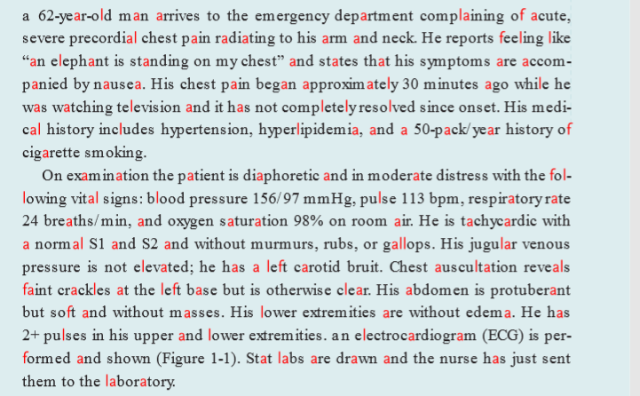

Slide 3
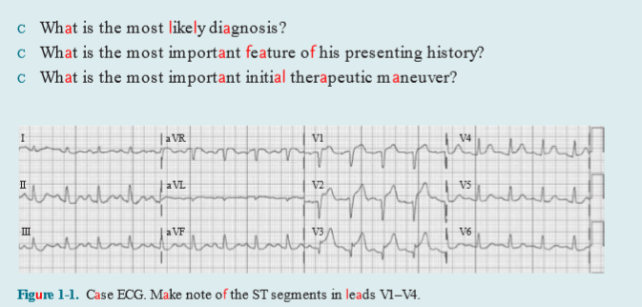

Slide 4
Summary:
This is a 62-year-old man who presents with a chest pain story that is classic for acute myocardial ischemia, including precordial discomfort radiating to the arm and neck.
He has risk factors for coronary artery disease, including elevated cholesterol, high blood pressure, and an extensive smoking history. He has a carotid bruit on exam that suggests significant underlying atherosclerosis. An acute surge of catecholamines is responsible for the patient’s tachycardia, elevated blood pressure, and diaphoresis. His ECG is diagnostic.

Slide 5
TREATMENT OF STEMI
After diagnosis of STEMI based on the above, all patients should be administered
aspirin 325 mg unless a true aspirin allergy exists.
Each patient should also receive an oral loading dose of an ADP inhibitor such as clopidogrel 600 mg, prasugrel 60 mg, or ticagrelor 180 mg. If the patient is selected for fibrinolytic therapy, then administration of clopidogrel 300 mg is recommended.
All patients should also receive a parenteral anticoagulant. Traditionally, unfractionated heparin has been used. For those undergoing fibrinolytic therapy, enoxaparin has been shown to be superior to unfractionated heparin.
Glycoprotein IIb/IIIa inhibitors should not be administered at first presentation in patients who have received dual antiplatelet therapy but generally are reserved for use by an interventional cardiologist if the patient is experiencing thrombotic complications.

Slide 6
TREATMENT OF STEMI
There are no absolute contraindications to PCI, and it is the recommended method of reperfusion when it can be performed in a timely manner. Specifically, the goal is to limit the “door to balloon” time at a PCI-capable facility to under 90 minutes; that is, angioplasty should be performed less than 90 minutes from the time the patient first presents for treatment. If the patient arrives to a nonPCI capable facility, an extra 30 minutes is permitted (for a total of 120 minutes) to allow time for transfer. If facilities for PCI are not available in a timely manner, then reperfusion with a fibrinolytic, unless contraindicated, should be employed within 30 minutes of

Slide 7
TREATMENT OF STEMI
hospital arrival. After administration of a fibrinolytic agent, all patients, especially those who are at high risk (extensive ST segment elevation, history of myocardial infarction, recentonset LBBB, tachycardia, or hypotension), should be transferred to a PCI-capable facility as soon as possible so that PCI can be performed as needed. After these initial therapies, the patient should be monitored in a coronary intensive care unit so that any potential complications can be quickly identified and treated.

Slide 8
SECONDARY PREVENTION
Because of the extensive toxic cardiovascular effects of smoking, any patient who smokes should stop immediately.
. Other risk factors, including hypertension and diabetes, should be optimized. Prior to discharge, all patients should leave the hospital on an evidence-based medical regimen to help prevent recurrent events and death.
High-dose statins, such as atorvastatin 80 mg daily, have been shown to be more effective than low-dose statins, even if their LDL (low-density lipoprotein) cholesterol is already low as statins have beneficial pleiotropic effects aside from lowering cholesterol.
All patients with a history of ACS should have a lifelong LDL goal of <70 mg/dL (milligrams per deciliter). Patients should also be prescribed antiplatelet agents such as aspirin 81 mg daily for life and an ADP inhibitor for at least a year

Slide 9
SECONDARY PREVENTION
Beta-blockers and angiotensinconverting enzyme inhibitors (ACEIs) should be employed to minimize ventricular remodeling and development of heart failure.
Angiotensin receptor blockers (ARBs) can be used in those intolerant to ACEIs. These medications are particularly important in patients with an impaired ejection fraction.
Eplerenone, an aldosterone antagonist, also reduces morbidity and mortality in post-infarct patients with an EF < 40%, even when added in combination with a ACEI (or ARB) and beta-blocker.
After STEMI, all patients are at an increased risk of sudden cardiac death. This is particularly true for patients with a depressed ejection fraction (EF), and thus an implantable cardioverter defibrillator (ICD) should be offered to patients whose EF remains depressed (EF < 35%) 40 days after the infarct event.

