Slide 1
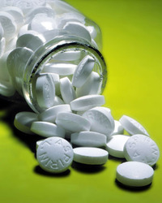

Slide 2
Herpes simplex and varicella–zoster infection
The two most important herpesvirus pathogens are herpes simplex virus (herpesvirus hominis) and varicella–zoster

Slide 3
Herpes simplex infections
Herpes infection of the mouth and lips and in the eye is generally associated with herpes simplex virus serotype 1n (HSV-1); other areas of the skin may also be infected, especially in immunodeficiency.
Genital infection is most often associated with HSV-2 and also HSV-1.
Treatment of herpes simplex infection should start as early as possible and usually within 5 days of the appearance of the infection.

Slide 4
Herpes simplex infections
In individuals with good immune function, mild infection of the eye (ocular herpes) and of the lips (herpes labialis or cold sores) is treated with a topical antiviral drug.
Severe infection, neonatal herpes infection or infection in immunocompromised individuals requires treatment with a systemic antiviral drug.
Primary or recurrent genital herpes simplex infection is treated with an antiviral drug given by mouth.

Slide 5
Varicella-zoster infections
- Regardless of immune function and the use of any immunoglobulins, neonates with chickenpox should be treated with a parenteral antiviral to reduce the risk of severe
disease.
- Oral therapy in children is not recommended as absorption is variable. Chickenpox in otherwise healthy children between 1 month and 12 years is usually mild and antiviral treatment is not usually required.

Slide 6
Varicella-zoster infections
- Chickenpox is more severe in adolescents and adults than in children; antiviral treatment started within 24 hours of the onset of rash may reduce the duration and severity of symptoms in otherwise healthy adults and adolescents.
- Antiviral treatment is generally recommended in immunocompromised patients and those at special risk (e.g. because of severe cardiovascular or respiratory disease or chronic skin disorder); in such cases, an antiviral is given for
10 days with at least 7 days of parenteral treatment.

Slide 7
Varicella-zoster infections
- Pregnant women who develop severe chickenpox may be
at risk of complications, especially varicella pneumonia.
Specialist advice should be sought for the treatment of
chickenpox during pregnancy.
Studies have shown, that in regards to chickenpox, ibuprofen and other NSAIDs can make the symptoms even worse. A study has shown that taking ibuprofen while having chickenpox can result in necrotising fasciitis, a skin infection

Slide 8
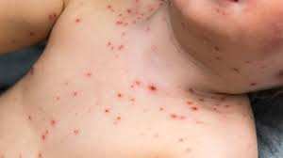
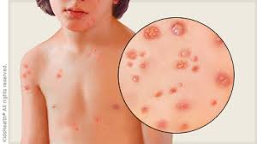

Slide 9
herpes zoster (shingles)
- In herpes zoster (shingles) systemic antiviral treatment can
reduce the severity and duration of pain, reduce complications, and reduce viral shedding.
- Treatment with the antiviral should be started within 72 hours of the onset of rash and is usually continued for 7–10 days.
Immunocompromised patients at high risk of disseminated or severe infection should be treated with a parenteral antiviral drug.
- Chronic pain which persists after the rash has healed (postherpetic neuralgia) requires specific management.

Slide 10
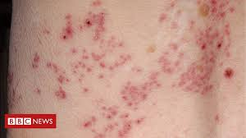
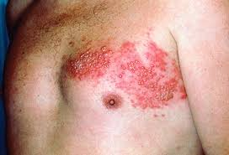
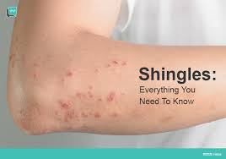

Slide 11
Treatment
Aciclovir is active against herpesviruses but does not eradicate them.
Uses of aciclovir include systemic treatment of varicella–zoster and the systemic and topical treatment of herpes simplex infections of the skin and mucous membranes.
It is used by mouth for severe herpetic stomatitis.
Aciclovir eye ointment is used for herpes simplex infections of the eye; it is combined with systemic treatment for ophthalmic zoster.

Slide 12
- Famciclovir a prodrug of penciclovir, is similar to aciclovir and is licensed for use in herpes zoster and genital herpes.
- Valaciclovir is an ester of aciclovir, licensed for herpes zoster and herpes simplex infections of the skin and mucous membranes (including genital herpes); it is also
licensed for preventing cytomegalovirus disease following
solid organ transplantation.
- Famciclovir or valaciclovir are suitable alternatives to aciclovir for oral lesions associated with herpes zoster.

Slide 13
- Valaciclovir once daily may reduce the risk of transmitting genital herpes to heterosexual partners—specialist advice should be sought.
- Foscarnet sodium is used for mucocutaneous herpes simplex virus infection unresponsive to aciclovir in immunocompromised patients; it is toxic and can cause renal impairment.
- Inosine pranobex has been used by mouth for herpes simplex infections; its effectiveness remains unproven.

Slide 14
Herpes simplex, treatment
▶ BY MOUTH
▶ Child 1–23 months: 100 mg 5 times a day usually for
5 days (longer if new lesions appear during treatment or if healing incomplete)
▶ adults: 200 mg 5 times a day usually for 5 days (longer if new lesions appear during treatment or if healing incomplete)

Slide 15
Aciclovir
Varicella zoster (chickenpox), treatment| Herpes zoster (shingles), treatment
▶ BY MOUTH
▶ Child 1–23 months: 200 mg 4 times a day for 5 days
▶ Child 2–5 years: 400 mg 4 times a day for 5 days
▶ Child 6–11 years: 800 mg 4 times a day for 5 days
▶ Child 12–17 years: 800 mg 5 times a day for 7 days
▶ Adult: 800 mg 5 times a day for 7 days
▶ BY INTRAVENOUS INFUSION
▶ Adult: 5 mg/kg every 8 hours usually for 5 days

Slide 16
Aciclovir
l CAUTIONS Elderly (risk of neurological reactions). Maintain adequate hydration (especially with infusion or high doses)
l INTERACTIONS → Appendix 1: aciclovir
l SIDE-EFFECTS
▶ Common or very common
▶ With intravenous use Nausea . Vomiting. photosensitivity reaction . skin reactions .
▶ With oral use Abdominal pain . diarrhoea . Nausea. vomiting
. dizziness . fatigue . fever. headache . Photosensitivity reaction . skin reactions .

Slide 17
Aciclovir
▶ Frequency not known
▶ With intravenous use Crystalluria
▶ With oral use Alopecia . crystalluria
l PREGNANCY Not known to be harmful—manufacturers advise use only when potential benefit outweighs risk.
l BREAST FEEDING Significant amount in milk after systemic
administration—not known to be harmful but manufacturer advises caution

Slide 18
Aciclovir
l RENAL IMPAIRMENT Risk of neurological reactions increased. Maintain adequate hydration (especially during
renal impairment).
Dose adjustments ▶ With intravenous use in adults Use
normal intravenous dose every 12 hours if eGFR 25–50 mL/minute/1.73 m2 (every 24 hours if eGFR 10–25 mL/minute/1.73 m2

Slide 19
Aciclovir
Consult product literature for intravenous dose if eGFR less than 10 mL/minute/1.73 m2
▶ With oral use in adults For herpes zoster, use normal oral
dose every 8 hours if eGFR 10–25 mL/minute/1.73 m2
(every 12 hours if eGFR less than 10 mL/minute/1.73 m2 ).
For herpes simplex, use normal oral dose every 12 hours if
eGFR less than 10 mL/minute/1.73 m2
.

Slide 20
Aciclovir
l DIRECTIONS FOR ADMINISTRATION
▶ With intravenous use in adults For intravenous infusion Zovirax IV ®, Aciclovir IV (Genus), give intermittently in Sodium chloride 0.9% or Sodium chloride and glucose;
l MEDICINAL FORMS There can be variation in the licensing of different medicines containing the same drug.

Slide 21
Aciclovir
Tablet
CAUTIONARY AND ADVISORY LABELS 9
▶ Aciclovir (Non-proprietary)
Aciclovir 200 mg Aciclovir 200mg tablets
Aciclovir 400 mg Aciclovir 400mg tablets
Aciclovir 800 mg Aciclovir 800mg tablets

Slide 22
Aciclovir
CAUTIONARY AND ADVISORY LABELS 9
▶ Aciclovir (Non-proprietary)
Aciclovir 40 mg per 1 ml Aciclovir 200mg/5ml oral suspension
Aciclovir 80 mg per 1 ml Aciclovir 400mg/5ml oral suspension

Slide 23
Aciclovir
Solution for infusion
ELECTROLYTES: May contain Sodium
▶ Aciclovir (Non-proprietary)
Aciclovir (as Aciclovir sodium) 25 mg per 1 ml Aciclovir 1g/40ml
solution for infusion vials
Aciclovir 250mg/10ml concentrate for solution for infusion vials
Aciclovir 500mg/20ml solution for infusion

Slide 24
Aciclovir
Powder for solution for infusion
ELECTROLYTES: May contain Sodium
▶ Aciclovir (Non-proprietary)
Aciclovir (as Aciclovir sodium) 250 mg Aciclovir 250mg powder for
solution for Infusion vials
Aciclovir (as Aciclovir sodium) 500 mg Aciclovir 500mg powder for
solution for infusion vials

Slide 25
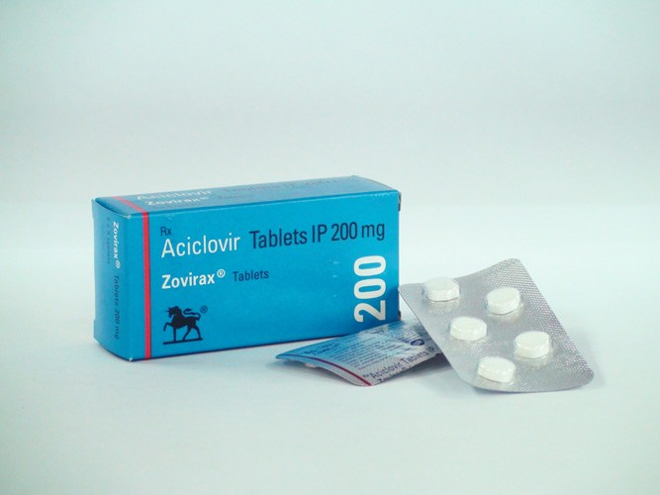
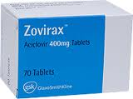

Slide 26
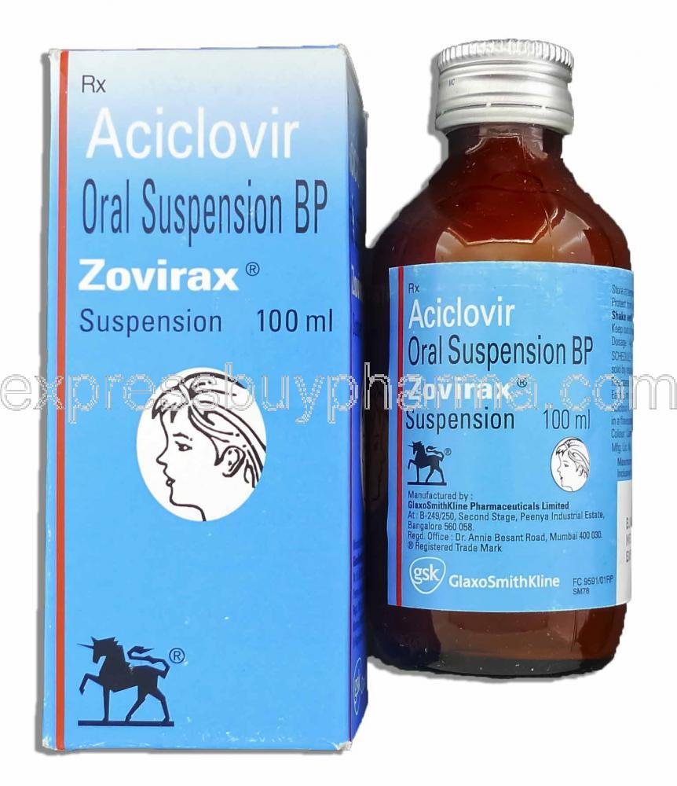

Slide 27
