Slide 1
TDM of
PHENYTOIN
REFERENCE: APPLIED CLINICAL PHARMACOKINETICS
by: lecturer HADEEL D NAJIM

Slide 2
Phenytoin is high protein bound (~90%)
Phenytoin is
eliminated by hepatic metabolism (>95%).
Phenytoin
follows Mechalis-Menten or saturable pharmacokinetics.

Slide 3
Therapeutic serum concentrations
Phenytoin is high protein bound (~90%)
Unbound fraction (fB) of phenytoin is (~10%)
The therapeutic range for total (unbound + bound) phenytoin serum concentrations in the treatment of seizures is 10-20 μg/mL
Unbound phenytoin serum concentrations 1–2 μg/mL.

Slide 4
Adverse effects related to serum conc.
>15 μg/mL ------- minor central nervous system depression such as drowsiness or fatigue.
> 20 μg/mL -------- nystagmus, lateral gaze
> 30 μg/mL -------- ataxia, slurred speech, and/or incoordination
> 40 μg/mL ------ mental status changes, including decreased mentation, severe confusion or lethargy, and coma are possible.
> 50 μg/mL --------Drug-induced seizure activity.

Slide 5
Since phenytoin is highly bound to albumin, you need to know factors cause its displacement from binding site-------which lead to increase unbound fraction (↑f_{B})
(1) Lack of binding protein due to insufficient plasma conc. of (↓albumin),
(2) Displacement of phenytoin from albumin binding sites by endogenous compounds,
(3) Displacement of phenytoin from albumin binding sites by exogenous compounds

Slide 7
Clinical Usefulness of Unbound Phenytoin
Concentrations
Unbound phenytoin concentrations are an extremely useful monitoring tool when used correctly.
The relationship between total concentration (C), unbound or “free” concentration (C_{f} ), and unbound or “free” fraction (f_{B}) is:
C_{f} = f_{B} .C

Slide 8
Therapeutic drug monitoring of phenytoin conc.
Total phenytoin serum concentrations is the mainstream way for routine therapeutic drug monitoring purposes.
Unbound phenytoin serum concentration monitoring restricted to patients with known reasons to have altered drug plasma protein binding.

Slide 9
For example, if low total phenytoin concentration (C=5 μg/mL), and patient has a satisfactory anticonvulsant response, one possible reason would be abnormal plasma protein binding (f_{B} = 20%) for some unidentified reason…
C_{f} = 0.2 . 5 ←------ not within therapeutic range
C_{f} = 1 μg/mL ←------ within therapeutic range
C_{f} = f_{B} .C

Slide 10
Conversely,,,,
If a patient has a possible phenytoin-related adverse drug reaction and the total phenytoin concentration is within the therapeutic range (15 μg/mL),
A possible reason could be abnormal protein binding (20%) for an unidentified reason,
C_{f} = f_{B} .C
= 0.2 ⋅ 15 μg/mL←------ within therapeutic range
= 3 μg/mL←------ toxic

Slide 11
Methods to estimate unbound phenytoin concentrations (C_{f})
1-Normalized total phenytoin concentration
CNormal Binding is the normalized total phenytoin concentration in μg/mL,
C is the actual measured phenytoin concentration in μg/mL ,
X is a constant equal to:
0.2 (if protein binding measurements conducted at 37°C)
0.25 (if conducted at 25°C)
0.1 (If the patient has end-stage renal disease Crcl<10–15 mL/min),
Alb is the albumin concentration in g/dL
C Normal Binding = C /(X ⋅Alb + 0.1)

Slide 12
2- Compute estimated free concentration (Cf EST):
But for patients with concurrent valproic acid administration…
*Do not need Cnormal binding
(PHT in μg/mL) total phenytoin concentration
(VPA in μg/mL) valproic acid concentration
C_{f EST} is compared to the usual therapeutic range for unbound phenytoin concentrations (1–2 μg/mL) and used for dosage adjustment purposes.
C_{f EST} = 0.1 CNormal Binding
C_{f EST} = (0.095 + 0.001 ⋅ VPA)PHT

Slide 13
Example 1 JM is an epileptic patient being treated with phenytoin. He has hypoalbuminemia (albumin = 2.2 g/dL) and normal renal function (creatinine clearance = 90 mL/min). His total phenytoin concentration is 7.5 μg/mL. Assuming that any unbound concentrations performed by the clinical laboratory will be conducted at 25°C, compute an estimated normalized phenytoin concentration for this patient.
CNormal Binding = C/(x ⋅ Alb + 0.1)
= C/(0.25 ⋅ Alb + 0.1)
= (7.5 μg/mL) / (0.25 ⋅ 2.2 g/dL + 0.1)
= 11.5 μg/mL
Cf EST = 0.1 CNormal Binding
= 0.1 ⋅ 11.5 μg/mL
= 1.2 μg/mL

Slide 14
Example 2 PM is an epileptic patient being treated with phenytoin and valproic acid. He has a normal albumin concentration (albumin = 4.2 g/dL) and normal renal function (creatinine clearance = 90 mL/min). His steady-state total phenytoin and valproic acid concentrations are 7.5 μg/mL and 100 μg/mL, respectively. Compute an estimated unbound phenytoin concentration for this patient.
Choose appropriate equation to estimate unbound phenytoin conc.
C_{f EST} = (0.095 + 0.001 ⋅ VPA)PHT
= (0.095 + 0.001 ⋅ 100 μg/mL)7.5 μg/mL
= 1.5 μg/mL

Slide 15
Dosage forms
❖ For parenteral use:
1- Phenytoin sodium, the sodium salt of phenytoin, contains (92% phenytoin), Infusion rate <50 mg/min
2- Fosphenytoin, a water soluble phosphate ester prodrug of phenytoin, Infusion rate <150 mg/min
❖ For oral use:
1- Capsules contain phenytoin sodium (92% phenytoin) extended phenytoin sodium capsules or prompt phenytoin capsules
2- Tablets and suspension contain phenytoin (100%)
Phenytoin tablets (50 mg, chewable) and
Suspension (125 mg/5 mL)

Slide 17
The clinical implication of
Michaelis-Menten pharmacokinetics

Slide 18
1- Clearance of phenytoin
The clearance of phenytoin is not a constant as it is with linear pharmacokinetics, but is concentration- or dose-dependent.
As the dose or concentration of phenytoin increases, the clearance rate decreases as the enzyme approaches saturable conditions:
-Vmax is the maximum rate of metabolism in mg/d,
-C is the phenytoin concentration in mg/L,
-Km is the substrate concentration in mg/L,
Cl↓ = Vmax / (Km + C↑)

Slide 19
2- Volume of Distribution Estimate
V_{d} = 0.7 L/kg
For obese ………..
V_{d} = 0.7 L/kg . ABW
= 0.7 L/kg . [IBW + 1.33(TBW − IBW)]

Slide 20
Example.. phenytoin follows saturable pharmacokinetics with average Michaelis-Menten constants of Vmax = 500 mg/d and Km = 4 mg/L. Find the clearance of the therapeutic range of phenytoin (10–20μg/mL).
Cl = Vmax/(Km + C)
= (500 mg/d) / (4 mg/L + 10 mg/L) = 36 L/d
Cl = (500 mg/d) / (4 mg/ + 20 mg/L) = 21 L/d

Slide 21
Then find V_{d}, t_{1/2} for a 70-kg person…
V_{d} = 0.7 L/kg ⋅ 70 kg ≈ 50 L
t_{1/2} = [0.693 ⋅ V] / Cl
= [0.693 ⋅ 50 L] / 36 L/d = 1 d
t_{1/2} = [0.693 ⋅ 50 L] / 21 L/d = 1.7 d
Half-life increase as phenytoin serum concentrations increase from (1day for 10 μg/mL) to (1.7day for 20 μg/mL).

Slide 22
Return to child pough score and interactions
Lets for example see what are the changes that occur with decreased protein binding of phenytoin according to the following scheme:

Slide 23
(↑Cl = ↑fBClint)
[↑V = VB + (↑fB / fT)VT].
[t1/2 = (0.693.↑V) /↑Cl]
(↓Css = k0/ ↑ Cl)
(Css,u = ↑fB ↓Css)

Slide 24
And the Result…
The pharmacologic effect of the drug does not change because the free concentration of drug in the blood is unchanged.
This can be an unexpected outcome for the decrease in plasma protein binding,
Especially because the total steady-state concentration of the drug decreased.

Slide 25
Concomitant use with valproic acid
Initially, valproic acid decreases phenytoin plasma protein binding via competitive displacement for binding sites on.
Then, as valproic acid concentrations increase, the hepatic enzyme inhibition component of the drug interaction comes into play (↓Cl′int).
The net result is total phenytoin concentrations are largely unchanged from baseline,
but unbound phenytoin concentrations and pharmacologic effect increase.

Slide 27
INITIAL DOSAGE DETERMINATION METHODS
Pharmacokinetic Dosing Method
Literature-Based Recommended Dosing

Slide 28
Pharmacokinetic Dosing Method
MICHAELIS-MENTEN PARAMETER ESTIMATES (Vmax, Km)
VOLUME OF DISTRIBUTION ESTIMATE (Vd)
STEADY-STATE CONCENTRATION SELECTION
SELECTION OF APPROPRIATE PHARMACOKINETIC MODEL AND EQUATIONS

Slide 29
1- Estimates Vmax & Km
Adult without any disease states and normal liver, renal plasma protein binding:
Vmax = 7 mg/kg/d (range: 1.5-14 mg/kg/d)
Km = 4 μg/mL (range: 1-15 μg/mL).
Children (6 months–6 years):
Vmax = 12 mg/kg/d
Km = 6 μg/mL
Older children (7–16 years):
Vmax = 9 mg/kg/d
Km = 6 μg/mL.

Slide 30
2-Volume of distribution
V_{d} for phenytoin = 0.7 L/kg
For obese individuals 30% or more above their ideal body weight, the volume of distribution can be estimated using the following equation:
V_{d} = 0.7 L/kg [IBW + 1.33(TBW − IBW)]
Adjusted body weight

Slide 31
3-Steady-state Concentration Selection
For the treatment of seizure:
❖ Required total phenytoin concentration 10-20 μg/mL
❖ Required free phenytoin concentration 1-2 μg/mL

Slide 32
4-Selection of Appropriate Pharmacokinetic Model and Equations
Vmax is the maximum rate of metabolism in mg/d
S is the fraction of the phenytoin salt form that is active phenytoin
S=0.92 for injection and capsules and fosphenytoin,
S=1.0 for suspensions and tablets
Km is the substrate concentration in mg/L (or μg/mL)
Css is the phenytoin concentration in mg/L (or μg/mL)
LD = (V . Css)/S
τ = 24 hr. for adult / oral
τ = 12 hr for children or I.V dose

Slide 33
Example 1 TD is a 50-year-old, 75-kg (5 ft 10 in) male with simple partial seizures who requires therapy with oral phenytoin. He has normal liver and renal function. Suggest an initial phenytoin dosage regimen designed to achieve a steady-state phenytoin concentration equal to 12 μg/mL.
For this patient…. Vmax = 7 mg/kg/d = 7 mg/kg/d ⋅ 75 kg = 525 mg/d.
Km = 4 mg/L.
for oral extended phenytoin sodium capsules (S = 0.92).
(τ) will be set to 24 hour
s.

Slide 34
Same patient but need IV phenytoin
Vmax = 525, Km = 4, S = 0.92
V_{d} = 0.7 L/kg ⋅ 75 kg = 53
3. LD = (V ⋅ Css) / S = (53 L ⋅ 12 mg/L) / 0.92 = 691 mg, rounded to 700 mg given at a maximal rate of 50 mg/min.
4. MD = 400 mg/d, (τ) will be set to 12 hours….. so MD = 200mg every 12 hours

Slide 35
Example 2 UO is a 10-year-old, 40-kg male with simple partial seizures who requires therapy with oral phenytoin. He has normal liver and renal function. Suggest an initial phenytoin dosage regimen designed to achieve a steady-state phenytoin concentration equal to 12 μg/mL.
Vmax = 9 mg/kg/d (child) = 9 mg/kg/d ⋅ 40 kg = 360 mg/d.
Km = 6 mg/L (child)
Oral phenytoin suspension (S = 1).
(τ) will be set to 12 hours
Phenytoin suspension: 125 mg every 12 hours

Slide 36
Literature-Based Recommended Dosing
MD for adult = 4–6 mg/kg/d
MD for children (6 months–16 years old) = 5–10 mg/kg/d
LD = 15–20 mg/kg
For obese individuals, adjusted body weight (ABW) use to compute loading doses. [IBW + 1.33 (TBW − IBW)]
If the patient has significant hepatic dysfunction (Child-Pugh score ≥8), maintenance doses prescribed using this method should be decreased by 25–50%

Slide 37
Example 1 TD is a 50-year-old, 75-kg (5 ft 10 in) male with simple partial seizures who requires therapy with oral phenytoin. He has normal liver and renal function. Suggest an initial phenytoin dosage regimen designed to achieve a steady-state phenytoin concentration equal to 12 μg/mL.
MD for adult = 4–6 mg/kg/d نأخذ المتوسط))
Using a rate of 5 mg/kg/d, the initial dose would be:
5 mg/kg/d ⋅ 75 kg = 375 mg/d, rounded to 400 mg/d.
Using a dosage interval of 24 hours.

Slide 38
Repeat it with IV phenytoin dosage
MD = 5 mg/kg/d,
= 5 mg/kg/d ⋅ 75 kg = 375 mg/d, rounded to 400 mg/d.
(τ) will be set to 12 hours, so give 200 mg of phenytoin sodium injection every 12 hours.
LD = 15–20 mg/kg.
= 15 mg/kg ⋅ 75 kg = 1125 mg, rounded to 1250 mg given no faster than 50 mg/min.

Slide 39
Use of Phenytoin Serum Concentrations to Alter Doses

Slide 40
Adjust phenytoin doses with one steady-state concentration:
1- Empiric dosing method
2- Pseudolinear pharmacokinetic method
3- Graves-Cloyd method
Adjust phenytoin doses with two steady-state concentrations:
1- Empiric dosing method
2- Ludden method

Slide 41
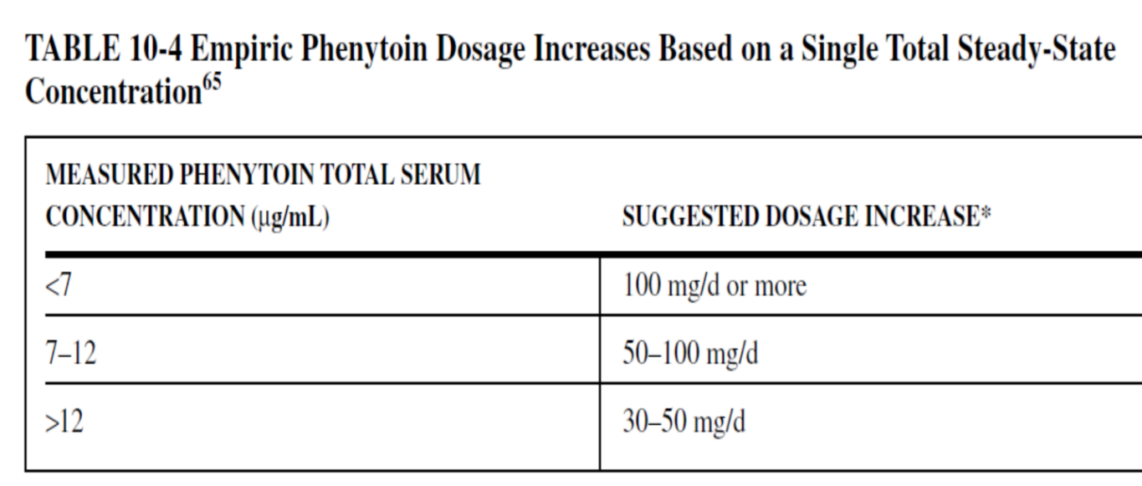
1- Empiric Dosing Method
Adjust phenytoin doses with one steady-state concentrations
Increase or decrease the dose according to the obtained concentration from the patient and according to the following table:

Slide 42
Example 1 TD is a 50-year-old, 75-kg (5 ft 10 in) male with simple partial seizures who requires therapy with oral phenytoin. He has normal liver and renal function. The patient was prescribed 400 mg/d of extended phenytoin sodium capsules for 1 month, and the steady-state phenytoin total concentration equals 6.2 μg/mL. The patient is assessed to be compliant with his dosage regimen. Suggest an initial phenytoin dosage regimen designed to achieve a steady-state phenytoin concentration within the therapeutic range.
1. Use Table 10-4 to suggest new phenytoin dose.
Table 10-4 suggests a dosage increase of ≥100 mg/d for this patient. The dose would be increased to 500 mg/d.
Note: A steady-state trough total phenytoin serum concentration should be measured after steady state is attained in 7–14 days. Phenytoin serum concentrations should also be measured if the patient experiences an exacerbation of their epilepsy, or if the patient develops potential signs or symptoms of phenytoin toxicity.

Slide 43
2- Pseudolinear Pharmacokinetic Method
1- Increase the dose empirically according to previous table.
2- Then calculate new Css from the new dose by linear pharmacokinetics equation:
Cssnew = (Dnew / Dold) Cssold
3- To account for Michaelis-Menten pharmacokinetics:
Add 15–33% for a dosage increase [Multiply the Css by 1.15 and 1.33]
Or
Subtract 15–33% for a dosage decrease [Multiply Css by 0.85 and 0.67]

Slide 44
Example 3 TD is a 50-year-old, 75-kg (5 ft 10 in) male with simple partial seizures who requires therapy with oral phenytoin. He has normal liver and renal function. The patient was prescribed 400 mg/d of extended phenytoin sodium capsules for 1 month, and the steady-state phenytoin total concentration equals 6.2 μg/mL. The patient is assessed to be compliant with his dosage regimen. Suggest phenytoin dosage regimen to achieve a steady-state phenytoin concentration within the therapeutic range.
A convenient dosage change would be 100 mg/d and the new dose will be 500 mg/d.
Cssnew = (Dnew / Dold)Cssold = (500 mg/d / 400 mg/d) 6.2 μg/mL = 7.8 μg/mL.
To account for Michaelis-Menten pharmacokinetics:
Serum concentration would be expected to increase 15%-33% greater than that predicted Css, then we multiply Css by 1.15 and 1.33
Css = 7.8 μg/mL ⋅ 1.15 = 9.0 μg/mL and Css = 7.8 μg/mL ⋅ 1.33 = 10.4 μg/mL.
Thus, a dosage increase of 100 mg/d would be expected to yield a total phenytoin steady-state serum concentration between 9–10 μg/mL.

Slide 45
3- Graves-Cloyd Method
Note: The (dose old) should be multiply by S factor (0.92) in capsule and injection before use it in the equation (below) and then the resultant (new dose) should be divided by S factor.

Slide 46
Example 5 TD is a 50-year-old, 75-kg (5 ft 10 in) male with simple partial seizures who requires therapy with oral phenytoin. He has normal liver and renal function. The patient was prescribed 400 mg/d of extended phenytoin sodium capsules for 1 month, and the steady-state phenytoin total concentration equals 6.2 μg/mL. The patient is assessed to be compliant with his dosage regimen. Suggest an initial phenytoin dosage regimen designed to achieve a steady-state phenytoin concentration within the therapeutic range.
Phenytoin sodium 400 mg equals 368 mg of phenytoin (400 mg ⋅ 0.92 = 368 mg).
A new total phenytoin steady-state serum concentration equal to 10 μg/mL is chosen for the patient:
Dnew = (Dold / Cssold) ⋅ Cssnew 0.199 ⋅ Cssold 0.804
= (368 mg/d / 6.2 mg/L) ⋅ (10 mg/L)^{0.199} ⋅ (6.2 mg/L)^{0.804}
= 407 mg/d.
This is equivalent to 442 mg/d of phenytoin sodium (407 mg/0.92 = 442 mg) rounded to 450 mg/d, or 400 mg/d on even days alternating with 500 mg/d on odd days.

Slide 47
Adjust phenytoin doses with two steady-state concentrations
Note : If (2) concentrations is given in question use the following methods to calculate the new dose
Increase or decrease the dose empirically according to obtained concentration from the patient.
1- Empiric Dosing Method

Slide 48
Example 1 TD is a 50-year-old, 75-kg (5 ft 10 in) male with simple partial seizures who requires therapy with oral phenytoin. He has normal liver and renal function. The patient was prescribed 400 mg/d of extended phenytoin sodium capsules for 1 month, and the steady-state phenytoin total concentration equals 6.2 mg/mL. The dosage was increased to 500 mg/d of extended phenytoin sodium capsules for another month, the steady state phenytoin total concentration equals 22.0 mg/mL, and the patient has some lateral-gaze nystagmus. The patient is assessed to be compliant with his dosage regimen. Suggest a new phenytoin dosage regimen designed to achieve a steady-state phenytoin concentration within the mid-to-upper end of the therapeutic range.
Empirically suggest new phenytoin dose.
The next logical dose to prescribe is phenytoin sodium 450 mg/d to be taken by the patient as 400 mg/d on even days and 500 mg/d on odd days.

Slide 49
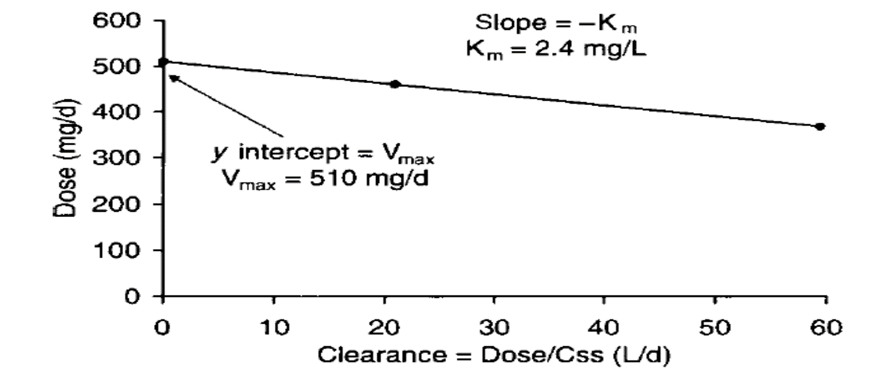
2- Ludden Method

Slide 50
Calculation steps:
To answer any question:
1- Multiply each dose by S before used in equation
2- Calculate actual Km
−Km = (MD1 − MD2) / [(MD1/Css1) − (MD2 / Css2)]
3 - Calculate actual Vmax
Vmax = MD + Km (MD / Css).
4- Use the actual Km & Vmax to calculate new dose
MD = (Vmax ⋅ Css) / [S (Km + Css)].

Slide 51
Example 5 TD is a 50-year-old, 75-kg (5 ft 10 in) male with simple partial seizures who requires therapy with oral phenytoin. He has normal liver and renal function. The patient was prescribed 400 mg/d of extended phenytoin sodium capsules for 1 month, and the steady-state phenytoin total concentration equals 6.2 μg/mL. The dosage was increased to 500 mg/d of extended phenytoin sodium capsules for another month, the steady state phenytoin total concentration equals 22.0 μg/mL, and the patient has some lateral-gaze nystagmus. The patient is assessed to be compliant with his dosage regimen. Suggest a new phenytoin dosage regimen designed to achieve a steady-state phenytoin concentration within the therapeutic range.
Multiply each dose by S before used in equation:
Phenytoin dose 1 = 0.92 ⋅ phenytoin sodium
= 0.92 ⋅ 400 mg/d = 368 mg/d,
phenytoin dose 2 = 0.92 ⋅ phenytoin sodium dose
= 0.92 ⋅ 500 mg/d = 460 mg/d,

Slide 52
2. Estimate actual Vmax and Km.
−Km = (MD1 − MD2) / [(MD1/Css1) − (MD2/Css2)] 1: refer to higher dose
= (460 mg/d − 368 mg/d) / [(460 mg/d / 22 mg/L) − (368 mg/d / 6.2 mg/L)]
= −2.4 mg/L, Km = 2.4 mg/L;
Vmax = MD + Km (MD/Css) (ممكن اختيار اي جرعة مع تركيزها)
= 368 mg/d + 2.4 (368 mg/d / 6.2 mg/L), Vmax = 510 mg/d.
3. Use the actual Km & Vmax to calculate new dose
MD = (Vmax ⋅ Css) / [S (Km + Css)].
= (510 . 10) / [0.92 (2.4 + 10)]
MD = 447 rounded to 450mg/d of phenytoin sodium

Slide 53
Use of Phenytoin Booster Doses to Immediately Increase Serum Concentrations
If a patient has a sub-therapeutic phenytoin serum concentration in an acute situation, it may be desirable to increase the phenytoin concentration as quickly as possible.
In this setting, it would not be acceptable to simply increase the maintenance dose and wait for therapeutic steady-state serum concentrations to be established in the patient.
A modified loading dose equation is used to accomplish computation of the booster dose (BD) which takes into account the current phenytoin concentration present in the patient:
BD = [(C_{desired} − C_{actual}) V] / S
C_{desired} is the desired phenytoin concentration,
C_{actual} is the actual current phenytoin concentration for the patient

Slide 54
Example 1 BN is a 22-year-old, 85-kg (6 ft 2 in) male with complex partial seizures who is receiving therapy with intravenous phenytoin sodium. He has normal liver and renal function. After receiving an initial loading dose of phenytoin sodium (1000 mg) and a maintenance dose of 300 mg/d of phenytoin sodium for 5 days, his phenytoin concentration is measured at 5.6 μg/mL immediately after seizure activity was observed. Compute a booster dose of phenytoin to achieve a phenytoin concentration equal to 15 μg/mL?
1. Estimate volume of distribution according to disease states and conditions present in the patient.
V = 0.7 L/kg ⋅ 85 kg = 60 L.
2. Compute booster dose.
BD = [(C desired – C actual) V] /S
= [(15 mg/L − 5.6 mg/L) 60 L] / 0.92 = 613 mg, rounded to 600 mg of Phenytoin sodium infused no faster than 50 mg/min.

Slide 55


