Slide 1
Code of Ethics for Pharmacists
Dr. Haider Raheem Mohammad

Slide 2
Code of Ethics for Pharmacists
The Code of Ethics sets out the principles that you must follow as a pharmacist or pharmacy technician. The Code is the Society’s core guidance on the conduct, practice and professional performance expected of you. It is designed to meet our obligations under The Pharmacists and Pharmacy Technicians Order 2007 and other relevant legislation. The principles of the Code are intended to guide and support the work you do and the decisions you make. They also inform the general public of the standards of behaviour that can be expected from the pharmacy professions.
The Code is founded on seven principles which express the values central to the identity of the pharmacy professions. The seven principles encapsulate what it means to be a registered pharmacist or pharmacy technician. Making these principles part of your professional life will maintain patient safety and public confidence in the professions.

Slide 3
1. MAKE THE CARE OF PATIENTS YOUR FIRST CONCERN
The care, well-being and safety of patients are at the centre of everyday professional practice. They must be your primary and continuing concern when practising, irrespective of your field of work. Even if you do not have direct contact with patients your actions or behaviour can still impact on their care or safety.

Slide 4
2. EXERCISE YOUR PROFESSIONAL JUDGEMENT IN THE INTERESTS OF PATIENTS AND THE PUBLIC
The need to balance the requirements of individuals with society as a whole and manage competing priorities and obligations is a feature of professional life. Guidelines, targets and financial constraints need to be taken into account, but they must not be allowed to compromise your ability to make an informed professional judgement on what is appropriate for patients in specific situations.

Slide 5
3. SHOW RESPECT FOR OTHERS
Demonstrating respect for the dignity, views and rights of others is fundamental in forming and maintaining professionally appropriate relationships with patients, their carers, colleagues and other individuals with whom you come into contact with.

Slide 6
4. ENCOURAGE PATIENTS TO PARTICIPATE IN DECISIONS ABOUT THEIR CARE
Patients have a right to be involved in decisions about their treatment and care. They should be encouraged to work in partnership with you and other members of the professional team to manage their healthcare needs. Successful partnership working requires effective communication and an ability to identify the individual needs of patients. Where patients are not legally capable of making decisions about their care you must seek the authority of persons who are empowered to make decisions on their behalf.

Slide 7
5. DEVELOP YOUR PROFESSIONAL KNOWLEDGE AND COMPETENCE
At all stages of your professional working life you must ensure that your knowledge, skills and performance are of a high quality, up to date and relevant to your field of practice.

Slide 8
6. BE HONEST AND TRUSTWORTHY
Patients, colleagues and the public at large place their trust in you as a pharmacy professional. You must behave in a way that justifies this trust and maintains the reputation of your profession.

Slide 9
7. TAKE RESPONSIBILITY FOR YOUR WORKING PRACTICES
Team working is a key feature of everyday professional practice and requires respect, co-operation and communication with colleagues from your own and other professions. When working as part of a team you remain accountable for your own decisions, behaviour and any work done under your supervision.

Slide 10
Applying the principles
It is your responsibility as a pharmacist to apply the principles of the Code of Ethics to your daily work, whether or not you routinely treat or care for patients. You must be able to show that you are aware of the Code and have followed the principles it lays down.
You are professionally accountable for your practice. This means that you are answerable for your acts and omissions, regardless of advice or directions from your manager or another professional. You are expected to use your professional judgement in the light of the principles of the Code and must be prepared to justify your actions if asked to do so.

Slide 11
Development of the law in relation to pharmacy, medicines and poisons
Between 1968 and 1978, the statutes relating to medicines, poisons and drugs were almost entirely repealed and replaced by new legislation. The Medicines Act 1968 now controlled the manufacture and distribution of medicines; the Poisons Act 1972 regulated the sale of non-medicinal poisons, while the Misuse of Drugs Act 1971 dealt with the abuse of drugs. In 1973, the National Health Service Reorganization Act brought about a major revision in the pharmaceutical services of the National Health Service (NHS). A new National Health Service Act in 1977 together with many amending Health Service Acts now regulate the pharmaceutical services.

Slide 12
Development of the law in relation to pharmacy, medicines and poisons
Before the middle of the 19th century, there were no legal restrictions in England on the sale of poisons or drugs, and anyone could describe themselves as a pharmaceutical chemist. Statutory control over sales was first applied to arsenic because, as the preamble to the Arsenic Act 1851 stated, the unrestricted sale of arsenic facilitates the commission of crime. The first statute relating to pharmacy followed the next year. The Pharmacy Act 1852 confirmed the charter of incorporation of the Pharmaceutical Society of Great Britain.

Slide 13
National Drug Code Directory
The Drug Listing Act of 1972 requires registered drug establishments to provide the Food and Drug Administration (FDA) with a current list of all drugs manufactured, prepared, propagated, compounded, or processed by it for commercial distribution.
The NDC, or National Drug Code, is a unique 10-digit, 3-segment number. It is a universal product identifier for human drugs in the United States. The code is present on all nonprescription (OTC) and prescription medication packages and inserts in the US. The 3 segments of the NDC identify the labeler, the product, and the commercial package size.

Slide 14
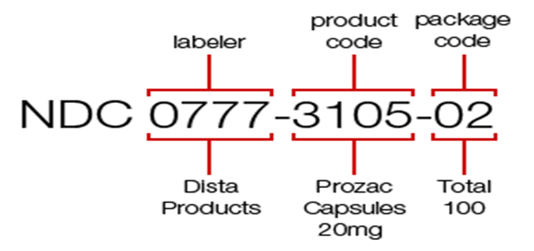
National Drug Code Directory
The first set of numbers in the NDC identifies the labeler (manufacturer, repackager, or distributer).
The second set of numbers is the product code, which identifies the specific strength, dosage form (i.e, capsule, tablet, liquid) and formulation of a drug for a specific manufacturer.
The third set is the package code, which identifies package sizes and types. The labeler code is assigned by the FDA, while the product and package code are assigned by the labeler.

Slide 15
National Drug Code Directory
For example, the NDC for a 100-count bottle of Prozac 20 mg is 0777-3105-02. The first segment of numbers identifies the labeler. In this case, the labeler code "0777" is for Dista Products Company, the labeler of Prozac. The second segment, the product code, identifies the specific strength, dosage form (i.e, capsule, tablet, liquid) and formulation of a drug for a specific manufacturer. In our case, "3105" identifies that this dosage form is a capsule. The third segment is the package code, and it identifies package sizes and types. Our example shows that the package code "02" for this bottle of Prozac identifies that 100 capsules are in the bottle. The FDA maintains a searchable database of all NDC codes on their website.

Slide 16
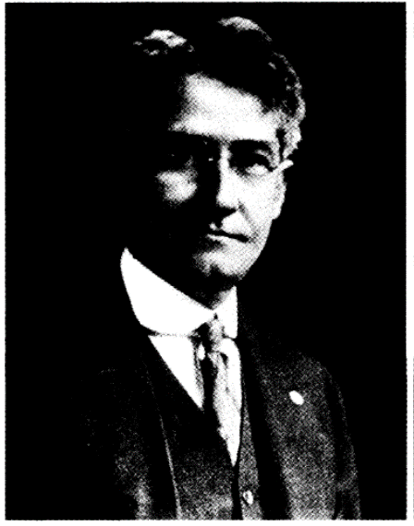
Charles H. La Wall (1871- 1937), Dean of the Philadelphia College of Pharmacy (1918-37) and President of the American Pharmaceutical Association (1918-19), architect of the first modern code of ethics for American pharmacy (1922).

Slide 17
In 1848 the Philadelphia College of Pharmacy promulgated the first American code of ethics for pharmacists. The painting "American Pharmacy Builds Its Foundations" by Robert Thorn shows the artist's conception of the founding of the College in 1821.

Slide 18


