Slide 1
Cost utility analysis
Part I
Lec.Zahraa Abdul Ghani

Slide 2
Cost utility analysis
Utility is the measurement of patient preference for a particular intervention in term of patient well being.
The most commonly used outcome measure in this type of analysis: quality-adjusted life-years (QALYs) gained.
A QALY combines survival periods (quantity of life) with health status valuations (quality of life) to provide a standard unit for measuring health gain.
Utility is an index which ranges in range between 0 (representing death) and 1 (representing perfect health)

Slide 3
The advantage of a CUA
1. different types of health outcomes and diseases with multiple outcomes of interest can be compared (unlike in CEA).
2. using one common unit such as the QALY.
3.CUA incorporates morbidity and mortality into this one common unit without having to determine or estimate the monetary value of these health outcomes (unlike CBA).

Slide 4
The disadvantage of CUA
1.It is difficult to determine an accurate utility or preference weight value
2. the methods for estimating utilities/QALYs may not be fully understood by many providers or decision makers.

Slide 5
When Is Cost-Utility Analysis Appropriate?
1.When health-related quality of life is the important outcome
for example, when comparing interventions that are not expected to have an impact on mortality, but a potential impact on patient function and well-being (eg, treatments for osteoarthritis).
2. When health-related quality of life is an important outcome—for example, evaluation of the outcomes associated with the treatment of acute myocardial infarction. Not only is lives saved an important outcome measure, but also the quality of the lives saved

Slide 6
3. When the intervention affects both morbidity and mortality and a combined unit of outcome is desired . for example, evaluation of a therapy, such as estrogen use by postmenopausal women, that can improve quality of life may reduce mortality from certain conditions (eg, heart disease), but may increase mortality from other conditions (eg, uterine cancer).
4. When the intervention being compared have a wide range of potential outcomes and there is a need to have a common unit of outcome for comparison
for example, the choice between providing increased prenatal care or expanding a hypertension screening and treatment program.
5. When the objective is to compare an intervention with others that have already been evaluated in terms of cost per QALY (or equivalent) gained.

Slide 7
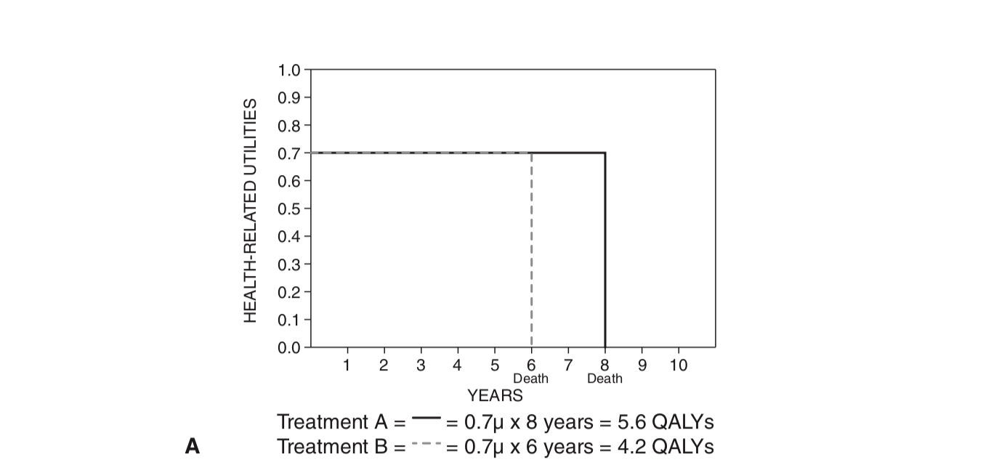
Examples for use of cost utility analysis:
For some research questions, utility adjustments may not be warranted. For example, if two pharmaceutical products have different outcomes based on the number of life-years saved (LYS), but the quality of each year of life for those on the two treatments are thought to be the very similar (see Fig. 6.1A), quality adjustment may not be as crucial.

Slide 8
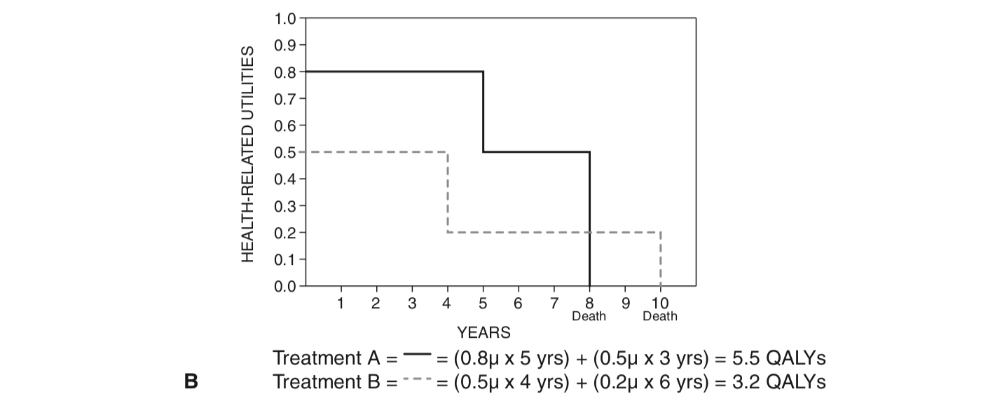
in many cases—for example, cancer treatment—both the length of life and the quality of life are different, depending on the therapy selected. Sometimes the treatments that extend life the longest are also the most toxic, so a measure that incorporates both length of life and quality of life is needed in these cases (see Fig. 6.1B).

Slide 9
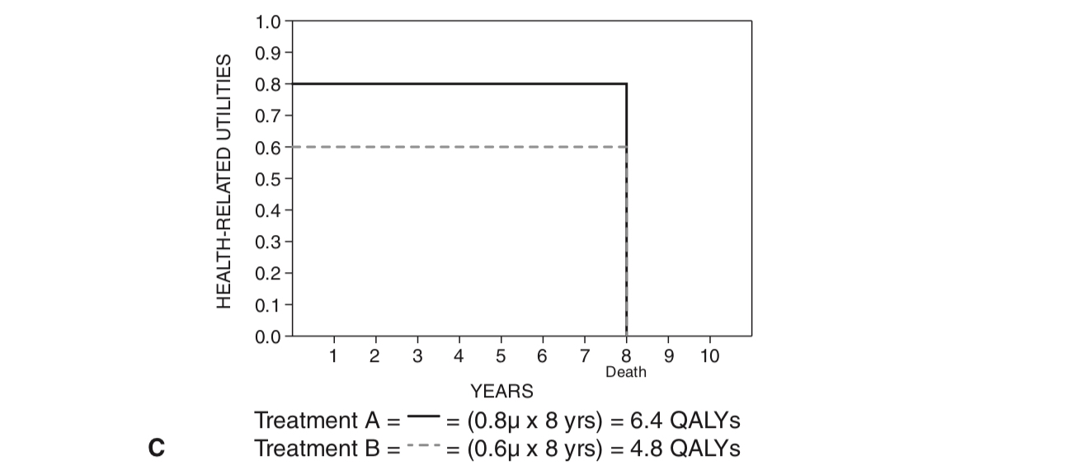
Many health conditions do not have an impact on patients’ length of life, but only on the quality of their life, and CUA may be a good choice for comparing treatments for these conditions (see Fig. 6.1C). Examples include conditions such as hearing loss, seasonal allergies, and erectile dysfunction.

Slide 10
Steps in Calculating QAlYS:
1.Develop a description of each disease state or condition of interest.
2. Choose a method for determining utilities.
3. Choose subjects who will determine utilities.
4. Sum the product of utility scores by the length of life for each option to
obtain QALYs.

Slide 11
step 1: Develop a description of each disease state or condition of interest.
The description should concisely depict the usual health effects expected from the disease state or condition. It should include the amount of pain or discomfort, any restrictions on activities, the time it may take for treatment, possible
changes in health perceptions (worry or concern), and any mental changes.

Slide 12
Example
Description of Hospital-Based Kidney Dialysis
You often feel tired and sluggish. A piece of tubing has been inserted into your arm or leg, which may restrict your movement. There is no severe pain but rather chronic discomfort. You must go to the hospital twice a week for 6 hours per visit. You must follow a strict diet (low salt, little meat, no alcohol). Many people be- come depressed because of the nuisances and restrictions, and some feel they are being kept alive by a machine.

Slide 13
Step 2: Choose Method for Determining utilities
1. direct elicitation (rating scale, standard gamble, and time tradeoff)
2. Indirect elicitation methods, using standardized weightings (e.g., EQ-5D and SF-6D surveys)

Slide 14
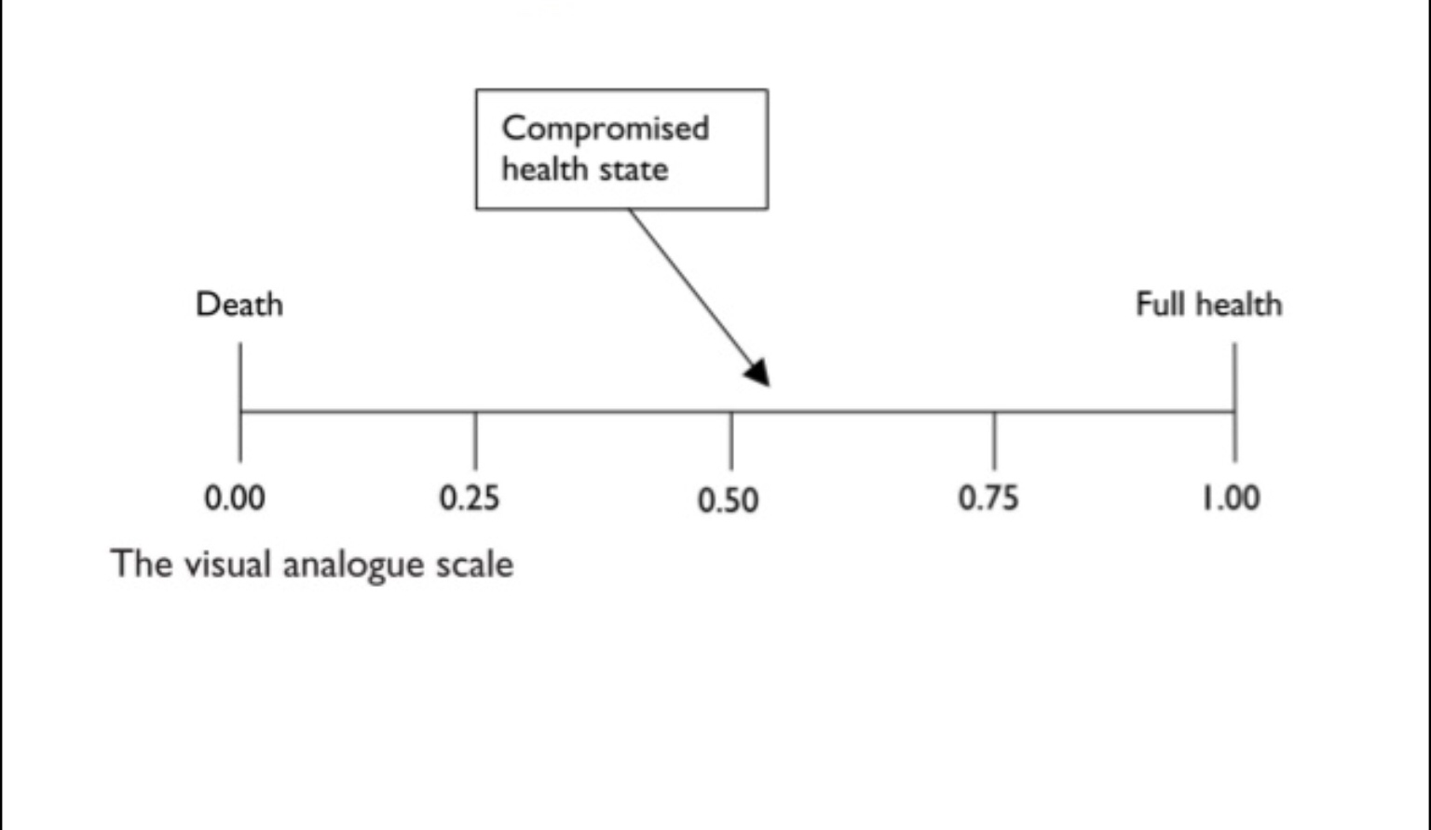
A.Rating scale

Slide 15
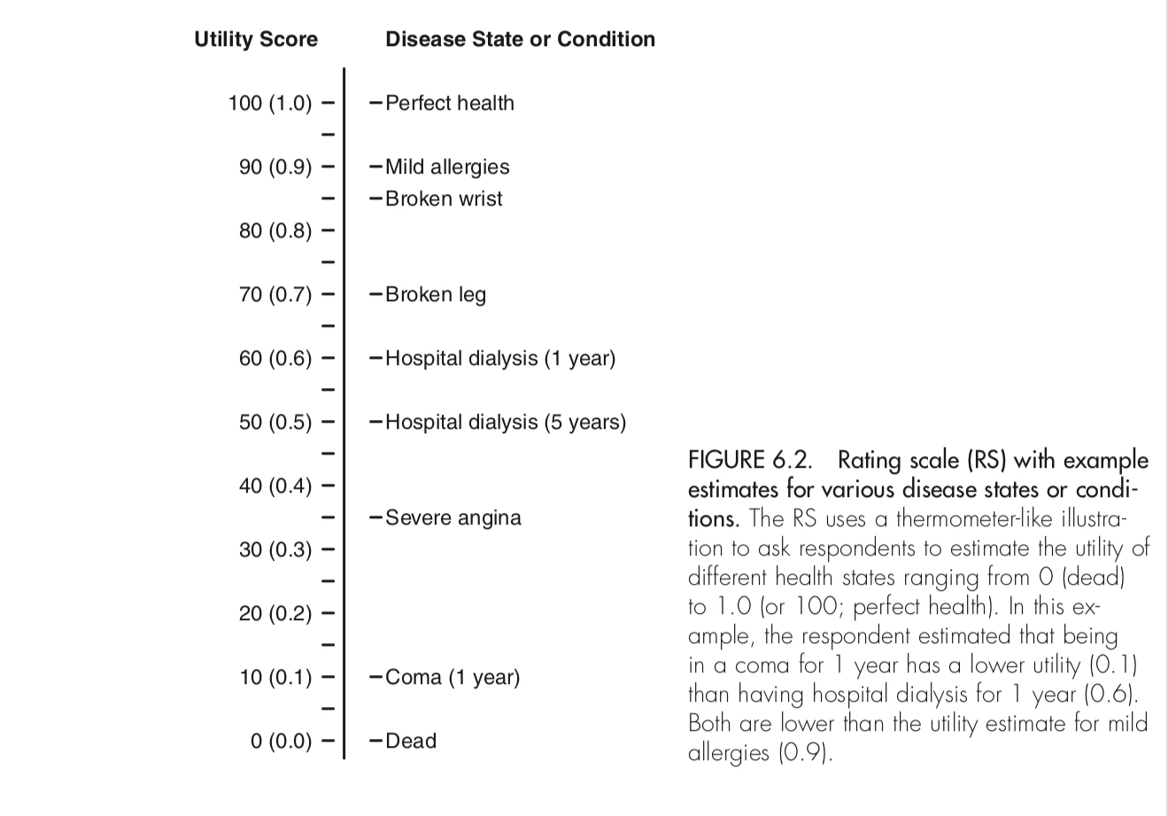

Slide 16
B.Standard gamble
example, a person considers two options: a kidney transplant with a 20% probability of dying (80% chance of returning to normal health) during the operation (Alternative 1) or certain dialysis for the rest of his or her life (Alternative 2).
If the person says he or she would have the operation if the chance of the successful operation p is 80% (chance of immediate death, 20%), the percent chance of success is decreased until the person reaches his or her point of indifference (the point where the two options are nearly equal and the person cannot decide between the two).
If the person says he or she would not have the operation if the percent chance for success was 80% (chance of dying, 20%), the percent chance of success is increased until the person reaches his or her point of indifference

Slide 17
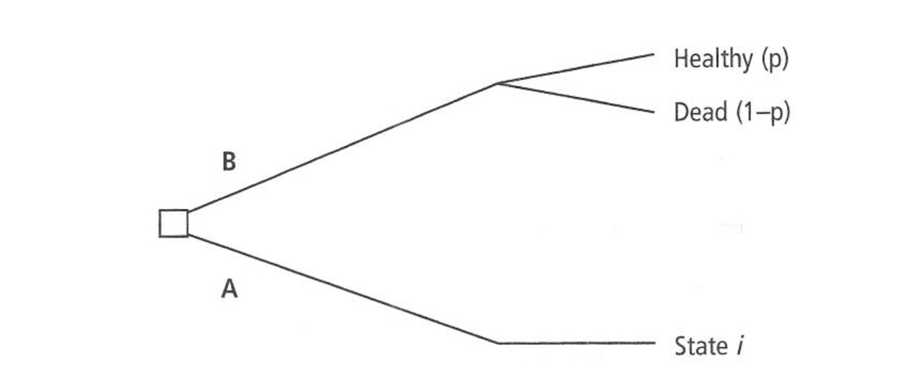
B.Standard Gamble

Slide 18
C.Time tradeoff
Alternative 1 is a certain disease state for a specific length of time (t), the life expectancy for a person with the disease, and then death.
Alternative 2 is being healthy for time x, which is less than t.
Time x is varied until the respondent is indifferent between the two alternatives.
The utility score for the health state is calculated as x divided by t.

Slide 19
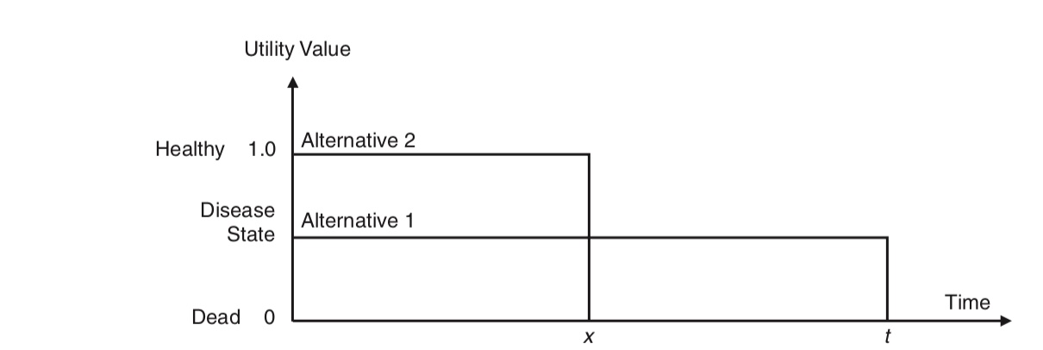
C. Time Tradeoff

Slide 20
For example, a person with a life expectancy of 40 years is given two options
Alternative 1 is having a chronic condition (e.g., kidney disease or diabetes) for 40 years,
Alternative 2 is being healthy (no disease) for 20 years followed by death.
If the person says he or she would rather have the disease for 40 years (t) than be healthy for 20 years, the number of years (x) in the healthy state is increased until the person is indifferent between the two alternatives.
If the person would rather be healthy for 20 years than have the disease for 40 years, the number of years (x) in the healthy state is decreased until the person is indifferent between the two alternatives.
Let us say that for a person who expects to live 40 more years, the person’s point of indifference is 30 years of health versus 40 years of kidney disease. The utility score would be x/ t = 30 / 40 or 0.75.

Slide 21
Comparisons of the Three Methods
The advantage of using the RS method to determine utilities is that
1. many disease states or conditions can be described to each subject
2. can be conducted via a questionnaire without face-to-face interaction.
3. it is less cognitively demanding than the other two methods.
The disadvantage of using the RS method is that:
1.it does not incorporate time into the utility score as easily as the other two methods.
2.It also may be biased in that people do not tend to cluster their values at the extreme ends of the scale.

Slide 22
The advantage of using the SG method is that
1.it is the “gold standard” and based on economic theory.
The Disadvantages of SG
1. people have difficulty understanding probabilities
2.subjects need to answer repeated questions, influenced by how the questions are phrased or presented.
3. It is time consuming
4. this is better administered in a face-to-face setting, or through an iterative process, which takes more resources than a self-administered questionnaire.
5. treatment of most chronic diseases does not approximate the gamble.

Slide 23
The advantages of the TTO method are that
1.it is more adaptable to diseases states than the SG, and it incorporates the time in the disease state or condition more easily than the RS.
The Disadvantages of TTO
1. It is time consuming ,subjects need to answer repeated questions because the time in a healthy state varies depending on the subject’s previous answers
2.require face-to-face administration or an iterative process

Slide 24
2. Indirect elicitation method:
Generic measures:are more useful when looking at groups of patients who may have different illnesses, and can be used to compare outcomes in different patient groups. One of the most widely used is the Short Form (SF)-36 health survey. This looks at:
• Physical functioning
• Physical role
• Bodily pain
• General health
• Vitality
• Social functioning
• Emotional role
• Mental health.

Slide 26
Euroqol (EQ-5D)
EQ-5D has five dimensions: mobility, self-care, usual activities, pain/ discomfort and anxiety/depression. There are three levels per dimension and respondents/patients describe themselves within this system.

