Slide 1
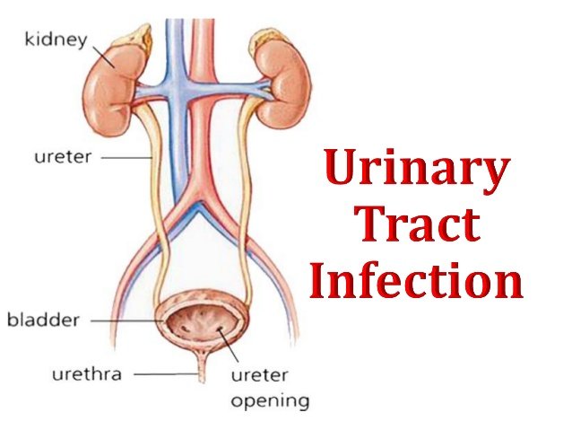

Slide 2
Premature infants have a higher rate than full-term infants, and neonatal boys are five to eight times more likely to have UTIs than neonatal girls.
In young children 1 to 5 years of age, significant bacteriuria occurs more in girls than boys, 4.5% compared with 0.5%, respectively.
Once adulthood is reached, bacteriuria increases in young, nonpregnant women (range, 1%–3%), yet remains low in men (up to 0.1%).
Symptomatic UTI affects 30% of women between 20 and 40 years of age, which represents a prevalence that is 30 times greater than that of men in the same age group.
The lifetime risk of UTIs in women is as high as 50% based on symptomatic reporting

Slide 3
The etiology of UTIs has remained relatively unchanged over the past several decades.
UTIs are either uncomplicated or complicated.
There is a lack of consensus regarding the definition of what makes a UTI complicated (specifically in postmenopausal women or patients with diabetes mellitus), but in general, a complicated UTI refers to a structural or functional abnormality of the urinary tract.
Patients with complicated UTIs are typically given longer treatment durations than those patients with uncomplicated infections.
Those with complicated UTIs by definition are also prone to more frequent infections.

Slide 4
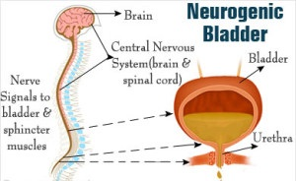
Underlying Structural Abnormalities
Congenital anomalies,
Neurogenic bladder,
Obstructive uropathy, is often caused by more resistant organisms such as
Pseudomonas aeruginosa,
Enterobacter and Serratia species

Slide 5
Risk Factors
Common risk factors for UTIs in women include sexual intercourse, use of a cervical diaphragm, use of spermicidal jellies, diabetes, and pregnancy.
In men, the risks are increased in uncircumcised males and older age men with prostatic hyperplasia.
Common risk factors for both men and women include urologic instrumentation, urethral catheterization, renal transplantation, neurogenic bladder, and urinary tract obstruction.

Slide 6
CLINICAL PRESENTATION AND DIAGNOSIS
Bacteriuria, or bacteria in the urine, does not always represent infection.
For this reason, quantitative diagnostic criteria have been created (Table 79–1) to identify the amount of bacteria in the urine that most likely represents true infection.
Clinically this is referred to as significant bacteriuria.
UTIs are classified as lower tract or upper tract disease. Lower tract urinary infections are usually less severe and are treated in the outpatient setting.
Cystitis, a common lower tract syndrome, involves inflammation of the bladder and is associated with symptoms of dysuria, nocturia, gross hematuria, and occasional suprapubic tenderness.
Upper tract disease such as pyelonephritis is generally more severe infection, and patients more often present with symptoms of systemic response such as fever, chills, and elevated white blood cell count.
Patients with upper tract infection are more likely to be admitted to the hospital for treatment.

Slide 7
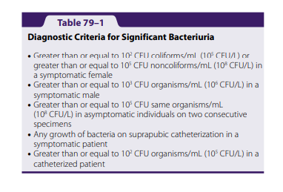

Slide 8
Clinical Presentation and Diagnosis of UTIs
General
• Most women present with hematuria; however, this is not a presentation restricted only to UTIs.
• Elderly patients frequently will not present with common signs and symptoms of UTI, but may present with altered mental status.
• More than 95% of uncomplicated UTIs are caused by a single organism.
• Patients may present with urosepsis.
Signs and Symptoms of Lower UTI • Dysuria, gross hematuria, suprapubic heaviness, nocturia, increased urinary frequency and urgency
Signs and Symptoms of Upper UTI • Fever, nausea, vomiting, malaise, and often severe flank pain
Laboratory Tests Urinalysis should show:
• Pyuria typically greater than 10 white blood cells/mm3 urine (10 × 106 /L)
• Bacteriuria, usually greater than 105 CFU organisms/mL (108 CFU/L)
• Nitrites present
• Leukocyte esterase present
Other Diagnostic Tests
• Bacterial urine culture
• Presence of costovertebral tenderness (upper UTI only)

Slide 9
TREATMENT
The goals of treatment are to eradicate the causative pathogen, prevent or treat consequences of infection, administer targeted antimicrobial therapy for the identified or most likely pathogen, minimize unnecessary exposure to noncausative organisms, and prevent, if possible, recurrence of infection.
Therapy is directed at microbiologic eradication of the offending organism through antibiotics with a defined duration of treatment based on the UTI classification.
Antimicrobial therapy is the cornerstone of treatment in symptomatic UTIs.
The selected antimicrobial should ideally be
  well tolerated,
  lend itself to patient compliance (low total number of doses),
  have adequate concentrations at the site of the infection in the urinary tract,
  have good oral bioavailability, and
  be narrow in antimicrobial spectrum to limit collateral damage and resistance development in human flora not affiliated with the infection.

Slide 10
For acute uncomplicated UTIs, it is reasonable to pursue oral empiric therapy with one dose (3000 mg) of fosfomycin, a 3-day course of trimethoprim-sulfamethoxazole (one double-strength tablet twice daily), or a 5-day course of nitrofurantoin (100 mg twice daily) depending on the patient’s characteristics and risk factors.
For treatment of multidrug resistant organisms, multiple doses of fosfomycin (given every other day) have been used.
The antibiotic selection for empiric therapy partly depends on known resistance rates in the geographic region, particularly E. coli resistance to trimethoprim-sulfamethoxazole.
Although fluoroquinolone antibiotics and certain β-lactam agents can be highly active and efficacious against E. coli, these agents should be considered alternative agents in uncomplicated UTIs due to their broad-spectrum activity and risk of resistance development in bacteria unaffiliated with the infection.

Slide 11
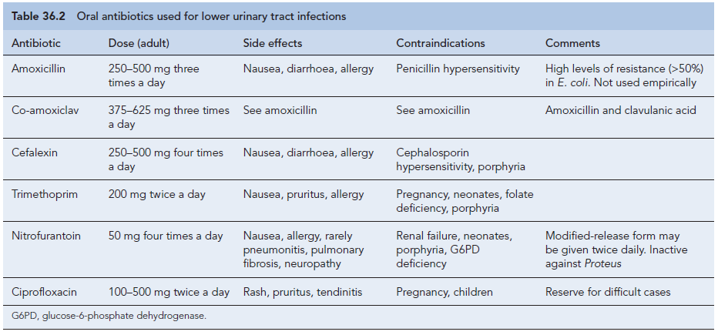

Slide 12
» Complicated UTIs
Complicated UTIs including acute pyelonephritis should be treated for at least 7 days and sometimes 2 weeks or longer
Acute Pyelonephritis
Patients who present with pyelonephritis usually have high grade fever (greater than 38.3°C [100.9°F]) and severe flank pain.
Select patients with pyelonephritis may be treated in the outpatient setting; however, patients with infection-related vomiting, decreased food intake, and dehydration may need to be treated in the hospital.
These patients will often receive IV antibiotics initially before being switched to oral therapy depending on susceptibility testing.
Patients with pyelonephritis are traditionally given 14 days of therapy.
Shorter course fluoroquinolone therapy for 7 days has been successful in women with acute pyelonephritis, but further studies are needed for validation.
Gram stain and culture are important in ensuring that appropriate antimicrobial coverage is selected.
Women who present with mild cases of pyelonephritis (defined as low-grade fever and a normal to slightly elevated peripheral white blood count, without nausea or vomiting) may be treated as outpatients.

Slide 14
Outpatient antibiotic therapy with trimethoprim-sulfamethoxazole, fluoroquinolones, or even β-lactam/β-lactamase inhibitor, such as amoxicillin-clavulanic acid is recommended.
In cases where an initial, one-time IV antibiotic is used as supplemental therapy, a single ceftriaxone dose or single high-dose aminoglycoside therapy could be used in lieu of an IV fluoroquinolone.
Hospitalized patients, suspected of having bacteremia or urosepsis, typically receive IV therapy such as a fluoroquinolone or a β-lactam plus an aminoglycoside.
When selecting fluoroquinolone antibiotics, ciprofloxacin may be ideal due to its relatively narrow spectrum of activity directed against gram-negative organisms.

Slide 15
Special Populations
» Pregnant Women
Changes to the urinary tract in pregnant women predispose them to an increased incidence of bacteriuria and subsequent UTIs that may follow.
These changes include alterations in amino acid and other nutrient concentrations in the urine along with physiologic changes such as reduced bladder tone and dilation of the renal pelvis and ureters.
An association exists between maternal UTI during pregnancy and fetal death, labor complications, mental retardation, and developmental delay.
Therefore, screening for UTI during pregnancy is necessary.
In pregnant patients with significant bacteriuria, whether symptomatic or asymptomatic, treatment is recommended to avoid these complications.
In the majority of patients, a sulfonamide (with the exception of use during the third trimester due to concerns for kernicterus), amoxicillin clavulanic acid, cephalexin, or nitrofurantoin are effective treatment options.
Tetracyclines and fluoroquinolones should be avoided due to risk of teratogenicity and ability to inhibit cartilage and bone development, respectively.
Follow-up usually consists of a urine culture 1 to 2 weeks after completion of therapy and then subsequent monthly urine cultures until birth.

Slide 16
» UTIs in Men
Although UTIs in men are not always complicated by definition, due to
the relative infrequency of UTIs in men compared with women,
an abnormality (structural or functional) should be suspected and therefore treated as a probable complicated infection until proven otherwise.
For this reason, men should not be treated with a single dose or short course of therapy if diagnosed with a UTI.
Typically, these patients will receive 2 weeks of therapy and in situations of failure may be treated up to 6 weeks, particularly if a prostatic source of infection is suspected.

Slide 17
Catheterized Patients
An indwelling catheter is commonly used in various health care settings and is associated with UTIs.
Bacteria may be introduced into the bladder via the catheter by colonization and direct introduction during catheterization.
UTIs as a result of an indwelling catheter are common and occur at a rate of 3% to 8% per day of catheter presence.
The approach to management of a patient with bacteriuria and an indwelling urinary catheter follows two paths.
The first, in asymptomatic patients with catheterization, is to hold antibiotics and remove the catheter if possible.
The second, in symptomatic patients with catheterization, is to initiate antibiotic therapy and remove the catheter if possible.
In both of the above situations, if discontinuation of the catheter is not possible, the patient should be recatheterized with a new urinary catheter if the previous catheter is greater than 2 weeks old

Slide 18
Outcome Evaluation
• Monitor the patient for resolution of symptoms with the goal of 48 to 72 hours to resolution after start of antimicrobial therapy
• If possible, follow-up on susceptibilities of the infecting organism detected by the urine culture
• Repeat urine culture is necessary only if symptoms do not acutely abate or reinfection or recurrence occurs. Resistance rates to E. coli are increasing to antibiotics commonly prescribed for UTI, and certain isolates are multidrug resistant.
• Depending on the chosen antibiotic therapy, evaluate the patient based on drug therapy monitoring parameters including those presented in Table 79–4 to optimize therapy and decrease incidence of adverse events.
Patient Care Process
Patient Assessment:
• Based on physical exam, review of systems, and urinalysis, determine whether the patient is experiencing signs and symptoms of UTI. • Assess patient medication history and risk factors for drug the potential of an antibiotic resistant infection. • Assess patient renal function and other laboratory tests for antibiotic dosing and systemic complications. • Identify potential sources of infection such as urinary catheters.
Therapy Evaluation:
• Based on urinalysis and Gram stain (if available), determine whether the empiric antibiotic selection is appropriate. • Based on culture and susceptibility data (if available), determine whether any changes should be made from your initial empiric antimicrobial selection (ie, resistance to the regimen initially selected). • Evaluate the patient’s symptoms to determine response to the antimicrobial regimen you have chosen. • Evaluate the patient for the presence of adverse drug reactions, drug allergies, and potential drug interactions.
Care Plan Development:
• Determine the optimal antibiotic dose and duration of therapy based on the patient and infection type (complicated vs uncomplicated). • Determine whether the patient may benefit from prophylactic therapy (ie, recurrent UTIs secondary to chronic urinary catheterization due to paraplegia). • Recommend lifestyle modifications as needed to minimize UTI recurrence. • Discuss the importance of medication adherence throughout the entire recommended treatment duration.
Follow-Up Evaluation:
• Stress the importance of complying with the prescribed antimicrobial regimen and to follow up with the health care provider if signs and symptoms recur.

Slide 19
From slide 18 onward not required. Just additional information

Slide 20
Significant Bacteriuria:
Defined as the presence of at least 100,000 bacteria/mL of urine.
Normally small numbers of bacteria are normally found in the anterior urethra and may be washed out into urine samples.
Counts of fewer than 1000 bacteria/mL are normally considered to be urethral contaminants unless there are exceptional clinical circumstances, such as a sick immunosuppressed patient.

Slide 21
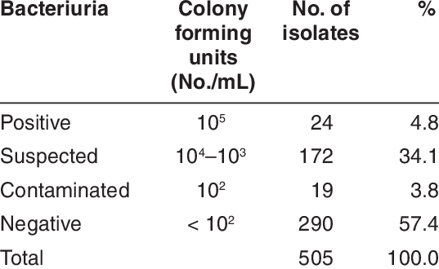

Slide 22
Asymptomatic Bacteriuria:
Significant bacteriuria in the absence of symptoms in the patient.
Cystitis:
Syndrome of frequency, dysuria and urgency,
Usually suggests infection restricted to the lower urinary tract, (the bladder and urethra).
Urethral syndrome:
Syndrome of frequency and dysuria in the absence of significant bacteriuria with a conventional pathogen

Slide 23
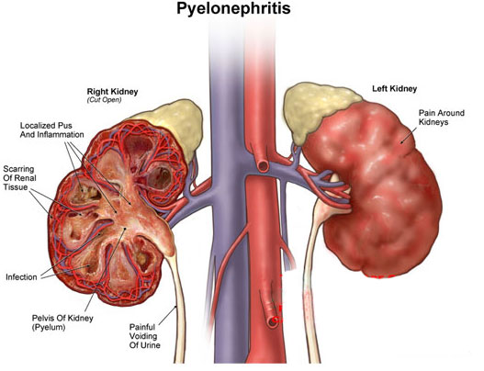
Acute pyelonephritis:
An acute infection of one or both kidneys.
Usually, the lower urinary tract is
also involved.

Slide 24
Chronic pyelonephritis:
IT IS confusing term used in different ways:
Continuous excretion of bacteria from the kidney,
Frequent recurring infection of the renal tissue,
Particular type of pathology of the kidney seen microscopically or by radiographic imaging, which may or may not be due to infection.
Although chronic infections of renal tissue are relatively rare, they do occur in the presence of kidney stones and in tuberculosis.

Slide 25
Aetiology and risk factors
AGE & GENDER
Causative Bacterium
Underlying Structural Abnormalities
Hospital-acquired urinary infections

Slide 26
AGE & GENDER
UTI is a problem in all age groups.
In infants up to the age of 6 months… much more common in boys than in girls.
In preschool children and adult … the prevalence is more in girls.
In the elderly, the prevalence of bacteriuria rises dramatically in both sexes.

Slide 27
Causative Bacterium
(80%) Escherichia coli is the most common
(20%) Gram-negative enteric bacteria such as Klebsiella and Proteus species, and by Grampositive cocci, particularly enterococci and Staphylococcus saprophyticus.
Rare causes: anaerobic bacteria and fungi
Viruses (in immunocompromised patients, particularly children)

Slide 28
Underlying Structural Abnormalities
Congenital anomalies,
Neurogenic bladder,
Obstructive uropathy, is often caused by more resistant organisms such as
Pseudomonas aeruginosa,
Enterobacter and Serratia species

Slide 29

Acquired
Hospital-acquired urinary infections,
Including those in patients with urinary catheters.

Slide 30
Pathogenesis
There are three possible routes by which organisms might reach the urinary tract:
The Ascending,
Blood-borne,
Lymphatic routes.

Slide 31
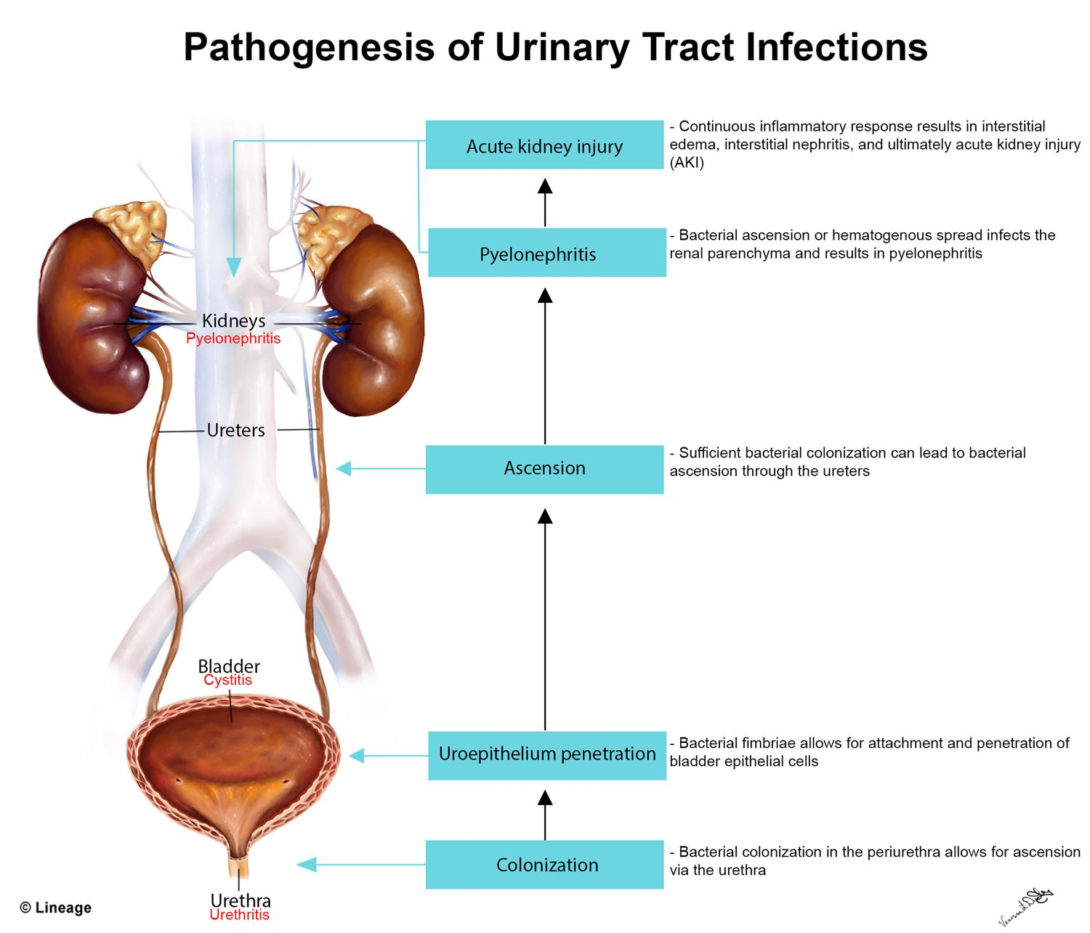
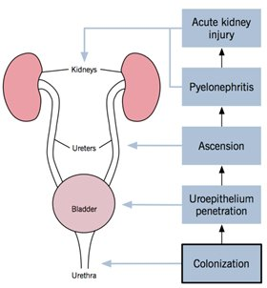

Slide 32
Why women more than men?
The urethra in women is shorter than in men,
The urethral meatus is closer to the anus,
Further, sexual intercourse appears to be important in forcing bacteria into the female bladder,
The risk is increased by the use of diaphragms and spermicides, which have both been shown to increase E. coli growth.

Slide 33
Natural defence mechanisms
High urea concentration and
Extremes of osmolality and pH inhibit pathologic growth.
The flushing mechanism of bladder emptying,
The bladder mucosa, by virtue of a surface glycosaminoglycan, is intrinsically resistant to bacterial adherence.
If infection occur---WBC are mobilized to the bladder surface to ingest and destroy invading bacteria.

Slide 34
Abnormalities of the urinary tract
Structural abnormality leading to the obstruction of urinary flow increases the likelihood of infection.
Such abnormalities:
Congenital anomalies of the ureter or urethra,
Renal stones and,
Enlargement of the prostate (in men).
Renal stones can become infected with bacteria, particularly Proteus and Klebsiella species, and thereby become a source of ‘relapsing’ infection.

Slide 35
Clinical manifestations
Babies and infants
Failure to thrive, vomiting, fever, diarrhoea and apathy
Misdiagnosed because the signs may not be referable to the urinary tract.
Prognosis:
Renal scarring,
Chronic pyelonephritis in adulthood,
Hypertension and
Renal failure.

Slide 36
Clinical manifestations
Children
Classic symptoms such as frequency, dysuria, haematuria.
Acute abdominal pain and vomiting

Slide 37
Clinical manifestations
Adults
Lower UTI
Frequency, Dysuria, Urgency, Haematuria.
Acute pyelonephritis (upper UTI)
Fever, Rigors and Loin Pain in addition to lower tract symptoms.
Systemic symptoms may vary from insignificant to extreme malaise.,
Untreated cystitis in adults rarely progresses to pyelonephritis, and bacteriuria does not seem to carry the adverse long-term consequences that it does in children.

Slide 38
Clinical manifestations
Elderly
UTI is one of the most frequent causes of admission to hospital.
Majority of cases are asymptomatic.
Symptoms are not diagnostic because frequency, dysuria, hesitancy and incontinence are common in elderly people without infection.
The infection may be the cause of deterioration in pre-existing conditions such as diabetes mellitus or congestive cardiac failure.

Slide 39
Investigations
The key to successful laboratory diagnosis of UTI lies in obtaining an uncontaminated urine sample for microscopy and culture.
Specimens must reach the laboratory within 1–2 h or should be refrigerated; otherwise, any bacteria in the specimen will multiply and might give rise to a false-positive result.

Slide 40
Treatment
Symptomatic UTI usually merits antibiotic treatment to eradicate both symptoms and pathogen.
Asymptomatic bacteriuria may or may not need treatment depending upon the circumstances of the individual case.
Bacteriuria in children and in pregnant women requires treatment, as does bacteriuria present when surgical manipulation of the urinary tract is to be undertaken, because of the potential complications.

Slide 41
Non-specific treatments
Drink a lot of fluids
Frequent bladder emptying.
Urinary Analgesics such as potassium or sodium citrate, which
Alkalinise the urine, but these should be used as an adjunct to antibiotics. (but not nitrofurantoin)

Slide 42
Antimicrobial
Blood levels of antibiotics appear to be unimportant in the treatment of lower UTI; what matters is the concentration in the urine.
However, blood levels probably are important in treating pyelonephritis, which may progress to bacteraemia.

Slide 43
Treatment of Cystitis
Oral treatment include:
Trimethoprim,
β-lactams, particularly amoxicillin, co-amoxiclav and cefalexin,
Fluoroquinolones (ciprofloxacin, norfloxacin and ofloxacin),
Nitrofurantoin.
Intravenous administration include:
β-lactams such as amoxicillin and cefuroxime,
Quinolones,
Aminoglycosides such as gentamicin.

Slide 44
In renal failure…
Agents of choice for treating UTI in the presence of renal failure are:
Penicillins and Cephalosporins attain satisfactory concentrations and are relatively non-toxic,
It may be difficult to achieve adequate therapeutic concentrations of some drugs in the urine, particularly nitrofurantoin and quinolones.
Further, accumulation and toxicity may complicate the use of aminoglycosides.

Slide 45
Antibiotic resistance
Extended-spectrum β-lactamase (ESBL-E. coli) is often pathogenic, result in bacteremia with resultant mortality…
(ESBL) bacteria producing enzymes destroy almost all commonly used β-lactams EXCEPT the carbapenem,
Most penicillins and cephalosporins largely useless in clinical practice.
Clavulanic acid is β-lactamase inhibitor, (co-amoxiclav)
ESBL Multiresistant to non-β-lactam antibiotics too, such as quinolones, aminoglycosides and trimethoprim.

Slide 46
Uncomplicated lower UTI
Treatment in adult
Trimethoprim,
Oral cephalosporin such as cefalexin,
Co-amoxiclav or
Nitrofurantoin,
The quinolones are best reserved for treatment failures and more
difficult infections,
Overuse of these important agents is likely to lead to an increase in resistance.

Slide 48
Duration of treatment
Traditionally, a course of 7–10 days (β-Lactams)
Short-course regimens for 3-days (trimethoprim and quinolones).
Or even single-dose therapy.
Single-dose therapy, advantages:
Low cost, good adherence and the minimisation of side effects,
Disadvantages:
Less effective than when the same agent is used for longer.

Slide 49
Treatment in Children
The drugs of choice include:
β-lactams,
Trimethoprim and
Nitrofurantoin.
Quinolones are relatively contraindicated in children because of the theoretical risk of causing cartilage and joint problems.
Children should be treated for 7–10 days.

Slide 50
Acute pyelonephritis
Severely ill patient ------
A first-choice agent would be Parenteral antibiotic:
Cefuroxime,
Gentamicin or
Ciprofloxacin.
When the patient is improving, switch to oral therapy, like Quinolone for 10–14 days.
Less severely ill patient…
Oral antibiotic with a shorter course

Slide 51
In hospital-acquired pyelonephritis
Start with a broad-spectrum agent such as:
Ceftazidime,
Ciprofloxacin,
Meropenem.
There is a risk that the infecting organism may be resistant to the usual first-line drugs.

Slide 53
Relapsing UTI
The main causes of persistent relapsing UTI are:
Renal infection,
Structural abnormalities of the urinary tract and,
In men, chronic prostatitis.

Slide 54
Catheter-associated infections
Even with the very best catheter care, most will have infected urine after 10–14 days of catheterisation,
The principles of antibiotic therapy for catheter-associated UTI as follows:
Do not treat asymptomatic infection.
If possible, remove the catheter before treating symptomatic infection.

Slide 55
Bacteriuria of Pregnancy
5% have asymptomatic bacteriuria.
A third of these women proceed to develop acute pyelonephritis.
Asymptomatic bacteriuria is associated with:
Low birth weight,
Prematurity,
Hypertension,
Preeclampsia.
The drugs of choice are amoxicillin or cefalexin or nitrofurantoin, 7 days of treatment

Slide 56
Prevention and prophylaxis
Adult only
long-term, low dose (Once) of:
Trimethoprim (100 mg) or
Nitrofurantoin (50 mg) at night will suffice.

Slide 57
Thank you

