Slide 1
Mixing
Lab 7

Slide 2
Definition
Mixing
A process that results in a randomization of dissimilar particles within a system.

Slide 3
Solid Mixing and their mechanisms

Slide 4
The variables effecting solid mixing:
NOTE:
Free flowing powders tend to segregate during or after mixing.
Highly cohesive powders are difficult to mix owing to agglomeration.
1- Particle size and particle size distribution
2- Particle density, elasticity, surface roughness and shape.

Slide 5
Mixing mechanisms
Solid mixing proceeds by the combination of one or more mechanism:
Convective mixing
Shear mixing
Diffusive mixing

Slide 6
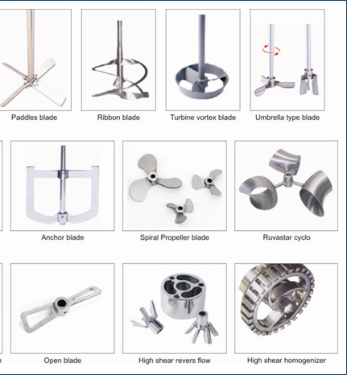
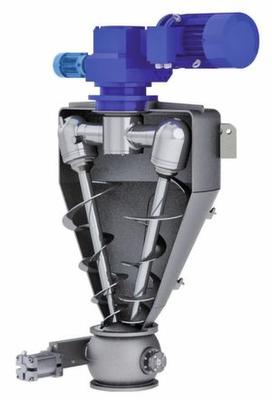
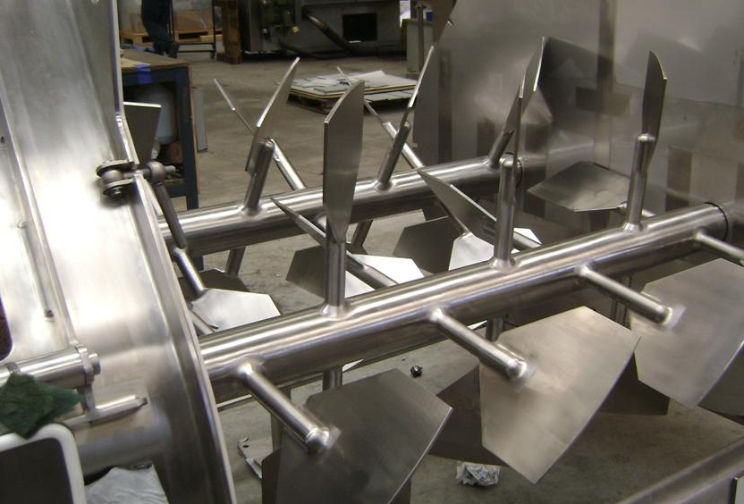
1. Convective mixing (Non- segregating)
Mechanism analogous to bulk transport
Convective (bulk) mixing occurred by: Inversion of powder bed
By the aid of:
A- Blades or paddles
B- Revolving screw
C- Any method of moving large mass of material from one part of powder bed to another.

Slide 7
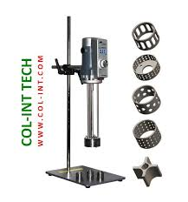
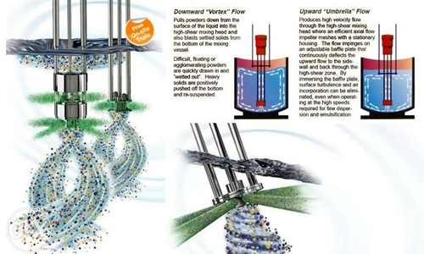
2. Shear mixing
(segregating)
As a result of forces within mass
slip planes
Depending on the flow characteristic of powder, that can occur in such a way to give rise to [laminar flow]
When shear occurs between regions of different composition and parallel to their interface.
Reduce the scale of segregation by thinning the dissimilar layers

Slide 8
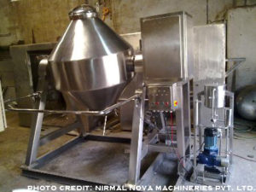
3- Diffusive mixing
(segregating)
Random motion of particles within a powder bed
Change position by single particles relative to one another
Reduction intensity of segregation
It occurs at the interface of dissimilar particles in shear mixing or any form of agitation that cause random motion of individual particles.

Slide 9
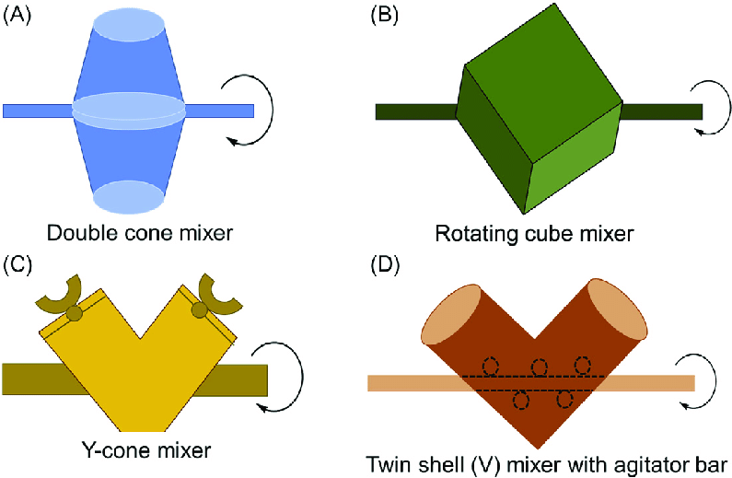
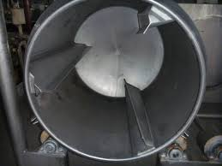
Equipments For solid mixing
Batch Mixing
1- tumbling mixers
Mixers consist of containers of one or several geometric forms (mounted and rotated about an axis).
Tumbling motion by baffles or by virtue of shape of container

Slide 10
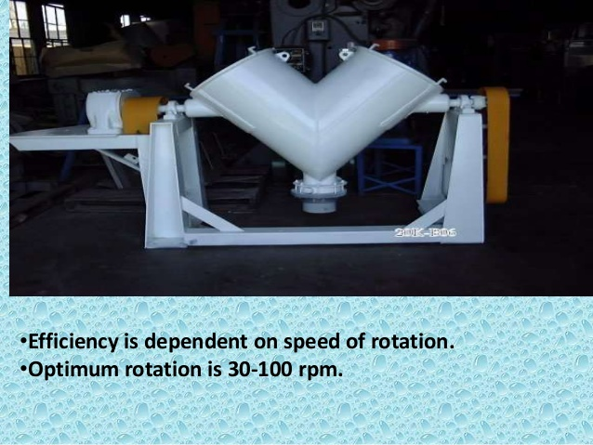
twin-shell blender (form V-shape mixers)
Effective because it’s mechanism of mixing is:
Bulk transport and shearing.
Efficiency is dependent on speed of rotation.
Optimum rotation (30 - 100 rpm).
Used for dry solid mixing.

Slide 11
2- Stationary container type:
Employs stationary container to hold the material and bring mixing by moving screws, paddles or blades.
Useful in mixing solids that have been wetted and therefore are in sticky or plastic state.

Slide 12
Well known stationary mixers include:
Ribbon blender
Consist of horizontal cylindrical tank usually opening at the top and fitted with helical blades.
Blades mounted on the shaft through the long axis of tank and have both right and left hand twist.

Slide 13
Helical flight mixers
Powders are lifted by a centrally located vertical screw and allowed to cascade to the bottom of the tank.

Slide 14
Mixer selection
Mixer selection and evaluation depend on:
1- Measuring degree of mixing
[according to the uniformity of powder bed that indicates the function of mixer ].
2- Power requirements
[power required to produce good mixture with appropriate time].
NOTE:- Unmixing and segregation might result from:
1- Improper mixing operation or wrong mixer or both,
2- After prolong mixing the milling occur because of abrasion of particles.
3- Powder properties that affecting solid mixing process.

Slide 15
For more informations, Follow the underlying links
https://www.youtube.com/watch?v=WRhCYNoIq-4
https://www.youtube.com/watch?v=jRkRLPnAWh0
https://www.youtube.com/watch?v=Aja9xbzcuG0
https://www.youtube.com/watch?v=DFUheo3biIc

