Slide 1
Milling
Lab-6-

Slide 2
Introduction
Milling: Is a mechanical process of reducing particle size of solids.
Milling also termed synonymously as comminution which represent:
Crushing
Disintegration
Dispersion
Grinding
Pulverization
All of these depend on product, equipment and process.
https://www.youtube.com/watch?v=cA7gG8gbj8I

Slide 3
Introduction- Milling equipment
Milling equipment classified according to the size of the milled product into:
Coarse milling (particles > 20-mesh)
Intermediate (particles 200- 20 mesh [74-840 micron])
Fine (particles < 200 mesh)

Slide 4
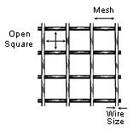
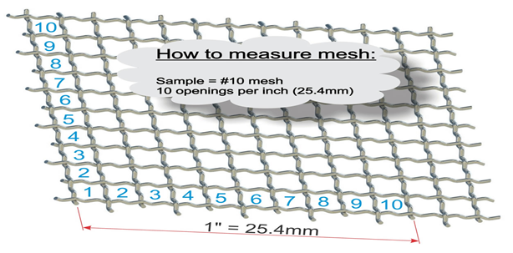
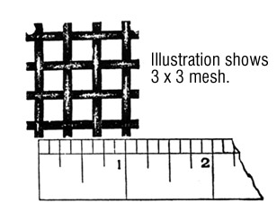
Note: Size expressed in term of mesh (number of openings per linear inch of a screen).

Slide 5
Pharmaceutical Applications
Increasing therapeutic efficacy of low solubility drugs due to increasing specific surface area (S.A per unit wt.) thus increasing area of contact with dissolving fluid, e.g. griseofulvin.
Facilitate drying of wet masses due to increase surface area and reduce the distance ( thickness) the moisture travel within particle to reach outer surface, e.g. granulation of wet mass in tablet preparation.
Facilitate easier and uniform mixing or blending
The ingredients are approximately of same size.
1
2
3

Slide 6
Pharmaceutical Applications
Solid dosage form that is artificially colored are often milled (to ensure that the mixture is not mottled and is uniform from batch to batch).
Lubricants should be milled to fine powder (to ensure their ability to coat surface of powder or granules).
Milling in ointments, creams and pastes provide smooth texture, better appearance and improve physical stability.
4
5
6
https://www.youtube.com/watch?v=i35IC8aCjXE

Slide 7
Size Distribution and Measurement
In naturally occurring particulate solids and milled solids.
The shape of particle is irregular, and size varies from largest to smallest size
Size distribution used instead of particle size
Which represents % frequency of each particle size (i.e what size present in what proportion)
%
Bell shape structure
Normal or Gaussian distribution if not then (Skewed distribution)

Slide 8
Methods of Measurement of Size Distribution
1
Microscopy
2
Sieving
3
Sedimentation
4
Other methods (sorption, electrical conductivity, light and x-ray scattering, permeametry, and particle trajectory).
https://www.youtube.com/watch?v=QQTb5JMQ4-s
https://www.youtube.com/watch?v=Gmhc7hsY7P4

Slide 9
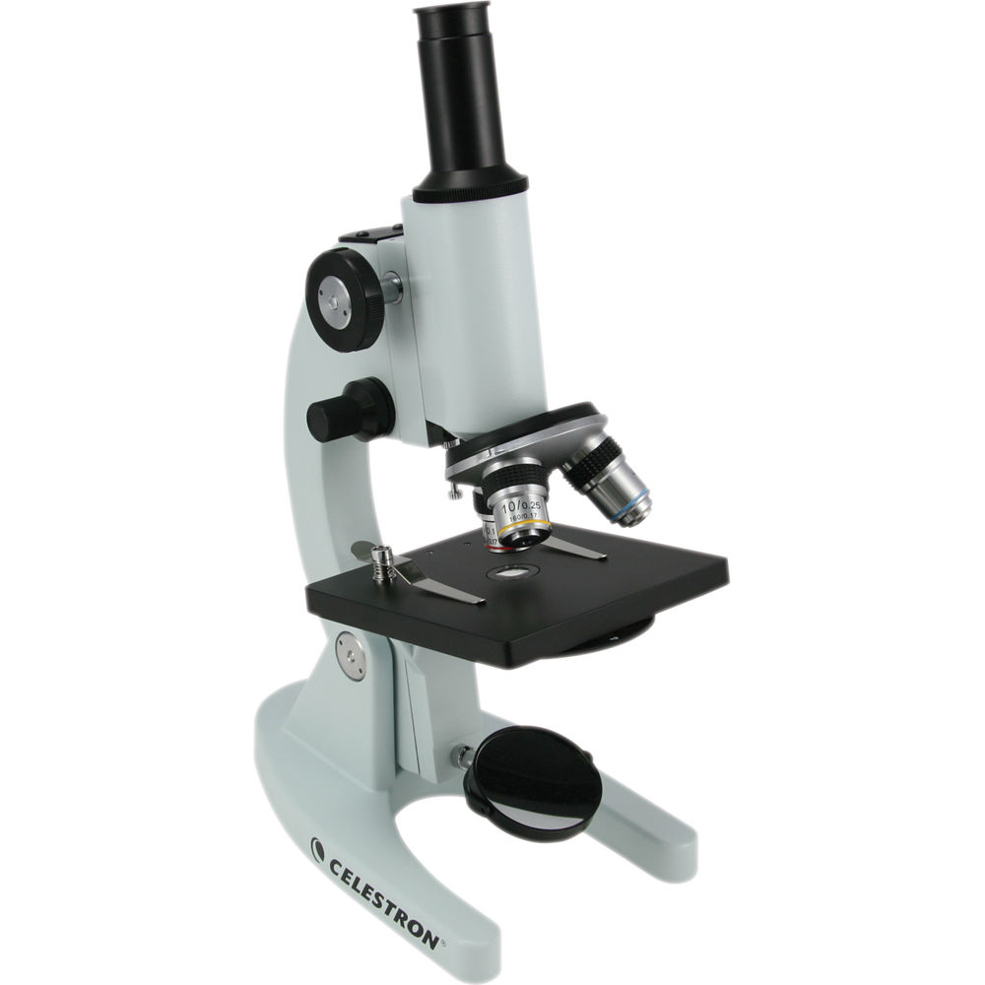
1- Microscopy
Direct Method for measuring P.S. distribution.
Disadvantages: can’t resolve particles if it’s size is close to the wave length of the light source.
https://www.youtube.com/watch?v=_CkcYrns-6I
https://www.youtube.com/watch?v=JuRyaDxERF4

Slide 10
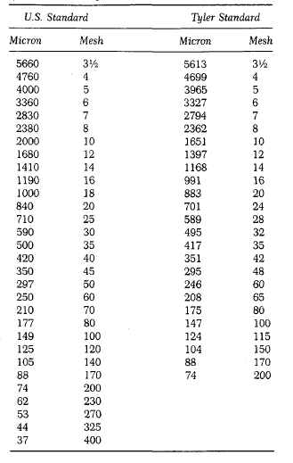
2- Sieving
It is pan with bottom of wire cloth with square openings.
Most widely method for measuring P.S. distribution.
Advantages: Inexpensive, simple, rapid, limited variation between operators.
https://www.youtube.com/watch?v=3Xqq1cxhD-s
https://www.youtube.com/watch?v=XYC5YM_AxoM

Slide 11
2- Sieving
Measuring diameter of powder bypass series of sieves:
30-mesh and retained on 45-mesh (diameter= 590 + 350)/2 or 470 microns.
Size of distribution effected by
1- No. of Sieves
(by passing powder through series of smaller sieves and weighing portion retained on each sieve).
2- Motion of sieve (vibratory, side-tap, bottom-tap, rotary-tab, rotary).
3- Time of sieving.
4- Load or thickness of powder (proportional to time).

Slide 12
Milling operations
A- open-circuit milling:
Materials is reduced to the desired size by passing it through the mill.
B- closed-circuit milling:
Materials discharge from mill pass through classifier or size-separation device, and the oversize are returned to the grinding chamber for further reduction in size.
https://www.youtube.com/watch?v=XYC5YM_AxoM
https://www.youtube.com/watch?v=f25qZT7ZZkM

Slide 13
Parts of mills
2- Grinding part (milling chamber)
3- Discharge part (Receiver)
1- Feed part

Slide 14
Important Note
The rate of discharge should be equal to the rate of feed.
A- If rate of feed is slow
B- If rate of feed is fast
the product discharge readily and the amount of undersize or fines is minimized.
the material remain in the milling chamber for long time because its discharge is impeded by large amount of material leads to greater size reduction and lower mill capacity.

Slide 15
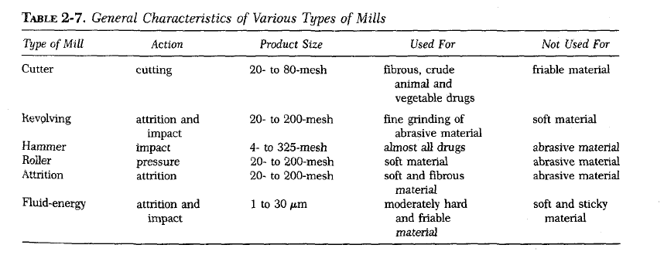
Types of Mills

Slide 16
Mechanism of size reduction
Cutting: materials cut by sharp blades
Compression: materials is crushed by pressure.
Impact: stationary materials hit moving materials at high speed or strikes a stationary surface (case of machine) shatters of materials to small pieces.
Attrition: materials subjected to pressure and surfaces are moving relative to each other shear forces which breaks particles.

Slide 17
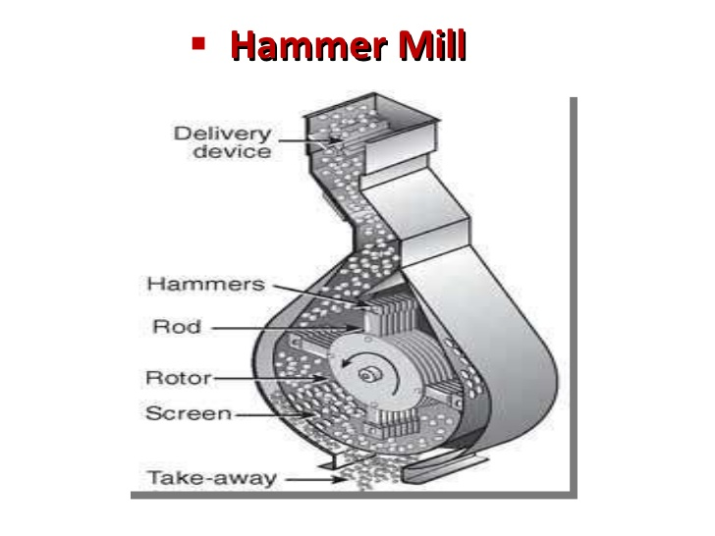
Hammer mill
Used for almost any type of size reduction (dry material, wet filter-press cakes, ointment, slurries).
It is popular in pharmaceutical industry because of versatility
Principle:
Operates as an impact between rapidly moving hammers mounted on the rotor and the powder material.
https://www.youtube.com/watch?v=fSTvbE77ucE
https://www.youtube.com/watch?v=odd9M_v18z0

Slide 18
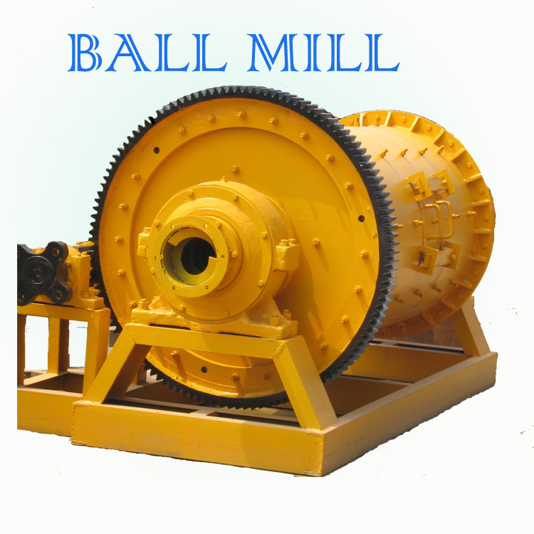
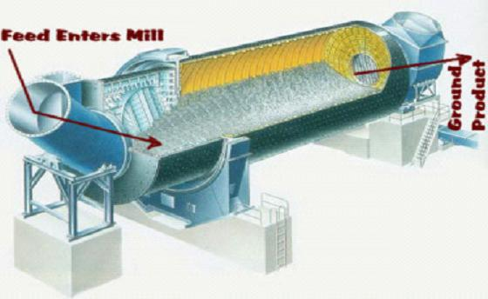
Ball mill
Principle:
Combination of impact and attrition.
A horizontal rotating hollow vessel of cylindrical shape filled with balls of steel or pebbles (grinding medium).
It includes
A- Pebble mill
B- Rods or bars mill
https://www.youtube.com/watch?v=L6sgGXXYdEU

Slide 19
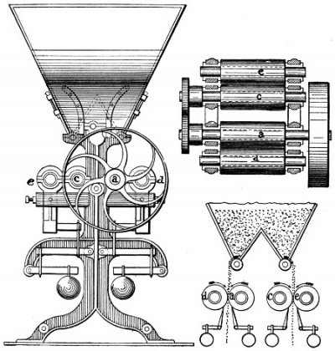
roller mill
Principle:
combination of compression and shearing action.
Mechanism of action:
2-5 smooth rollers operating at different speed.
https://www.youtube.com/watch?v=yffPcrHcy3c

Slide 20
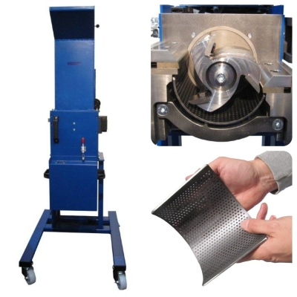
cutting mill
Principle: cutting and shearing action
Uses: for fibrous and tough material.
Types: single and double runner disc mills.
https://www.youtube.com/watch?v=1FVHv3SVxUk

Slide 21
Procedure
weigh the beaker (200 g).
weigh the brown sugar granules (150 g) in a beaker and subtract from the weigh of the beaker.
350 g (weight of beaker + brown sugar)
Mill the brown sugar in the hammer mill for 1 min to allow the powder to pass through the sieve [18 mesh] then weigh the remaining.
Sieve the remaining powder through series of sieves (0.59 mm [30 mesh], 0.297 mm [50 mesh], 0.210 mm [70 mesh] and weigh the powder remaining.

Slide 22
Whole Weight of brown sugar = 150 g
Particle size | Wt. of sugar retained | Cumulative wt. retained | % cumulative retained | % pass (100 - % cumulative)
1 mm | 2 g | 2 g | 2/150 x 100 = 1.33 % | 100 – 1.33 = 98.67%
0.59 mm | 14 g | 16 g | 16/150 x 100 = 10.66% | 100 - 10.66 = 89.34%
0.297 mm | 36 g | 52 g | 52/150 x 100 = 34.66% | 100 – 34.66 = 65.34%
0.21 mm | 97 g** | 149 g | 149/150 x 100 = 99.3% | 100 – 99.3 = 0.7%
* This means that most of sugar can not pass through the sieve
https://www.youtube.com/watch?v=JcLtXblqqGg

Slide 23
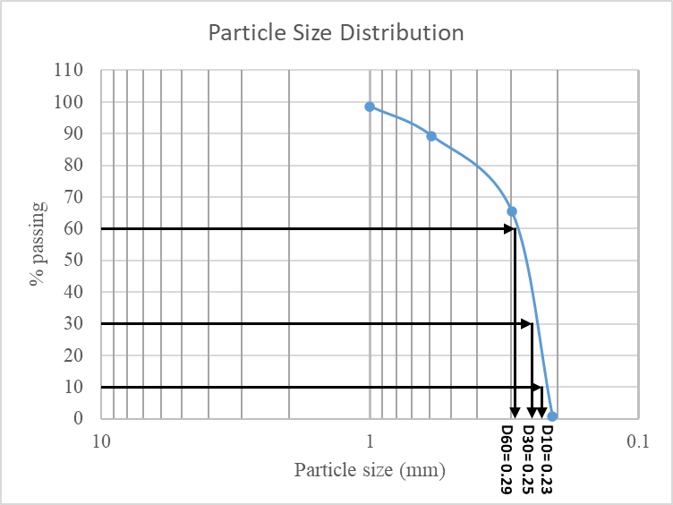
https://www.youtube.com/watch?v=o5fTAuwSGRE

Slide 24


