Slide 1
cardiovascular system
Lipid Regulating Drugs
Msc sura abbas
Clinical pharmacy dept.
4th stage

Slide 2
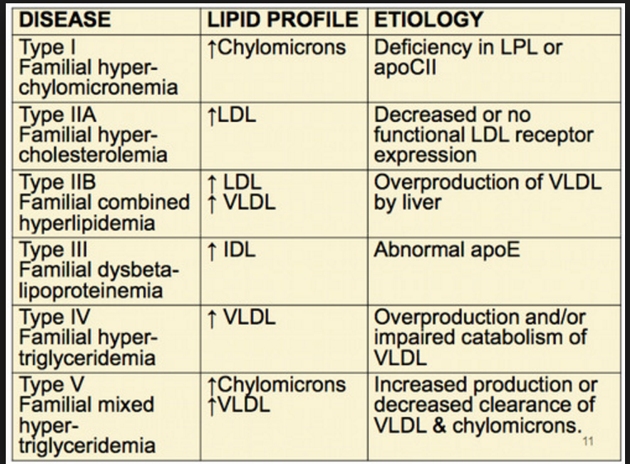

Slide 3
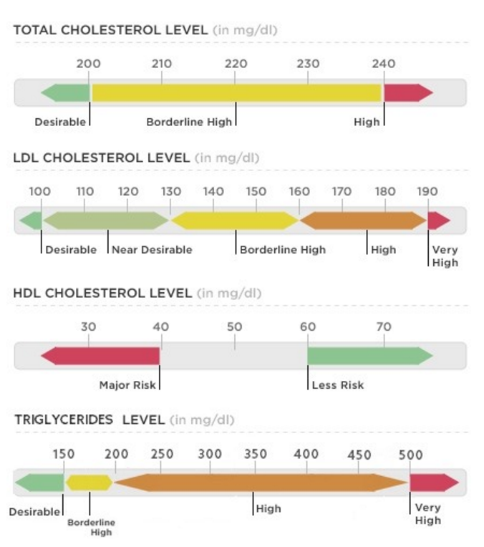
Normal lipid profile levels

Slide 4
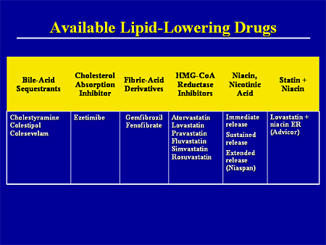

Slide 5
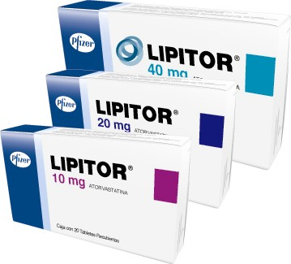
Statin

Slide 6
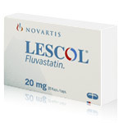
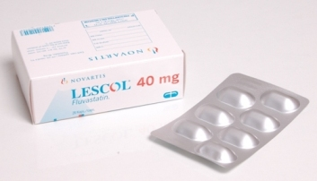
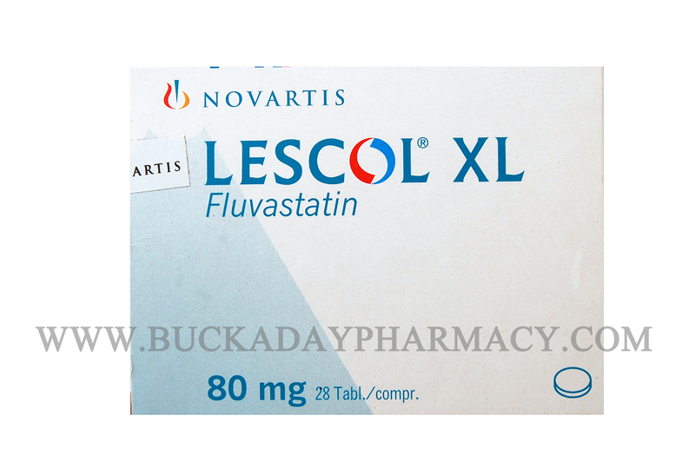

Slide 7
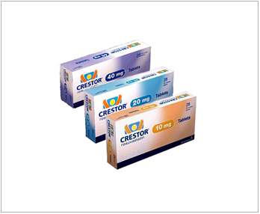

Slide 8
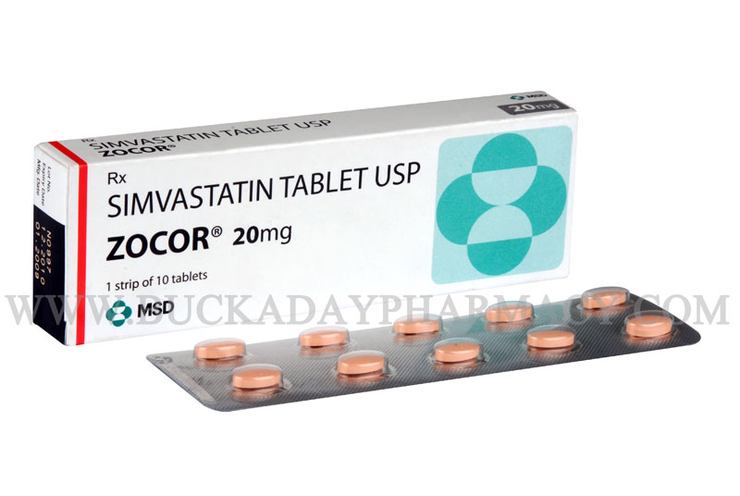
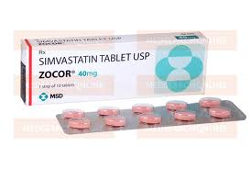

Slide 9
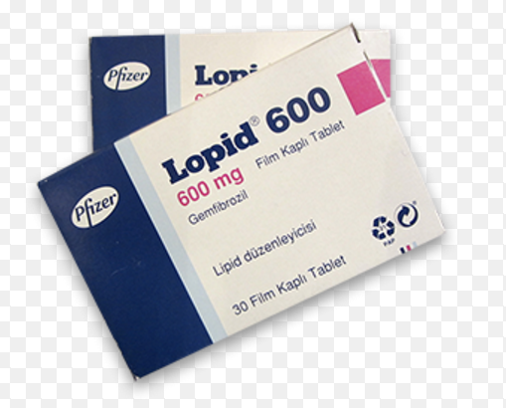
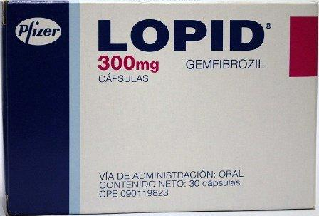
Fibrate

Slide 10
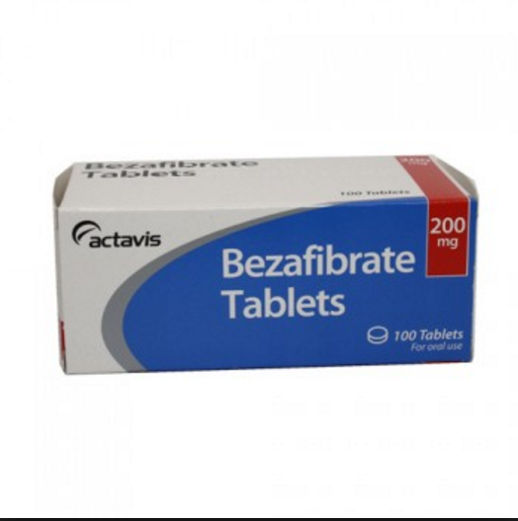
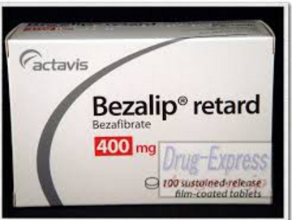
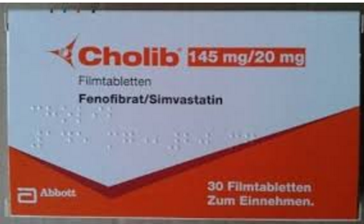

Slide 11
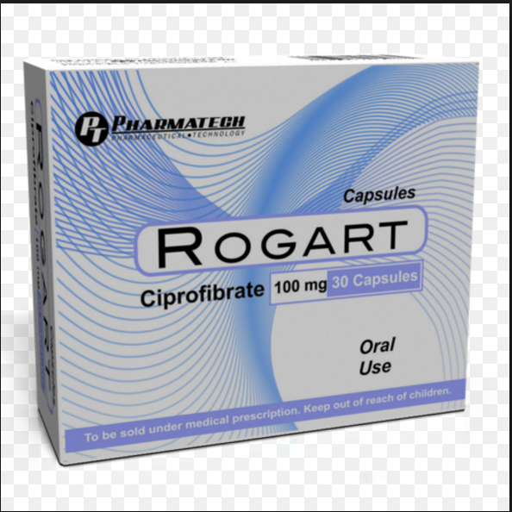
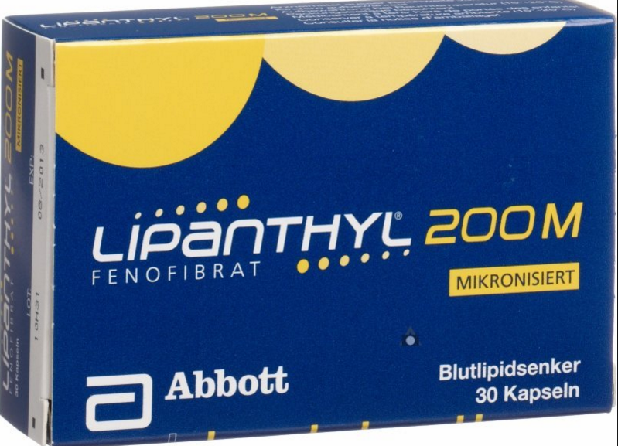

Slide 12
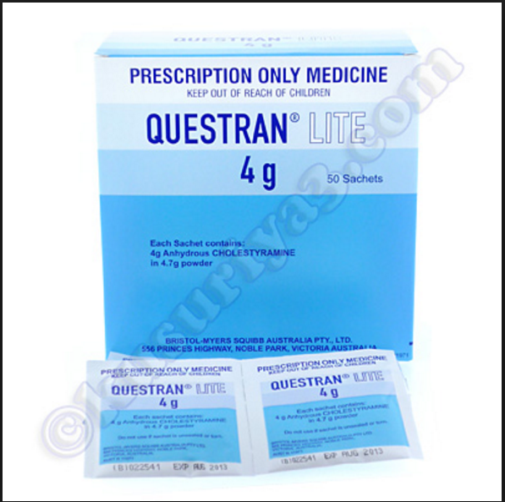
Bile acid sequestrants

Slide 13
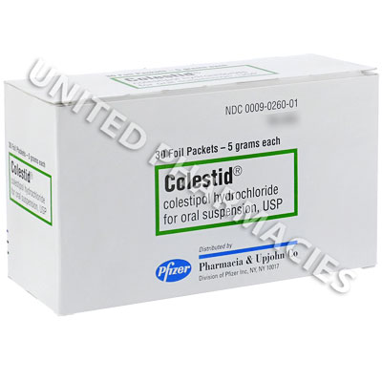
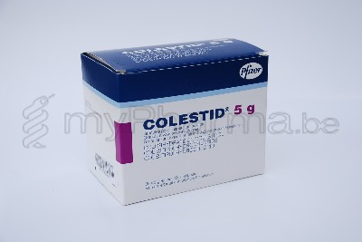

Slide 14
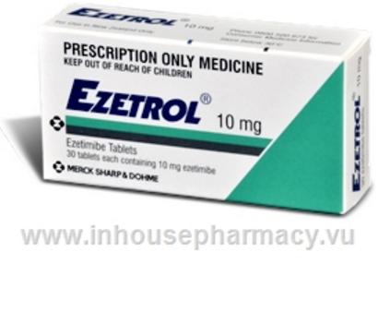
Cholesterol absorption inhibitors (Ezetimibe)

Slide 15
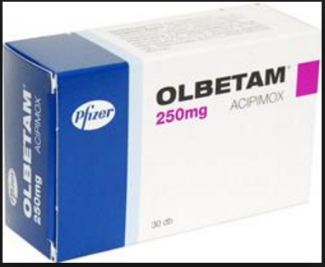
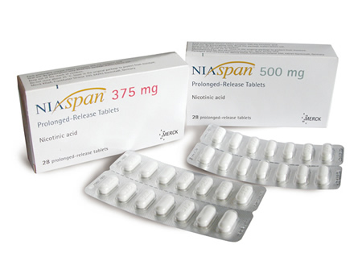
Nicotinic Acid derivatives

Slide 16
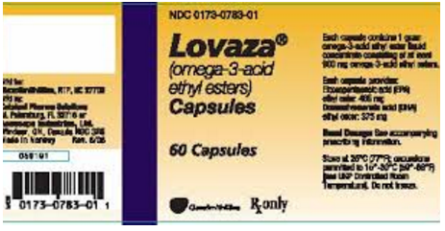
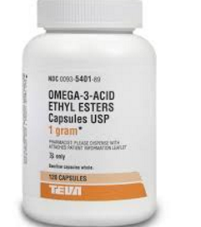
Omega-3-acid ethyl esters

Slide 17
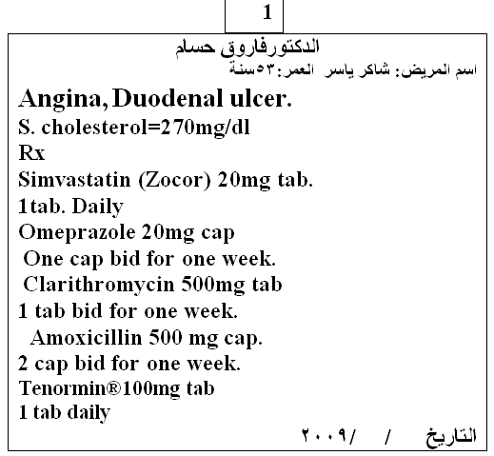
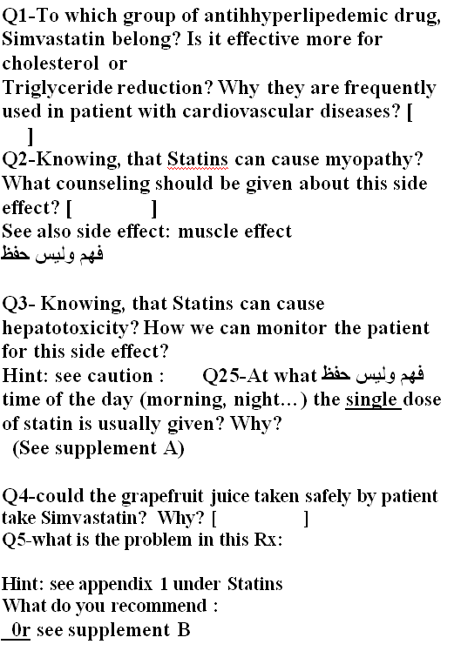
Cases

Slide 18
cases
name: mohammed ali age:55 y
Serum TG = 400 mg\dl, BP 160\90
Rx:
Fenofibrates 200 mg 1*1
Lisinopril 10 mg 1*1
Aspirin 100 mg 1*1
Q1\ to which antihyperlipidemic gp fenofibrates belong?
Q2\ what are caution, CI, common SE?
Q3\If you administer fenofibrates to this patient what are the counselling advices or patient education and advisory label will you provide?
Q4\ is it effective more for lowering cholesterol or TG ?
Q5\ if the patient return to you and ask for cheaper alternative with same effect what will you suggest with max doses?

Slide 19


