Slide 1
Cardiovascular system part 2
Assist. Lec. Sura abbas
Assist. Lec. Lubab tareq

Slide 4
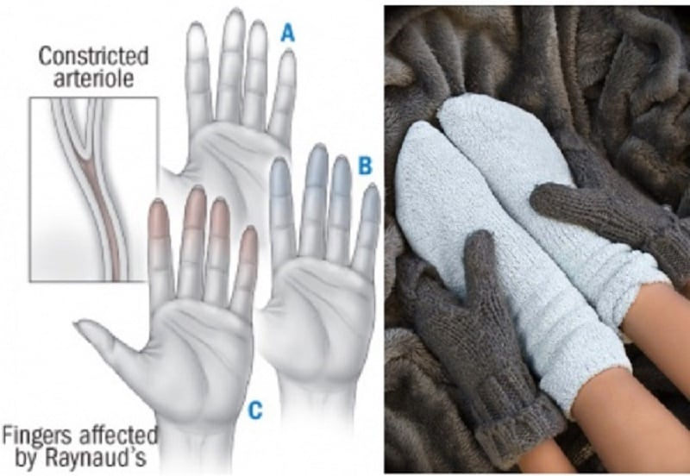
Adverse effects of BB
Beta blockers are generally well tolerated and most adverse effects are mild and transient.
Reactions may be more severe after intravenous than oral doses;
ocular use has also been associated with systemic adverse effects.
Among the most serious adverse effects are heart failure, hypotension, heart block, and bronchospasm.
fatigue and coldness of the extremities; when beta blockers are used for long-term treatment of asymptomatic diseases such as hypertension, such effects may be an important determinant of patient compliance

Slide 5
Adverse effects of BB
Cardiovascular effects include bradycardia and hypotension; heart failure or heart block may be precipitated or worsened in patients with underlying cardiac disorders. Abrupt withdrawal of beta blockers may exacerbate angina and may lead to sudden death.
Bronchospasm, shortness of breath, and dyspnoea may be precipitated, particularly in patients with a history of obstructive airways disease, due to blockade of beta2 receptors in bronchial smooth muscle. Drugs with selectivity for beta1 receptors or with intrinsic sympathomimetic activity at beta2 receptors may be less likely to induce bronchospasm
CNS effects include headache, depression, dizziness, hallucinations, confusion, amnesia, and sleep disturbances including nightmares. Coma and convulsions have been reported after beta-blocker overdosage. Beta blockers that are lipid soluble are more likely to enter the brain and would be expected to be associated with a higher incidence of CNS adverse effects,

Slide 6
Adverse effects of BB
Adverse gastrointestinal effects include nausea and vomiting, diarrhoea, constipation, and abdominal cramping.
Beta blockers interfere with carbohydrate and lipid metabolism and can produce hypoglycaemia, hyperglycaemia, and changes in blood concentrations of triglycerides and cholesterol
Skin rash, pruritus, exacerbation of psoriasis, excess sweating, and reversible alopecia have occurred with use of beta blockers.

Slide 7
Adverse effects of BB
Decreased tear production, blurred vision, conjunctivitis, and soreness are among the ocular symptoms that have been reported.
Haematological reactions include nonthrombocytopenic purpura, thrombocytopenia, and rarely agranulocytosis. Transient eosinophilia can occur.
An asymptomatic increase in antinuclear antibodies has occurred with many beta blockers; SLE has also been reported.
Other adverse effects reported with some beta blockers include dry mouth, raised liver enzymes, male impotence, sclerosing peritonitis, and retroperitoneal fibrosis.

Slide 9
Other Uses of Beta- blockers:
Beta-blockers can be used to control the pulse rate in patients with phaeochromocytoma. However, they should never be used alone as beta-blockade without concurrent alpha-blockade may lead to a hypertensive crisis
2. Thyrotoxicosis (Beta-blockers are used in pre-operative preparation for thyroidectomy. Administration of propranolol hydrochloride can reverse clinical symptoms of thyrotoxicosis within 4 days.
3. Beta-blockers have been used to alleviate some symptoms of anxiety; probably patients with palpitation, tremor, and tachycardia respond best.

Slide 10
contraindiactions
Asthma . cardiogenic shock . hypotension . marked bradycardia . metabolic acidosis . phaeochromocytoma (apart from specific use with alphablockers) Prinzmetal’s angina . second-degree AV block . severe peripheral arterial disease . sick sinus syndrome .third-degree AV block . uncontrolled heart failure

Slide 11
CONTRA-INDICATIONS, FURTHER INFORMATION
▶ Bronchospasm Beta-blockers, including those considered to be cardioselective, should usually be avoided in patients with a history of asthma, bronchospasm or a history of obstructive airways disease.
However, when there is no alternative, a cardioselective beta-blocker can be given to these patients with caution and under specialist supervision. In such cases the risk of inducing bronchospasm should be appreciated and appropriate precautions taken.

Slide 12
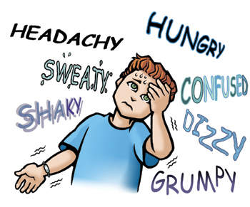
Cautions:
Diabetes . first-degree AV block . history of obstructive airways disease (introduce cautiously) . myasthenia gravis . portal hypertension (risk of deterioration in liver function) . psoriasis . symptoms of hypoglycaemia may be masked . symptoms of thyrotoxicosis may be masked

Slide 13
Caution is advised in patients with a history of hypersensitivity—may increase sensitivity to allergens and result in more serious hypersensitivity response.
Furthermore beta-adrenoceptor blockers may reduce response to adrenaline (epinephrine).
PREGNANCY Beta-blockers may cause intra-uterine growth restriction, neonatal hypoglycaemia, and bradycardia; the risk is greater in severe hypertension.

Slide 14
Breast feeding and monitoring parameters
With systemic use in the mother, infants should be monitored as there is a risk of possible toxicity due to beta-blockade. However, the amount of most betablockers present in milk is too small to affect infants.
Monitor lung function (in patients with a history of obstructive airway disease).

Slide 15
Treatment cessation
Avoid abrupt withdrawal especially in ischaemic heart disease. Sudden cessation of a beta-blocker can cause a rebound worsening of myocardial ischaemia and therefore gradual reduction of dose is preferable when beta-blockers are to be stopped.

Slide 16
carvedilol
INDICATIONS AND DOSE
Hypertension
▶ BY MOUTH ▶ Adult: Initially 12.5 mg once daily for 2 days, then increased to 25 mg once daily; increased if necessary up to 50 mg daily, dose to be increased at intervals of at least 2 weeks and can be given as a single dose or in divided doses
▶ Elderly: Initially 12.5 mg daily, initial dose may provide satisfactory control
Adjunct to diuretics, digoxin, or ACE inhibitors in symptomatic chronic heart failure
▶ BY MOUTH▶ Adult: Initially 3.125 mg twice daily, dose to be taken with food, then increased to 6.25 mg twice daily, then increased to 12.5 mg twice daily, then increased to 25 mg twice daily, dose should be increased at intervals of at least 2 weeks up to the highest tolerated dose, max. 25mg twice daily in patients with severe heart failure or body-weight less than 85 kg; max. 50mg twice daily in patients over 85 kg

Slide 17
HEPATIC IMPAIRMENT Manufacturer advises avoid in severe impairment. Dose adjustments Manufacturer advises dose adjustment may be required in moderate impairment.
MONITORING REQUIREMENTS Monitor renal function during dose titration in patients with heart failure who also have renal impairment, low blood pressure, ischaemic heart disease, or diffuse vascular disease.
MEDICINAL FORMS. Forms available from special-order manufacturers include:
oral suspension
Tablet
CAUTIONARY AND ADVISORY LABELS 8
▶ Carvedilol (Non-proprietary) 3.125 mg, 6.25mg, 25 mg

Slide 18
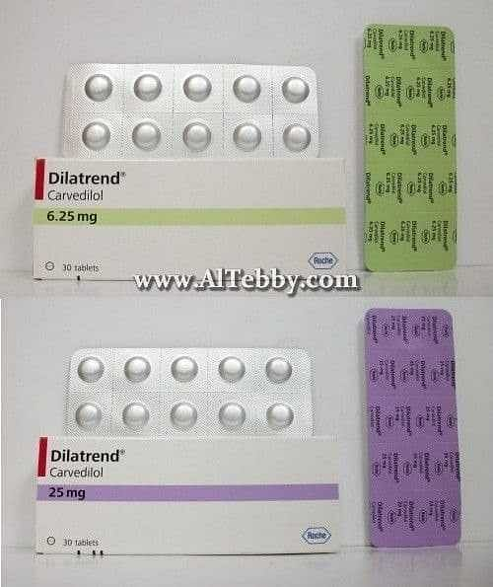
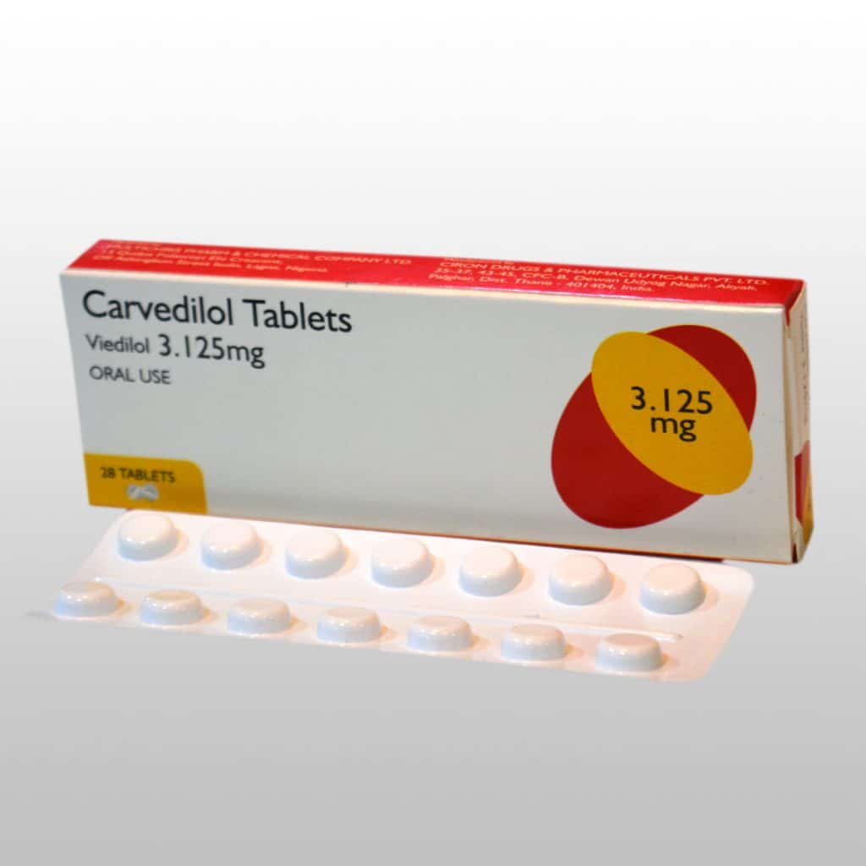

Slide 19
propranolol
INDICATIONS AND DOSE
Hypertension
▶ BY MOUTH
▶ Adult: Initially 80 mg twice daily, dose should be increased at weekly intervals as required; maintenance 160–320 mg daily
Angina
▶ BY MOUTH
▶ Adult: Initially 40 mg 2–3 times a day; maintenance 120–240 mg daily

Slide 20
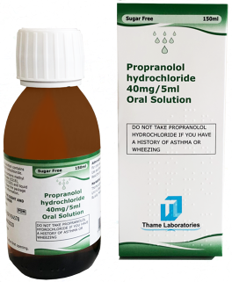
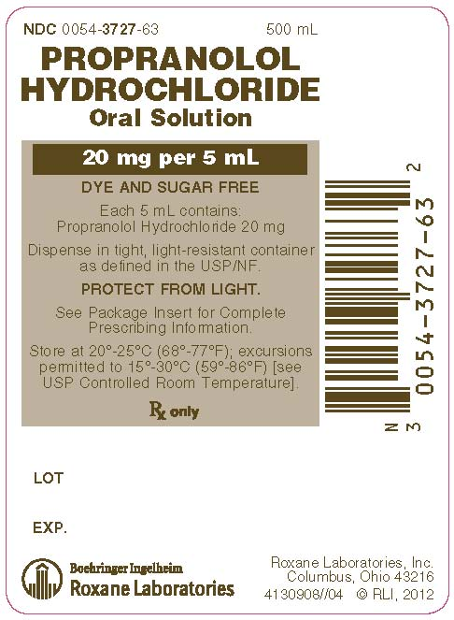
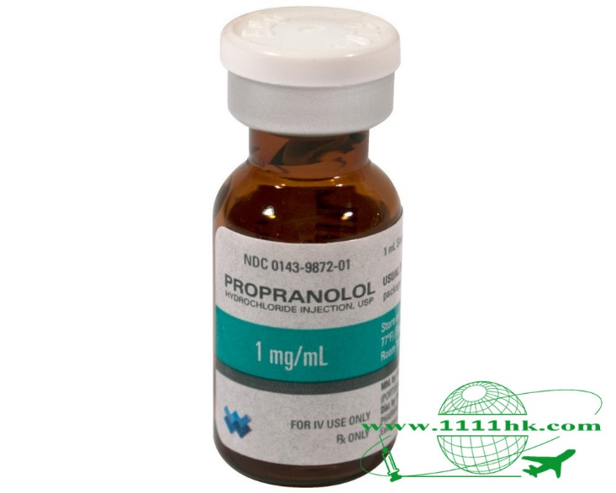
Oral solution: Propranolol hydrochloride 1 mg per 1 ml, 2mg per 1 ml, 8mg per 1 ml, 10 mg per 1 ml
Modified release capsule 80 mg , 160 mg
Tablet 10 ,40, 80 ,160 mg

Slide 21
Timolol maleate
INDICATIONS AND DOSE
Hypertension
▶ BY MOUTH
▶ Adult: Initially 10 mg daily in 1–2 divided doses, then increased if necessary up to 60 mg daily, doses to be increased gradually. Doses above 30mg daily given in divided doses, usual maintenance 10–30 mg daily; maximum 60 mg per day

Slide 22
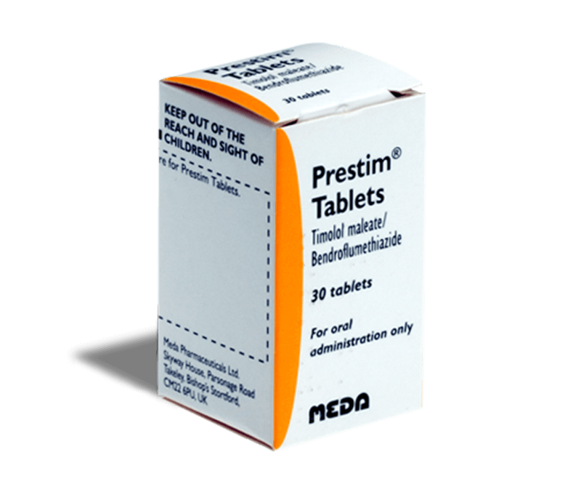
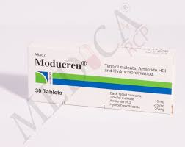
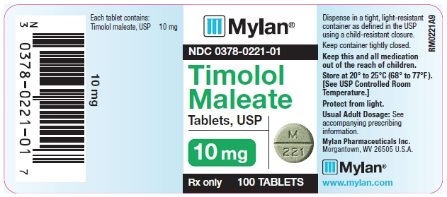
MEDICINAL FORMS
Tablet
CAUTIONARY AND ADVISORY LABELS 8
▶ Timolol maleate (Non-proprietary) Timolol maleate 10 mg
Timolol with amiloride and hydrochlorothiazide
Timolol with bendroflumethiazide

Slide 23
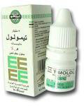
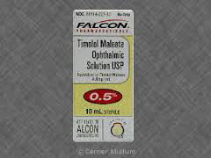
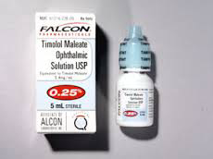
Glaucoma

Slide 24
Atenolol
INDICATIONS AND DOSE
Hypertension
▶ BY MOUTH
▶ Adult: 25–50 mg daily, higher doses are rarely necessary
Angina
▶ BY MOUTH
▶ Adult: 100 mg daily in 1–2 divided doses

Slide 25
RENAL IMPAIRMENT
Dose adjustments ▶ With oral use Max. 50 mg daily if eGFR 15–35 mL/minute/1.73m2; max. 25mg daily or 50mg on alternate days if eGFR less than 15 mL/minute/1.73m2.
DIRECTIONS FOR ADMINISTRATION For intravenous infusion (Tenormin ®), give intermittently in Glucose 5% or Sodium chloride 0.9%. Suggested infusion time 20 minutes.

Slide 26
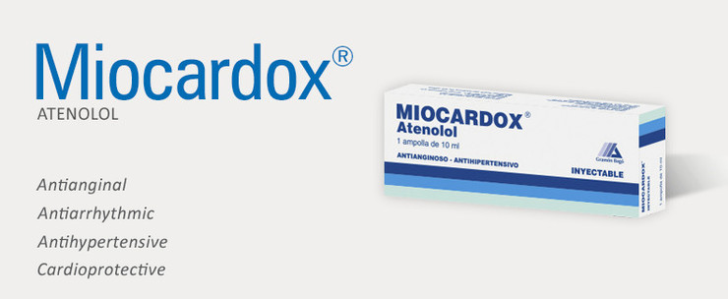
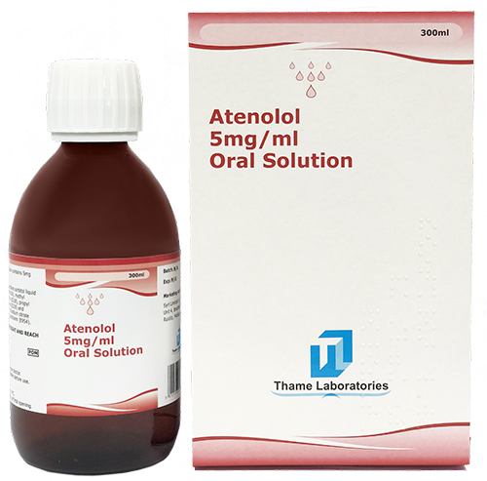
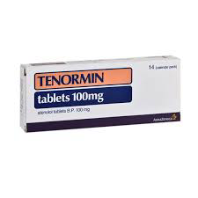
Atenolol 5 mg / 10 ml ampoule (0.5 mg/ml)
Atenolol 5 mg per 1 ml (25mg/5ml)

