Slide 1
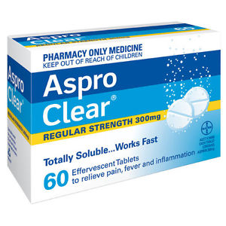
LAB 2
Solubilization of Aspirin
Lab2
Done by :
Lecturer
Zeina Dawood Sura Zuhair Hiba Sabah

Slide 2
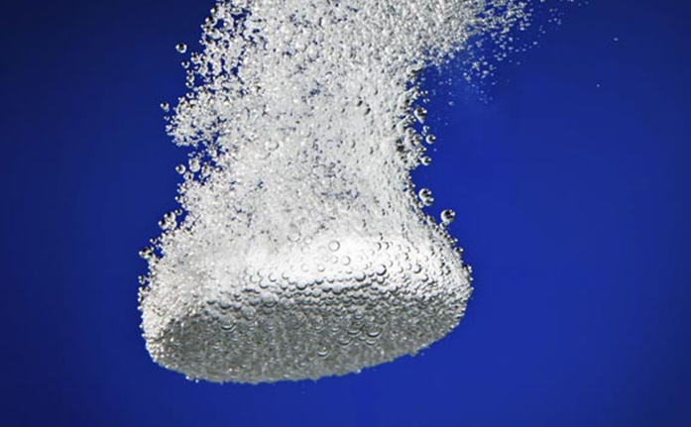
I.Introduction
Acetylsalicylic acid is the scientific name of the aspirin, yet currently explored by various companies for commercial benefits has analgesic and antipyretic activity.
Soluble formulations of aspirin are currently available on the market. Basically, it is slightly soluble in water; hence, aspirin needs enhancements to be solubilized .

Slide 3
Enhancement of aspirin solubilization
1/Surface Active Agent
2/Salt Formation
3/Complex formation
Through Dipole –dipole interaction
Solubilization of Aspirin

Slide 4
For instance, Aspro Clear is soluble, effervescent tablet containing aspirin. The effervescence and favorable pH condition required for solubility of aspirin are facilitated by:
incorporating sodium bicarbonate and citric acid in the formulation.
Aspro Clear reported to provide faster relief of pain than plain aspirin tablets. Another method is by forming dipole-dipole interaction.

Slide 5
II. Kinds of forces
Generally, there are two kinds of forces, or attractions, which operate in a molecule:
Intramolecular and intermolecular.
Intramolecular forces are the forces that hold atoms together within a molecule.
Intermolecular forces are forces that exist between molecules (Figure: 1).

Slide 6
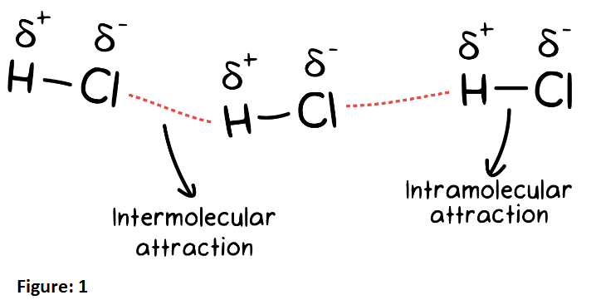
A)

Slide 7
Intermolecular forces are much weaker than the intramolecular forces of attraction but are important because they determine the physical properties of molecules like

Slide 8
Physical properties
melting point
Enthalpies of fusion
And vaporization
Boiling point

Slide 9
Therefore, the intermolecular force:
1. Hydrogen bond.
2. London dispersion forces, under the category of van der Waal forces
3. Dipole-dipole Interactions

Slide 10
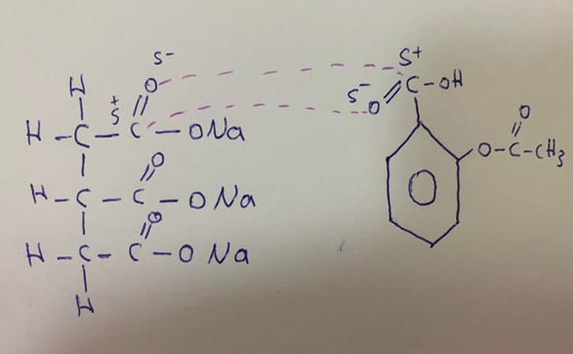
Dipole –Dipole interaction
These forces occur when the partially positively charged part of a molecule interacts with the partially negatively charged part of the neighboring molecule .
Dipole-dipole interactions are the strongest intermolecular force of attraction.
(Trisodium Cirate)
(Aspirin)

Slide 11
III. Experimental Work
Part l:
MATERIALS :Acetyl salicylic acid , tri-sodium citrate, distilled water, phenol red , sodium hydroxide and filter paper
GLASS WARE and EQUIPMENTS : conical flasks, graduated pipettes, funnel, burette. In addition to electrical balance.
Aim of Experiment: to calculate the minimum amount of tri sodium citrate required to solubilize 1g of Asprin.

Slide 12
Part ll: Experimental method
1. Add 1 g of Aspirin to the following flasks then :

Slide 13
2. Add 50 mL of distilled water to each flask.
3. Shake the flasks for 10 min., then apply filtration step.
4. Take 10 mL of the filtrate solution and titrate with NaOH (0.1N) using phenol red as an indicator.
5. Record the end point taking into account the end point appears when the color changes from yellow to pink.
6. Finally, plot percent of aspirin dissolved versus grams tri-sodium citrate used

Slide 14
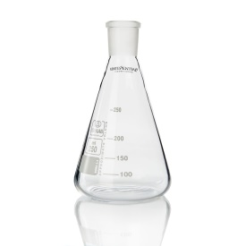
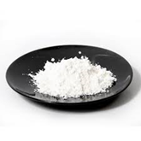
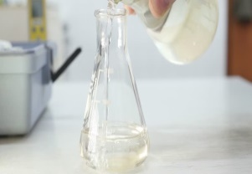
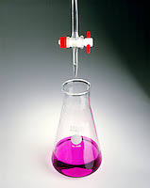
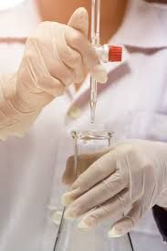
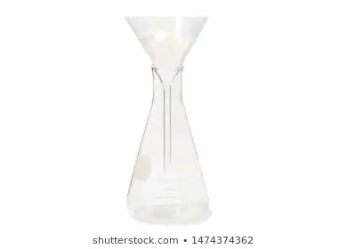
Steps of the experiment
Weigh 1 g Asprin+1g of Tri Sodium Citrate
Put in dry conical flask
Add 50ml of water
Then Shake for 10 minute
Change Color from
Yellow to pink
Take 10ml of filtrate ,2drops of phenol red ,titrate with(0.1N)NaOH
Filtration

Slide 15
When the amount of tri-sodium citrate is higher than that required for dissolving aspirin, the excess will dissociate to citrate ion and sodium ion, the later will form with water NaOH which results in the reaching the end point faster, and less than the real end point.

Slide 16
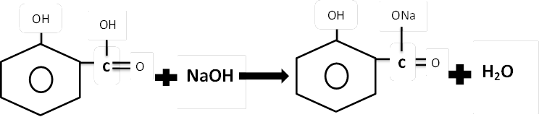
The chemical factor will be:
1 M.wt Aspirin = 1 M.wt NaOH
1eq.wt of aspirin = 1eq.wt of NaOH
180 g = 1L of 1N NaOH
180/1000 g = 1ml of 1N NaOH
180/1000* 0.1 = 1ml of 0.1N NaOH
Each 1ml of 0.1N NaOH = 0.018 g Aspirin
End point * chemical factor = g aspirin dissolve in 10ml
Multiply the results by 10 = g%.

Slide 17
Tabulate the results .
%gram of asprin dissolved | gram of asprin dissolved In 10ml | End point | Amount of Tri sodium citrate | Amount of Asprin | Conical Flask
 |  |  | 0g | 1g | 1
 |  |  | 1g | 1g | 2
 |  |  | 2g | 1g | 3
 |  |  | 3g | 1g | 4
 |  |  | 4g | 1g | 5

Slide 18
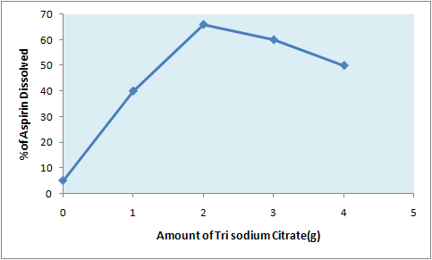
Plot percent of aspirin versus grams of tri sodium citrate used.

Slide 19


