Slide 1
Hospital pharmacy services
Lecturer Dr. Abeer A .Rashid
Lecturer assistant: Zahraa A.

Slide 2
Hospital classification
Ownership: public or private
Type of care provided: primary, secondary or tertiary
Teaching affiliation: provision of specialist training within the institution.

Slide 3
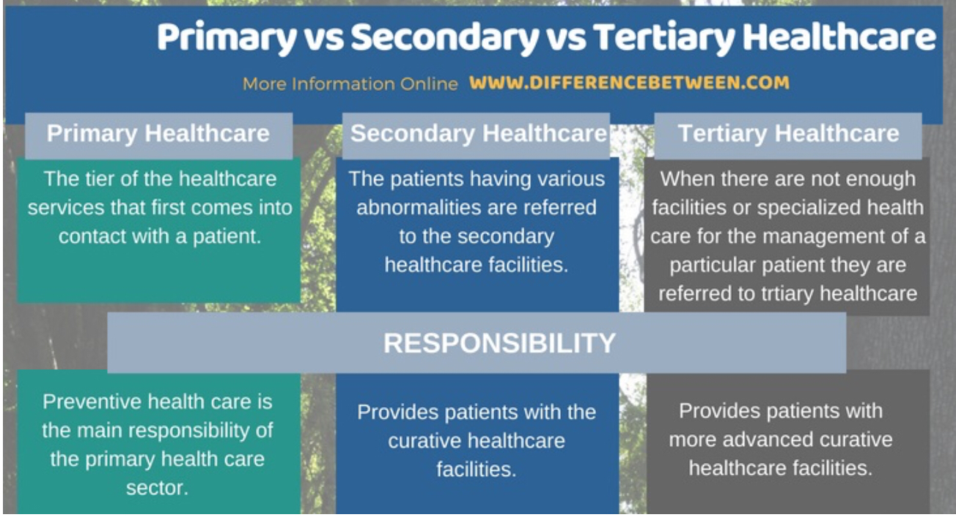

Slide 4
Organisational structure of the hospital
Hospital director
Financial officers
Director of pharmaceutical services
Director of nursing
Human resources manager
Medical resources
Physiotherapy, occupational therapy department.

Slide 5
Organisation of pharmaceutical services
Director is in charge of:
financial management
inter-departmental affairs
quality assurance
provision of professional services.

Slide 6
Purchasing of equipment
Enteral and parenteral infusion pumps (e.g. patient-controlled analgesia pump)
• Computer systems
• Refrigerator and narcotic cupboards
• Counting systems, tablet counter, containers
• Laminar airflow hoods
• Gloves
• Balance.

Slide 7
Considerations when purchasing equipment
Specifications, functionality
Reliability of the equipment
Personnel training
Cost
Maintenance
User-friendliness
Portability
Lease vs purchase.

Slide 8
Professional hospital pharmacy services
Medicines supply to inpatients and outpatients
Clinical pharmacy
Drug information service
Drug and therapeutics committee
Infection control committee
Medical gases

Slide 9
Cytotoxic dispensing
Special units (e.g. total parenteral nutrition, extemporaneous preparation)
Developing systems of seamless care: integrating community and hospital pharmaceutical services.

Slide 10

Medicines supply to inpatients

Slide 11
Pharmacist could be involved in:
prescription sheet design to ensure an easy- to follow documentation of medicines to be administered
medicines storage and medicine stock levels at ward level.

Slide 12
Dispensing medicines for the wards
List of ward stock items maintained updated
Topping up of ward stock: maintain practical stock levels to ensure that wards have the required medicines in the appropriate amounts and avoid hoarding, stock wastage, pilferage
Consider unit-dose dispensing: may lead to increased pharmacist time during dispensing of medicines to wards but it is an efficient system that reduces medication errors. Cost effectiveness of the system employed needs to be assessed.

Slide 13
Pharmacists must ensure that the quality of the medicines used in the hospital remains intact until they are administered to the patient. This is achieved by ensuring:
proper storage and handling of medicines even in the wards (e.g. rotation of stock
removal of damaged or expired products
stability and incompatibility of parenteral admixtures).

Slide 14
The pharmacists’ approach towards nurses should be based on a teamwork approach inviting nurses to ask questions when they require information and to cooperate to ensure appropriate management of drugs on the wards.

Slide 15
Definition of ward stock
Medicines where at least five or six patients are receiving it at the same time
Products should not be expensive
Products should have a good shelf-life
No major contraindications to their use and no requirements for specialist care and supervision

Slide 16
Include commonly used items (e.g. paracetamol tablets)
Label: name of drug, strength, instructions for use (e.g. dilution/reconstitution), storage requirements, no dosage instructions and patient names
Items used without prescription (e.g. disinfectants, antiseptics).

Slide 17
Monitoring ward stocks Hospital pharmacy services
Pharmacy staff should establish a working relationship with nurses and ward manager
Ensure cleanliness and hygiene
Advise on appropriate storage conditions
Remind ward staff to carry out stock rotation when new stock is received
Correct stock levels
Ensure appropriate monitoring of refrigerators
Check controlled drugs cupboard.

Slide 18
# Drugs to be stored in a refrigerator include total parenteral nutrition (TPN) solutions, reconstituted antibacterial suspensions and cytotoxic drugs, insulin, vaccines
# Items and drugs that are not to be stored in refrigerator include heparin, blood and urine specimens, food, inflammables
# A good procedure is to prepare a list on the door of the refrigerator of all the items that require storage in a refrigerator
#Check that all items in the refrigerator require to be stored in a refrigerator (usually between 2 and 8C).

Slide 19
Specific pharmaceutical dosage forms: eye preparations
Good practice is required to prevent cross infections
Eyes are at greater risk of developing an infection when an injury has occurred or a surgical intervention was carried out
Use of single-dose preparations preferred but some preparations may not be available in this presentation and costings have to be considered
For preparations presented as multiple dose, the product should not be used for more than 1 week; separate bottles are used for each eye, and new bottles used postoperatively

Slide 20
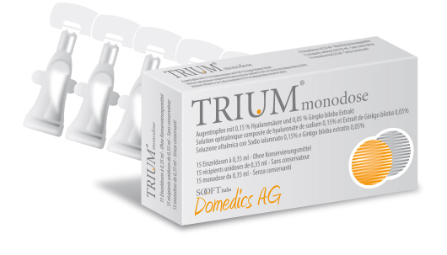

Slide 21
Pharmacists’actions in the development of protocols to standardise practical nursing techniques on the wards
Blood sugar monitoring technique
Use of patients’ own medicines
Administration of injections
Intravenous additives
Medicines administration
Nebuliser therapy
Urine testing
Ordering and storage of medicines.

Slide 22
Drug and therapeutics committee
Aims are:
to maintain a hospital formulary
to develop and implement policies on drug use including, for example, generic substitution, therapeutic guidelines and cost-containment policies.

Slide 23
Infections control committee
Aims are:
to review use of anti-infective agents
to develop and implement policies and guidelines regarding the use of anti-infective agents
to develop policies for wound management.

Slide 24
Drug information services
Aims are:
to respond to queries from different departments and other care settings
to evaluate drug usage
to investigate drug activity and coordinate clinical trials activity (this activity may be shared with the quality assurance unit)
to coordinate reporting programmes for adverse drug reactions and medication errors
to provide poison information
to produce publications
to educate and provide professional development for professionals.

Slide 25
Wound management committee
Aims are:
to design protocols for wound management
to liaise with the infections control committee to identify antibacterial agents that are less likely to develop bacterial resistance
to use proper wound treatment and appropriate dressings
to keep wound treatment cost-effective
to address factors precipitating wound development (e.g. uncontrolled diabetes).

Slide 26
Clinical pharmacy services
therapeutic drug monitoring
pharmacokinetic dosing
patient education
medication counselling
drug utilisation review
participation in pharmacotherapy decision making and in patient follow-up.

Slide 27
Documentation of pharmacist actions in pharmacy held patient records should contain information on:
age, weight and height
medical history
allergic or adverse drug reaction history
renal function
hepatic function.

