Slide 1
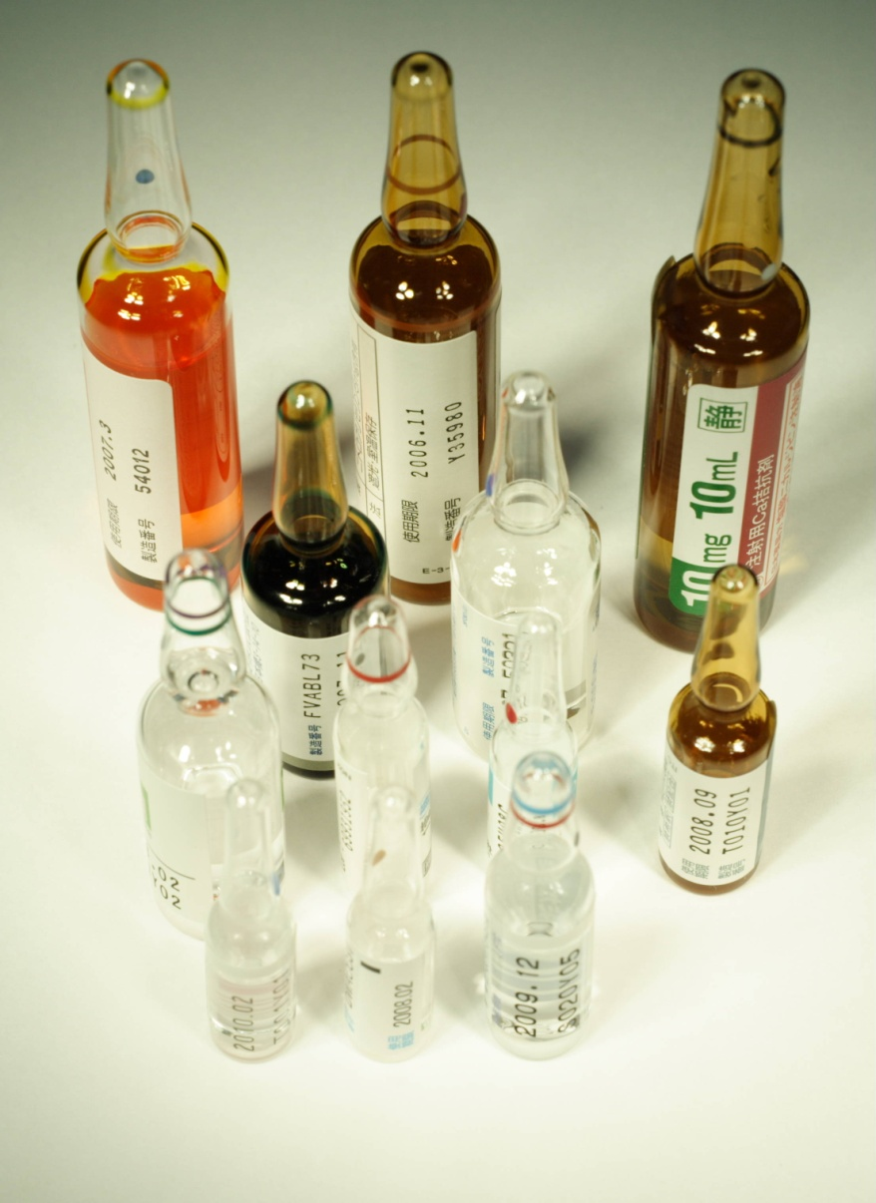
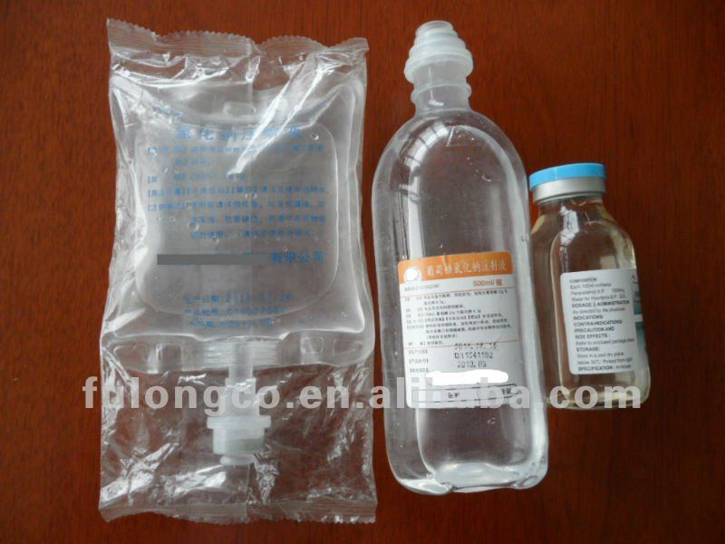
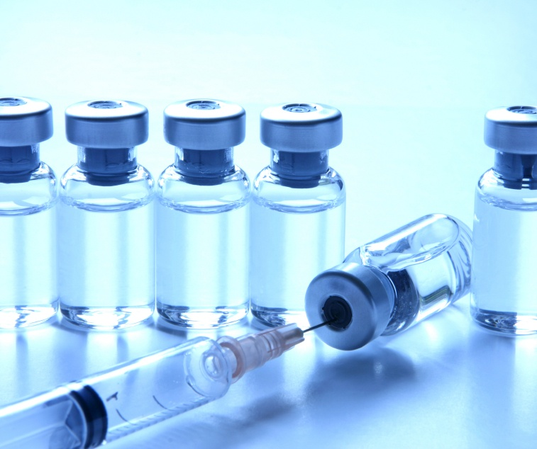
Paranterals
Lab -8-

Slide 2
parenterals are sterile preparations containing one or more active ingredients intended for administration by injection, infusion or implantation. They are packaged in either single or multi-dose containers.
They considered unique among other dosage forms since they are injected through the skin or mucus membrane into the internal body compartments, so they must be free from microbial contamination and from toxic components as well as posses high level of purity.

Slide 3
Pharmacologically parenterals can be divided into:
1- Solutions ready to be injected.
2- Dry soluble materials reconstituted prior use.
3- Dry insoluble materials reconstituted prior use.
4- Suspensions ready to be injected.
5- Emulsions which are used mostly for lipid supplements, nutrients, but now not used because the main problem in the formulation of parenteral emulsions is the attainment and the maintenance of uniform oil droplet which should be of 1-5 microns in size as the internal phase.

Slide 4
All these preparations require high level of purity of all ingredients as well as freedom from chemical, physical (particles), microbial contaminants, and pyrogen free (as indicative of a microbiologically clean process).
They usually require different additives like buffers to stabilize the pH of the product, and additives to keep them isotonic, as well as stabilizers, preservatives and antioxidants.
Routes for administration for parenteral preparations includes intravenous, intramuscular, subcutaneous (hypodermic), intradermal, intrathecal or intraspinal (in the cerebrospinal fluid).

Slide 5
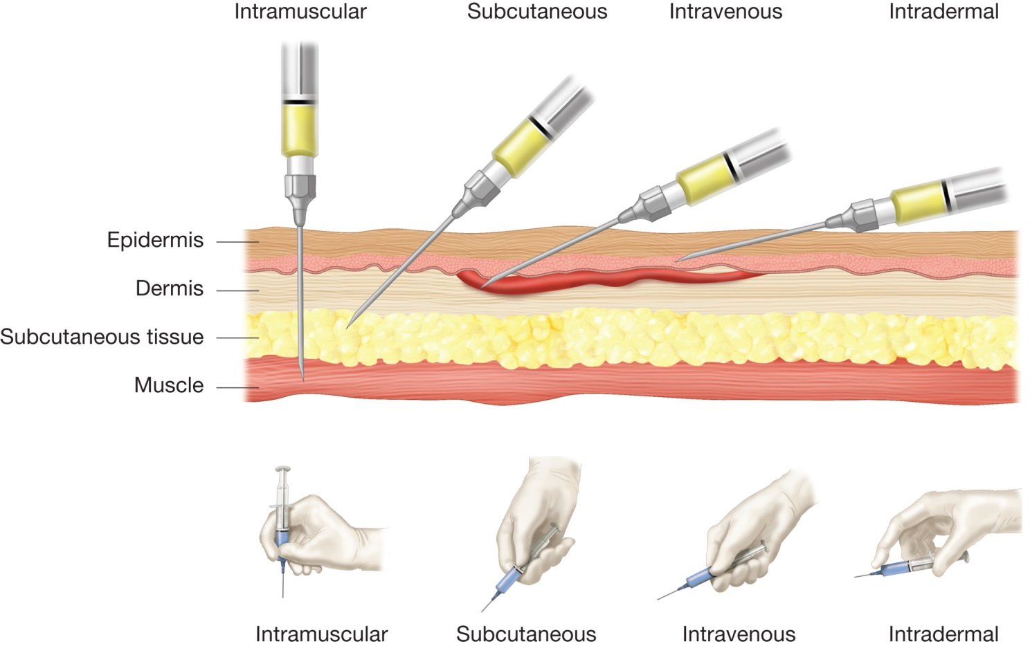

Slide 6
Vehicles or solvents
Additives
Containers
Formulation of parenterals

Slide 7
(1) Vehicles or solvents:
The solvents suitable for sterile products are limited to those that produce a little or no tissue irritation which could be either aqueous (water) solvents or non-aqueous solvents.
Aqueous (water) solvents
  The water is the most common since it’s the vehicle for all natural body fluids. This water must be purified, pyrogen free, and sterile.
Sometime it’s necessary to eliminate water entirely or in part from the vehicle primarily because of solubility factors or hydrolytic reactions, so the used solvents must be non-toxic, non-irritant, and do not cause sensitivity and do not exert adverse effects on the ingredients of the formulation.
non-aqueous solvents

Slide 8
Tonicity contributors
Antioxidants
Preservatives
Additives
Buffers
Stabilizers

Slide 9
These substances must be:
1- Non-toxic in the quantity administered to the patient.
2- Do not interfere with the therapeutic efficacy.
3- Do not interfere with the assay of the active ingredient.
4- Must be active and present when needed throughout the life of the product.

Slide 10
(2) Additives:
A variety of ingredients may be added to a formulation to provide the required stability and therapeutic efficacy, they include:
A- Buffers: Like acetate, citrate, and phosphate, these added to maintain the required pH for many products and to decrease slight differences in pH that may occur.
The pH of the injectable required for maximum solubility may not be that for maximum stability, so a balance pH must be achieved to maintain maximum solubility and stability.
The buffer systems are selected with consideration of their effective pH range, concentration, and their chemical effects to the total product.

Slide 11
B- Antioxidants: these are included in many formulations to protect the therapeutic agent from oxidation particularly under accelerated conditions of thermal sterilization, e.g. salt of sulfur dioxide (sulfite, meta-bisulfite, bisulfite) in aqueous paranterals.
Note: For products in which the oxygen enters degradation reactions, an antioxidant effect can be achieved by displacing air (O2) from the container with the product, this can be accomplished by saturation of the liquid with either N2 or CO2 and sealing of the final product after displacing the air from the product with gas.

Slide 12
C- Tonicity contributors: Which are compounds that contributing to the isotonicity of a product to reduce the pain of injection in areas with nerve endings like Nacl. The buffers may act as tonicity contributors as well as stabilizer for the pH.
D- Preservatives: The type used depends on the type of the vehicle used and it’s may be an antibacterial agent in a bacteriostatic concentration which included in the formulation of the products packaged in multiple doses vials, for example benzyl alcohol, benzylkonium chloride, and chlorobutanol.

Slide 13
E- Stabilizers:
They may include chelating agents, solubilizers, hydrolysis inhibitors, antifoamings and others for specialized reasons.
EDTA, are chelating agent serve the same effect as the antioxidant, also it may be added to prevent the leaching of the ferrous that is present in amber vials and ampoules to the constituents.
dimethylacetamide, ethyl alcohol, glycerin, lecithin, povidone are common example of solubilizers.

Slide 14
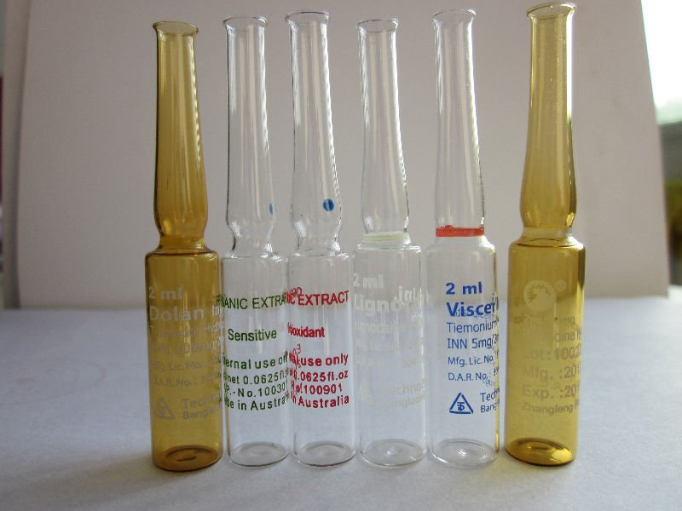
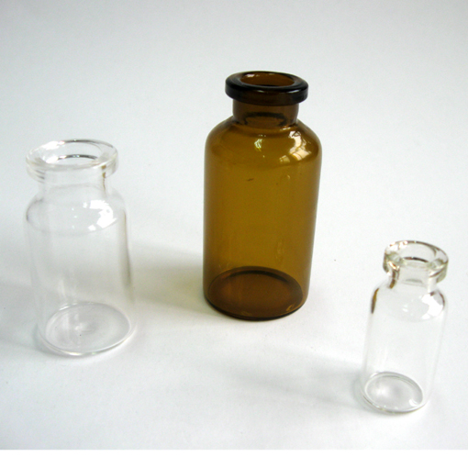
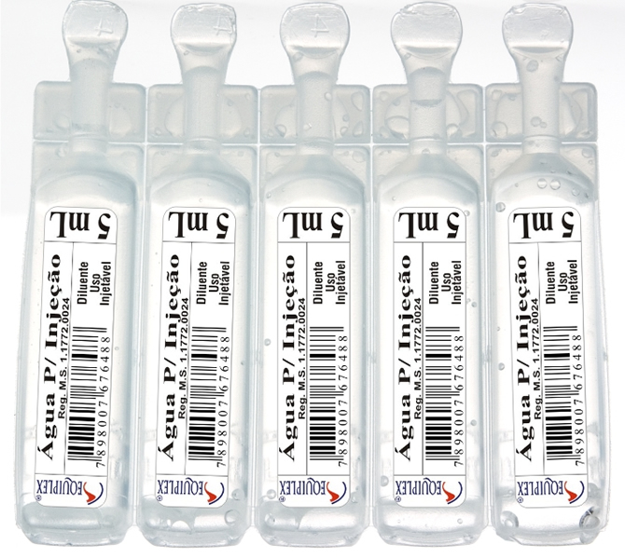
(3) Containers: They must be inert, non-toxic, easy transport, easy sterilize, and easily cleaned.
We have 2 types plastic and glass containers, and each has advantages and disadvantages.

Slide 15
Evaluation of Parenterals
Leaker test
Clarity test
Pyrogen test
Sterility test

Slide 16
1- Leaker test:
It is mainly used to determine the efficiency of the sealing so the incompletely sealed ampoules may be discarded, this is detected by producing a negative pressure within completely sealed ampoule usually in a vacuum chamber, while the ampoule is entirely submerged in deeply colored dye solution usually 0.5-1% methylene blue, then the subsequent atmospheric pressure will cause the dye to penetrate any opening, thus make it visible after washing the ampoule to clear it from the dye. For this reason this test is used for colorless solutions and clear containers.
There is certain limitation of this test including:
1- The vials and bottles are not subjected to leaker test because the rubber closure is not rigid.
2- also capillaries of about 1.5 microns in diameter or smaller may not be detected by this test.
3- It is performed only for colorless solutions and clear containers.

Slide 17
2- Clarity test:
It could be done by visual inspecting of each externally clean containers under a good light, baffled against reflection into the eyes and viewed against a black and white background with the contents set in motion with a swirling action. A moving particle is much easier to see than the one that is stationary, but the care must be exercised to avoid introducing air bubbles which are difficult to distinguish from dust particles. The human inspector is subjected to reduction in efficiency by eye strain, fatigue, emotional disturbances
For this reason instrumental methods more accurate which depends on the principle of light scattering, light absorption and electrical resistance and these used to obtain particle count and size distribution.

Slide 18
3- Pyrogen test:
The pyrogens are products of the metabolism of the microorganism which will produce rising in body temperature.
This test is done by injecting the sample in the vein of 6 rabbits and observe the temperature of the rabbits for 3 hour period by the means of rectal thermometer, if the temperature increases then the product is contaminated and should be rejected, while if only 1 rabbit temperature increased so perform the test with additional 6 rabbits and only 1 rabbit temperature increase out of 12 rabbits is allowed, thus more than 1 rabbit the product will be unaccepted.

Slide 19
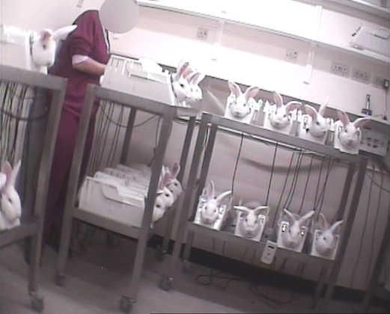

Slide 20
4- Sterility test: After the sterilization step a sample is taken and inoculated on agar, incubated at 37° C for 14 days then observe if any growth develops.
Note: The autoclave is used to ensure the sterilization process occurred completely, by utilizing a specific indicators like browne’s tube that filled with a heat sensitive chemical indicator that changes from red to green when subjected for elevated temperatures for the required length of time.

Slide 21
types of sterilization process
1- Physical sterilization: which is either thermal such is dry heat, oven, moist heat, or autoclave, and non-thermal methods such as UV light, filtration, ionizing radial light.
2- Chemical sterilization: with the utilization of certain chemical agents such as ethylene oxide.
Note: the choice of the proper type of sterilization process depends on the physico-chemical properties of the drug, the type of the container as vial or ampoule since in vial the rubber is affected by heat.

Slide 22
The area of preparation of injection must have these properties:
1-Aseptic Area
2- Isolated Area
3- Circulated with filtered air to remove the dust and bacteria.
4- Easily cleaned and sterilize
5- No large holes are present.
6- Working people must ware certain clothing.

Slide 23


