Slide 1
Non Steroidal Anti-Inflammatory Drugs (NSAIDs)
Assistant lecturer :
Noor Wafaa Hashim

Slide 2
Drugs:
Diclofenac potassium
Diclofenac sodium
Indomethacin
Meloxicam
Piroxicam
Selective Cox2 inhibitor: Etoricoxib

Slide 3
Diclofenac Potassium
Indication and dose:
Pain and inflammation in rheumatic disease and other
musculoskeletal disorders
▶ BY MOUTH
▶ Child 14–17 years: 75–100 mg daily in 2–3 divided doses
▶ Adult: 75–150 mg daily in 2–3 divided doses
Acute gout
▶ BY MOUTH
▶ Adult: 75–150 mg daily in 2–3 divided doses
Postoperative pain
▶ BY MOUTH
▶ Child 9–13 years (body-weight 35 kg and above): Up to
2 mg/kg daily in 3 divided doses; maximum 100 mg per
day
▶ Child 14–17 years: 75–100 mg daily in 2–3 divided doses
▶ Adult: 75–150 mg daily in 2–3 divided doses
Migraine
▶ BY MOUTH
▶ Adult: 50 mg, to be given at onset of migraine, then
50 mg after 2 hours if required, then 50 mg after
4–6 hours; maximum 200 mg per day
Fever in ear, nose, or throat infection
▶ BY MOUTH
▶ Child 9–17 years (body-weight 35 kg and above): Up to
2 mg/kg daily in 3 divided doses; maximum 100 mg per
day

Slide 4
Diclofenac Potassium
UNLICENSED USE : Voltarol ® Rapid not licensed for use in
children under 14 years or in fever.
CONTRA-INDICATIONS :Active gastro-intestinal bleeding .
active gastro-intestinal ulceration . cerebrovascular
disease . history of gastro-intestinal bleeding related to
previous NSAID therapy . history of gastro-intestinal
perforation related to previous NSAID therapy . history of
recurrent gastro-intestinal haemorrhage (two or more
distinct episodes) . history of recurrent gastro-intestinal
ulceration (two or more distinct episodes) . ischaemic
heart disease . mild to severe heart failure . peripheral
arterial disease

Slide 5
Diclofenac Potassium
CAUTIONS:Allergic disorders . cardiac impairment (NSAIDs may impair renal function) . coagulation defects . connective-tissue disorders . Crohn’s disease (may be exacerbated) . elderly (risk of serious side-effects and fatalities) . history of cardiac failure . hypertension . Left ventricular dysfunction . oedema . risk factors for cardiovascular events . ulcerative colitis (may be exacerbated)
INTERACTIONS → Appendix 1: NSAIDs
SIDE-EFFECTS:
▶ Common or very common Appetite decreased . diarrhoea .
dizziness . gastrointestinal discomfort . gastrointestinal
disorders . headache . nausea . skin reactions . vertigo .
vomiting

Slide 6
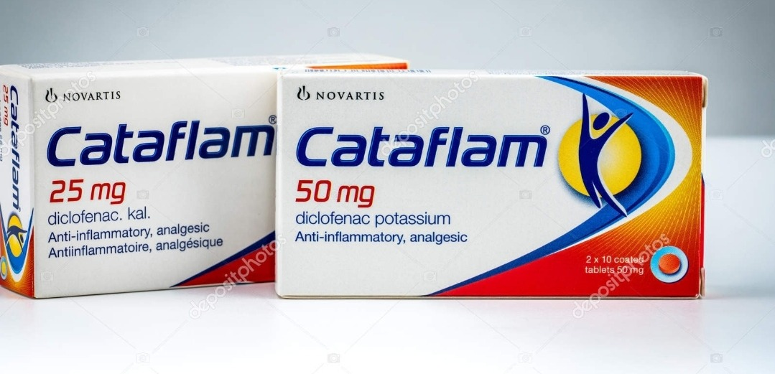
Diclofenac Potassium

Slide 7
Diclofenac Potassium
ALLERGY AND CROSS-SENSITIVITY Contra-indicated in
patients with a history of hypersensitivity to aspirin or any
other NSAID—which includes those in whom attacks of
asthma, angioedema, urticaria or rhinitis have been
precipitated by aspirin or any other NSAID.
CONCEPTION AND CONTRACEPTION Caution—long-term
use of some NSAIDs is associated with reduced female
fertility, which is reversible on stopping treatment.
PREGNANCY Avoid unless the potential benefit outweighs
the risk. Avoid during the third trimester (risk of closure of
fetal ductus arteriosus in utero and possibly persistent
pulmonary hypertension of the newborn); onset of labour
may be delayed and duration may be increased.
BREAST FEEDING Use with caution during breast-feeding.
Amount in milk too small to be harmful.
HEPATIC IMPAIRMENT Manufacturer advises caution in
mild to moderate impairment; avoid in severe impairment.
RENAL IMPAIRMENT Avoid if possible or use with caution.
Avoid in severe impairment.

Slide 8
Diclofenac Potassium
Dose adjustments The lowest effective dose should be used for the shortest possible duration.Monitoring In renal impairment monitor renal function; sodium and water retention may occur and renal function may deteriorate, possibly leading to renal failure.
Tablet:
CAUTIONARY AND ADVISORY LABELS 21( Take with or just after food, or a meal)
Diclofenac potassium 25 mg
Diclofenac potassium 50 mg

Slide 9
Diclofenac sodium
INDICATIONS AND DOSE
Pain and inflammation in musculoskeletal disorders |
Acute gout
▶ BY MOUTH USING IMMEDIATE-RELEASE MEDICINES
▶ Adult: 75–150 mg daily in 2–3 divided doses
▶ BY RECTUM
▶ Adult: 75–150 mg daily in divided doses
Pain and inflammation in rheumatic disease including
juvenile idiopathic arthritis
▶ BY MOUTH USING IMMEDIATE-RELEASE MEDICINES
▶ Adult: 75–150 mg daily in 2–3 divided doses
▶ BY RECTUM
▶ Adult: 75–150 mg daily in divided doses
Postoperative pain
▶ BY MOUTH USING IMMEDIATE-RELEASE MEDICINES
▶ Adult: 75–150 mg daily in 2–3 divided doses
▶ BY RECTUM
▶ Adult: 75–150 mg daily in divided doses
DICLOMAX RETARD ®
Pain and inflammation in rheumatic disease (including
juvenile idiopathic arthritis) and other musculoskeletal
disorders | Acute gout | Postoperative pain
▶ BY MOUTH
▶ Adult: 1 capsule once daily

Slide 10
Diclofenac sodium
DICLOMAX SR ®
▶ Adult: 1 cPain and inflammation in rheumatic disease (including
juvenile idiopathic arthritis) and other musculoskeletal
disorders | Acute gout | Postoperative pain
▶ BY MOUTH
Capsule 1–2 times a day, alternatively
2 capsules once daily
MOTIFENE ®
Pain and inflammation in rheumatic disease (including
juvenile idiopathic arthritis) and other musculoskeletal
disorders | Acute gout | Postoperative pain
▶ BY MOUTH
▶ Adult: 1 capsule 1–2 times a day
VOLTAROL ® 75MG SR TABLETS
Pain and inflammation in rheumatic disease (including
juvenile idiopathic arthritis) and other musculoskeletal
disorders | Acute gout | Postoperative pain
▶ BY MOUTH
▶ Adult: 1 tablet 1–2 times a day

Slide 11
Diclofenac sodium
VOLTAROL ® EMULGEL
Relief of pain in musculoskeletal conditions | Adjunctive
treatment in knee or hand osteoarthritis
▶ TO THE SKIN
▶ Adult: Apply 3–4 times a day, therapy should be
reviewed after 14 days (or after 28 days for
osteoarthritis)
VOLTAROL ® RETARD
Pain and inflammation in rheumatic disease (including
juvenile idiopathic arthritis) and other musculoskeletal
disorders | Acute gout | Postoperative pain
▶ BY MOUTH
▶ Adult: 1 tablet once daily
VOLTAROL ® SOLUTION FOR INJECTION
Postoperative pain
▶ BY DEEP INTRAMUSCULAR INJECTION
▶ Adult: 75 mg 1–2 times a day for maximum 2 days,
twice daily administration in severe cases, to be
injected into the gluteal muscle
Acute exacerbations of pain
▶ BY DEEP INTRAMUSCULAR INJECTION
▶ Adult: 75 mg 1–2 times a day for maximum 2 days,
twice daily administration in severe cases, to be
injected into the gluteal muscle

Slide 12
Diclofenac sodium
Ureteric colic
▶ BY DEEP INTRAMUSCULAR INJECTION
▶ Adult: 75 mg, then 75 mg after 30 minutes if required
Acute postoperative pain (in hospital setting)
▶ BY INTRAVENOUS INFUSION
▶ Adult: 75 mg, then 75 mg after 4–6 hours if required for
maximum 2 days; maximum 150 mg per day
Prevention of postoperative pain (in hospital setting)
▶ BY INTRAVENOUS INFUSION
▶ Adult: Initially 25–50 mg, to be given after surgery over
15–60 minutes, then 5 mg/hour for maximum 2 days;
maximum 150 mg per day

Slide 13
Diclofenac sodium
CONTRA-INDICATIONS
With intravenous use Dehydration . history of asthma .
history of confirmed or suspected cerebrovascular bleeding
. history of haemorrhagic diathesis . hypovolaemia .
operations with high risk of haemorrhage
▶ With systemic use Active gastro-intestinal bleeding . active
gastro-intestinal ulceration . avoid suppositories in
proctitis . cerebrovascular disease . congestive heart failure
. history of gastro-intestinal bleeding related to previous
NSAID therapy . history of gastro-intestinal perforation
related to previous NSAID therapy . history of recurrent
gastro-intestinal haemorrhage (two or more distinct
episodes) . history of recurrent gastro-intestinal ulceration
(two or more distinct episodes) . ischaemic heart disease .
peripheral arterial disease

Slide 14
Diclofenac sodium
CAUTIONS:
▶ With systemic use Allergic disorders . cardiac impairment
(NSAIDs may impair renal function) . coagulation defects .
connective-tissue disorders . Crohn’s disease (may be
exacerbated) . elderly (risk of serious side-effects and
fatalities) . history of cardiac failure . hypertension . left
ventricular dysfunction . oedema . risk factors for
cardiovascular events . ulcerative colitis (may be
exacerbated)
▶ With topical use Avoid contact with eyes . avoid contact with
inflamed or broken skin . avoid contact with mucous
membranes . not for use with occlusive dressings . topical
application of large amounts can result in systemic effects,
including hypersensitivity and asthma (renal disease has
also been reported)

Slide 15
Diclofenac sodium
SIDE-EFFECTS
▶ Common or very common
▶ With systemic use Appetite decreased . diarrhoea . dizziness
. gastrointestinal discomfort . gastrointestinal disorders .
headache . nausea . oedema . rash (discontinue) . skin
reactions . vertigo . vomiting
▶ With topical use Conjunctivitis . muscle tone increased .
oedema . rash (discontinue) . sensation abnormal . skin
reactions . skin ulcer
Topical application of large amounts of diclofenac can result in systemic
effects.

Slide 16
Diclofenac sodium
ALLERGY AND CROSS-SENSITIVITY Contra-indicated in
patients with a history of hypersensitivity to aspirin or any
other NSAID—which includes those in whom attacks of
asthma, angioedema, urticaria or rhinitis have been
precipitated by aspirin or any other NSAID.
CONCEPTION AND CONTRACEPTION
▶ With systemic use Caution—long-term use of some NSAIDs
is associated with reduced female fertility, which is
reversible on stopping treatment.

Slide 17
Diclofenac sodium
PREGNANCY
▶ With systemic use Avoid unless the potential benefit
outweighs the risk. Avoid during the third trimester (risk of
closure of fetal ductus arteriosus in utero and possibly
persistent pulmonary hypertension of the newborn); onset
of labour may be delayed and duration may be increased.
▶ With topical use Patient packs for topical preparations carry
a warning to avoid during pregnancy.
BREAST FEEDING
▶ With systemic use Use with caution during breast-feeding.
Amount in milk too small to be harmful.
▶ With topical use Patient packs for topical preparations carry
a warning to avoid during breast-feeding.

Slide 18
Diclofenac sodium
HEPATIC IMPAIRMENT
▶ With systemic use Manufacturer advises caution in mild to
moderate impairment; avoid in severe impairment.
RENAL IMPAIRMENT
▶ With systemic use Avoid if possible or use with caution.
Avoid in severe impairment.
▶ With intravenous use Avoid intravenous use if serum
creatinine greater than 160 micromol/litre . Contraindicated
in moderate or severe renal impairment.
Dose adjustments ▶ With systemic use The lowest effective
dose should be used for the shortest possible duration.
Monitoring ▶ With systemic use In renal impairment
monitor renal function; sodium and water retention may
occur and renal function may deteriorate, possibly leading
to renal failure.

Slide 19
Diclofenac sodium
Gastro-resistant tablet:
CAUTIONARY AND ADVISORY LABELS 5, 25
Diclofenac sodium 25 mg
Diclofenac sodium 50 mg
Suppository:
Diclofenac sodium 12.5 mg
Diclofenac sodium 25 mg
Diclofenac sodium 50 mg
Diclofenac sodium 100 mg
Gel:
Diclofenac diethylammonium 11.6 mg per 1 gram

Slide 20
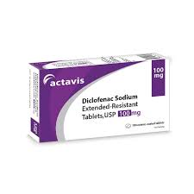
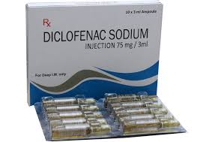

Slide 21
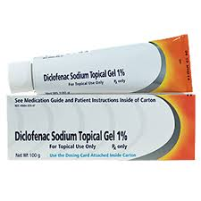
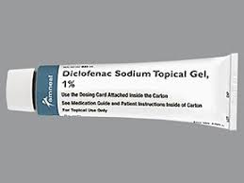
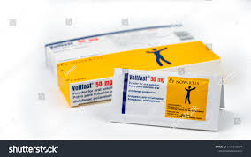

Slide 22
Indometacin
INDICATIONS AND DOSE
Pain and moderate to severe inflammation in rheumatic disease and other musculoskeletal disorders
▶ BY MOUTH USING IMMEDIATE-RELEASE MEDICINES
▶ Adult: 50–200 mg daily in divided doses
▶ BY RECTUM
▶ Adult: 100 mg twice daily if required, dose to be
administered at night and in the morning, combined
oral and rectal treatment, maximum total daily dose
150–200mg
▶ BY MOUTH USING MODIFIED-RELEASE MEDICINES
▶ Adult: 75 mg 1–2 times a day
Acute gout
▶ BY MOUTH USING IMMEDIATE-RELEASE MEDICINES
▶ Adult: 150–200 mg daily in divided doses
▶ BY RECTUM
▶ Adult: 100 mg twice daily if required, dose to be
administered at night and in the morning, combined
oral and rectal treatment, maximum total daily dose
150–200mg
▶ BY MOUTH USING MODIFIED-RELEASE MEDICINES
▶ Adult: 75 mg 1–2 times a day
Dysmenorrhoea
▶ BY MOUTH USING IMMEDIATE-RELEASE MEDICINES
▶ Adult: Up to 75 mg daily
▶ BY RECTUM
▶ Adult: 100 mg twice daily if required, dose to be administered at night and in the morning, combined oral and rectal treatment, maximum total daily dose 150–200mg
▶ BY MOUTH USING MODIFIED-RELEASE MEDICINES
▶ Adult: 75 mg daily

Slide 23
Indometacin
CONTRA-INDICATIONS Active gastro-intestinal bleeding .
active gastro-intestinal ulceration . history of gastrointestinal
bleeding related to previous NSAID therapy .
history of gastro-intestinal perforation related to previous
NSAID therapy . history of recurrent gastro-intestinal
haemorrhage (two or more distinct episodes) . history of
recurrent gastro-intestinal ulceration (two or more
distinct episodes) . severe heart failure
CAUTIONS
GENERAL CAUTIONS Allergic disorders . cardiac impairment
(NSAIDs may impair renal function) . cerebrovascular
disease . coagulation defects . connective-tissue disorders .
Crohn’s disease (may be exacerbated) . elderly (risk of
serious side-effects and fatalities) . epilepsy . heart failure .
ischaemic heart disease . parkinsonism . peripheral arterial
disease . psychiatric disturbances . risk factors for
cardiovascular events . ulcerative colitis (may be
exacerbated) . uncontrolled hypertension
SPECIFIC CAUTIONS
▶ With rectal use Avoid rectal administration in haemorrhoids
. avoid rectal administration in proctitis

Slide 24
Indometacin
SIDE-EFFECTS
GENERAL SIDE-EFFECTS Agranulocytosis . alopecia . anaphylactic reaction . angioedema . anxiety . Appetite decreased . arrhythmias . asthma . blood disorder . Bone marrow disorders . breast abnormalities . chest pain . Coma . confusion . congestive heart failure . constipation .
corneal deposits . depression . diarrhoea . Disseminated intravascular coagulation . dizziness . drowsiness . dysarthria . erythema nodosum . eye disorder . eye pain . fatigue . fluid retention . flushing . Gastrointestinal discomfort . gastrointestinal disorders . gynaecomastia .
haemolytic anaemia . haemorrhage . hallucination . headache . hearing impairment . hepatic disorders . hyperglycaemia . hyperhidrosis . hyperkalaemia . hypotension . inflammatory bowel disease . insomnia .
leucopenia . movement disorders . muscle weakness . nausea . nephritis tubulointerstitial . nephrotic syndrome .
oedema . oral disorders . palpitations . pancreatitis . paraesthesia . peripheral neuropathy . photosensitivity
reaction . platelet aggregation inhibition . Psychiatric disorders . renal failure (more common in patients with
pre-existing renal impairment) . respiratory disorders . seizures . severe cutaneous adverse reactions (SCARs) .
skin reactions . syncope . thrombocytopenia . tinnitus . urine abnormalities . vasculitis . vertigo . vision disorders .
vomiting
SPECIFIC SIDE-EFFECTS
▶ With oral use Dyspnoea . malaise . pulmonary oedema .
sigmoid lesion perforation

Slide 25
Indometacin
ALLERGY AND CROSS-SENSITIVITY Contra-indicated in
patients with a history of hypersensitivity to aspirin or any
other NSAID—which includes those in whom attacks of
asthma, angioedema, urticaria or rhinitis have been
precipitated by aspirin or any other NSAID.
CONCEPTION AND CONTRACEPTION Caution—long-term
use of some NSAIDs is associated with reduced female
fertility, which is reversible on stopping treatment.
PREGNANCY Avoid unless the potential benefit outweighs
the risk. Avoid during the third trimester (risk of closure of
fetal ductus arteriosus in utero and possibly persistent
pulmonary hypertension of the newborn); onset of labour
may be delayed and duration may be increased.

Slide 26
Indometacin
BREAST FEEDING Amount probably too small to be
harmful—manufacturers advise avoid. Use with caution
during breast-feeding.
HEPATIC IMPAIRMENT Use with caution; there is an
increased risk of gastro-intestinal bleeding and fluid
retention. Avoid in severe liver disease.
RENAL IMPAIRMENT Avoid if possible or use with caution.
Avoid in severe impairment.
Dose adjustments The lowest effective dose should be used
for the shortest possible duration.
Monitoring In renal impairment monitor renal function;
sodium and water retentionmay occur and renal function
may deteriorate, possibly leading to renal failure.
MONITORING REQUIREMENTS During prolonged therapy
ophthalmic and blood examinations particularly advisable.
PATIENT AND CARER ADVICE
Driving and skilled tasks Dizziness may affect performance
of skilled tasks (e.g. driving).

Slide 27
Indometacin
MEDICINAL FORMS:
Suppository:
Indometacin 100 mg
Modified-release capsule:
CAUTIONARY AND ADVISORY LABELS 21, 25
(21 Take with or just after food, or a meal)
(25 Swallow this medicine whole. Do not chew or crush)
Indometacin 75 mg
Capsule:
CAUTIONARY AND ADVISORY LABELS 21
(21 Take with or just after food, or a meal)
Indometacin 25 mg
Indometacin 50 mg

Slide 28
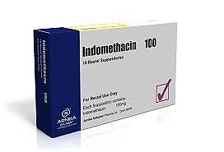
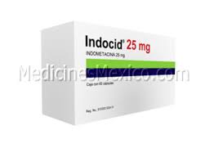
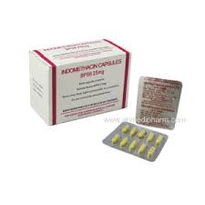

Slide 29
Meloxicam
INDICATIONS AND DOSE
Exacerbation of osteoarthritis (short-term)
▶ BY MOUTH▶ Child 16–17 years: 7.5 mg once daily, then increased if
necessary up to 15 mg once daily▶ Adult: 7.5 mg once daily, then increased if necessary up
to 15 mg once daily
Pain and inflammation in rheumatic disease | Ankylosing
spondylitis
▶ BY MOUTH▶ Child 16–17 years: 15 mg once daily, then reduced to
7.5 mg once daily if required▶ Adult: 15 mg once daily, then reduced to 7.5 mg once
daily if required▶ Elderly: 7.5 mg once daily
Relief of pain and inflammation in juvenile idiopathic
arthritis and other musculoskeletal disorders in children
intolerant to other NSAIDs
▶ BY MOUTH▶ Child 12–17 years (body-weight up to 50 kg): 7.5 mg once daily
▶ Child 12–17 years (body-weight 50 kg and above): 15 mg once daily

Slide 30
Meloxicam
UNLICENSED USE Not licensed for use in children under
16 years.
CONTRA-INDICATIONS Active gastro-intestinal bleeding .
active gastro-intestinal ulceration . following coronary
artery bypass graft surgery . history of gastro-intestinal
bleeding related to previous NSAID therapy . history of
gastro-intestinal perforation related to previous NSAID
therapy . history of recurrent gastro-intestinal
haemorrhage (two or more distinct episodes) . history of
recurrent gastro-intestinal ulceration (two or more
distinct episodes) . severe heart failure
CAUTIONS Allergic disorders . cardiac impairment (NSAIDs
may impair renal function) . cerebrovascular disease .
coagulation defects . connective-tissue disorders . Crohn’s
disease (may be exacerbated) . elderly (risk of serious

Slide 31
Meloxicam
Side effects and fatalities) . heart failure . ischaemic heart disease . peripheral arterial disease . risk factors for cardiovascular events . ulcerative colitis (may be exacerbated) . uncontrolled hypertension
SIDE-EFFECTS ▶ Common or very common Constipation . diarrhoea . gastrointestinal discomfort . gastrointestinal disorders .headache . nausea . Vomiting
ALLERGY AND CROSS-SENSITIVITY Contra-indicated in
patients with a history of hypersensitivity to aspirin or any
other NSAID—which includes those in whom attacks of
asthma, angioedema, urticaria or rhinitis have been
precipitated by aspirin or any other NSAID.
CONCEPTION AND CONTRACEPTION Caution—long-term
use of some NSAIDs is associated with reduced female
fertility, which is reversible on stopping treatment

Slide 32
Meloxicam
PREGNANCY Avoid unless the potential benefit outweighs the risk. Avoid during the third trimester (risk of closure of fetal ductus arteriosus in utero and possibly persistent pulmonary hypertension of the newborn); onset of labour may be delayed and duration may be increased.
BREAST FEEDING Use with caution during breast-feeding. Present in milk in animal studies—manufacturer advises avoid.
HEPATIC IMPAIRMENT Manufacturer advises caution in mild to moderate impairment; avoid in severe impairment.
RENAL IMPAIRMENT Avoid if possible or use with caution.
▶ In adults Avoid if eGFR less than 25 mL/minute/1.73m2.
▶ In children Avoid if estimated glomerular filtration rate less than 25 mL/minute/1.73m2.
Dose adjustments The lowest effective dose should be used for the shortest possible duration. Monitoring In renal impairment monitor renal function; sodium and water retention may occur and renal function may deteriorate, possibly leading to renal failure

Slide 33
Meloxicam
MEDICINAL FORMS
Orodispersible tablet :
Meloxicam 7.5 mg
Meloxicam 15 mg
Tablet:
CAUTIONARY AND ADVISORY LABELS 21
(21 Take with or just after food, or a meal)
Meloxicam 7.5 mg
Meloxicam 15 mg

Slide 34
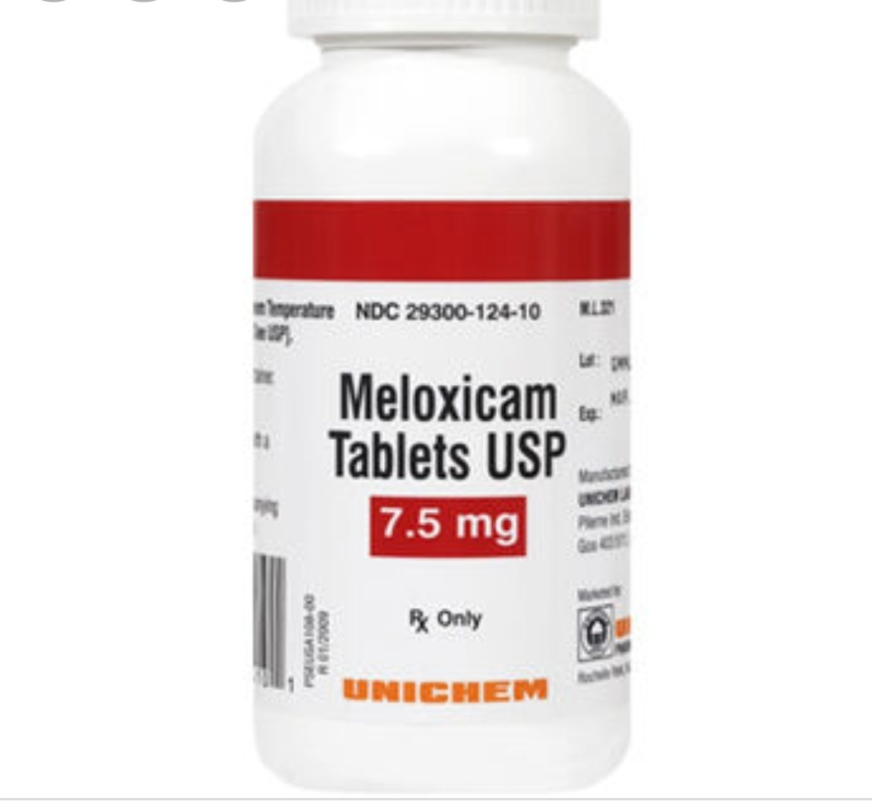
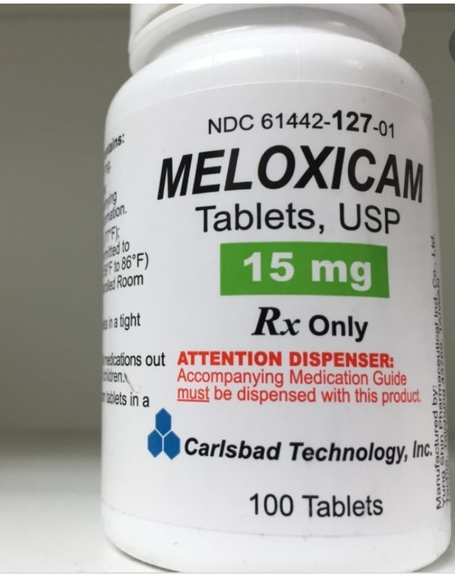

Slide 35
Piroxicam
INDICATIONS AND DOSE
Rheumatoid arthritis (initiated by a specialist) |
Osteoarthritis (initiated by a specialist) | Ankylosing
spondylitis (initiated by a specialist)
▶ BY MOUTH
▶ Adult: Up to 20 mg once daily
Pain relief in musculoskeletal conditions | Treatment in
knee or hand osteoarthritis (adjunct)
▶ TO THE SKIN
▶ Adult: Apply 3–4 times a day, 0.5% gel to be applied;
review treatment after 4 weeks

Slide 36
IMPORTANT SAFETY INFORMATION (Piroxicam )
▶ With systemic use The CHMP has recommended restrictions on the use of piroxicam because of the increased risk of gastrointestinal side effects and serious skin reactions. The CHMP has advised that:
piroxicam should be initiated only by physicians experienced in treating inflammatory or degenerative rheumatic diseases.
piroxicam should not be used as first-line treatment in adults, use of piroxicam should be limited to the symptomatic relief of osteoarthritis, rheumatoid arthritis, and ankylosing spondylitis.
piroxicam dose should not exceed 20mg daily.
piroxicam should no longer be used for the treatment of acute painful and inflammatory conditions. treatment should be reviewed 2 weeks after initiating piroxicam, and periodically thereafter. concomitant administration of a gastro-protective agent should be considered. Topical preparations containing piroxicam are not affected by these restrictions.

Slide 37
Piroxicam
CONTRA-INDICATIONS
▶ With systemic use Active gastro-intestinal bleeding . active
gastro-intestinal ulceration . history of gastro-intestinal bleeding . history of gastro-intestinal perforation . history
of gastro-intestinal ulceration . inflammatory bowel disease . severe heart failure
CAUTIONS
▶ With systemic use Allergic disorders . cardiac impairment (NSAIDs may impair renal function) . cerebrovascular
disease . coagulation defects . connective-tissue disorders .
Crohn’s disease (may be exacerbated) . elderly (risk of serious side-effects and fatalities) . heart failure .
ischaemic heart disease . peripheral arterial disease . Risk factors for cardiovascular events . ulcerative colitis (may be exacerbated) . uncontrolled hypertension
▶ With topical use Avoid contact with eyes . avoid contact with
inflamed or broken skin . avoid contact with mucous
membranes . not for use with occlusive dressings . topical
application of large amounts can result in systemic effects,
including hypersensitivity and asthma (renal disease has
also been reported)

Slide 38
Piroxicam
SIDE-EFFECTS
▶ Common or very common Gastrointestinal discomfort .
gastrointestinal disorders . nausea . skin reactions
ALLERGY AND CROSS-SENSITIVITY Contra-indicated in
patients with a history of hypersensitivity to aspirin or any
other NSAID—which includes those in whom attacks of
asthma, angioedema, urticaria or rhinitis have been
precipitated by aspirin or any other NSAID.
CONCEPTION AND CONTRACEPTION
▶ With systemic use Caution—long-term use of some NSAIDs
is associated with reduced female fertility, which is
reversible on stopping treatment.

Slide 39
Piroxicam
PREGNANCY
▶ With systemic use: Avoid unless the potential benefit
outweighs the risk. Avoid during the third trimester (risk of
closure of fetal ductus arteriosus in utero and possibly
persistent pulmonary hypertension of the newborn); onset
of labour may be delayed and duration may be increased.
▶ With topical use Patient packs for topical preparations carry
a warning to avoid during pregnancy.
BREAST FEEDING
▶ With systemic use: Use with caution during breast-feeding.
Amount too small to be harmful.
▶ With topical use :Patient packs for topical preparations carry
a warning to avoid during breast-feeding.

Slide 40
Piroxicam
HEPATIC IMPAIRMENT
▶ With oral use Manufacturer advises caution.
RENAL IMPAIRMENT
▶ With systemic use Avoid if possible or use with caution.
▶ With topical use Deterioration in renal function has also
been reported after topical use.
Dose adjustments ▶ With systemic use The lowest effective
dose should be used for the shortest possible duration.
Monitoring ▶ With systemic use In renal impairment
monitor renal function; sodium and water retention may
occur and renal function may deteriorate, possibly leading
to renal failure.

Slide 41
Piroxicam
DIRECTIONS FOR ADMINISTRATION Piroxicam
orodispersible tablets can be taken by placing on the
tongue and allowing to dissolve or by swallowing.
▶ For topical preparations apply with gentle
massage only.
PATIENT AND CARER ADVICE
▶ For topical preparations, patients and their carers should be
advised to wash hands immediately after use.
Photosensitivity
▶ With topical use Patients should be advised against
excessive exposure to sunlight of area treated in order to
avoid possibility of photosensitivity.

Slide 42
Piroxicam
MEDICINAL FORMS:
Orodispersible tablet:
CAUTIONARY AND ADVISORY LABELS 10, 21
Piroxicam 20 mg
Gel:
Piroxicam 0.5% gel
Capsule:
CAUTIONARY AND ADVISORY LABELS 21
(21 Take with or just after food, or a meal)
Piroxicam 10 mg
Piroxicam 20 mg

Slide 43
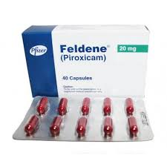
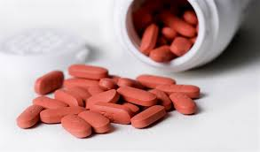

Slide 44
COX-2 inhibitors :Etoricoxib
INDICATIONS AND DOSE
Pain and inflammation in osteoarthritis
▶ BY MOUTH
▶ Child 16–17 years: 30 mg once daily, increased if
necessary to 60 mg once daily
▶ Adult: 30 mg once daily, increased if necessary to
60 mg once daily
Pain and inflammation in rheumatoid arthritis |
Ankylosing spondylitis
▶ BY MOUTH
▶ Child 16–17 years: 60 mg once daily, increased if
necessary to 90 mg once daily
▶ Adult: 60 mg once daily, increased if necessary to
90 mg once daily
Acute gout
▶ BY MOUTH
▶ Child 16–17 years: 120 mg once daily for maximum
8 days
▶ Adult: 120 mg once daily for maximum 8 days

Slide 45
Etoricoxib
CONTRA-INDICATIONS Active gastro-intestinal bleeding .
active gastro-intestinal ulceration . cerebrovascular
disease . inflammatory bowel disease . ischaemic heart
disease . mild to severe heart failure . peripheral arterial
disease . uncontrolled hypertension (persistently above
140/90mmHg)
CAUTIONS Allergic disorders . cardiac impairment (NSAIDs
may impair renal function) . coagulation defects .
connective-tissue disorders . Crohn’s disease (may be
exacerbated) . dehydration . elderly (risk of serious side effects
and fatalities) . history of cardiac failure .
hypertension . left ventricular dysfunction . oedema . risk
factors for cardiovascular events . ulcerative colitis (may be
exacerbated)

Slide 46
Etoricoxib
SIDE-EFFECTS:
▶ Common or very common Arrhythmias . asthenia .
bronchospasm . constipation . diarrhoea . dizziness . Fluid retention . gastrointestinal discomfort . Gastrointestinal disorders . headache . hypertension . increased risk of infection . influenza like illness . nausea . oedema . Oral ulceration . palpitations . skin reactions . Vomiting
ALLERGY AND CROSS-SENSITIVITY Contra-indicated in patients with a history of hypersensitivity to aspirin or any other NSAID—which includes those in whom attacks of asthma, angioedema, urticaria or rhinitis have been
precipitated by aspirin or any other NSAID.
CONCEPTION AND CONTRACEPTION Caution—long-term use of some NSAIDs is associated with reduced female fertility, which is reversible on stopping treatment.
PREGNANCY Manufacturer advises avoid (teratogenic in animal studies). Avoid during the third trimester (risk of
closure of fetal ductus arteriosus in utero and possibly persistent pulmonary hypertension of the newborn); onset
of labour may be delayed and duration may be increased.
BREAST FEEDING Use with caution during breast-feeding.
Manufacturer advises avoid—present in milk in animal studies.

Slide 47
Etoricoxib
HEPATIC IMPAIRMENT Manufacturer advises caution in
mild to moderate impairment; avoid in severe impairment
Dose adjustments Manufacturer advises max. 60mg once
daily in mild impairment; max. 30 mg once daily in
moderate impairment.
RENAL IMPAIRMENT Avoid if possible or use with caution.
▶ In adults Avoid if eGFR less than 30 mL/minute/1.73m2.
▶ In children Avoid if estimated glomerular filtration rate less
than 30 mL/minute/1.73m2.
Dose adjustments The lowest effective dose should be used
for the shortest possible duration.
Monitoring In renal impairment monitor renal function;
sodium and water retention may occur and renal function
may deteriorate, possibly leading to renal failure.
MONITORING REQUIREMENTS Monitor blood pressure
before treatment, 2 weeks after initiation and periodically
during treatment.

Slide 48
Etoricoxib
MEDICINAL FORMS
Tablet:
Etoricoxib 30 mg
Etoricoxib 60 mg
Etoricoxib 90 mg
Etoricoxib 120 mg

Slide 49
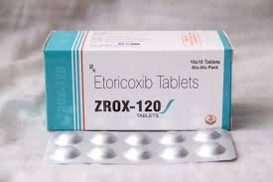
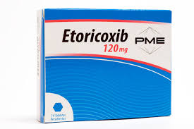

Slide 50
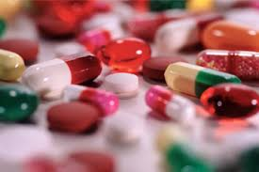
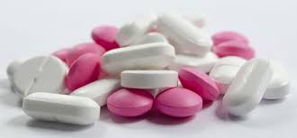
Thank you

