Slide 1
Clinical Toxicology Initial Evaluation & Management of the Poisoned Patient (I) Lec. 1 & 2 5th Year 2020-2021 University of Mustansiriyah/College of Pharmacy Department of Pharmacology & Toxicology Lecturer Rua Abbas Al-Hamdy

Slide 2
Objectives of lecture:
At the end of this lecture, you should be able to:
determine vital signs & toxic syndromes that help in the initial evaluation of the poisoned patient,
determine the general steps involved in management of the poisoned patient, &
identify the methods used for prevention of further poison absorption.

Slide 3
Initial evaluation of the patient: vital signs & toxic syndromes:
American physicians & nurses have attempted to standardize their approach to the assessment of patients. At the New York Hospital in 1865, pulse rate, respiratory rate, & temperature were incorporated into the bedside chart & called “vital signs.”

Slide 4
It was not until the early part of the 20th century, however, that blood pressure determination also became routine.
Additional components of the standard emergency assessment, such as oxygen saturation by pulse oximetry, capillary blood glucose, & pain severity, are now also beginning to be considered vital signs.

Slide 5
Vital signs they frequently provide valuable physiologic clues to the toxicologic etiology & severity of an illness.
Table 1 presents the normal vital signs for various age groups.

Slide 6
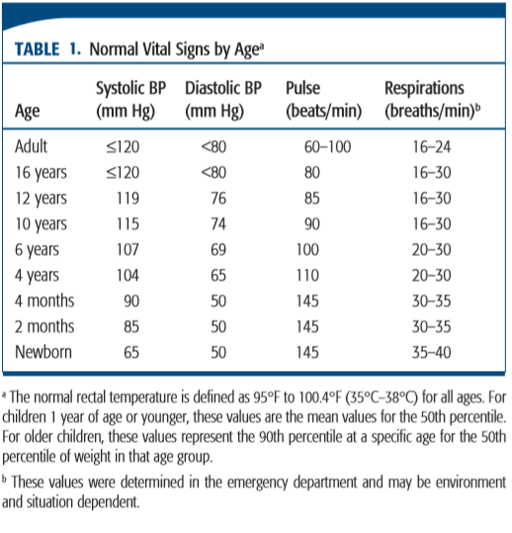

Slide 7
Toxidromes:
The term toxidromes from the words toxic syndromes to describe the groups of signs & symptoms that consistently result from particular toxins.
These syndromes are usually best described by a combination of the vital signs & clinically apparent end-organ manifestations.
Table 2 includes some of the most important signs & symptoms & the xenobiotics most commonly responsible for these manifestations.

Slide 8
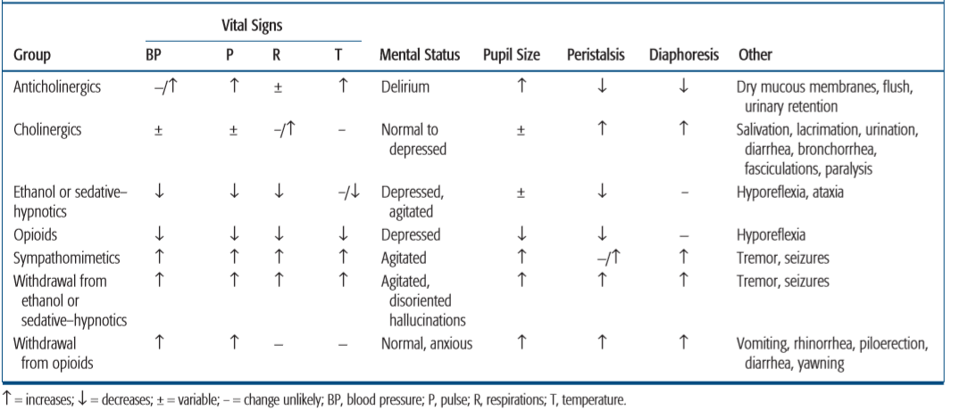
Table 2. Toxic syndromes

Slide 9
Blood pressure:
Xenobiotics cause hypotension by four major mechanisms: decreased peripheral vascular resistance, decreased myocardial contractility, dysrhythmias, & depletion of intravascular volume.
Hypertension from xenobiotics may be caused by CNS sympathetic overactivity, increased myocardial contractility or increased peripheral vascular resistance, or a combination of these.

Slide 10
Pulse rate:
Extremely useful clinical information can be obtained by evaluating the pulse rate.
The normal heart rate for adults was defined by consensus more than 50 years ago as a regular rate greater than 60 beats/min & less than 100 beats/min.

Slide 11
Because pulse rate is the net result of a balance between sympathetic (adrenergic) & parasympathetic (muscarinic & nicotinic) tone, many xenobiotics that exert therapeutic or toxic effects or cause pain syndromes, hyperthermia, or volume depletion also affect the pulse rate.

Slide 12
With respect to temperature, there is a direct correlation between pulse rate & temperature in that pulse rate increases approximately 8 beats/min for each 1.8°F (1°C) elevation in temperature.
The inability to differentiate easily between sympathomimetic & anticholinergic xenobiotic effects by vital signs alone illustrates the principle that no single vital sign abnormality can definitively establish a toxicologic diagnosis.

Slide 13
Respirations:
Establishment of an airway & evaluation of respiratory status are the initial priorities in patient stabilization.
Although respirations are typically assessed initially for rate alone, careful observation of the depth & pattern is essential for establishing the etiology of a systemic illness or toxicity.
It has been suggested that “normal” respiratory rates are 16 to 24 breaths/ min in adults with more rapid rates that are inversely related to age in children.

Slide 14
The term hyperventilation may mean tachypnea (an increase in ventilatory rate), hyperpnea (an increase in tidal volume), or both.
Hyperventilation may result from the direct effect of a CNS stimulant, such as the direct effect of salicylates, on the brainstem. However, salicylate poisoning characteristically produces hyperventilation by tachypnea, but it also produces hyperpnea, with or without tachypnea.
Bradypnea may occur when a CNS depressant acts on the brainstem.

Slide 15
A progression from fast to slow breathing may also occur in a patient exposed to increasing concentrations of cyanide or carbon monoxide.

Slide 16
Temperature:
Temperature evaluation & control are critical. However, temperature assessment can be done only if safe & reliable equipment is used.
an axillary temperature is taken in any patient (especially those found outdoors).
Obtaining rectal temperatures using a nonglass probe is essential for safe & accurate temperature determinations in agitated individuals.

Slide 17
The core temperature or deep internal temperature (T) is relatively stable (98.6° ± 1.08°F; 37° ± 0.6°C) under normal physiologic circumstances.
Hypothermia (T <95°F; <35°C) & hyperthermia (T >100.4°F; >38°C) are common manifestations of toxicity.

Slide 18
Life-threatening hyperthermia (T >106°F; >41.1°C) from any cause may lead to extensive rhabdomyolysis, myoglobinuric renal failure, & direct liver & brain injury & must therefore be identified & corrected immediately.
Hyperthermia of this extreme nature is usually attributed to environmental heat stroke; extreme psychomotor agitation; or xenobiotic-related temperature disturbances such as malignant hyperthermia, the serotonin syndrome, or the neuroleptic malignant syndrome.

Slide 19
Hypothermia is probably less of an immediate threat to life than hyperthermia, but it requires rapid appreciation, accurate diagnosis, & skilled management.
Hypothermia impairs the metabolism of many xenobiotics, leading to unpredictable delayed toxicologic effects when the patient is warmed.

Slide 20
General considerations in management of the poisoned patient:
You must realize that “the care of the PATIENT is the first priority’’
The familiar adage “Treat the patient, not the poison” must always be followed.

Slide 21
The following general steps represent important elements of the initial clinical encounter for a poisoned patient:
Clinical stabilization of the patient
Clinical evaluation (history, physical, laboratory, radiology)
Prevention of further toxicant absorption
Enhancement of toxicant elimination
Administration of antidote (if available)
Supportive care, close monitoring, & clinical follow-up.

Slide 22
Clinical stabilization:
The ﬁrst priority in the treatment of poisoning is to stabilize the patient which involves the assessment of the ABC.
A: airway
B: breathing
C: circulation

Slide 23
Assessment of the patient’s airway (ability to move air into & out of the lungs), breathing (the presence of spontaneous respirations), & circulation (adequate blood pressure & perfusion of vital organs) is the initial step of emergency treatment.

Slide 24
Control of drug/toxicant-induced seizures can be an important component of the initial stabilization of the poisoned patient.
After the “ABCs” (airway, breathing, & circulation) have been addressed, the patient’s level of consciousness should be assessed.

Slide 25
Management of patients with altered mental status:
Altered mental status (AMS) is defined as the deviation of a patient’s sensorium from normal.
Although it is commonly construed as a depression in the patient’s level of consciousness, a patient with agitation, delirium, psychosis, & other deviations from normal is also considered to have an AMS.

Slide 26
Within the first 5 minutes of managing a patient with an AMS, the following therapeutic interventions should be considered , & if indicated, administered:
High-flow oxygen (8–10 L/min) to treat a variety of xenobiotic induced hypoxic conditions.
Hypertonic dextrose: 0.5–1.0 g/kg of D 50 W for an adult or a more dilute dextrose solution (D 10 W or D 25 W) for a child; the dextrose is administered as an IV bolus to diagnose & treat or exclude hypoglycemia.

Slide 27
Naloxone (0.05 mg IV with upward titration) for an adult or child with opioid-induced respiratory compromise.

Slide 28
Clinical history in the poisoned patient:
The primary goal of obtaining the medical history in poisoned patients is to determine the substance the patient was exposed to & the extent & timing of exposure.
Unfortunately, in contrast to most specialties of medicine, the clinical history from the initial clinical encounter with the poisoned patient is sometimes not available because:
either the patient is unresponsive & unable to provide the history or the history provided is unreliable.

Slide 29
The history may be unreliable due to:
inability of the patient to recall pertinent facts relating to the ingestion or exposure or in the setting of an attempted suicide or,
patient who has taken illegal substances, the patient often is not willing to provide an accurate history.

Slide 30
Physical examination:
One of the most important actions performed during the initial clinical encounter in the treatment of the poisoned patient is the physical examination.
A thorough examination of the patient is required to assess the patient’s condition, & determine the patient’s mental status.

Slide 31
In addition, ﬁndings from the physical examination allow one to categorize the patient’s physical examination parameters into broad classes referred to as toxic syndromes (toxidromes), as mentioned previously.

Slide 32
Occasionally, a characteristic odor can be detected on the poisoned patient’s breath or clothing, which may point exposure or poisoning by a speciﬁc agent.
Table 3 lists some of the better recognized odors & the substance associated with the odor.

Slide 33
Table 3. Characteristic odors associated with poisonings
Odor | Potential poison
Bitter almonds | Cyanide
Eggs | Hydrogen sulfide
Garlic | Organophosphates, *DMSO, thallium
Mothballs | Naphthalene, camphor
Wintergreen | Methylsalicylate
*DMSO: dimethyl sulphoxide

Slide 34
Prevention of further poison absorption:
During the early phases of treatment of a poisoned patient who has had a toxic exposure via the oral, inhalation, or the topical route, the opportunity to prevent further absorption of the poison to minimize the total amount of chemical that reaches the systemic circulation may be possible.

Slide 35
For chemicals presented by the inhalation route,
the main intervention to prevent further absorption is removal of the patient from the environment where the toxin is found &
to provide adequate ventilation & oxygenation for the patient.

Slide 36
For topical exposures,
patient clothing containing the chemical must be removed & properly disposed in airtight wrappings or containers to ensure that the rescuers & healthcare providers are adequately protected from secondary exposure.
Most topical exposures require gentle washing of the skin with water & mild soap taking care not to cause cutaneous abrasions of the skin that may enhance dermal absorption.

Slide 37
Avoid using any greases or creams because they will only keep the xenobiotic in close contact with the skin & ultimately make removal more difficult.

Slide 38
When ocular contamination occurs,
irrigation with lukewarm water must be immediately instituted and continued for at least 15 to 20 min.
Contact lenses, if present, should be removed & the eyes held directly under a softly flowing stream of water.
The victim should seek medical attention immediately after irrigation.

Slide 39
For absorption of an oral poison,
The optimal time to intervene to prevent continued absorption of an oral poison is as soon as possible after the ingestion.
The four primary methods are currently available to prevent gastrointestinal absorption (gastrointestinal decontamination):
induction of emesis with syrup of ipecac,
gastric lavage,
oral administration of activated charcoal, &
whole-bowel irrigation.

Slide 40
Gastric emptying:
The principle theory governing gastric emptying is very simple: If a portion of xenobiotic can be removed before absorption, its potentially toxic effect should either be prevented or minimized.
Two methods:
Either emesis can be induced with the administration of syrup of ipecac, or
orogastric lavage.

Slide 41
Time is an important consideration, in that for gastric emptying to be beneficial, a consequential amount of xenobiotic must still be present in the stomach.
Studies have found that very few poisoned patients arrive at the emergency department within 1 to 2 hours after ingestion.
Many authors advise against interventions beyond 1 hour after ingestion.

Slide 42
Gastric emptying may be indicated if:
There is reason to believe that, given the time of ingestion, a significant amount of the ingested xenobiotic is still present in the stomach.
The ingested xenobiotic is known to produce serious toxicity or the patient has obvious signs or symptoms of life-threatening toxicity.
The ingested xenobiotic is not adsorbed by activated charcoal or activated charcoal is unavailable.

Slide 43
Although the ingested xenobiotic is adsorbed by activated charcoal, the amount ingested exceeds the activated charcoal-to-xenobiotic ratio of 10:1 even when using a dose of activated charcoal that is twice the standard dose recommended.
The patient has not had spontaneous emesis.
No highly effective specific antidote exists.

Slide 44
Ipecac syrup:
Ipecac is derived from the dried rhizome &roots of plants belonging to the family Rubiaceae, such as Cephaelis acuminata & Cephaelis ipecacuanha.
Cephaeline & emetine are the two alkaloids largely responsible for the production of nausea & vomiting, with cephaeline being the more potent.

Slide 45
Mechanism of action:
Syrup of ipecac induces vomiting by local activation of peripheral emetic sensory receptors in the proximal small intestine & by central stimulation of the chemoreceptor trigger zone that serves as a sensory area, resulting in subsequent activation of the central vomiting center.
5HT 3 receptors mediate the nausea & vomiting produced by syrup of ipecac by both mechanisms.

Slide 46
Early vomiting usually occurs within 30 min & is due to direct stimulant action on the GI tract.
A second phase occurs after 30 min, resulting from direct stimulant action on the chemoreceptor trigger zone that activates the vomiting center located in the reticular formation.

Slide 47
Induction of emesis with ipecac syrup:
Although a mainstay for poison center-directed induction of emesis for decades, ipecac syrup is rarely used today as efﬁcacy & studies of clinical outcomes associated with use of syrup of ipecac have called into question the overall beneﬁt of its use.
Syrup of ipecac as a chemical for the prevention of toxicant absorption has largely been replaced by activated charcoal.

Slide 48
The American Academy of Clinical Toxicology & the European Association of Poisons Centres & Clinical Toxicologists issued a position paper regarding the use of syrup of ipecac in 2004, which stated that the syrup of ipecac should not be used routinely in the management of the poisoned patient & that there was insufﬁcient data to either support or exclude ipecac administration soon after poison ingestion.

Slide 49
The Academy of Pediatrics currently states that “the first action for a caregiver of a child who may have ingested a toxic substance is to consult with the local poison center.
Many clinical toxicologists believe that there remains a limited role for the clinical use of syrup of ipecac, mainly in rural areas where the length of time before a poisoned patient can reach medical care is signiﬁcant, especially when the chemical ingested is poorly adsorbed to activated charcoal.

Slide 50
Administration:
Recommended doses of ipecac syrup:
Age Quantity
6—12 months 5-10 mL
1—12 years 15 mL
Adults 30 mL
If vomiting does not ensue after the first dose, the same dose may be repeated once 20 to 30 minutes after administration of the first dose.
Home users should be warned that persistent vomiting for more than 2 hours may indicate toxicity from the primary xenobiotics ingested.

Slide 51
Contraindications for use of syrup of ipecac are:
children less than six months of age;
in the ingestion of a caustic agent (acid or alkali);
in a patient with a depressed level of consciousness, or
when there is a signiﬁcant risk of aspiration of gastric contents such as for ingestion of a liquid hydrocarbon with high aspiration potential.

Slide 52
Toxicity of ipecac:
Syrup of ipecac is generally safe & well tolerated, & toxicity is rarely seen in doses recommended.
Some of its adverse effects may include protracted vomiting, diarrhea, lethargy, diaphoresis, & fever.
The toxic component of ipecac is emetine, a cardiotoxin. Chronic abuse of ipecac in patients with anorexia nervosa or bulimia has resulted in peripheral myopathies & sometimes fatal cardiomyopathies.

Slide 53
There are reports of serious adverse effects associated with long-term abuse of syrup of ipecac. These cases demonstrate that significant cumulative toxicity can result from repeated ingestion of a substance that is ordinarily not toxic in doses normally ingested acutely.

