Slide 1
asthma
Assistant lecturer sura abbas

Slide 2
Drugs to be reviewed in this lab
Inhaled cs
Systemic cs
Leukotriene receptor antagonist
Mast cell stabilizer

Slide 3
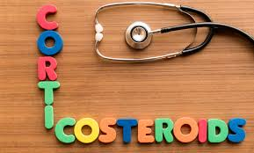

Slide 4
Inhaled corticosteroid
Corticosteroids are effective in asthma; they reduce airway inflammation (and hence reduce edema and secretion of mucus into the airway).
An inhaled corticosteroid is used regularly for prophylaxis of asthma. Regular use of inhaled corticosteroids reduces the risk of exacerbation of asthma.
Corticosteroid inhalers must be used regularly for maximum benefit. Beclomethasone dipropionate, budesonide , fluticasone , and mometasone furoate appear to be equally effective.

Slide 5

Corticosteroids (inhaled)
IMPORTANT SAFETY INFORMATION
MHRA/CHM ADVICE: CORTICOSTEROIDS: RARE RISK OF CENTRAL SEROUS CHORIORETINOPATHY WITH LOCAL AS WELL AS SYSTEMIC ADMINISTRATION
Central serous chorioretinopathy is a retinal disorder that has been linked to the systemic use of corticosteroids. Recently, it has also been reported after local administration of corticosteroids via inhaled and intranasal, epidural, intra-articular, topical dermal, and periocular routes.
Fluid build up under retina=referral

Slide 6
SIDE-EFFECTS of inhaled cs
▶ Common or very common Headache . oral candidiasis .
pneumonia (in patients with COPD) (in adults) . Taste altered . voice alteration
▶ Uncommon Anxiety . bronchospasm paradoxical . cataract .vision blurred
▶ Rare or very rare Adrenal suppression . Behaviour abnormal . glaucoma . growth retardation (in children) .sleep disorder

Slide 7
SIDE-EFFECTS, FURTHER INFORMATION
Systemic absorption may follow inhaled administration particularly if high doses are used or if treatment is prolonged. Therefore also consider the side-effects of systemic corticosteroids.
Candidiasis The risk of oral candidiasis can be reduced by using a spacer device with the corticosteroid inhaler; rinsing the mouth with water after inhalation of a dose may also be helpful. An anti-fungal oral suspension or oral gel can be used to treat oral candidiasis without discontinuing corticosteroid therapy.
Paradoxical bronchospasm The potential for paradoxical bronchospasm (calling for discontinuation and alternative therapy) should be borne in mind. Mild bronchospasm may be prevented by inhalation of a short acting beta2 agonist beforehand (or by transfer from an aerosol inhalation to a dry powder inhalation).

Slide 8
PREGNANCY Inhaled drugs for asthma can be taken as normal during pregnancy.
BREAST FEEDING Inhaled corticosteroids for asthma can be taken as normal during breast-feeding.
MONITORING REQUIREMENTS
▶ In children The height and weight of children receiving prolonged treatment with inhaled corticosteroids should be monitored annually; if growth is slowed, referral to a pediatrician should be considered.

Slide 9
Beclomethasone dipropionate
INDICATIONS AND DOSE
Prophylaxis of asthma
▶ BY INHALATION OF POWDER
▶ Child 5–11 years: 100–200 micrograms twice daily, dose to be adjusted as necessary
▶ Child 12–17 years: 200–400 micrograms twice daily; increased if necessary up to 800 micrograms twice daily, dose to be adjusted as necessary
▶ Adult: 200–400 micrograms twice daily; increased if necessary up to 800 micrograms twice daily, dose to be adjusted as necessary

Slide 10
MHRA/CHM ADVICE (JULY 2008)
Beclometasone dipropionate CFC-free pressurized metered-dose inhalers are not interchangeable
MHRA/CHM ADVICE: PRESSURISED METERED DOSE INHALERS (PMDI): RISK OF AIRWAY OBSTRUCTION FROM ASPIRATION OF LOOSE OBJECTS
PATIENT AND CARER ADVICE Steroid card should be issued with high doses of inhaled beclomethasone dipropionate.

Slide 11
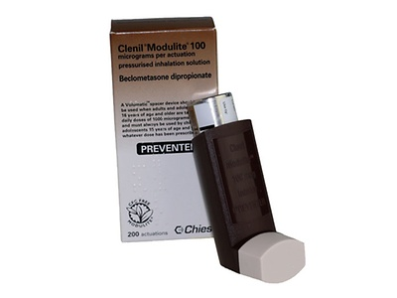
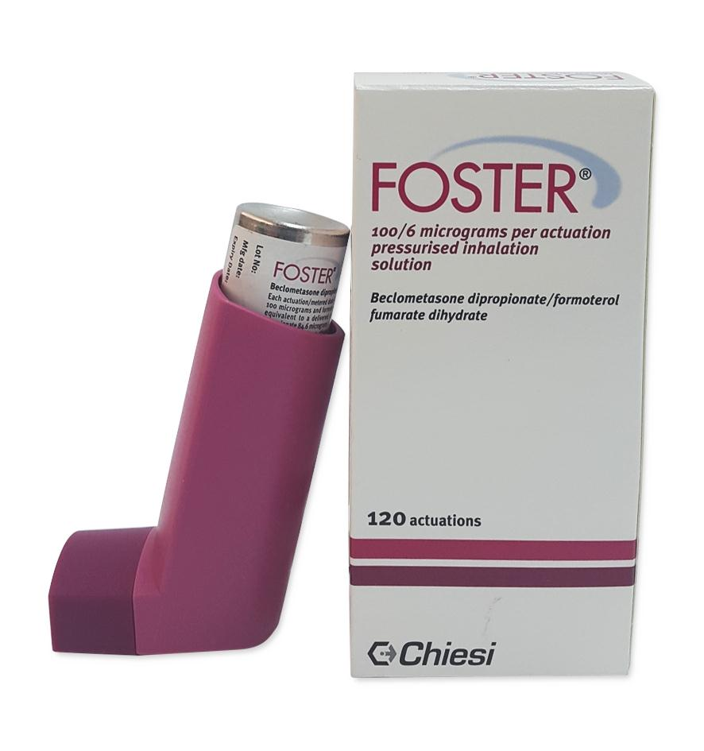
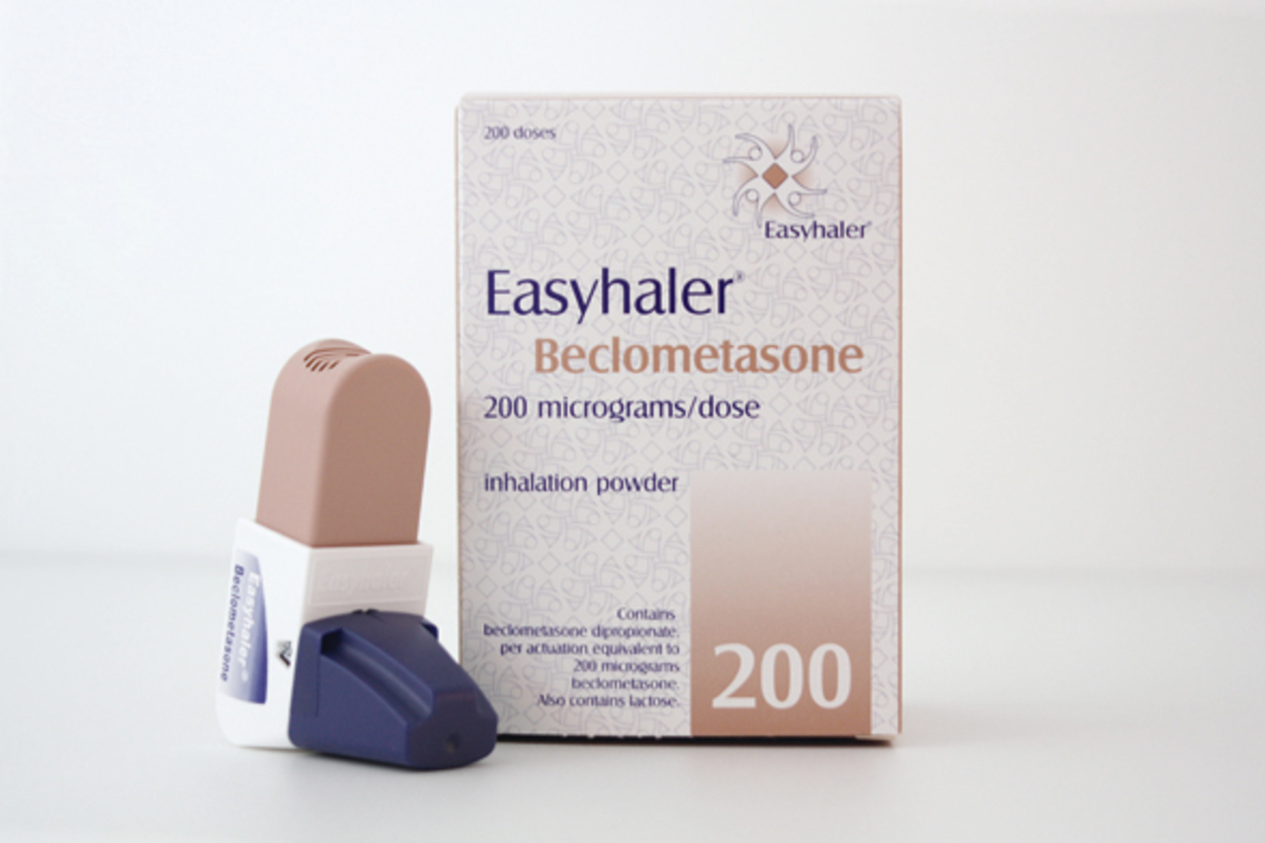
Beclomethasone

Slide 12
Budesonide
DRUG ACTION Budesonide is a glucocorticoid, which exerts significant local anti-inflammatory effects.
Prophylaxis of mild to moderate asthma (in patients stabilized on twice daily dose)
▶ BY INHALATION OF POWDER
▶ Child 6–11 years: 200–400 micrograms once daily, dose to be given in the evening
▶ Child 12–17 years: 200–400 micrograms once daily (max. per dose 800 micrograms), dose to be given in the evening
▶ Adult: 200–400 micrograms once daily (max. per dose 800 micrograms), dose to be given in the evening

Slide 13
Prophylaxis of asthma
▶ BY INHALATION OF POWDER
▶ Child 6–11 years: 100–400 micrograms twice daily, dose to be adjusted as necessary
▶ Child 12–17 years: 100–800 micrograms twice daily, dose to be adjusted as necessary
▶ Adult: 100–800 micrograms twice daily, dose to be adjusted as necessary

Slide 14
▶ BY INHALATION OF NEBULISED SUSPENSION
▶ Child 6 months–11 years: 125–500 micrograms twice daily, adjusted according to response; maximum 2 mg per day
▶ Child 12–17 years: Initially 0.25–1 mg twice daily, adjusted according to response, doses higher than recommended max. may be used in severe disease; maximum 2 mg per day
▶ Adult: Initially 0.25–1 mg twice daily, adjusted according to response, doses higher than recommended max. may be used in severe disease; maximum 2 mg per day

Slide 15
Budesonide
DRUG ACTION Budesonide is a glucocorticoid, which exerts significant local anti-inflammatory effects.
PULMICORT ® RESPULES
Prophylaxis of asthma
▶ BY INHALATION OF NEBULISED SUSPENSION
▶ Child 3 months–11 years: Initially 0.5–1 mg twice daily, reduced to 250–500 micrograms twice daily
▶ Child 12–17 years: Initially 1–2 mg twice daily, reduced to 0.5–1 mg twice daily
▶ Adult: Initially 1–2 mg twice daily, reduced to 0.5–1 mg twice daily

Slide 16
PULMICORT ® TURBOHALER
Prophylaxis of asthma
▶ BY INHALATION OF POWDER
▶ Adult: 100–800 micrograms twice daily, dose to be adjusted as necessary
Alternative in mild to moderate asthma, for patients previously stabilised on a twice daily dose
▶ BY INHALATION OF POWDER
▶ Adult: 200–400 micrograms once daily (max. per dose
800 micrograms), to be taken in the evening

Slide 17
PATIENT AND CARER ADVICE With high doses, a steroid card should be supplied. Patients or carers should be given advice on how to administer budesonide dry powder inhaler and nebulizer suspension.

Slide 18
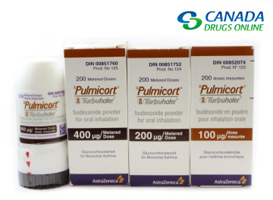
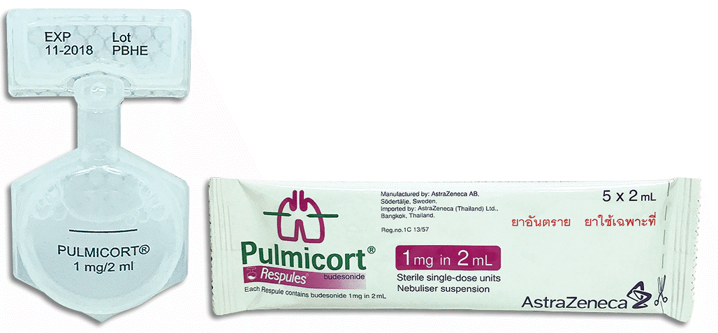
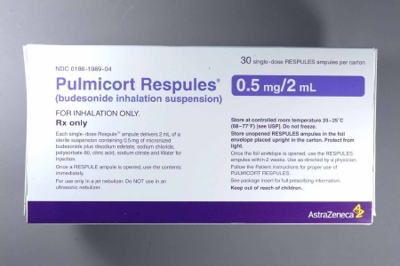
Budesonide

Slide 19
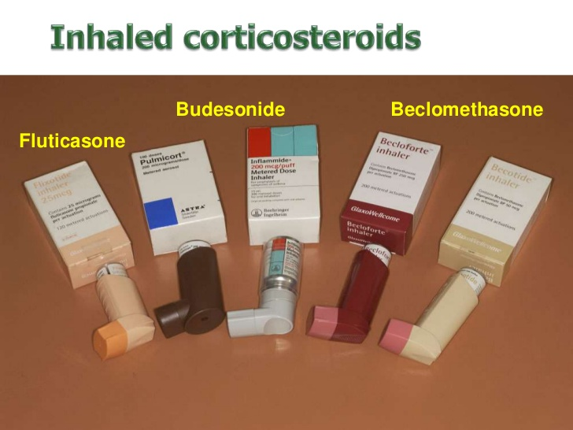

Slide 20
Systemic corticosteroid
An acute attack of asthma should be treated with a short course of an oral corticosteroid starting with a high dose.
No need for tapering the dose
An oral corticosteroid should normally be taken as a single dose in the morning to reduce the disturbance to circadian cortisol secretion. Dosage should always be titrated to the lowest dose that controls symptoms. Regular peak-flow measurements help to optimize the dose.
Parenteral corticosteroids
Hydrocortisone injection has a role in the emergency treatment of acute severe asthma.

Slide 21
Systemic corticosteroid
Glucocorticoid side effects
. diabetes
. osteoporosis, which is a danger, particularly in the elderly, as it can result in osteoporotic fractures for example of the hip or vertebrae;
. in addition high doses are associated with avascular necrosis of the femoral head.
muscle wasting (proximal myopathy) can also occur.
. corticosteroid therapy is also weakly linked with peptic ulceration and perforation.
. psychiatric reactions may also occur

Slide 23
Side effect of systemic cs in general
Common or very common Anxiety . behaviour abnormal . cataract subcapsular . cognitive impairment . Cushing’s syndrome . electrolyte imbalance . fluid retention . gastrointestinal discomfort . headache . healing impaired . hirsutism . hypertension . increased risk of infection . menstrual cycle irregularities . mood altered . nausea . osteoporosis . peptic ulcer . psychotic disorder . Skin reactions . sleep disorders . weight increased
▶ Uncommon Adrenal suppression . alkalosis hypokalaemic . appetite increased . bone fractures . diabetic control impaired . eye disorders . fatigue . glaucoma . Haemorrhage . heart failure . hyperhidrosis . hypotension . leucocytosis . myopathy . osteonecrosis . pancreatitis . papilloedema . seizure . thromboembolism . tuberculosis reactivation . vertigo . vision blurred

Slide 24
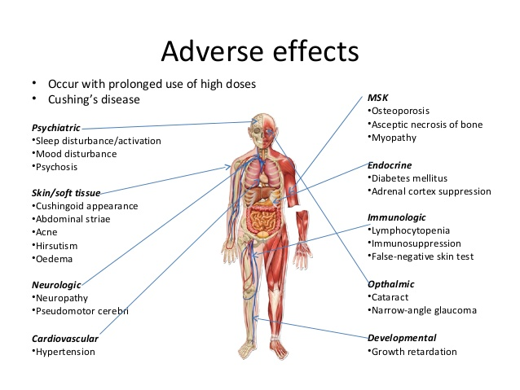
Side effect of systemic cs in general

Slide 25
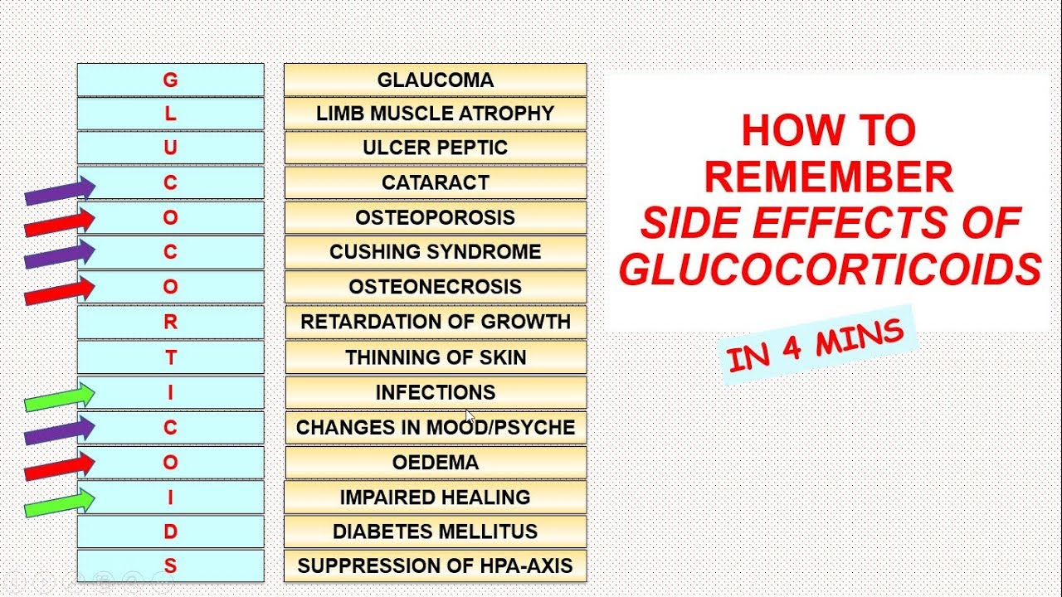

Slide 26
Cautions of systemic cs in general
Congestive heart failure . diabetes mellitus (including a family history of) . diverticulitis . epilepsy . glaucoma (including a family history of or susceptibility to) . history of steroid myopathy . history of tuberculosis orX-ray changes (frequent monitoring required) . hypertension . hypothyroidism . infection (particularly untreated) . myasthenia gravis . ocular herpes simplex (risk of corneal perforation) . osteoporosis (in children) . osteoporosis (post-menopausal women and the elderly at special risk) (in adults) . peptic ulcer . psychiatric reactions . recent intestinal anastomoses . recent myocardial infarction (rupture reported) . severe affective disorders (particularly if history of steroid-induced psychosis) . should not be used long-term . thromboembolic disorders . ulcerative colitis

Slide 27
▶ Rare or very rare Malaise . tendon rupture
▶ Frequency not known Chorioretinopathy . Growth retardation (very common in children) . Intracranial pressure increased with papilledema (usually after withdrawal) . telangiectasia

Slide 28
Prednisolone
DRUG ACTION Prednisolone exerts predominantly glucocorticoid effects with minimal mineralocorticoid effects.
Mild to moderate acute asthma (when oral corticosteroid taken for more than a few days) | Severe or life-threatening acute asthma (when oral corticosteroid taken for more than a few days)
▶ BY MOUTH
▶ Child 1 month–11 years: 2 mg/kg once daily (max. per
dose 60 mg) for up to 3 days, longer if necessary

Slide 29
Mild to moderate acute asthma | Severe or life-threatening acute asthma
▶ BY MOUTH
▶ Child 1 month–11 years: 1–2 mg/kg once daily (max. per
dose 40 mg) for up to 3 days, longer if necessary
▶ Child 12–17 years: 40–50 mg daily for at least 5 days
▶ Adult: 40–50 mg daily for at least 5 days

Slide 30
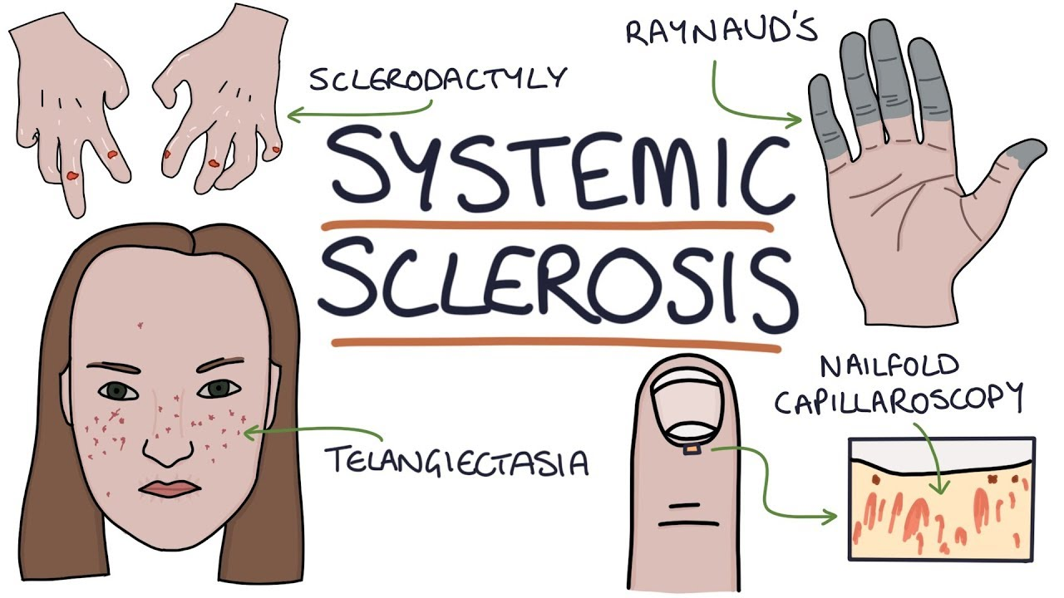
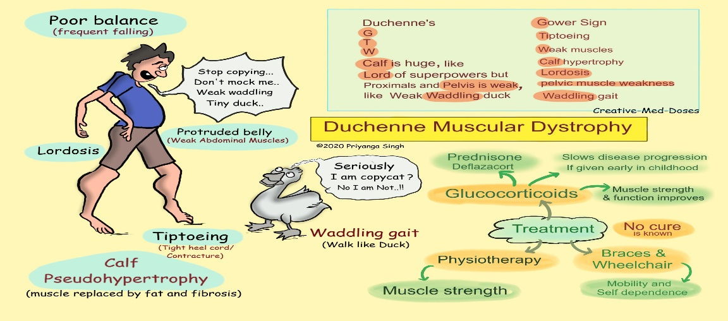
Caution:
With systemic use Duchenne’s muscular dystrophy (possible transient rhabdomyolysis and myoglobinuria following strenuous physical activity) . systemic sclerosis (increased incidence of scleroderma renal crisis with a daily dose of 15mg or more)
Side effect:
With oral use Diarrhoea . dizziness . dyslipidemia .lipomatosis . protein catabolism . scleroderma renal crisis

Slide 31
PREGNANCY As it crosses the placenta 88%of prednisolone is inactivated.
Monitoring ▶ With systemic use Pregnant women with fluid
retention should be monitored closely.
BREAST FEEDING Prednisolone appears in small amounts in breast milk but maternal doses of up to 40mg daily are unlikely to cause systemic effects in the infant.
Monitoring ▶ With systemic use Infant should be monitored for adrenal suppression if mother is taking a dose higher than 40 mg.

Slide 32
MONITORING REQUIREMENTS
▶ With systemic use Manufacturer advises monitor blood pressure and renal function (s-creatinine) routinely in patients with systemic sclerosis—increased incidence of scleroderma renal crisis.

Slide 33
MEDICINAL FORMS
Gastro-resistant tablet( 1, 2.5,5mg)
CAUTIONARY AND ADVISORY LABELS 5, 10, 25
Soluble tablet(5 mg)
CAUTIONARY AND ADVISORY LABELS 10, 13, 21
Tablet (1, 2.5,5, 20,25 mg)
CAUTIONARY AND ADVISORY LABELS 10, 21

Slide 34
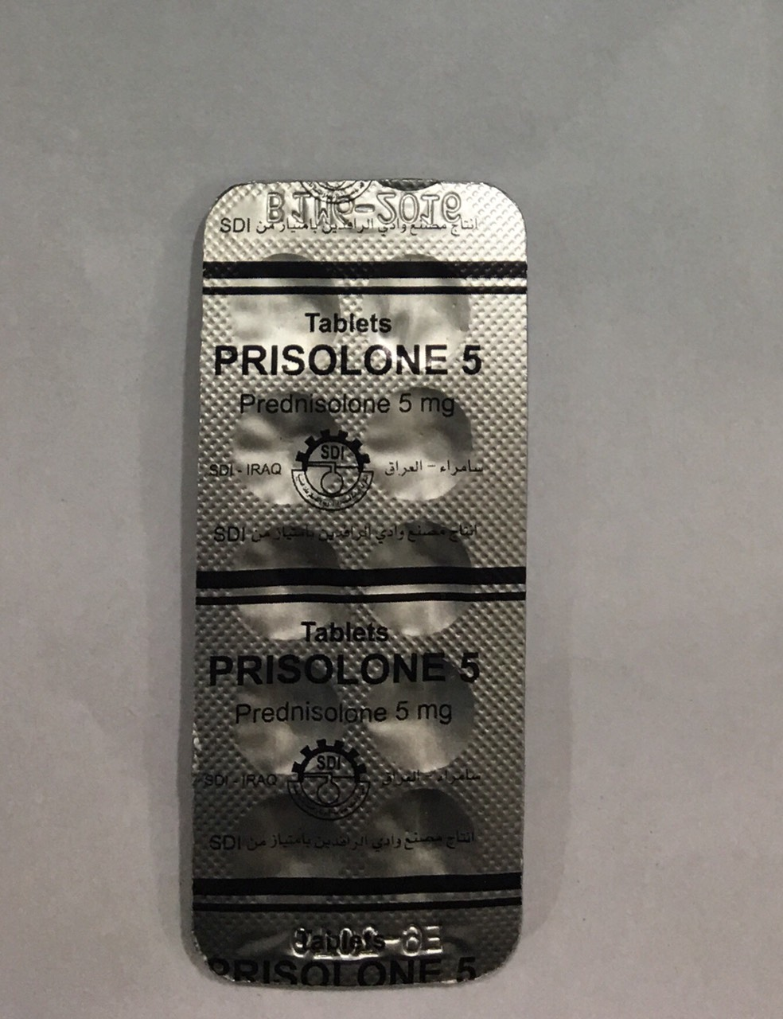
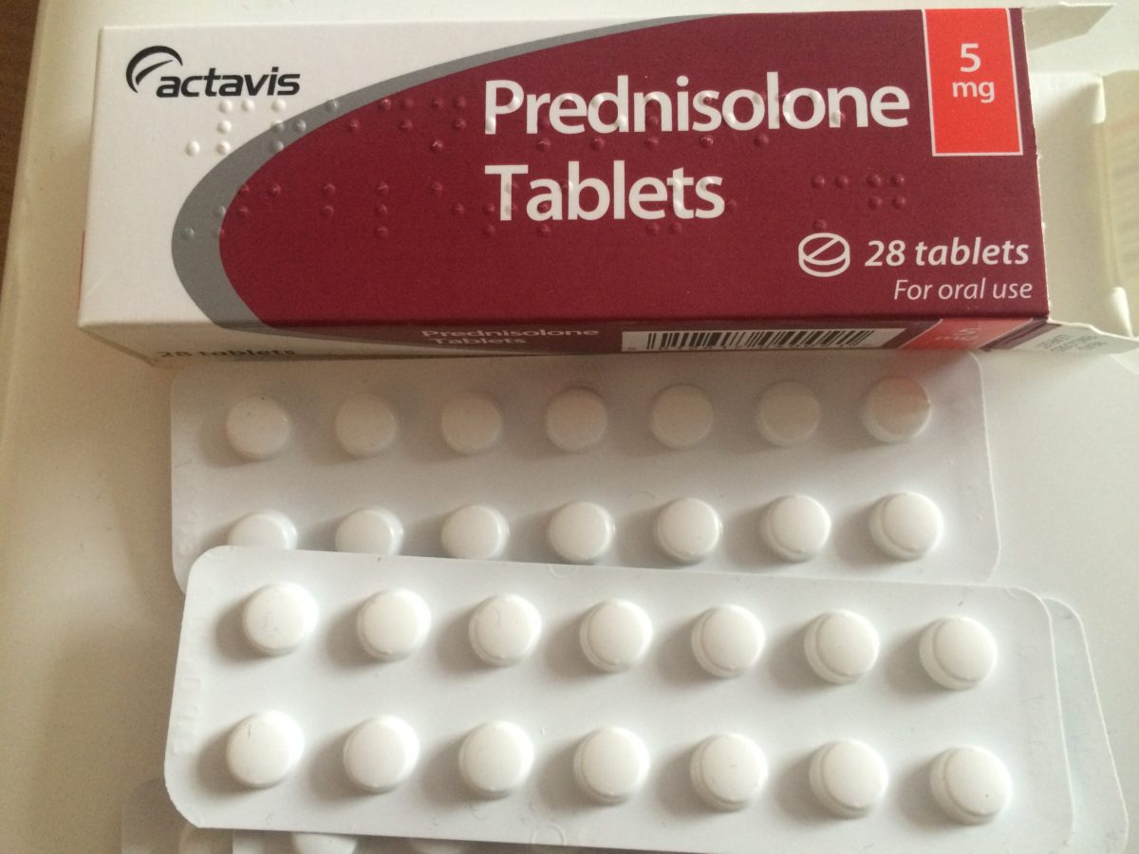

Slide 35
Leukotriene receptor antagonist
The leukotriene receptor antagonist montelukast blocks the effects of cysteinyl leukotrienes in the airways.
Montelukast has not been shown to be more effective than a standard dose of inhaled corticosteroid, but the two drugs appear to have an additive effect. The leukotriene receptor antagonists may be of benefit in exercise-induced asthma and in those with concomitant rhinitis, but they are less effective in those with severe asthma who are also receiving high doses of other drugs.
Zafirlukast
Lipoxygenase inhibitor is zileuton

Slide 36
Montelukast
INDICATIONS AND DOSE
Prophylaxis of asthma
▶ BY MOUTH
▶ Child 6 months–5 years: 4 mg once daily, dose to be taken in the evening
▶ Child 6–14 years: 5 mg once daily, dose to be taken in the evening
▶ Child 15–17 years: 10 mg once daily, dose to be taken in the evening
▶ Adult: 10 mg once daily, dose to be taken in the evening

Slide 37
Symptomatic relief of seasonal allergic rhinitis in patients with asthma.
▶ BY MOUTH
▶ Child 15–17 years: 10 mg once daily, dose to be taken in the evening
▶ Adult: 10 mg once daily, dose to be taken in the evening

Slide 38
l SIDE-EFFECTS
▶ Common or very common Diarrhoea . fever . gastrointestinal discomfort . headache . nausea . Skin reactions . upper respiratory tract infection . Vomiting
PREGNANCY Manufacturer advises avoid unless essential. There is limited evidence for the safe use of montelukast during pregnancy; however, it can be taken as normal in women who have shown a significant improvement in asthma not achievable with other drugs before becoming pregnant

Slide 39
BREAST FEEDING Manufacturer advises avoid unless essential.
DIRECTIONS FOR ADMINISTRATION Granules may be swallowed or mixed with cold, soft food (not liquid) and taken immediately.
With leukotriene receptor antagonist, prescribers should be alert to the development of eosinophilia, vasculitic rash, worsening pulmonary symptoms, cardiac complications, or peripheral neuropath.

Slide 40
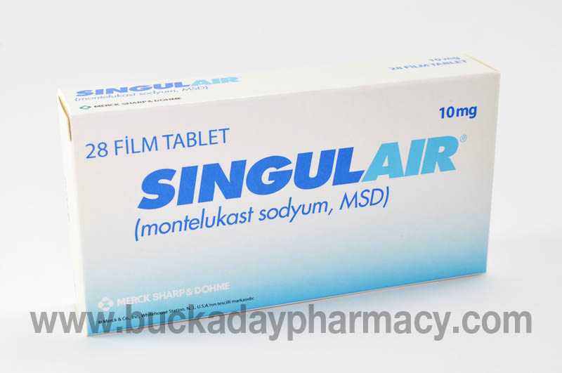
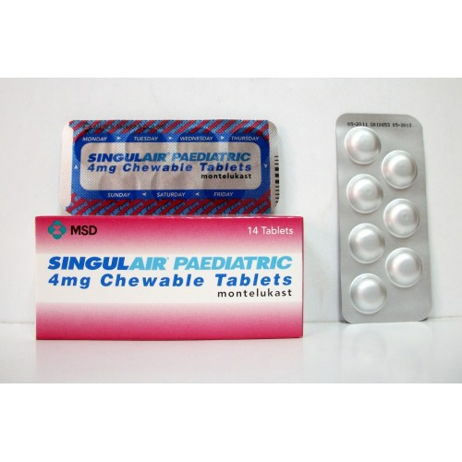
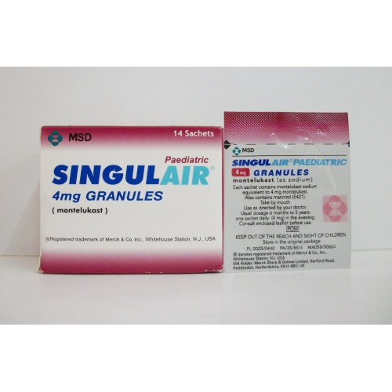
Montelukast

Slide 41
MAST-CELL STABILISERS
Cromoglicate and related therapy: The mode of action of sodium cromoglicate and nedocromil sodium is not completely understood.
They may be of value in asthma with an allergic basis, but, in practice, it is difficult to predict who will benefit; they could probably be given for 4 to 6 weeks to assess response. Dose frequency is adjusted according to response but is usually 3 to 4 times a day initially; this may subsequently be reduced.
Sodium cromoglicate can prevent exercise-induced asthma. Sodium cromoglicate and nedocromil sodium may also have a role in allergic conjunctivitis; sodium cromoglicate is used also in allergic rhinitis and allergy-related diarrhoea.

Slide 42
Sodium cromoglicate
INDICATIONS AND DOSE
Prophylaxis of asthma
▶ BY INHALATION OF AEROSOL
▶ Child 5–17 years AND ADULTS: Initially 10 mg 4 times a day, additional dose may also be taken before exercise, increased if necessary to 10 mg 6–8 times a day; maintenance 5 mg 4 times a day, 5mg is equivalent to 1 puff

Slide 43
MHRA/CHM ADVICE: PRESSURISED METERED DOSE INHALERS
(PMDI): RISK OF AIRWAY OBSTRUCTION FROM ASPIRATION OF LOOSE OBJECTS
CAUTIONS
▶ When used by inhalation Discontinue if eosinophilic pneumonia occurs
SIDE-EFFECTS
▶ When used by inhalation Cough . headache . Pneumonia eosinophilic . rhinitis . throat irritation
▶ With oral use Arthralgia . nausea . rash
SIDE-EFFECTS, FURTHER INFORMATION When used by inhalation, if paradoxical bronchospasm occurs, a short acting beta2-agonist should be used to control symptoms; treatment with sodium cromoglicate should be discontinued

Slide 44
PREGNANCY Not known to be harmful.
▶ When used by inhalation Can be taken as normal during
pregnancy.
BREAST FEEDING Unlikely to be present in milk.
▶ When used by inhalation Can be taken as normal during
breast-feeding.
TREATMENT CESSATION
▶ When used by inhalation Withdrawal of sodium cromoglicate should be done gradually over a period of one week— symptoms of asthma may recur

Slide 45
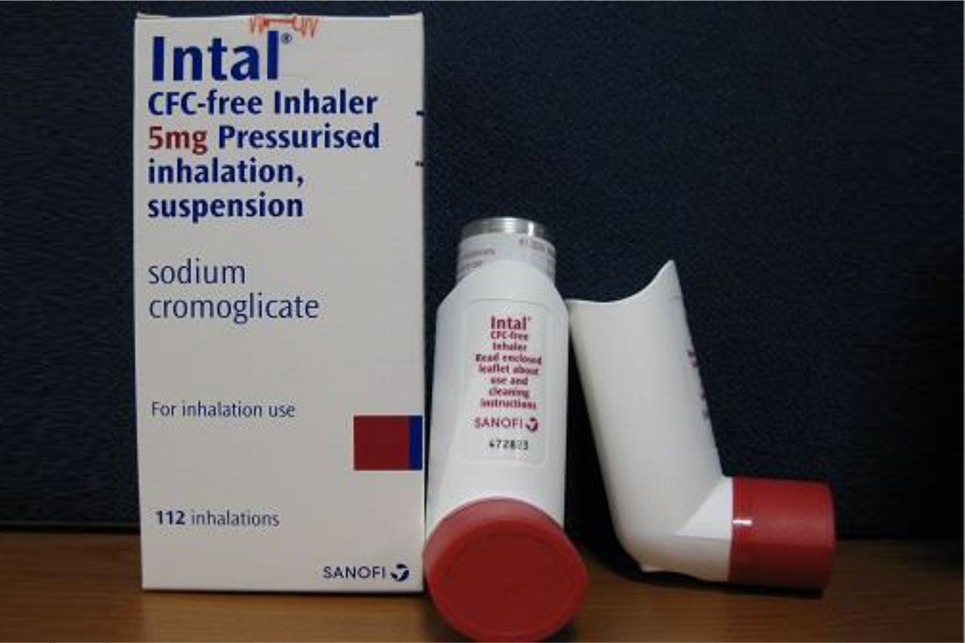
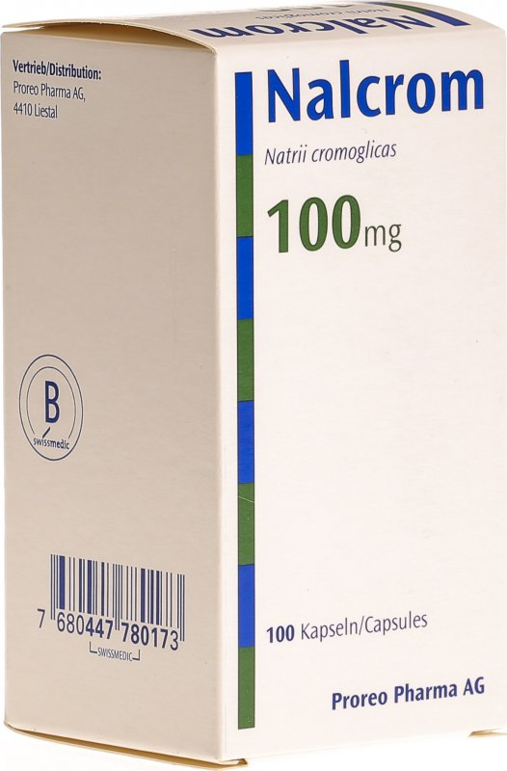

Slide 46


