Slide 1
Effect of Parasympathomimetic
Drugs on Glandular Secretions in Rats
Lab-6
Department of Pharmacology and Toxicology,
Mustansiriyah University
Jan 2021
Asst. Lec. Zakariya Al-Mashhadani

Slide 2
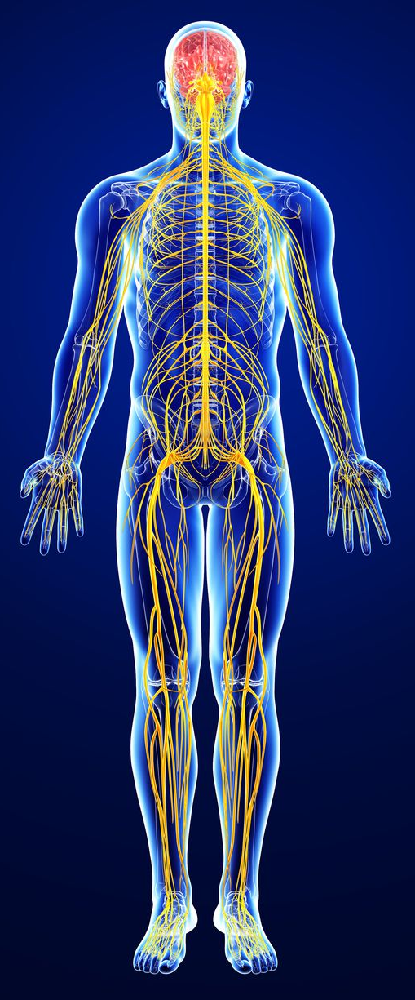
Nervous System
The nervous system consists of the brain, spinal cord, sensory organs, and all of the nerves that connect these organs with the rest of the body
The brain and spinal cord form the control center known as the central nervous system (CNS), where information is evaluated and decisions are made
The sensory nerves and sense organs of the peripheral nervous system (PNS) send information to CNS and regulate organs functions by efferent and afferent nerves

Slide 3
Autonomic Nervous System
The autonomic nervous system conveys all the outputs from the CNS to the rest of the body, except for the motor innervation of skeletal muscle
Compose of two neurons, the pre-ganglionic neuron with cell body in the CNS and the post-ganglionic neuron with cell body in the autonomic ganglia
The main processes that it regulates are:
  Control circulation, respiration, digestion, and body temperature
  Contraction and relaxation of vascular and visceral smooth muscle
  All exocrine and certain endocrine secretions
  The heartbeat
  Energy metabolism, particularly in liver and skeletal muscle
Three main parts
  sympathetic
  parasympathetic
  The enteric nervous system

Slide 4
Autonomic Nervous System
The Parasympathomimetic nervous system innervates a large number of organs.
The neurotransmitter acetylcholine (Ach) mediates the transmission of impulses from the preganglionic neurons to postganglionic neurons as well as the transmission of impulses from postganglionic nerve terminals to the effector organs.
The action of Ach at the effector organ can be mimicked by drugs like Carbachol, methacholine, or muscarine. The sites at which Ach and the Parasympathomimetics act are called Muscarinic receptors (M receptors) and they are sensitive to block by atropine

Slide 5
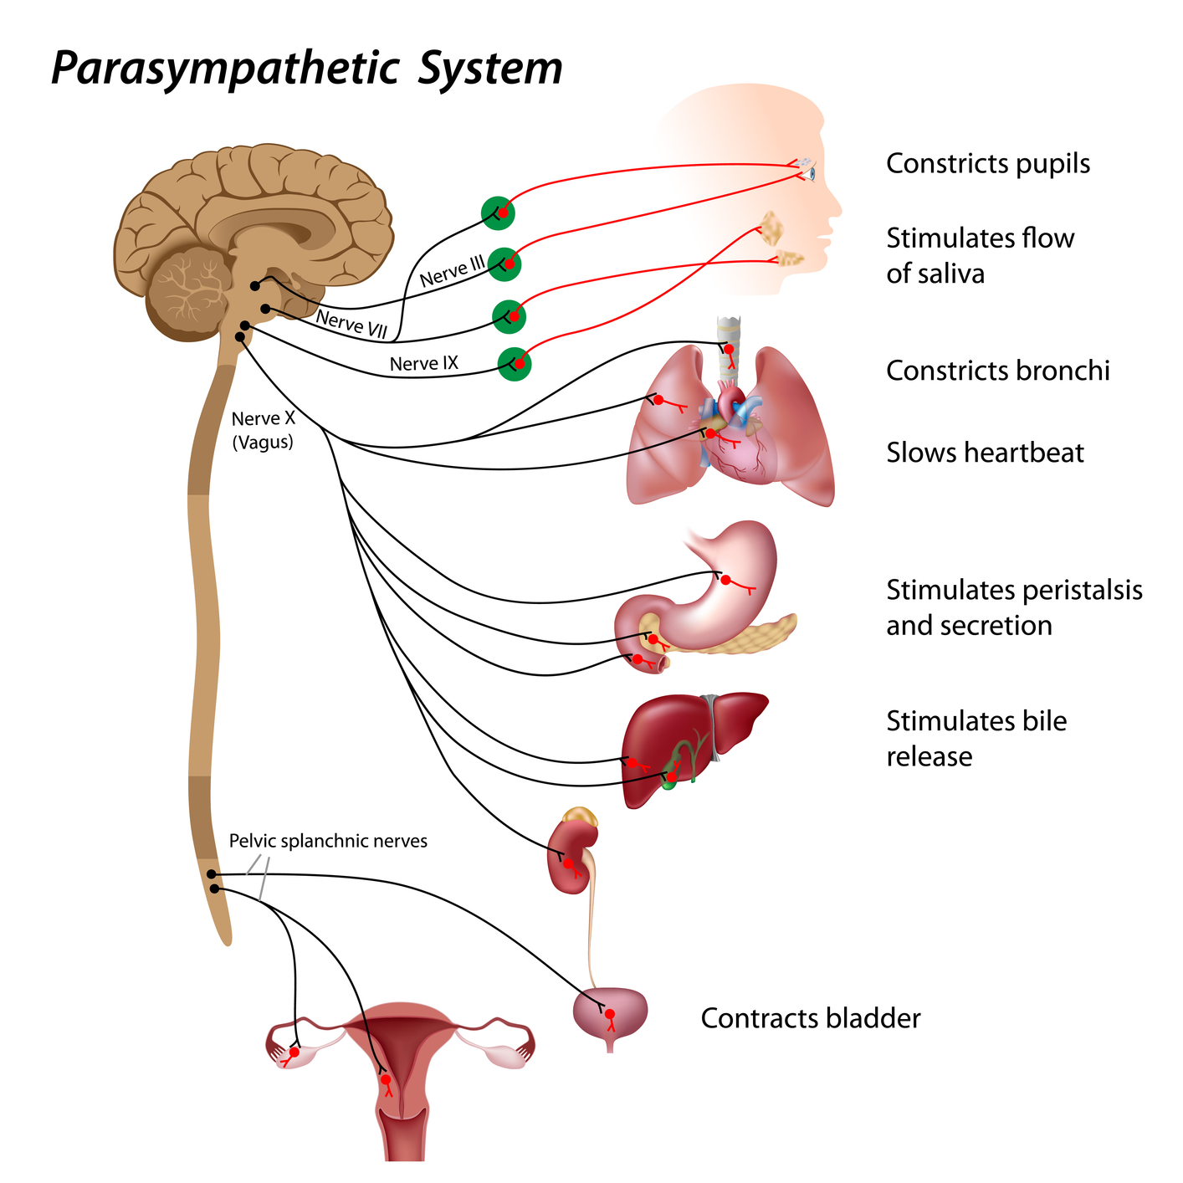
Parasympathetic N.S.
Ach is the only neurotransmitter of this system that can act on two types of receptors: Nicotinic R. and Muscarinic R.

Slide 6
Muscarinic Receptors
G. protein coupled receptors
Five types of these receptors (M1-M5)
M1 receptors (neural): C.N.S., gastric parietal cells, they mediate an excitatory effect result an increase of acid secretion
M2 receptors (cardiac); present in the heart, they exert an inhibitory effects causing bradycardia
M3 receptors (glandular); present in the smooth muscle of G.I.T., bronchial, bladder and exocrine glands; like sweat gland, salivary and lacrimal gland. They mediate excitatory effect which increases the glandular secretion and contraction of visceral smooth muscle
M4 and M5 receptors; present in C.N.S. but their functions are not fully identified

Slide 7
parasympathomimetic Drugs
Direct-acting
Indirect-acting
Receptor agonists
Cholinesterase inhibitors
Choline esters
METHACHOLINE
CARBACHOL
BETHACHOLINE
Alkaloids
PILOCARPINE
Reversible
PHYSOSTIGMINE
NEOSTIGMINE
PYRIDOSTIGMINE
Irreversible
Organo Phosphates

Slide 8
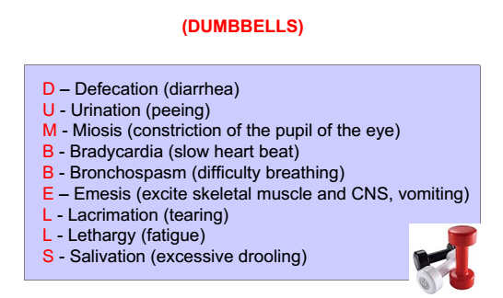
Antimuscarinic agents
Block M.R. cause an inhibition of all M. function
Have little or no action at skeletal N.M.J. or autonomic ganglia, they do not block N.R .
Reverse excessive cholinergic effects (reverse DUMBBELLS)

Slide 9
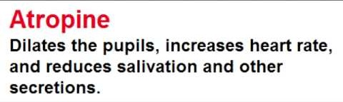
Antimuscarinic agents
Atropine (Hyoscyamine)
  Orally absorbed , cross BBB
  Competitive antagonist to Ach at all muscarinic receptors
Scopolamine: anti-motion sickness
Pirenzepine: block M.R. of the gastric parietal glands; hence it is preferred in the treatment of gastric ulcer
Ipratropine: useful in the treatment of asthma to decrease secretion & dilate obstructed air ways

Slide 10
Principle
Ach and parasympathomimetics stimulates the secretion of different glands in the body, like mucous, sweat, salivary and tear glands as well as secretory activity of the stomach, intestine and pancreas.
In the rat, there is a special horseshoe-shaped gland is located within the bony orbit called Harderian gland.
This gland Involves muscarinic receptors.

Slide 11
Aim of the experiment
This exp. was designed to show the stimulatory effect of cholinergic drug on glandular secretion
to prove that these glands are parasympathetically innervated and contain a muscarinic type of receptors.

Slide 12
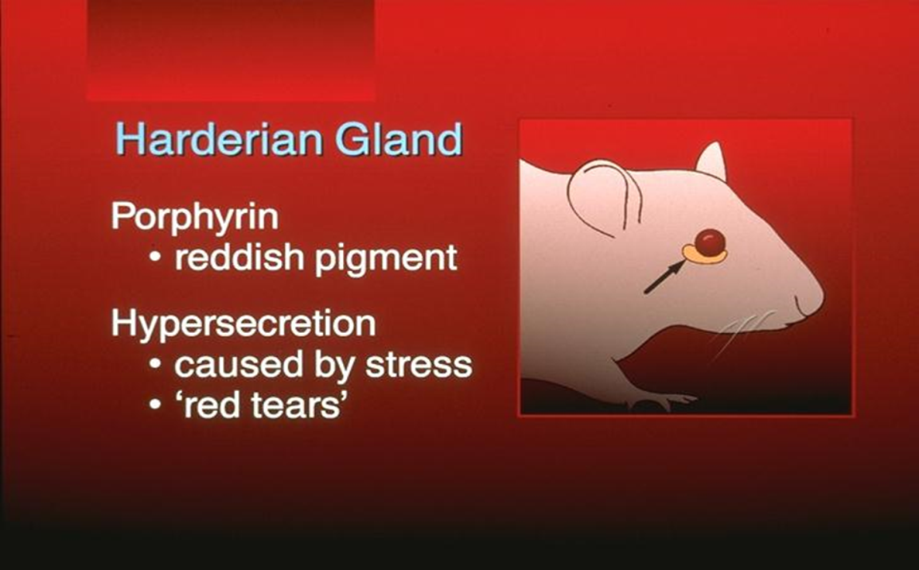
Effect of Parasympathomimetic Drugs on Glandular Secretions in Rats
The Harderian gland
The Harderian gland (or Harder's lacrimal gland) is an exocrine gland, horseshoe-shaped located within the bony orbit
Secretions from this gland include the reddish pigment porphyrin

Slide 13
The Harderian gland
Harderian secretions coat the eye, and drain down into the nose through the nasolacrimal duct. A rat may smear the secretions around his nose
Involves muscarinic receptors
Hypersecretion in stressed rats is often referred to as "red tears" (chromodacryorrhea)
Rats overproduce porphyrin when they are:
  Stressed, ill, or poorly fed
  Water deprivation
  Joint pain , morphine withdrawal
  Acetylcholine injections
After injection with acetylcholine, for example, profuse amounts of porphyrin were secreted almost immediately and overflowed the eye to stain the eyelids within minutes

Slide 14
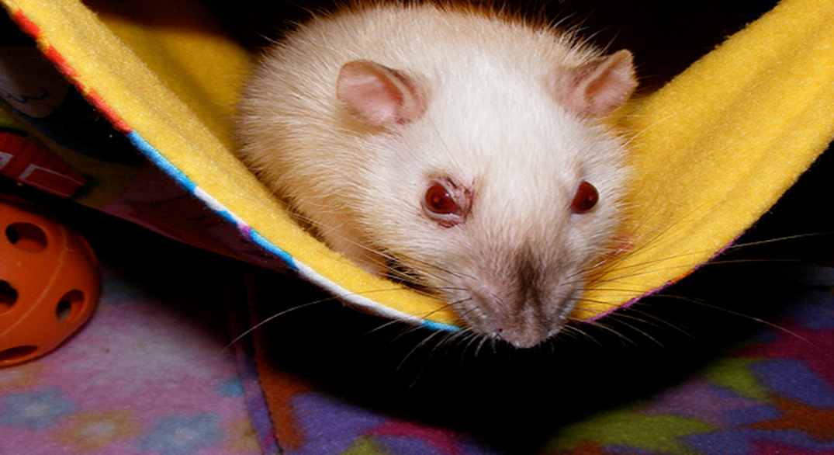
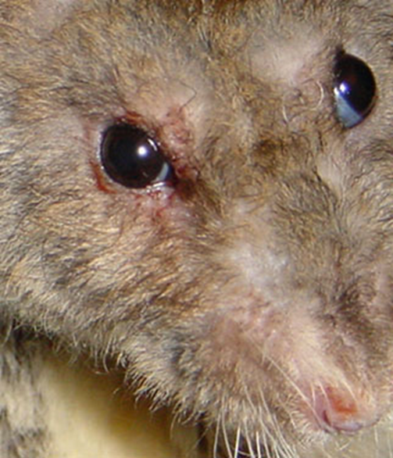
The Harderian gland secretion

Slide 15
The Harderian gland
Cholinergic agonists such as neostigmine, carbachol, and pilocarpine caused chromodacryorrhea
Nicotine does not !!
Atropine blockes chromodacryorrhea induced by systemic administration of direct-acting cholinergic agonists !!
Thus, chromodacryorrhea appears to be a muscarinic receptor-related event

Slide 16
Experimental protocol
Procedure:
  Inject 100 mg/kg of Pilocarpine I.P into a rat/mouse.
  Examine the eyes for tears by wiping the eyelids with cotton to detect the bloody tears. Note salivation and nasal secretion…..etc.
  Inject another rat with 1 mg/kg of atropine I.P, wait about 15-25 minutes, and inject the rat with Pilocarpine 100 mg/kg I.P.
  Examine for bloody tears, salivation and nasal secretion….etc

Slide 17
Results
Parameters | Pilocarpine | Atropine+ Pilocarpine | Effectors organ/gland | Receptor
Bloody tears
Salivation
Urination
Defecation
Tremor
Sk.M. contraction

