Slide 1

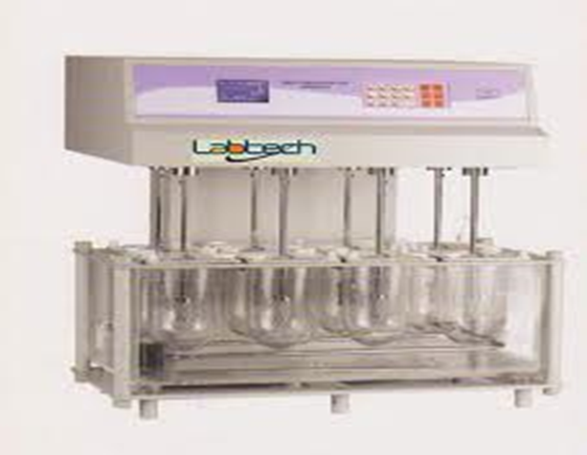
Biopharmaceuitcs
lab 6
In vitro dissolution study of per – oral tablet

Slide 2
Introduction :
Dissolution is a process of going into
solution form .
A basic principle of drug absorption is that absorption takes place only after a drug is in solution .this means that drug given orally in solid dosage form must dissolve in GIT fluid before absorption occurs

Slide 3
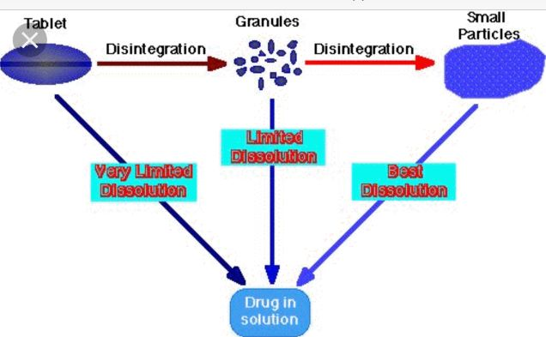
The following process occurs before absorption of solid dosage forms
Notes :
Pero- oral means taken orally
Oral means work on oral cavity

Slide 4
Dissolution and Absorption
When drug is slightly soluble the rate limiting factor for absorption is dissolution
While for highly soluble drug the rate limiting factor is absorption

Slide 5
Factors affecting dissolution rate
Agitation intensity
Drug solubility
Surface area exposed to dissolution medium

Slide 6

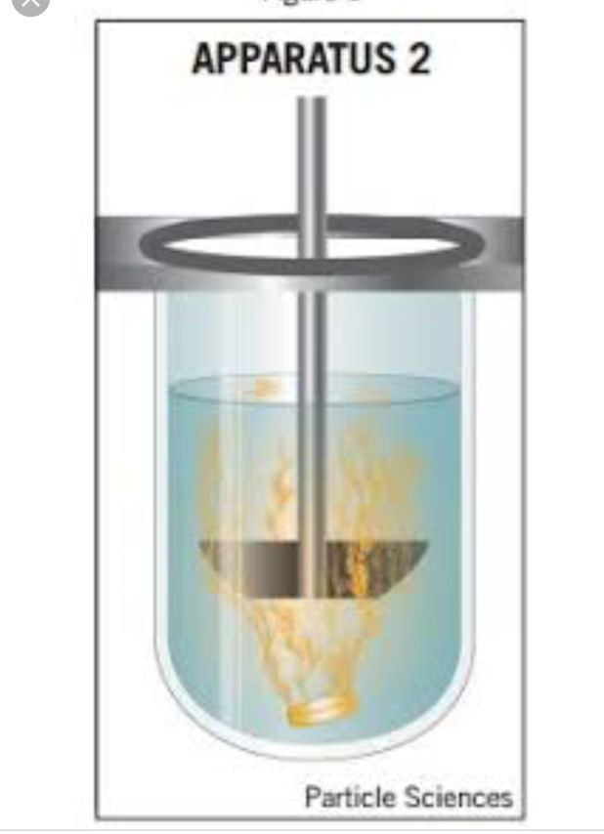
Method :
By using dissolution apparatus (karl kolb)
(apparatus 2 paddle type )
The conditions of the experiment are made so that they simulate body conditions .
A temperature 37 º C and a rotation speed of 50 r.p.m
The dissolution medium is artificial gastric juice or artificial intestinal juice .

Slide 7
Dissolution testing is a key quality control test
• Dissolution tests can be conducted in simple buffer solutions or in more bio-relevant dissolution media
• Dissolution tests are normally performed under sink conditions
• There are four types of compendial dissolution apparatus: the basket apparatus (USP I), the paddle apparatus(USPII) , the reciprocating cylinder and the flow-through cell
•A dissolution test is said to be performed under sink conditions if the concentration of the drug in the bulk of the dissolution medium does not exceed 10% of the solubility of the drug.

Slide 8
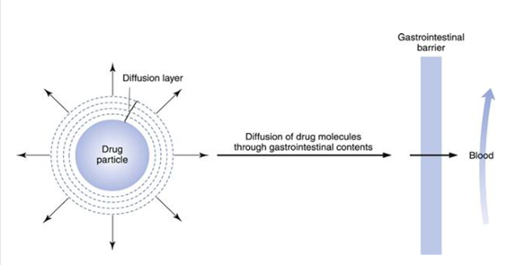
Under sink conditions, the concentration gradient between the diffusion layer surrounding the solid drug particles and the concentration in the dissolution medium is assumed to be constant

Slide 9
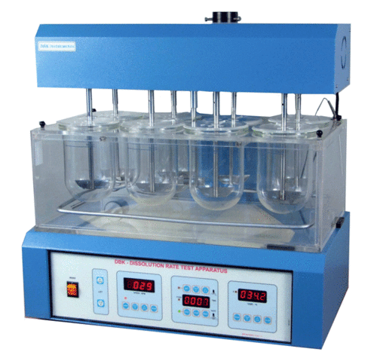

Slide 10
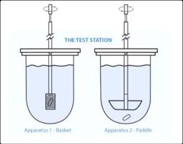

Slide 11
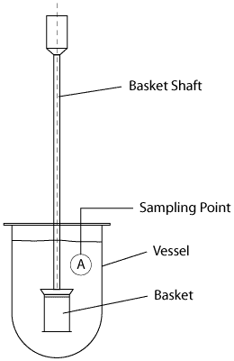
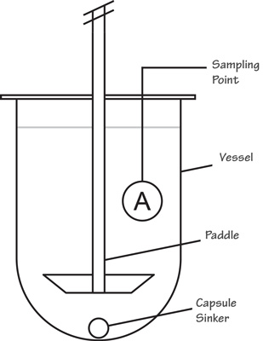
Sampling point
USP/NF – midway from top of basket or paddle to top of fluid and no closer than 1 cm to side of flask
BP – halfway between basket and side at middle of basket

Slide 12
Thank you

