Slide 1
Dry Granulation
Lab 3
Industrial pharmacy

Slide 2
Dry granulation
Granulation is the process in which the primary powder particles are made to adhere to form large multi –entities called granules.
Primary reasons for granulation:
To prevent segregation.
To improve flow properties of the mix.
To improve compaction characteristics of the mix.

Slide 3
Secondary reasons for granulation
Reduce the hazard associated with the generation of toxic dust which may arise when handling powder.
Reduce the hazard associated with the storage of powder that is slightly hygroscopic and may adhere to form a cake.
More convenient for storage and shipment as it is denser than powder and occupies less volume per unit weight.

Slide 4
Dry granulation preparation of granules by dry compression [compaction] (powder particles aggregate at high pressure) Then milling to random size Then in dry granulator or homogenizer To get certain size.
Wet granulation granules are formed by addition of binder solution and sieving.

Slide 5
Unit operations in tablet manufacturing
Dry granulation
Wet granulation
Direct compression
Drug
Diluent
Glidant
disintegrant
Drug
Diluent
Lubricant
Mixing
Mixing
Mixing
Drug
Diluent
compression
Wetting granulation
comminution
Binder solvent
Drying
Disintegrant
Glidant
Lubricant
screening
lubricant
Mixing
Disintegrant
Glidant
lubricant
Screening
Mixing
Mixing
Compression Mix
Fill die, Compress tablet, Eject tablet
Metal check, dedusting, coating, package

Slide 6
Methods of dry granulation
A. Slugging technique (double compression)
B. Roller compaction technique

Slide 7
A- Slugging technique:
Slug: large flat tablet (large compact) or pellets contains half amount of lubricant, but its not actually tablet because it doesn't obey the method of evaluation or assay of the tab.
Prepare the formula
Milling
Weigh all the substances and ½ amount of lubricant. (Because it is needed during slugging by tablet machine to eject the slug from die).
Mix well by mixer and compress into large tab. (slug) using large punch and die (diameter ¾ to 1.25 inch).
Grinding slug by dry granulator or homogenizer to convert slug to granules.

Slide 8
Weigh granules and divide by weight of single tablet to get real no. of tablets
Real no. of tablets =total weight of granules before 2nd lubrication/wt. of single tab. before 2nd lubrication
Second compression after addition of calculated amount of lubricant, mix and compress by normal machine.
Question ; why we calculate the real no. of tablets?

Slide 9
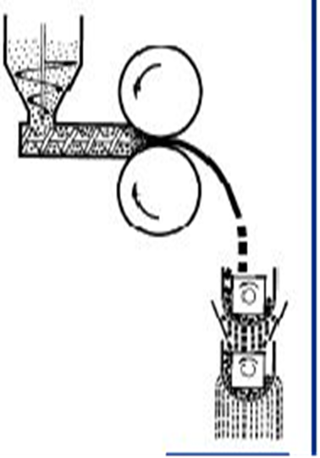
Rollers or chilsonator roller compactor
Two rolls rotate against each other, to increase the density of powder by pressing it between the rollers and get a thin wide sheet or ribbon equivalent to the slug produced by slugging, then these ribbons or aggregates are screened to produce uniform granules.

Slide 10
Advantages of dry granulation
More economic, less space, less equipment than wet granulation.
No need for drying so it is not time consuming.
Used for moisture sensitive materials.
The disintegration time is improved because the binder used in powder form, so the adhesive effect is less so fast disintegration.
No migration of colors (mottling) that may occur in wet granulation because of presence of moisture.

Slide 11
Disadvantages of dry granulation
Slugging required specialized heavy duty machine
Produces more dust which may cause contamination of the product.
Decreases the dissolution of insoluble drugs.
Generation of charges of static electricity that affect the flowability

Slide 12
Advantage of roller compactor over slugging
Increased product capacity
Greater control on compaction pressure and dwell time
No need for excessive lubrication of the powder.

Slide 13
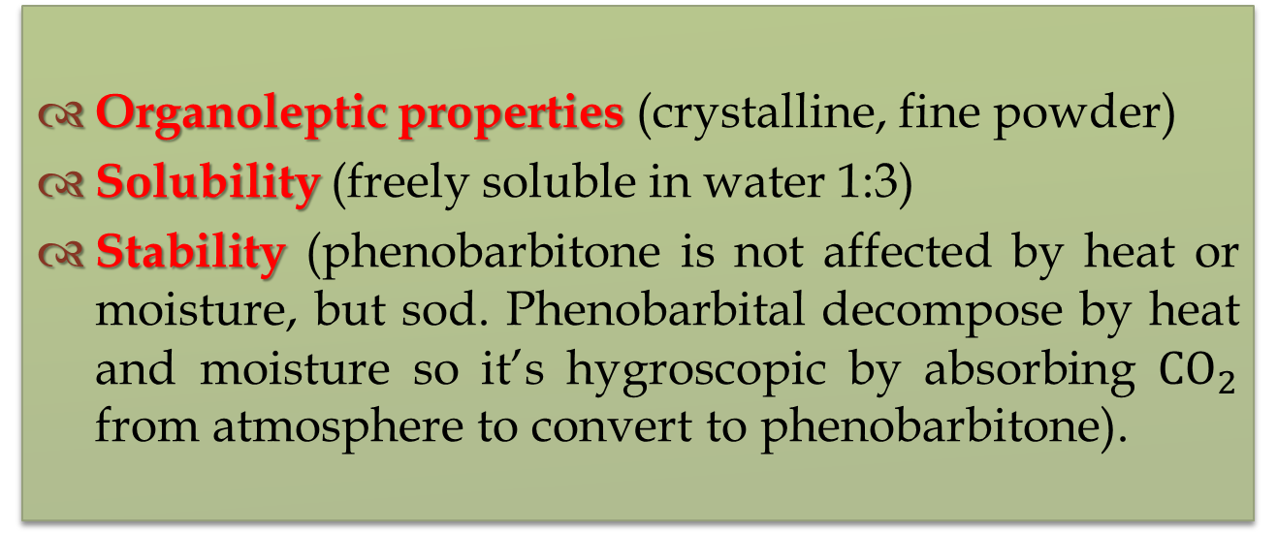
Preparation of sodium phenobarbital tab. by using dry granulation
Organoleptic properties (crystalline, fine powder)
Solubility (freely soluble in water 1:3)
Stability (phenobarbitone is not affected by heat or moisture, but sod. Phenobarbital decompose by heat and moisture so it’s hygroscopic by absorbing ${CO}_{2}$ from atmosphere to convert to phenobarbitone).

Slide 14
Formula
Sod. Phenobarbitone 15 mg (active ingredient)
Lactose 5 mg ( diluent)
Emcompress 20 mg ( diluent)
Starch 20 mg (disintegrant)
Acacia 10 mg (binder)
Sod. Stearate 5 mg ( lubricant)
Prepare 30 tablets

Slide 15
Calculations:-
Total wt of tablet= 15+5+20+20+10+5= 75
Since, half amount of lubricant should be added in the 1st mixing step
So,
5mg/2= 2.5 mg of Sod. stearate per tablet
2.5* 30= 75 mg of Sod. Stearate should added in the 1st lubrication
Also,
75-2.5= 72.5 mg wt of single tablet before 2nd lubrication
Suppose, the wt of granules mixture before 2nd lubrication are 2040 mg
Real no. of tablets= 2040/72.5
= 28.1 tablets
Therefore,
2.5*28= 70 mg of sod. Stearate added in the 2nd lubrication

Slide 16
Question.
Sod. Phenobarbital can not be prepared by wet method while phenobarbitone can be prepared by wet method . Why?
Both of them can not be prepared by direct compression . Why?

Slide 17
Question.
Lactose and emcompress (dicalcium phosphate) both are used as diluents in this formula. What are the benefits of adding both diluents in this formula?
Two tablets, one prepared by dry granulation and the other is prepared by wet granulation.
Which one do you expect to have faster disintegration?

Slide 18


