Slide 1
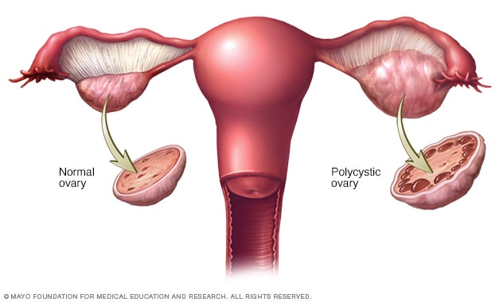
Polycystic ovarian syndrome
Prepared by:
Assist Lect. Rasha Saadi Abbas

Slide 2
Definition
Polycystic ovary syndrome (PCOS), previously known as Stein-Leventhal syndrome, is a disorder in which numerous benign cysts form on the ovaries under a thick, white covering.
It is most common in women under 30 years old.

Slide 3
Pathogenesis and pathophysiology
Elevated serum LH concentrations and an increased serum LH: FSH ratio result either from an increased GnRH hypothalamic secretion or less likely from a primary pituitary abnormality.
This results in dysregulation of androgen secretion and increased intra-ovarian androgen, the effect of which in the ovary is follicular atresia, maturation arrest, polycystic ovaries, and anovulation.

Slide 4
Pathogenesis (cont.)
Hyperinsulinemia is a contributing factor to ovarian hyperandrgenism, independent of LH excess.
A role for insulin growth factor (IGF) receptors has been postulated for the association of PCOS and DM. Imbalance of these hormones prevents the ovaries from releasing an egg each month.
It also results in an increased production of the male hormone testosterone by the ovaries.

Slide 5
Symptoms of PCOS
Amenorrhea (no menstrual period), infrequent menses, and/or oligomenorrhea (irregular bleeding).
Oligo or anovulation (infrequent or absent ovulation).
Hyperandrogenism.
Infertility
Cystic ovaries
Enlarged ovaries.
Obesity or weight gain.
Insulin resistance, hyperinsulinemia, and diabetes.
Dyslipidemia (lipid abnormalities).
Hypertension.
Hirsutism.
Alopecia
Acne/Oily Skin/Seborrhea
Acanthosisnigricans (dark patches of skin, tan to dark brown/black).

Slide 6
Diagnoses
A. Biochemical analysis: Fasting comprehensive biochemical and lipid panel,2-hour GTT with insulin levels (also called IGTT), LH:FSH ratio, serum total testosterone level, Sex Hormone Binding Globulin (SHBG) level, serum androstenedione level, serum prolactin level and serum TSH, T4,T3 level.
B. Imaging studies: pelvic U/S (or CT scan) reveals the presence of 2-fold-5-fold ovarian enlargement with a thickened tunica albuginea, thecal hyperplasia, and 20 or more subcapsullar follicles from 1-15 mm in diameter.

Slide 7
PCOS

Slide 8
Metabolic derangements
diet and exercise in patients with PCOS who are obese, endocrine-metabolic parameters markedly improve after 4-12 weeks of dietary restriction. Their SHBG levels rise and free testosterone levels fall by 2-fold. Serum insulin and IGF-1 levels also decrease. Weight loss in patients with PCOS who are obese is associated with a reduction of hirsutism and a return of ovulatory cycles in 30% of women. A moderate amount of daily exercise increases of levels of IGF-1 binding protein and decreases IGF-1 levels by 20%. Modest weight loss of 2-5% of total body weight can help restore ovulatory menstrual periods in obese patients with PCOS. A daily 500-1000 calorie deficit with 150 minutes of exercise per week can cause ovulation.

Slide 9
Metformin
Lowering insulin levels also helps to reduce the production of testosterone, thus diminishing many of the symptoms associated with excess testosterone: hair growth on the body, alopecia (scalp hair loss), acne, and, possibly, cardiovascular risk.
Metformin improves insulin resistance and decrease hyperinsulinemia in patients with PCOS. The usual starting dose is 500 mg given orally twice a day. A decrease in body fat will lower the conversion of androgens to esterone thereby help restore ovulation.
Pioglitazone (Actos®) and Rosiglitazone (Avandia®) are insulin-sensitizing agents that improve glucose tolerance and insulin resistance.

Slide 10
Anovulation
Metformin can reduce hyperinsulinemia and hyperandrogenemia in PCOS.
Metformin combined with clomiphene resulted in ovulation in 76% of patients compared with 42% in patients who received clomiphene alone.
Clomiphene dose : 50 mg tablet once daily starting from about 5 day of menstrual cycle and for five days only and can be repeated for up to 6 cycle
Other, more aggressive, treatments for infertility (including injection of gonadotropin hormones and assisted reproductive technologies) may also be required in women who desire pregnancy and do not become pregnant on clomiphene therapy

Slide 11
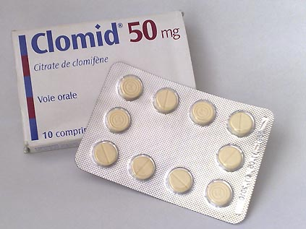
Clomiphene
It is a selective estrogen receptor modulator (SERM) that increases production of gonadotropins by inhibiting negative feedback on the hypothalamus.
Administered during follicular phase of menstrual cycle. It act by increasing gonadotrophin release from the pituitary, leading to enhanced follicular recruitment & growth.
It is effective in inducing ovulation in 85% of women & the current recommendation is for 6 cycles of treatment

Slide 12
Clomiphene
It is recommended that tretment are monitered with serial U/S scans to minimize the risk of multiple pregnancy & risk of OHSS.
Adverse effects
1. Multiple pregnancy 5-12%
2. Ovarian hyper stimulation syndrome (OHSS).
3. Hot flushing
4. Headache
5. Abdominal discomfort
6. Visual blurring
7. Rarely cause reversible alopecia

Slide 13
Hirsutism
A. Hair removal: short-term non-pharmacologic treatments of hirsutism include shaving and use of chemical depilatories and/or bleaching cream.. Weight reduction decreases androgen production in women who are obese; therefore, losing weight can slow hair growth.
B. Oral contraceptives: women who do not wish to become pregnant can be effectively treated for hirsutism with oral contraceptives. Oral contraceptives slow hair growth in 60-100% of women with hyperandrogenemia. Therapy can be started with a preparation that has a low dose of estrogen and a nonandrogenic progestin. Preparations that have norgestrel and levonorgestrel should be avoided because of their androgenic activity.

Slide 14
Hirsutism (cont.)
C. Spironolactone: antiandrogens, such as spironolactone, are effective for hirsutism. Spironolactone 50-100 mg twice daily is an effective primary therapy for hirsutism. Because of its potential teratogenic effects, spironolactone should be prescribed with an oral contraceptive. Adverse effects of spironolactone include GI discomfort, and irregular menstrual bleeding (which can be managed by adding an oral contraceptive).
D. Flutamide: 250 mg daily or finasteride 5 mg daily.
E. Eflornithine: Eflornitliine (Vaniqa®) is a topical cream that can be used to slow the hair growth. Eflornithine works by inhibiting ornithine decarboxylase, which is essential for the rapidly dividing cells of hair follicles.

Slide 15
Menstrual irregularity :
This is treated with an oral contraceptive, which not only inhibits ovarian androgen production but also increases SHBG production.
Best choices in PCOS is Diane®
Diane-35, which contains ethinylestradiol (35 μg) and cyproterone acetate (2 mg), Cyproterone acetate has anti-androgen effects resulting in part from its blockade of androgen receptors

Slide 16
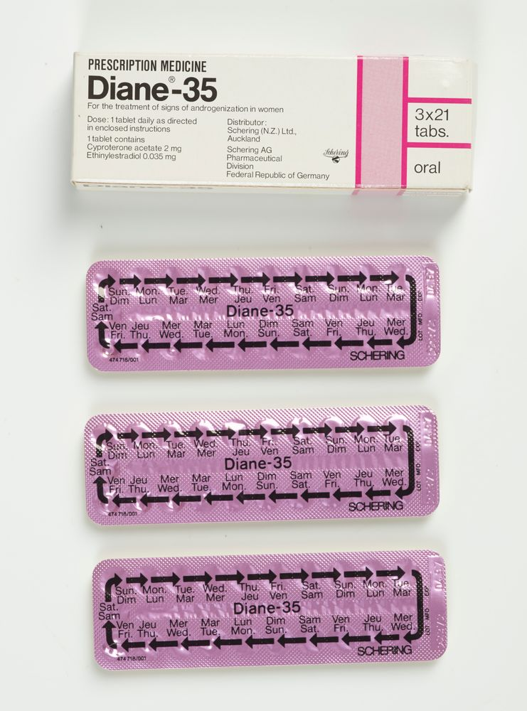
Diane® Regulate menstruation and promote complete uterine shedding and decrease risk of endometrial cancer and circulating androgen level decrease due to increase production of SHBG.

Slide 17
Surgical Care
surgical management is aimed mainly at restoring ovulation.

Slide 18
Questions
Should all women (even unmarried one) treat polycystic ovarian syndrome?
Yes, to prevent endometrial hyperplasia and adenocarcinoma

Slide 19
Useful website to review PCOS
Polycystic Ovary Syndrome | PCOS | Nucleus Health
https://www.youtube.com/watch?v=FsNKyKS7M_s&t=6s

