Slide 1
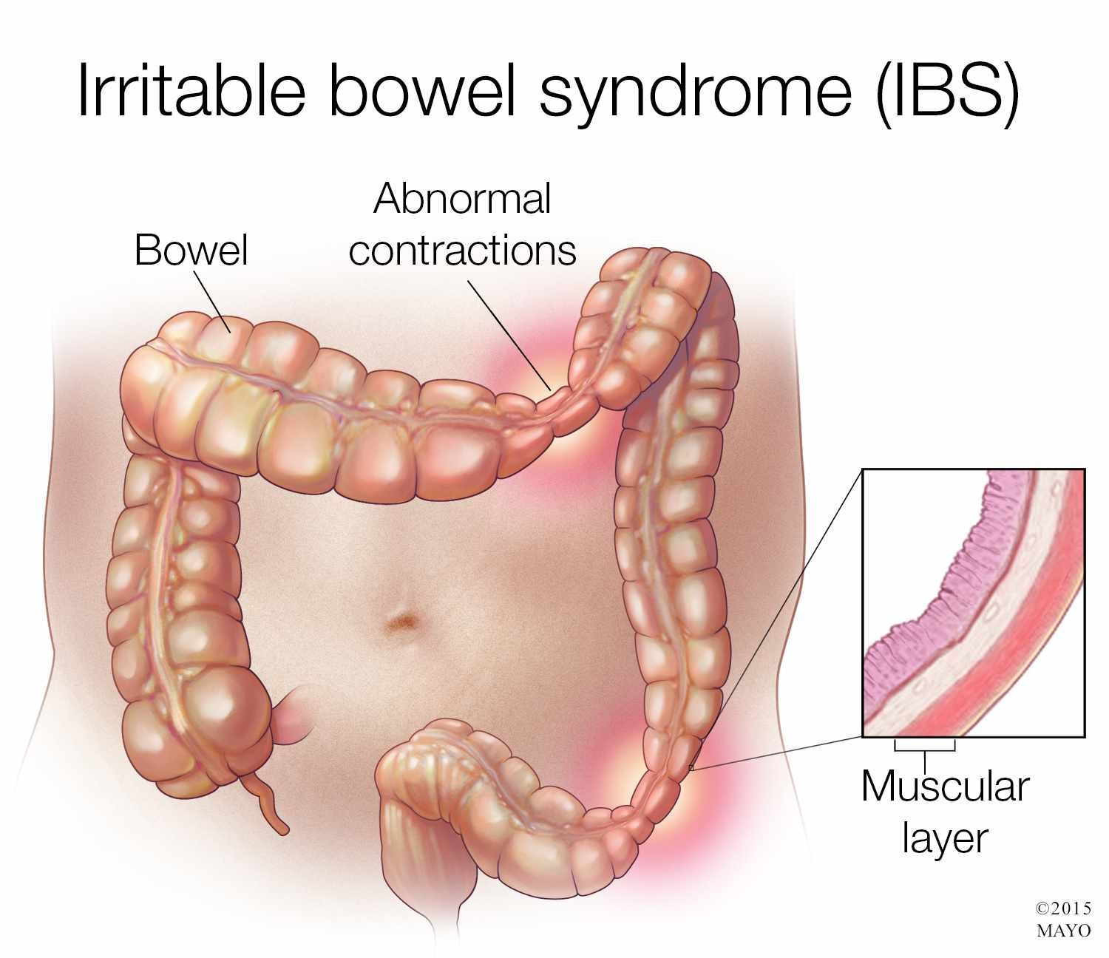
Irritable Bowel Syndrome (IBS)
Prepared by
Assist Lect. Rasha Saadi Abbas

Slide 2
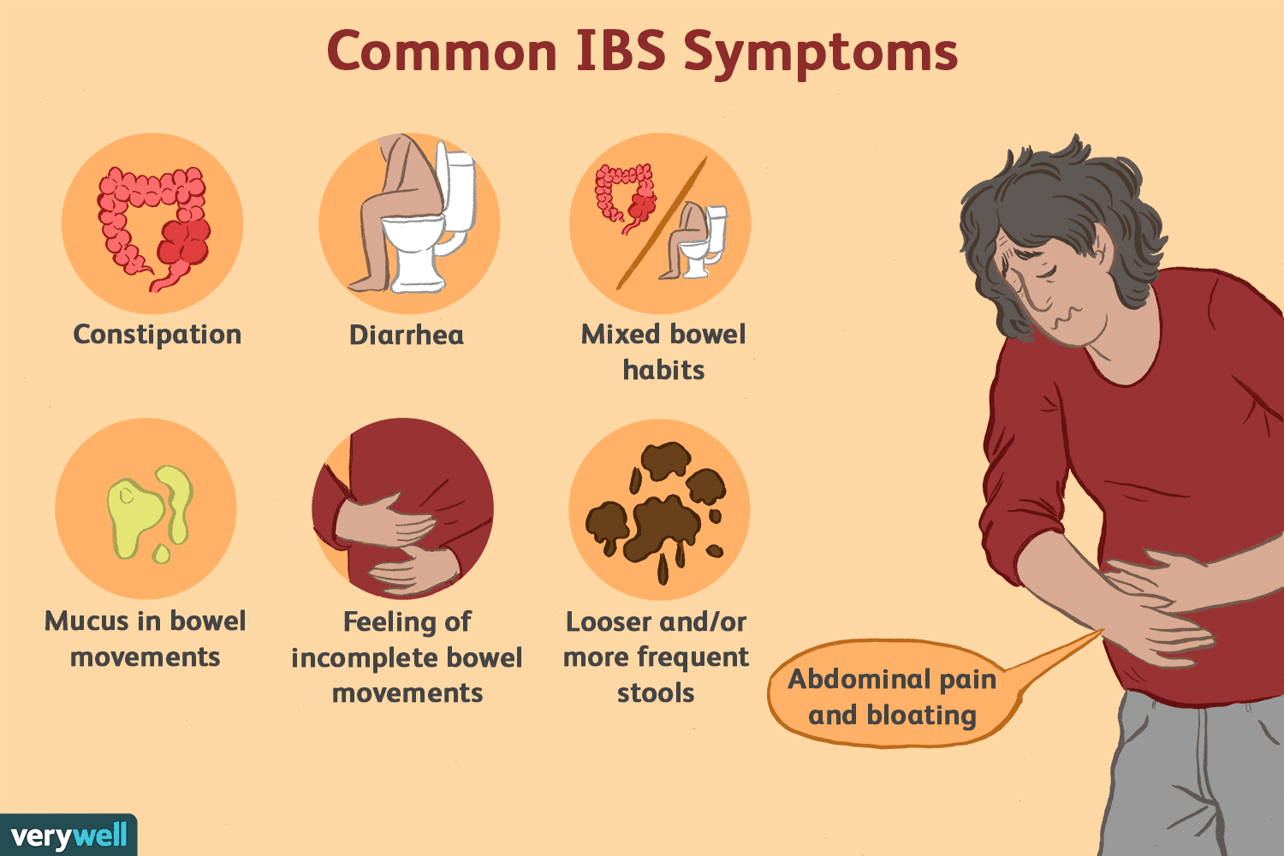

Slide 3
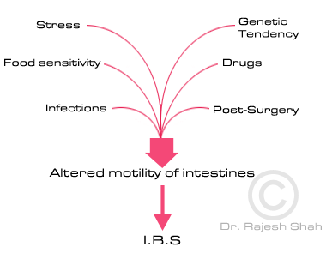

Slide 4
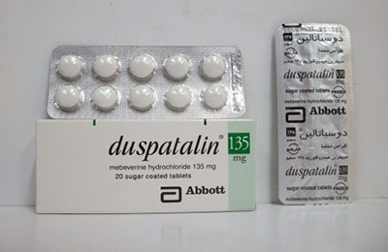
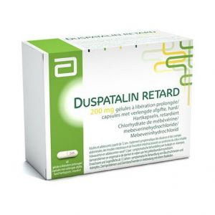
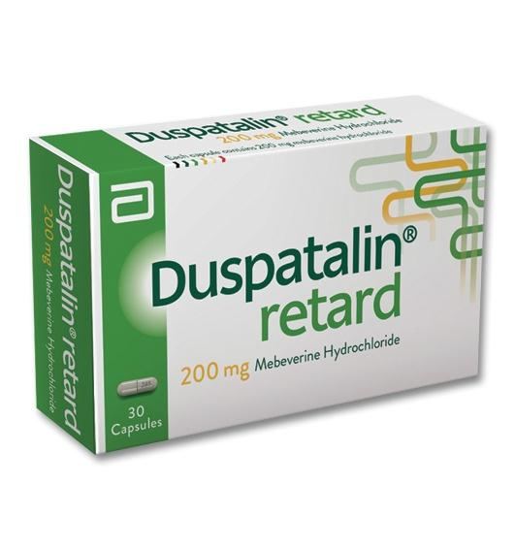
Antispasmodic drugs\ Mebeverine Hydrochloride

Slide 5
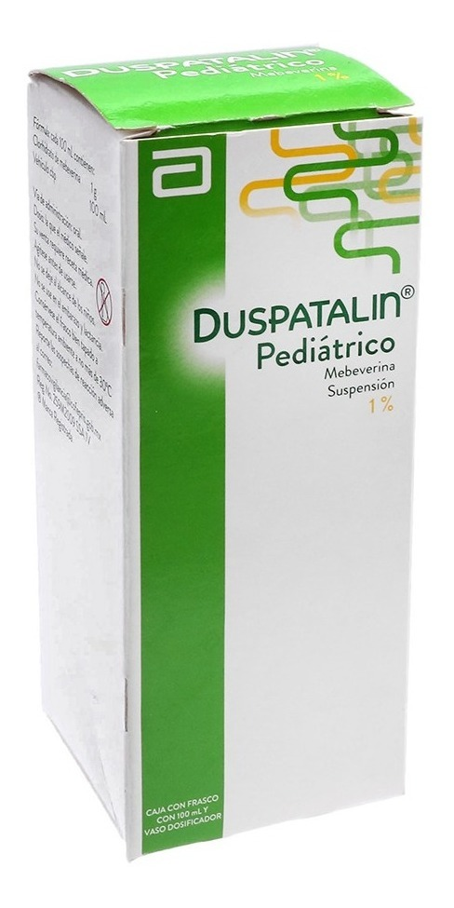
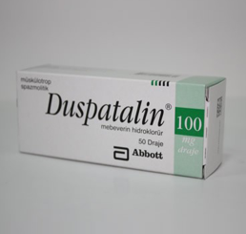

Slide 6
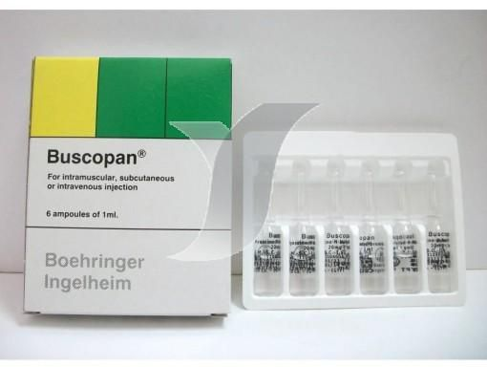
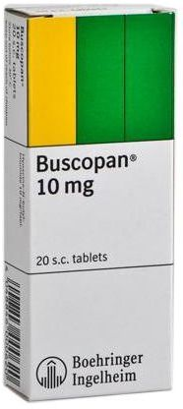
Antispasmodic drugs\ Hyoscine butylbromide (Buscopan®)

Slide 7
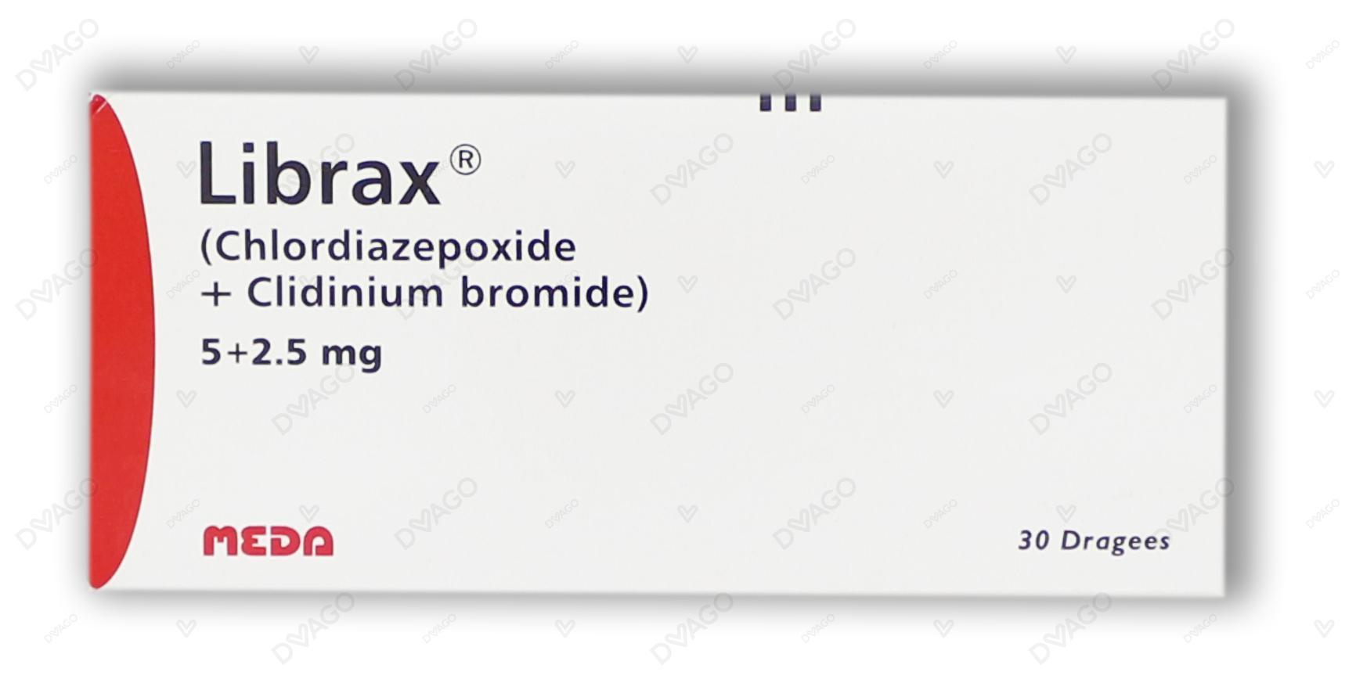
Antispasmodic drugs\ Chlordiazepoxide and clidinium bromide (Librax®)

Slide 8
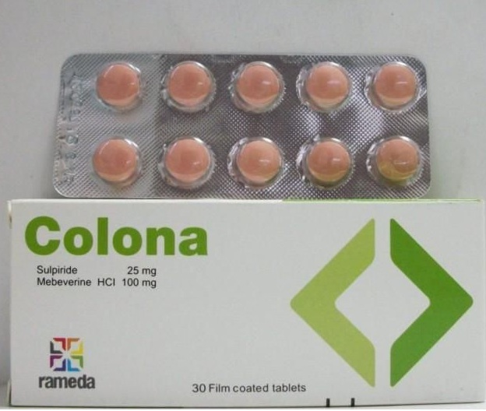
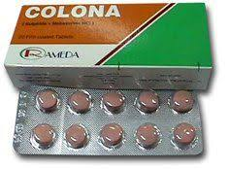
Sulpiride and Mebeverine HCL (Colona®)

Slide 9
(Colona®)
Colona® Contian
Sulpiride 25 mg + Mebeverine HCL 100 mg
Selective central dopamine D2 receptor blocker. It exert mood elevating effect due to its neuroleptic effect) and anti emetic action.
Potent direct antispasmodic acting mainly on the smooth muscles of the GIT and particularly on colonic spasm

Slide 10

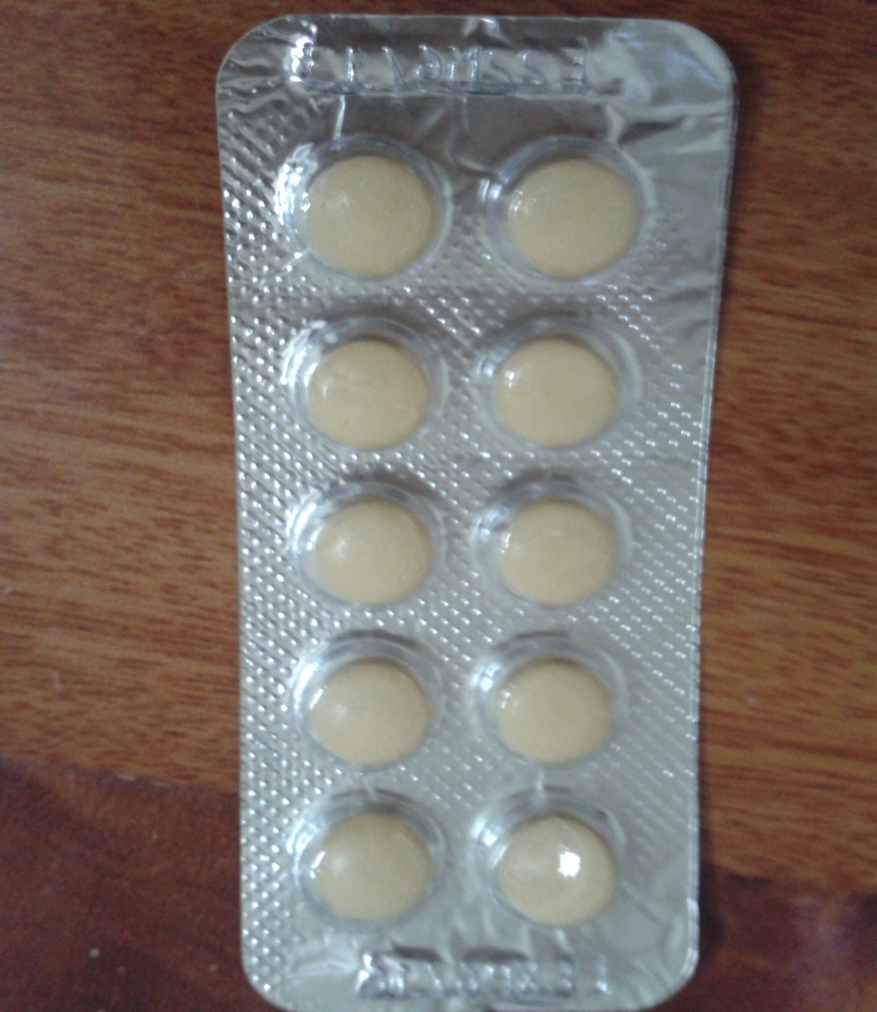
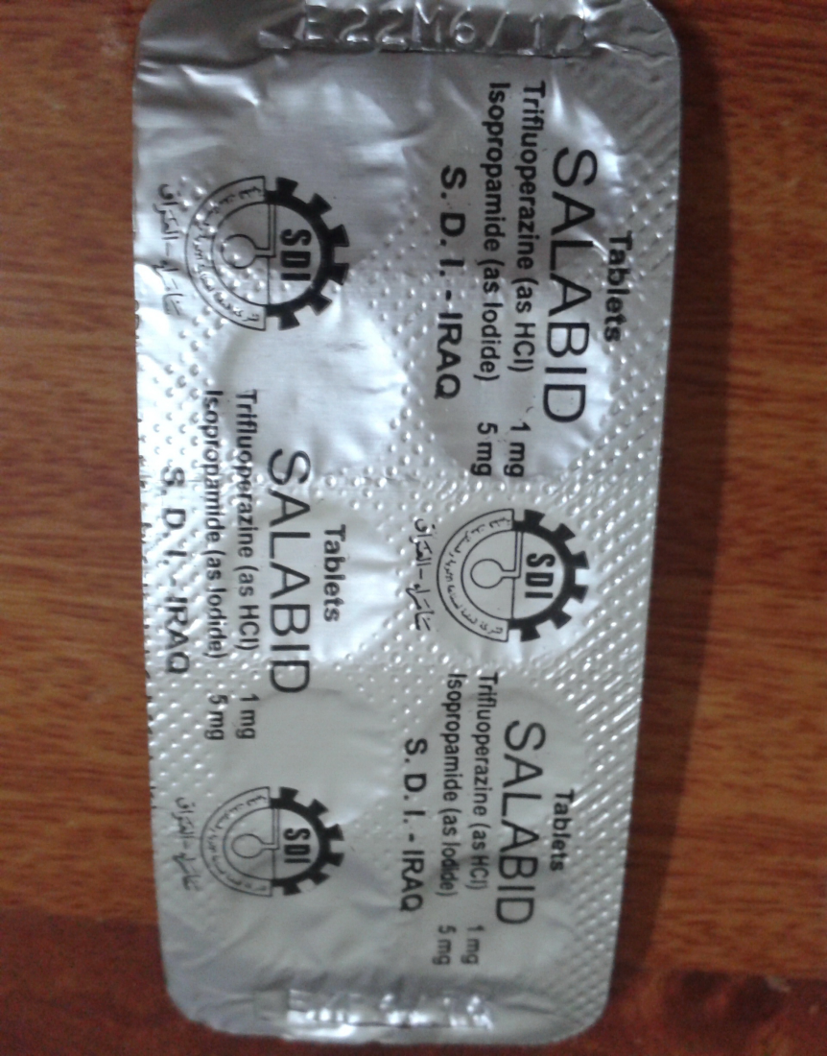

Slide 11
Stelabid ®
Stelabid ® contian
Isopropamide 5 mg + Trifluoperzine HCL 1 mg
Long acting anti cholinergic agent that provide 12 hr anti secretory antispasmodic activity
Is a piperazine phenothiazine with antipsychotic and antiemetic properties

