Slide 1
Hyperthyroidism
Assistant lecturer :
Noor Wafaa Hashim

Slide 2
Hyperthyroidism
Synonymous with ‘overactive thyroid’ and ‘thyrotoxicosis’.
Epidemiology
Incidence of 0.2–0.3% of men and 2–3% women.
Aetiology
Graves’ disease (autoimmune)
Occurs in females, aged 20–40.

Slide 3
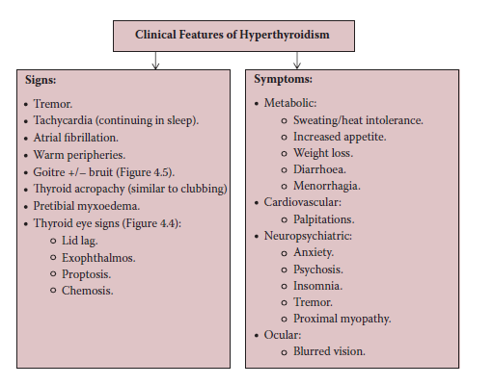

Slide 4
The body produces antibodies that are structurally similar to the binding site of TSH, causing excessive release of T3 and T4 by the thyroid.
There is an association with other autoimmune conditions (e.g., type I diabetes mellitus, vitiligo, Addison’s disease). And may occur following infection with Yersinia or E. coli.
Eye signs (exophthalmos, lid lag) are more common in Graves’ disease.
May have a smooth, enlarged thyroid gland.
Hyperthyroidism is usually due to an inherent thyroid abnormality; pituitary causes are rare.

Slide 5
Diagnosis
Hyperthyroidism is confirmed by thyroid function tests (TFTs):
↓TSH (<0.5 mU/L) , ↑T3 and T4 (except in rare pituitary or gonadal causes).
In Graves’ disease, thyroid peroxidase (TPO) and thyroglobulin antibodies can be measured.
Imaging
Thyroid scintogram uses radioactive iodine to identify overactive areas within the gland (‘hot nodules’).
Ultrasound scans (USS) and computed tomography (CT) allow detail of the gland and identification of compression of adjacent structures.
Biopsy
Allows histological analysis.

Slide 6
Treatment
Medication
Anti-thyroid drugs can be used definitively or in preparation for surgery.
Carbimazole (first line) or propylthiouracil
Acts by interfering with hormone synthesis.
‘Block and replace’ (high-dose anti-thyroid drugs to completely suppress hormone production alongside replacement thyroxine) or suppression with lower doses, aiming for lower hormone levels.
Control of symptoms, such as palpitations and tremor, may be provided by beta-blockers with propranolol.

Slide 7
Treatment
Radio-iodine
As the thyroid is the only organ to take up iodine, radioactive isotopes (I131) can be given to destroy the thyroid gland.
Surgery
May be partial or total excision depending on the cause.
In a subtotal thyroidectomy the posterior rim is left so to avoid damage to the parathyroid glands.
Four main indications for surgery over medical therapy:
when a quick, effective treatment is desired (e.g. in young women with Graves’ disease);
when anti-thyroid drugs have proved ineffective;
toxic multi-nodular goitre (better medical and cosmetic outcome);
toxic solitary nodule (often resistant to medical treatment).

Slide 8
Treatment
Pre-operative considerations:
Thyroid function should be normalised as much as possible to avoid the dangers of thyrotoxicosis and thyroid storm.
Anti-thyroid drugs are often stopped 10–14 days pre-operatively as they increase vascularity to the gland.

Slide 9
Complications
Hypothyroidism and Hyperthyroidism—Late recurrence due to inadequate excision.
Thyroid crisis (rare).
There is hyperpyrexia, tachycardia and mania.
Recurrent laryngeal nerve injury .May cause slight ‘hoarseness’ of voice to complete loss of vocal function and critical airway narrowing.
Tracheal damage and Hemorrhage.

Slide 10
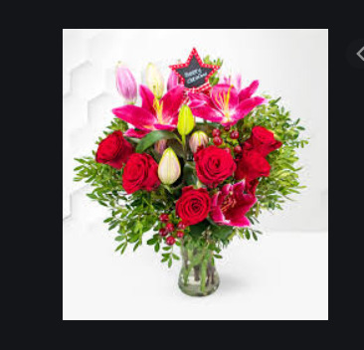
Thank you

