Slide 1
Medical Microbiology
Assistant Prof. Dr. Fitua Al-Saedi
Department of Clinical Laboratory Science
College of Pharmacy
Medical Microbiology

Slide 2
Microbiology
Is the study of Microorganisms, a large and diverse group of microscopic organisms existing as single cells or clusters. Micro- organisms include some eukaryotes and prokaryotes, viruses,
viroids, and prions.

Slide 3
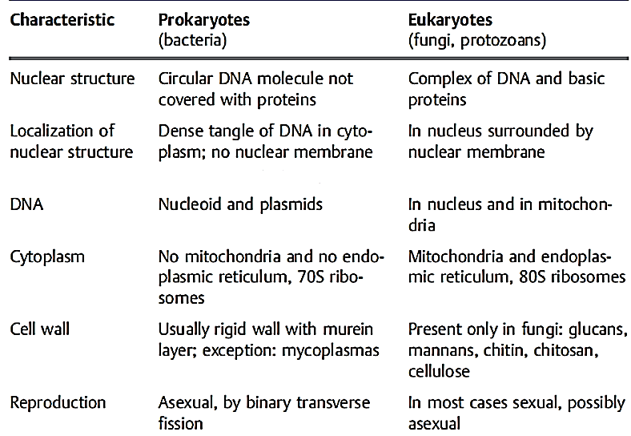

Slide 4
Prokaryotes are unicellular organisms that lack organelles or other internal membrane-bound structures. Therefore, they do not have a nucleus, but, instead, generally have a single chromosome: a piece of circular, double-stranded DNA located in an area of the cell called the nucleoid.
Prokaryotes include bacteria, mycoplasma, and obligate intracellular bacteria
a -Bacteria
1-Have a cell wall.
2-May be normal flora or may be pathogenic bacteria.
3-reproduced asexually by binary trans-verse fission.

Slide 5
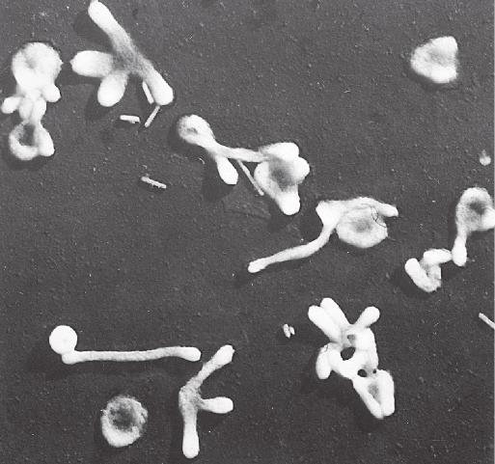
b- Mycoplasma
1- Mycoplasmas are bacteria without rigid cell walls.
2- Some, such as Mycoplasma pneumoniae, an agent of pneumonia, contain sterols in their membrane.
3-Mycoplasmas lack a target for cell wall-inhibiting antimicrobial agents (eg, penicillins and cephalosporins) and are therefore resistant to these drugs.
4- They are found in a wide variety of forms, the most common being the coccoid cell. Threadlike forms also occur in various lengths.

Slide 6
C- Obligate intracellular bacteria include:
Rickettsiae: These organisms are obligate intracellular parasites, rod shaped
to coccoid, that reproduce by binary transverse fission.
Chlamydiae: These organisms are obligate intracellular parasites that are
able to reproduce in certain human cells only and are found in two stages:
The infectious, non -reproductive particles called elementary bodies.
The non -infectious, intracytoplasmic, reproductive forms known as
reticulate bodies.

Slide 7
Viruses: Are not cells. Obligate intracellular parasites that
Contain only one type of nucleic acid, either DNA or RNA surrounded by protein shells known as capsids. In some animal viruses, the capsid is surrounded by a membrane called an envelope. This envelope is made up of a lipid bilayer. It also contains glycoproteins.
Possess no enzymatic energy-producing system and no protein-synthesizing apparatus.
Force infected host cells to synthesize virus particles.
Are called bacteriophages (or phages) if they have a bacterial host.

Slide 8
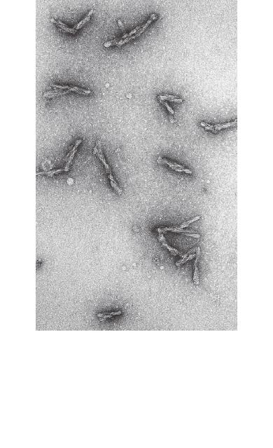
Viroids: Obligate intracellular parasites. Small, single-stranded, covalently closed circular RNA molecules. The extracellular form of the viroid is naked RNA—there is no capsid of any kind. The RNA molecule contains no protein-encoding genes, and the viroid is therefore totally dependent on host functions for its replication.(cause plant disease)
Prions (proteinaceous infectious particles): are protein molecules that is responsible for degenerative central nervous system disease of animals (e.g., Bovine spongiform encephalopathy) and humans (e.g., Creutzfeldt-Jakob Disease (CJD).

Slide 9
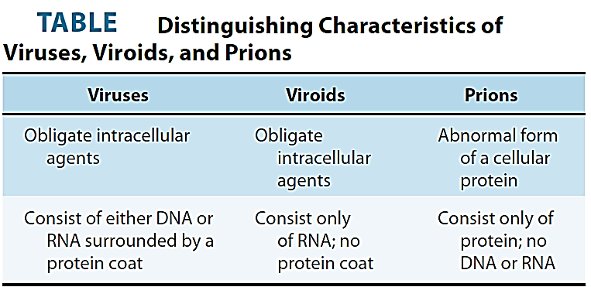

Slide 10
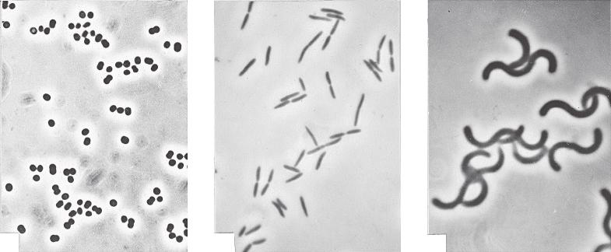
Bacterial Morphology
Shape: Along with other properties, bacterial shape is used to identify bacteria. It is determined by the mechanism of cell wall assembly.
Bacteria have three basic forms:
1- Coccus or Cocci are bacterial cells that are spherical(e.g., Staphylococcus aureus)
2- Bacilli; uniform thickness, rounded ends, pointed ends.
(e.g., Bacillus subtilis)
3- Curved or spiral rods. comma shaped, spiral, screw shaped (e.g., Vibrio cholera, Treponema pallidum).
Some bacterial species are pleomorphic (e.g. Mycoplasma pneumoniae).

Slide 11
Arrangement of bacterial cells
Bacteria are also characterized based on how cocci and bacilli aggregate themselves. The aggregation of cells is specific to each bacteria.
Arrangement of cocci cells
Singly: Bacteria that appear as single cell, is just called as cocci
Diplococci: These cells are found in pairs and they are found attached to each other
Streptococcus: These bacteria form long chains and remain attached to each other
Staphylococcus: These bacteria are arranged irregularly in clusters like grapes
Arrangement of Bacilli
Singly: Bacteria that exists as single cell, called bacilli
Diplobacilli: These bacteria has two rod shaped cells which are attached to each other
Streptobacilli: Cells are arranged as long chains in these bacteria

Slide 12
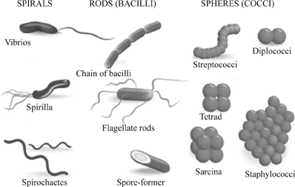

Slide 13
Staining
Light microscope and chemical-staining techniques are usually used to determine bacterial shape.
Simple staining: In this technique, a single staining substance, e.g., methylene blue, is used.
Differential staining: Two stains with differing affinities to different bacteria are used in differential staining techniques, the most important of which is Gram staining. Gram-positive bacteria stain blue-violet, Gram-negative bacteria stain red.

Slide 14
Gram Stain
Most bacteria are classified as gram positive or gram negative
according to their response to the Gram-staining procedure. This procedure was named for the histologist Hans Christian Gram, who developed this differential staining procedure in an attempt to stain bacteria in infected tissues.
The Gram stain depends on the ability of certain bacteria (the gram-positive bacteria) to retain a complex of crystal violet (a purple dye) and iodine after a brief wash with alcohol or acetone. Gram-negative bacteria do not retain the dye–iodine complex and become translucent, but they can then be counterstained with safranin (a red dye). Thus, gram-positive bacteria look purple under the microscope, and gram-negative bacteria look red. The distinction between these two groups turns out to reflect fundamental differences in their cell envelopes

Slide 15
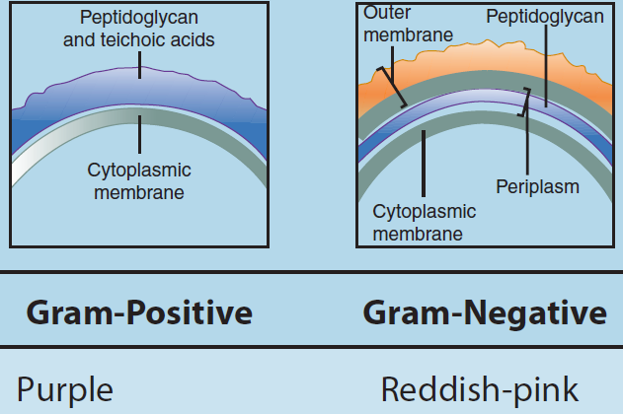
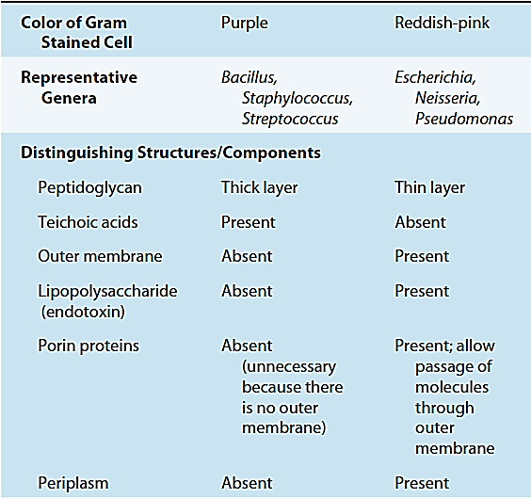
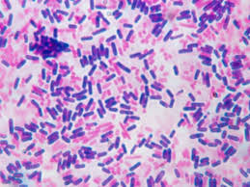

Slide 16
Thanks

