Slide 1
Diarrhea and Constipation
Prepared by:
Assist . Lect: Rasha Saadi Abbas

Slide 2
Diarhhoea

Slide 3
Definition
Diarrhoea is defined as an increased frequency of bowel evacuation, with the passage of abnormally soft or watery faeces (more than 3 bowel movement/ day is considered abnormal).

Slide 4
Patient assessment with diarrhea
1. Age: Infants (younger than 1 year) and elderly patients are especially at risk of becoming dehydrated.
2. Duration
-Diarrhea of > 1-day duration in children < 1 year need referral.
-Diarrhea of >2 days duration in children < 3 years need referral.
-Diarrhea of > 3 days duration in older children and adults need referral.

Slide 5
Types of diarrhea
Acute diarrhea: is rapid in onset and produces watery stools that are passed frequently.
- Chronic diarrhea: Recurrent or persistent diarrhea may be due to an irritable bowel or, more seriously, a bowel tumor, an inflammation of the bowel (e.g. ulcerative colitis or Crohn’s disease), an inability to digest or absorb food (malabsorption, e.g. coeliac disease) or diverticular disease of the colon.

Slide 6
Symptoms
- Abdominal cramps, flatulence, weakness or malaise. Nausea and vomiting, and fever---acute diarrhea (infective in origin).
- Vomiting and fever in infants ---------- severe dehydration will develop.
- Diarrhea in infants is whether the baby has been taking milk feeds and other drinks as normal. Reduced fluid intake predisposes to dehydration.
- The presence of blood or mucus in the stools is an indication for referral.
Diarrhea with severe vomiting or with a high fever would also require referral.

Slide 7
Causes of diarrhea
1. Viral: Viruses are often responsible for gastroenteritis.
2. Bacterial: These are the food-borne infections previously known as food poisoning.
3. Protozoan infections

Slide 8
Medication
Some drugs may cause diarrhea as :
• Antacids: Magnesium salts
• Antibiotics
• Antihypertensives: methyldopa; beta-blockers (rare)
• Digoxin (toxic levels)
• Diuretics (furosemide)
• Iron preparations
• Laxatives
• Misoprostol
• Non-steroidal anti-inflammatory drugs
• Selective serotonin reuptake inhibitors
Treatment timescale: One day in children; otherwise 2 days.

Slide 9
Treatment of diarrhea
Oral rehydration therapy (ORS, ORT)
Anti-motility drugs
Antispasmodic
Anti-Bacterial drugs
Adsorbents and bulk forming drugs

Slide 10
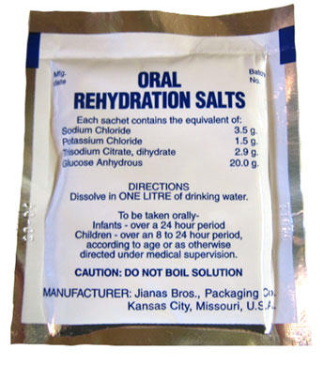
ORT or ORS

Slide 11
Patient education
1. Patients should be reminded that only water should be used to make the solution (never fruit or fizzy drinks) and that boiled and cooled water should be used for children younger than 1 year.
2. Boiling water should not be used, as it would cause the liberation of carbon dioxide.
3. The solution can be kept for 24 h if stored in a refrigerator. Fizzy, sugary drinks should never be used to make rehydration fluids, as they will produce a hyperosmolar solution that may exacerbate the problem. The sodium content of such drinks, as well as the glucose content, may be high.
4. Home-made salt and sugar solutions should not be recommended, since the accuracy of electrolyte content cannot be guaranteed, and this accuracy is essential, especially in infants, young children and elderly patients.
5. Special measuring spoons are available; their correct use would produce a more acceptable solution, but their use should be reserved for the treatment of adults, where electrolyte concentration is less crucial.

Slide 12
Amount of rehydration solution
Amount of rehydration solution to be offered to patients.
Quantity of solution Age (per watery stool)
Under 1 year 50 mL (quarter of a glass)
1–5 years 100 mL (half a glass)
6–12 years 200 mL (one glass)
Adult 400 mL (two glasses)

Slide 13
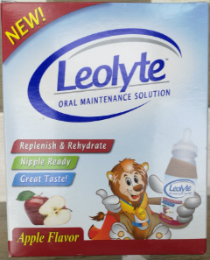
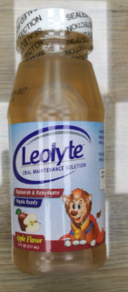

Slide 14
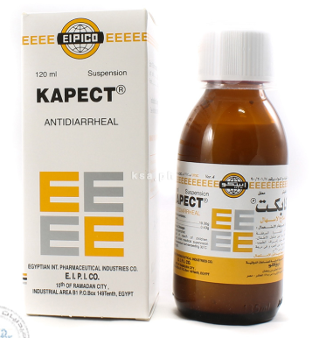
Antidiarrheal/ Intestinal adsorbent
Pectokoalin

Slide 15
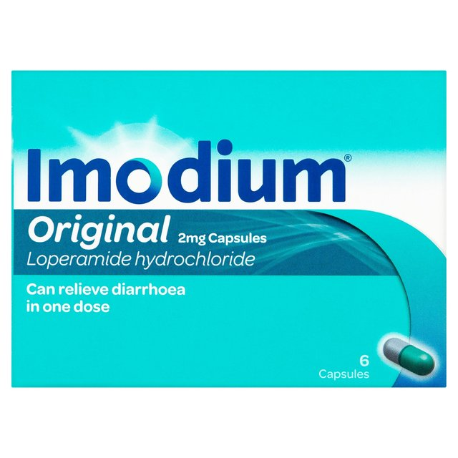
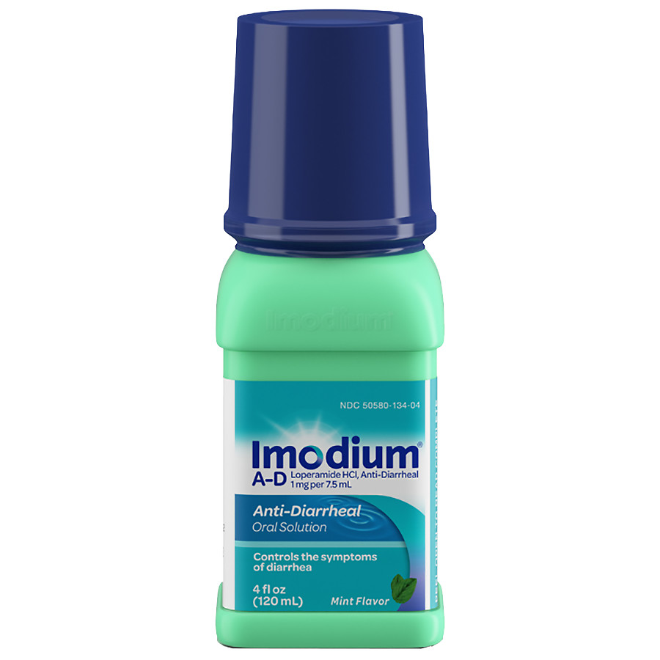
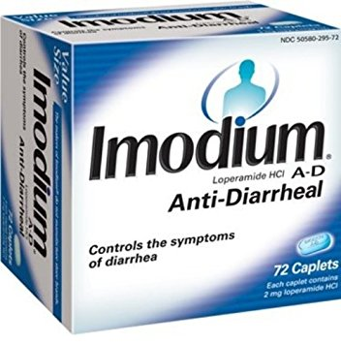
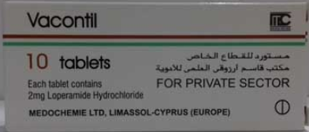
Antidiarrheal/ Antipropulsive antimotility
Loperamide

Slide 16
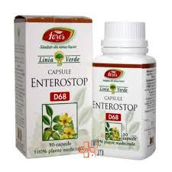
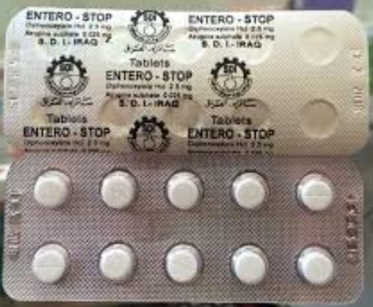
Antidiarrheal/ Antipropulsive
Co-Phenotrope

Slide 17


