Slide 1

Prepared By
Assist. Lect. Rasha Saadi Abbas

Slide 2
Gestational Diabetes Case
A 28-year-old G4P2A1 presents to a doctor for a routine prenatal visit at 24 weeks’ gestation. Her physical examination is unremarkable and fetal wellbeing is reassuring. The doctor recommend testing for gestational diabetes mellitus (GDM).
1 What is GDM?
2 Should everyone be screened for GDM? If so, at what gestational age should they be screened?
3 Her 1-hour OGTT is 182 mg/dL. Does she have GDM?

Slide 3
Gestational Diabetes
Gestational Diabetes (GD) is the most common type of diabetes complicating pregnancy, and most patients are obese.
The women with GD have a normal oral glucose tolerance test (OGTT) when she is not pregnant, so her disease usually is mild.
Pregnancy is associated with increased tissue resistance to insulin, resulting in increased levels of blood insulin as well as glucose and triglycerides.
These changes are due to placental lactogen and elevated circulating estrogens and progesterone.

Slide 4
Placental Lactogen
Action:
Maternal insulin sensitivity leading to increase blood glucose level
Maternal glucose utilization to increase fetus nutrition
Lipolysis leading to release fatty acid which considered as fuel to fetus

Slide 5
Risk factors for gestational diabetes mellitus (GDM)
1. Maternal age greater than 30 years.
2. Previous macrosomic, malformed, or stillborn infant.
3. GDM in a previous pregnancy.
4. Family history or diabetes.
5. Maternal obesity.
6. Persistent glucosuria.
7. Chronic use of certain drug such as β-agonists or corticosteroids.

Slide 6
Maternal Problems
1. Hypoglycemia: occurs during the first half of pregnancy due to increased insulin sensitivity.
2. Hyperglycemia: occurs during the second half of pregnancy.
3. Urinary tract infection (UTI).
4. Hypertension: the abnormal blood vessels of pregnant women with DM can lead to the development of hypertension in the later weeks of gestation since the abnormal endothelium cannot produce enough prostacyclin to antagonize the elevated angiotensin II vasopressor levels.
5. Hydromnios: excess amounts of aminotic fluid can occur with DM especially if glucose is poorly controlled since maternal hyperglycemia produces fetal hyperglycemia and fetal glucosuria.
6. Retinopathy.

Slide 7
Infant Problems
1. Spontaneous abortion.
2. Congenital abnormalities: CVS and CNS most affected systems
3. Respiratory distress: since hyperglycemia interferes with ability of cortisol to accelerate surfactant production.
4. Hypoglycemia: since the fetus exposed to high glucose levels coming across the placenta from a hyperglycemic mother reacts by producing large amounts of insulin in an attempt to reduce glucose.
5. Macrosomia: more than 4 kg.
6. Hypocalcemia.
7. Hyperbilirubinemia: results from a higher hematocrit developed in utero especially if oxygen availability is decreased.
8. Perinatal mortality: since acute deprivation caused by glucose binding to Hb or sudden shifts in water and electrolytes with glucose movements have been suspected.

Slide 8
Screening and Diagnosis for GDM
A 2-hour 75-g oral glucose tolerance test (OGTT) is performed with measurement of plasma glucose values at 1- and 2-hour post glucose challenge (unless fasting blood glucose (FBG) exceeds 92 mg/dL since this is diagnostic of GDM).
The test is considered abnormal and diagnostic for GDM if any single serum glucose value meets or exceeds the following cutoffs:
Fasting plasma glucose (FPG) ≥92 mg/dL (5.1 mmol/L)
One-hour post challenge ≥180 mg/dL (10.0 mmol/L)
Two-hour post challenge ≥153 mg/dL (8.5 mmol/L).

Slide 9
Management
1. Diet control.
2. Insulin therapy:
All patients taking oral hypoglycemic agents should immediately be transitioned to insulin therapy, preferably before conception. (A possible exception is (Glucophage®) use in patients with poly cystic ovarian syndrome (PCOS) and infertility).
The insulin regimen is individualized based on the type of DM, glucose control, and gestational age.
Insulin absorption is most effective when injected into the subcutaneous tissue in the abdomen.

Slide 10
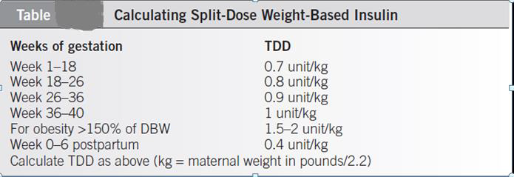
To calculate the initial 24-hour total daily dose (TDD) insulin requirement, the health care provider should use the patient’s current weight and the number of weeks of gestation.
Table below includes dosing recommendations for women with DM1, DM2, and GDM.

Slide 11
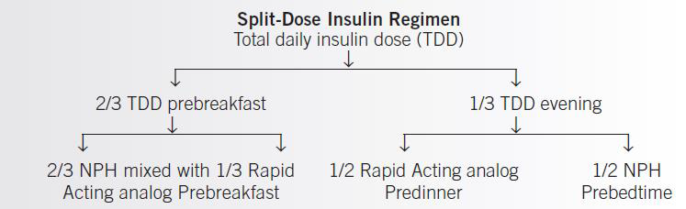

Slide 12
Management
If a patient experiences nocturnal hypoglycemia (less than 60 mg/dL), the evening regimen of rapid-acting and intermediate-acting insulin may be split to give the rapid-acting before dinner and intermediate-acting insulin before the important bedtime snack.
The goal is to first achieve normal AM fasting values and then focus on the rest of the glucose profile.
If nocturnal hypoglycemia is identified, patients should have the evening dose of intermediate- or long-acting insulin reduced. Delaying NPH administration until bedtime may help minimize nocturnal hypoglycemia. Otherwise, the caloric intake (especially protein) at the bedtime snack may be increased.

Slide 13
Home work
Why hypocalcemia occur in infant of diabetic mother?

Slide 14


