Slide 1
Prepared By
Assist. Lect. Rasha Saadi Abbas

Slide 2
Terminology
1. Parity: is the no. of live birth at any age or stillbirth after 24 weeks of gestation.
2. Nullipara: a woman who has never delivered a fetus or fetuses beyond 20 weeks of gestation.
3. Gravida:a is the total no. of pregnancy regardless of how they ended (abortion, normal pregnancy).
4. Nullgravida: a nulligravida or gravida 0 is a woman who has never been pregnant.
5. Primigravida: a primigravida or gravida 1 is a woman who is pregnant for the first time or has been pregnant one time.
6. Elderly primigravida: an elderly primigravida is a woman in her first pregnancy, who is at least 35 years old.

Slide 3
Example
A woman who has 2 complete abortions and 1 normal pregnancy may be termed as
G3P1A2
Gravida
Abortion
Parity

Slide 4
Obstetrical Abbreviations
-Expected Date of Delivery (EDD)
- First Missed Period (FMP)
- Last Menstrual Period (LMP)
- Fetal Movement ( FM)
- Poly Cystic Ovary Syndrome (PCOS)
- Neural Tube Defect (NTD)
- Fetal Life ( FL)
- Pregnancy Test (PT)
- Caesarean Section (C/S)
- Normal Vaginal Delivery (NVD)
- Premature Uterine Contractions (PUC)
- Respiratory Distress Syndrome (RDS)

Slide 5
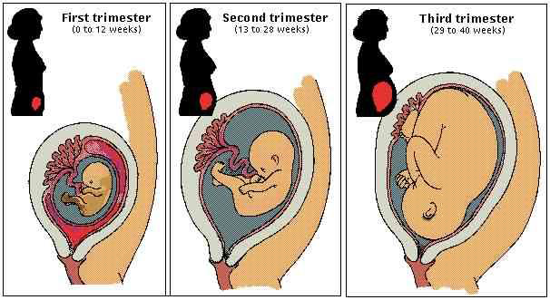
Trimesters of Pregnancy
The human gestation period is 36-42 weeks, and is divided into three stages called trimesters. Each trimester is three months.

Slide 6
Pregnancy Signs and Symptoms
1. Nausea and vomiting
2. Heartburn
3. Constipation
4. Ptyalism
5. Varicosities and Hemorrhoids
6. Leg Cramps
7. Backache
8. Headache
9. Urinary Frequency
10. Leukorrhea
11. Syncope

Slide 7
Laboratory Evaluation
1. Maternal Serum Screening Tests:
A. Amniocentesis (also referred to as amniotic fluid test or AFT):
B. Chorionic Villus Sampling (CVS)
C. Alfa-fetoprotein (AFP or MSAFP) test
2. Screening for Gestational Diabetes
all patients between 24 and 28 weeks gestation.
3. Researching for Rh Antibodies
4. Screening for Bacterial Vaginosis
5. Testing for Group B Streptococci (GBS)

Slide 8
Nutrition in pregnancy
1. Folic acid:
Dietary Allowance (RDA) for folate equivalents for pregnant women is 600 micrograms.
2. Iron:
The dose is 200 mg tid.
3. Calcium:
recommended dietary allowance (RDA) of 1200 mg May during pregnancy.

Slide 9
Nutrition in pregnancy (cont.)
4. Zinc
The RDA during pregnancy is increased from 15 to 20 mg /day.
5. Vitamin D
400-500IU vitamin D supplementation have been reported to be safe and adequate.
6. Vitamin A

Slide 10
Pregnancy Loss and Spontaneous Abortion
Abortion is the termination of pregnancy by any means, resulting in the expulsion of an immature, nonviable fetus.
The term “miscarriage,” although imprecise, has been used for all types of pregnancy losses up to a gestational age of 20 to 22 weeks.
The term miscarriage is used often in the lay language and refers to spontaneous abortion.

Slide 11
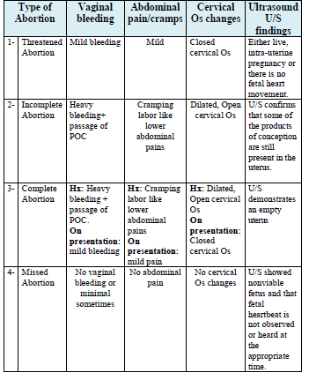

Slide 12
1- Threatened abortion
Vaginal bleeding, with or without menstrual-like cramps, in the first 20 weeks of pregnancy is the most common manifestation of threatened abortion. There is frequently no history of passage of tissue or rupture of membranes.

Slide 13
1- Threatened abortion/ Management
Progesterone is prescribed in 13-40% of women with threatened miscarriage. Progesterone is the main product of the corpus luteum, and giving Progesterone is expected to support a potentially deficient corpus luteum gravidarum and induce relaxation of a cramping uterus although progesterone does not seem to improve outcome in women with threatened miscarriage. However, local application of a progestogen was found to subjectively decrease uterine cramping more rapidly than bed rest alone in one small study.
Example of progesterone giving for threatened abortion:
Dydrogesterone (Duphaston®) 10 mg tab (2-3 tab/ day).

Slide 14
2- Incomplete abortion
Incomplete abortion is the partial expulsion of the products of conception before the 20th week of gestation.

Slide 15
2- Incomplete abortion /Treatment
I. Stabilization
II. Cervical ripening agents
Cervical ripening agents aid in patient comfort and reduce the difficulty of uterine evacuation procedures.
• Available cervical ripening agents include Misoprostol, Mifepristone, and osmotic dilators.
For medical management of women with an incomplete abortion and a uterus less than 12 weeks in size Misoprostol (Cytotec®) 600 μg orally or 400 μg sublingually is used. Doses can be repeated every 3 hours for up to three total doses.
III. Curettage

Slide 16
3- Complete abortion
Complete abortion refers to a documented pregnancy that spontaneously passes all of the products of conception.

Slide 17
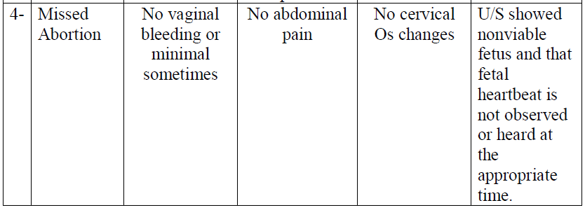
4- Missed abortion
Missed abortion is defined as the retention of product of conception (POC) after death of the fetus. There is no definition of the length of time of retention of the POC.

Slide 18
4- Missed abortion / Treatment
Misoprostol
For missed abortion, misoprostol can be increased to 800 μg vaginally or 600 μg sublingually. Doses can be repeated every 3 hours for up to three total doses.
Misoprostol may be used for outpatient treatment of missed or incomplete abortion in patients with:
• Stable vital signs
• No evidence of infection
• Good reliability
• Fetus measuring less than 13 weeks’ gestation
• POC with no fetal pole on transvaginal ultrasound

Slide 19
4- Missed abortion / Treatment
I. Dilation and curettage (D&C)
• D&C is available for missed abortions that are less than 12 to 14 weeks’ gestation by fetal size on ultrasound. If the cervix is not dilated, then preoperative dilation is accomplished with laminaria or prostaglandin cervical-dilating agents.
II. Dilation and evacuation (D&E)
• D&E is available for missed abortions greater than 14 weeks’ gestation by fetal size on ultrasound. The D&E procedure is used rather than D&C when there are fetal bones and associated risk for uterine perforation

Slide 20
5- Habitual abortion
Habitual abortion, also known as recurrent pregnancy loss (RPL), is defined as three or more consecutive spontaneous abortions of clinical, pre-viable pregnancies (documented by ultrasound or histopathology).

