Slide 1
the Phase Rule and Different Components
Lab(2) physical pharmacy
Done By:
Lecturer Sura Zuhair
Assistant Lecturer Hiba Sabah
Assistant Lecturer Zeina Dawoad

Slide 2
phase rule : is a relationship for determining the least number of variables required to define the state of the system.
-phase :-is homogeneous physically distinct portion of the system which is separated from other parts of the system by bounding surfaces
(e.g. water & its vapor is one component two phase system)
Number of component :is the smallest number of constituents by which the phase of equilibrium system can be expressed as a chemical formula or equation.

Slide 3
Two component systems containing liquid phase
-as we know ethyl alcohol & water are miscible in all proportions , while water & mercury are completely immiscible regardless the amount of each.
Between these two extremes lie a whole range of system which exhibit a partial miscibility ( or immiscibility) such as water & phenol , as their miscibility affected by two factors conc. & temp.

Slide 5
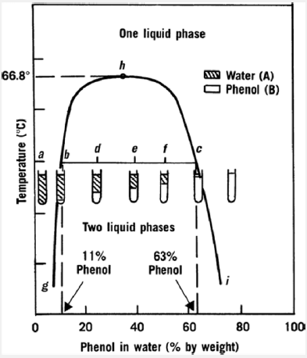
To see the effect of temp. & conc. ,we draw graph paper of temp. versus conc.

Slide 7
binodal curve :- is the curve that separates two phase area from one phase area .
-tie line :- is the line drawn across the region of two phases (conjugate phases ) as each temp. has its own tie line.
-upper consolute temp. or critical solu. Temp. :- is the maximum temp. at which two phase region exists .
Water & phenol system it is 66.8 as all combinations above this temp. is completely miscible & give one phase system.
-mass ratio:-is the relative amount by wt. of conjugate phase ,it depends on the position in tie line & temp.
properties of the tie –line in two component systems:-
1-it is parallel to the base line
2-all systems prepared along the tie line at equilibrium separated into two conjugate phases of constant composition.

Slide 8
For instance, consider a system containing 24% by weight of phenol and 76% by weight of water (point d in the diagram). At equilibrium two liquid phases have been presented in the tube. The upper one, A, has a composition of 11% phenol in water (point b on the diagram), whereas the lower layer, B, contains 63% phenol (point c on the diagram). The relative weights of the two phases can be calculated by the equation
11%--------24%----- 63%
b-----------d------------c

Slide 9
advantages of binodal curve :-
Binodal curve or phase diagram is used to formulate systems containing more than component in single liq. phase product
Q: At 25 C a tie line 7%---------70%, find the mass ratio and the composition of each phase of 40% w/w phenol by water at this temperature, note that the total weight is 10 g?
7%-------40%------------70%
b-----------d---------------c
Wt of A = dc 70-40 = 30 = 10 (mass ratio)
Wt of B bd 40-7 33 11
10+11=21 (total parts)
21
x 10 (total wt.) x= 4.76 gm wt of A
10-4.76 = 5.24 gm wt of B
If we want to know the amount of phenol and water in each phase
For phase A For phase B
100 70 100
X 4.76 x= 0.33gm of phenol in A X 5.24 X= 3.6gm of phenol in B
4.76-0.33= 4.42 gm of water in A 5.24- 3.6= 1.57gm of water in B

Slide 10
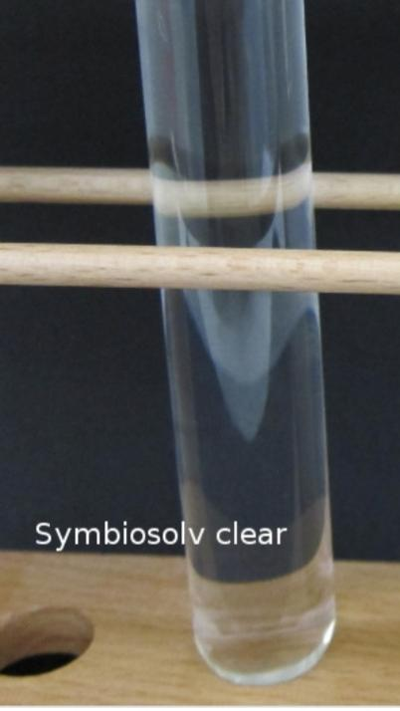
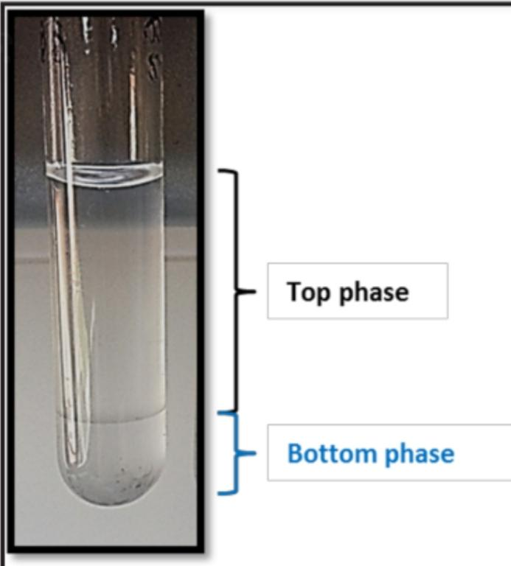
Procedure:
Prepare the following percent W/W phenol/water(10 gm total) 2%,7%,9%,11% ,24%,40%,55 %,63%,70%,75%.
Put test tube in a fixed temperature in water bath (25 C⁰) or (left test tube at room temp.) and keep it for 10 minutes at that temp.
Take the test tubes out and before their temp has changed record which one has 2 phases and which has one phase.
Repeat the work at higher temp using the following temp.40C⁰, 50C⁰, 70C⁰.
Draw a curve temp verses concentrations showing your 2 phases area and one phase area in the curve.
Draw tie line for each temp.
Take 40% W/W for example to find the mass ratio and the composition of each phase at different temp.
Mention the upper consulate temp

Slide 11
The results of two components (phenol +water)
Temp | 2% | 7% | 9% | 11% | 24% | 40% | 55% | 63% | 70% | 75%
25C°
40C°
50C°
70C°

