Slide 1
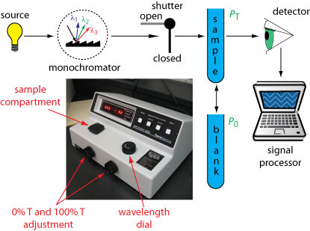
LAB 1 PART(2)practical part preparation of Calibration curve of salicylic acid with the application of statistics

Slide 2
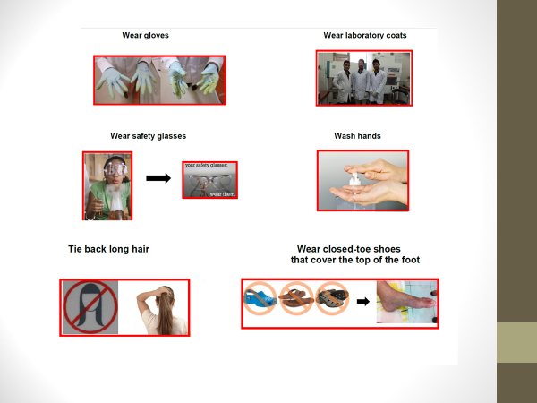

Slide 3
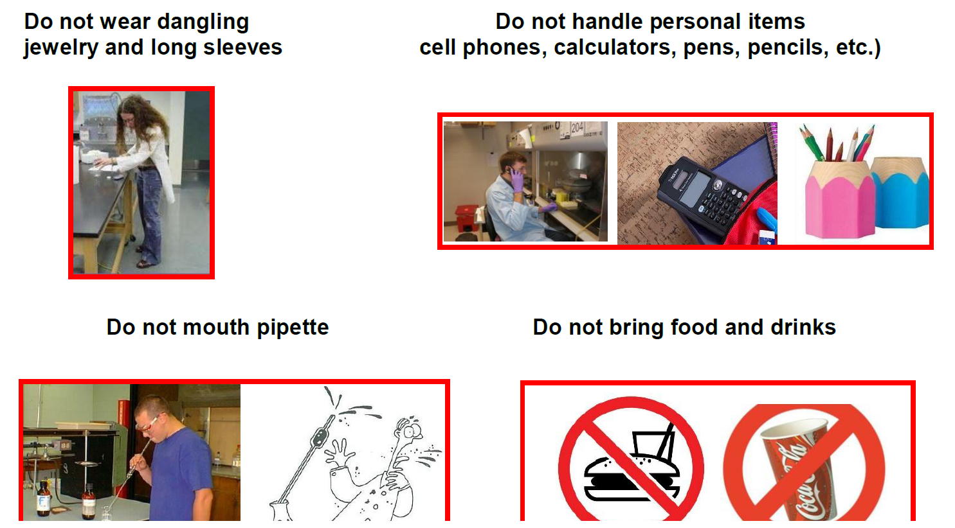
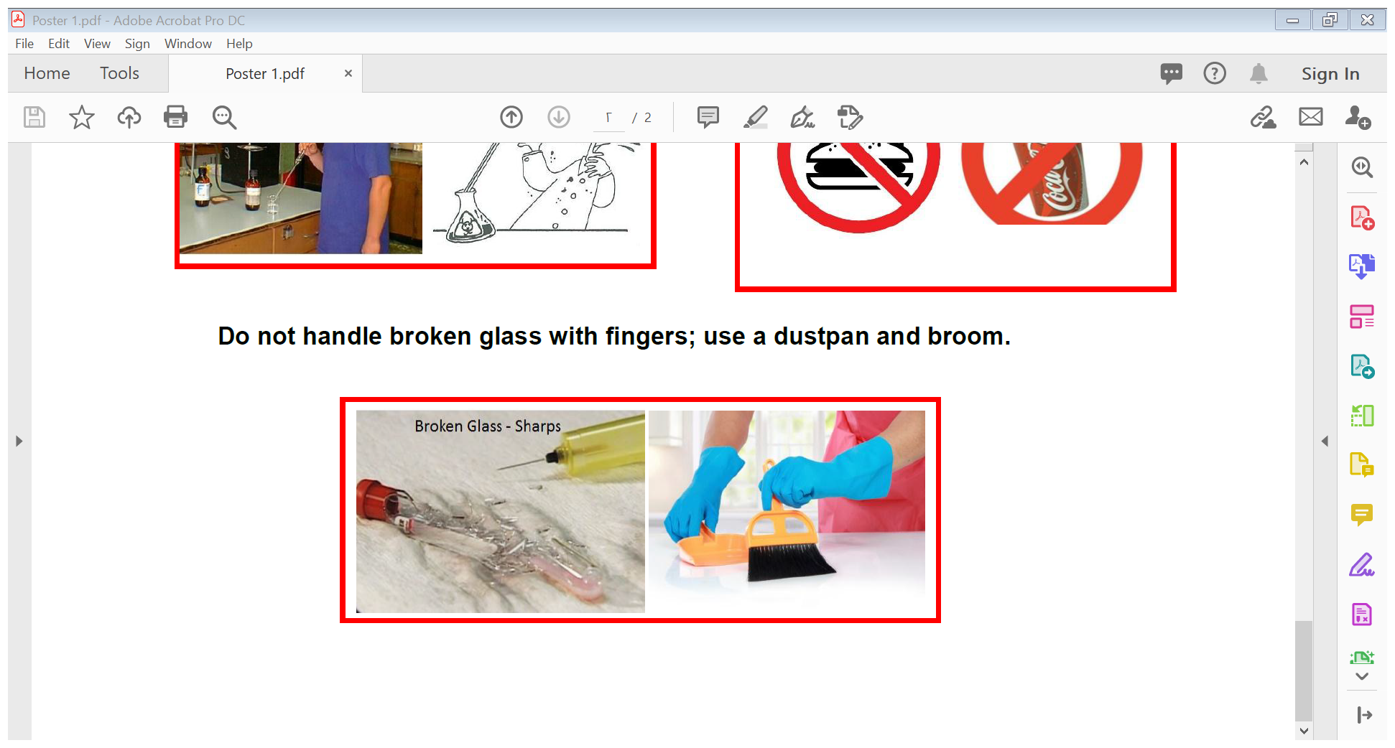

Slide 4
SPECTROPHOTOMETRIC METHOD
Supervised by
Assistant prof. Masar Basim
Lecturer Nora Zawar
Lecturer Ashti Mohamed
Assistant lecturer Zahraa Ammer

Slide 5
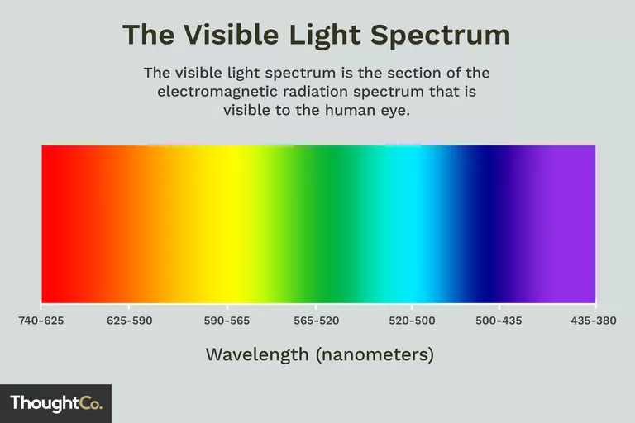

Slide 6
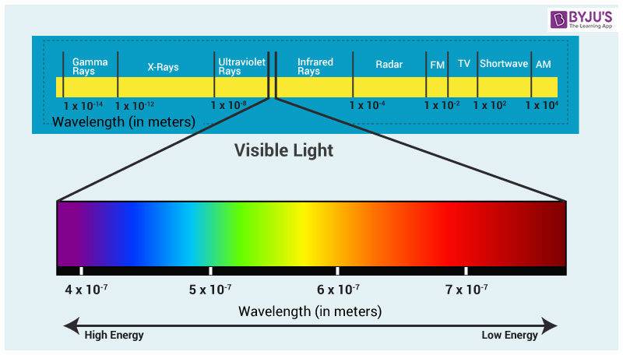

Slide 7
In pharmaceutical spectrophotometric analysis
The measurement of the amount of visible or ultraviolet light of a definite wave length which is absorbed by a solution involve the use of spectrophotometer
Visible light , of wave length 400-760 nm
Ultraviolet , between 200-400 nm

Slide 8
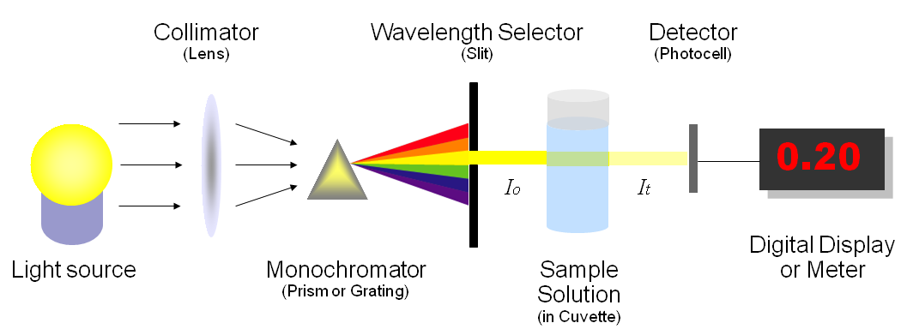
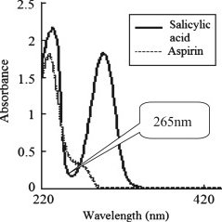
SPECTROPHOTOMETER

Slide 9
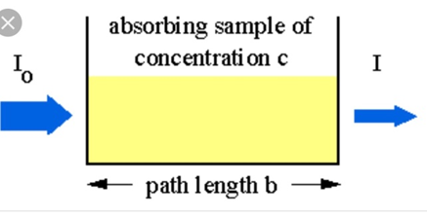

Slide 10
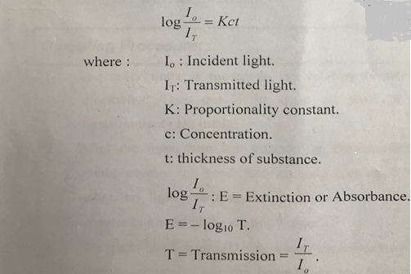
The fundamental relationship
Used in spectrophotometry is Beer and lambert laws in combination:

Slide 11
What is the aim of experiment ?
The aim is to prepare a calibration curve of salicylic acid from a series of standard solutions why?
to use it as a reference curve to obtain the concentration of unknown sample of the same drug .

Slide 12

Procedure and calculations:
1. prepare 250 ml of stock solution of sodium salicylate containing equivalent of 200 mg salicylic acid /100 ml
Why sodium salicylate ?

Slide 13
Why sodium salicylate ??
Note : sodium salicylate is readily soluble in cold water , so it is used to prepare the stock solution of sodium salicylate after calculating its equivalent content of the acid .
while salicylic acid is sparingly soluble in cold water (1 part in 550 parts of water ), but more soluble in hot water (1part acid in 15 parts of boiling water ), from which it can be recrystallized

Slide 14
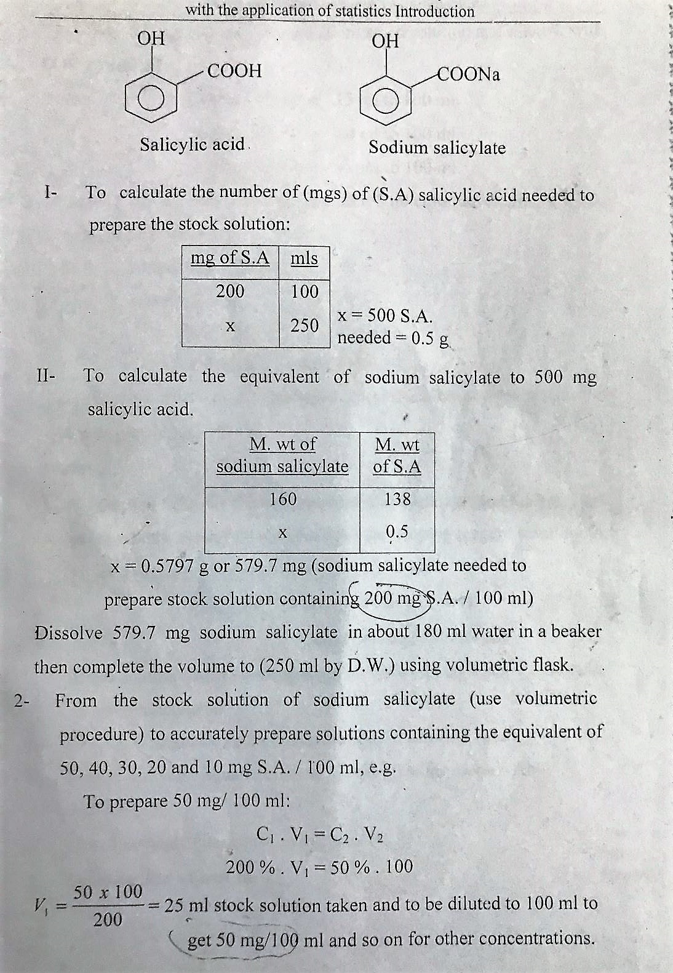

Slide 15
579.7 mg of sodium salicylate needed to prepare 200 mg of salicylic acid /100ml
2- dissolve 579.7 mg of sod. Salicylate in 180
ml of water then complete the volume to 250 ml by using volumetric flask (PRIMARY STOCK)
3- the PRIMARY stock solution of sodi salicylate containing equivalent of 200 mg\100 ml of salicylic acid
From this primary stock prepare other stock solution 100 mg \100 ml by using
CIVI=C2V2
200%X V1= 100%X100
V1=50 ml of primary stock and complete the volume up to 100 ml d,w (SECONDARY STOCK)

Slide 16
from this secondary stock Prepare serial dilutions (use volumetric procedures ) accurately prepare solutions containing equivalent of 50, 40 ,30 , 20 , 10mg/ 10 ml
For example to prepare 50 mg\10 ml
C1V1=C2 V2
100 mg x V1= 50 mgx10 ml
V1 =5 ml of stock solution to be taken and complete the volume by d.w up to 10 ml
Same procedure for other dilutions

Slide 17

For 40 mg 4 ml of stock complete up to 10 ml d.w
For 30 mg 3 ml of stock complete up to 10 ml d.w
For 20 mg 2 ml of stock complete up to 10 ml d.w
For 10 mg 1 ml of stock complete up to 10 ml d.w
4- set the spectrophotometer wave length at 265 nm( lamda max for salicylic acid )
5- the blank in this experiment is d.w
6- auto zero the spectrophotometer by using blank
7-put the sample in the cuvette and read absorbance

Slide 18
8 –record your results concentration versus absorbance
9- draw your results by using graph paper (make calculation using excel program)
9 – obtain straight line equation by using least square method
10- calculate y prime for each concentration
11 – draw y prime versus concentration by using excel Microsoft program
12- add trend line

Slide 19
Notes:
b. Blank in this experiment consist of 1 ml d w +5 ml color developing reagent .
4- plot the absorbance versus concentration of S.A.
5- APPLY the least square method to calculate the slope and intercept .
6- use straight line equation to calculate y
7- draw the line of best fit

Slide 20


