Slide 1
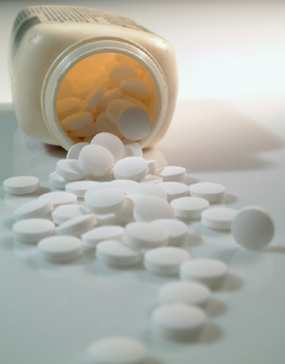
Tablet Dosage Form
Lab 1

Slide 2
Tablets
Tablets are solid dosage form usually prepared with the aid of suitable pharmaceutical excipients.
They may vary in:
size,
shape,
weight,
hardness,
thickness,
disintegration and
dissolution characteristics.
And in other aspects; depending upon their intended use and method of manufacture.

Slide 3
Ingredients used in tablets
Drugs
Fillers or diluents (bulking agent)
  To make a reasonably sized tablet e.g. Starch, lactose
Binders:
  To promote adhesion of particles of formulation and enable granulation also maintenance of integrity of final tablet e.g. PVP, acacia mucilage, starch paste
Binders may be added as:
Dry powder in dry granulation
Solution in wet granulation
Disintegrants
  To promote breakup of the tablets into small particles
  To promote rapid release of the drug and thus rapid availability.
e.g. Starch, cellulose derivatives and avicel pH 101, 102 (absorb water and swell thus increase the internal pressure of tablet then rupture of tablet into small granules).
Lubricants & anti- adherants
  To reduce the friction during tablet ejection between the walls of the tablet and the walls of the punches and the die cavity e.g. Steric acid and its derivatives, talc.

Slide 4
Glidants
  Reducing friction between the particles
  To improve the flow properties of the powder mixture
  e.g. Silica derivatives
Dissolution (enhancers and retardants)
Wetting agents: increase wettability by using surfactant like SLS
Antioxidants
Preservatives
Coloring agents: improve appearance and distinguish products from each other.
Flavoring agents and sweetening agents: improve taste and flavor like lozenges and chewable tablets e.g. mannitol and artificial sweetener.

Slide 5
Tablet compression machine
Hopper for holding and feeding granulation (or powder) to be compressed
Feed frame for distributing granulation from the hopper into the dies
Dies for controlling the size and shape of the tablet
Punches for compressing the granulation within the dies
Cam tracks for guiding the movement of the punches

Slide 6
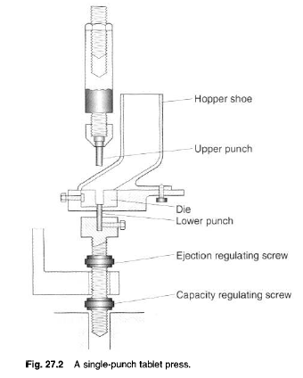

Slide 7
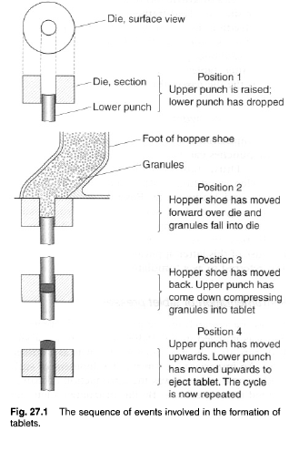

Slide 8
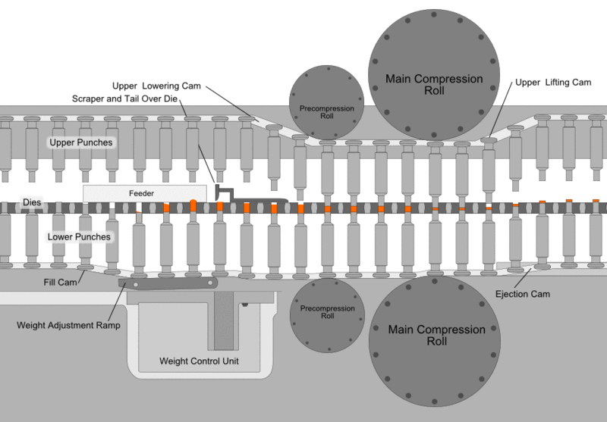

Slide 9
Compression process
Filling
  By gravitational flow of powder from hopper via the die table into die. The die is closed at its lower end by the lower punch.
Compression
  The upper punch descends and enters the die and the powder is compressed until a tablet is formed.
  During the compression phase, the lower punch can be stationary or can move upwards in the die.
  After maximum applied force is reached, the upper punch leaves the powder i.e. the decompressed phase.
Ejection
  During this phase, the lower punch rises until its tip reaches the level of the top of the die. The tablet is subsequently removed from the die and die table by a pushing device.

Slide 10
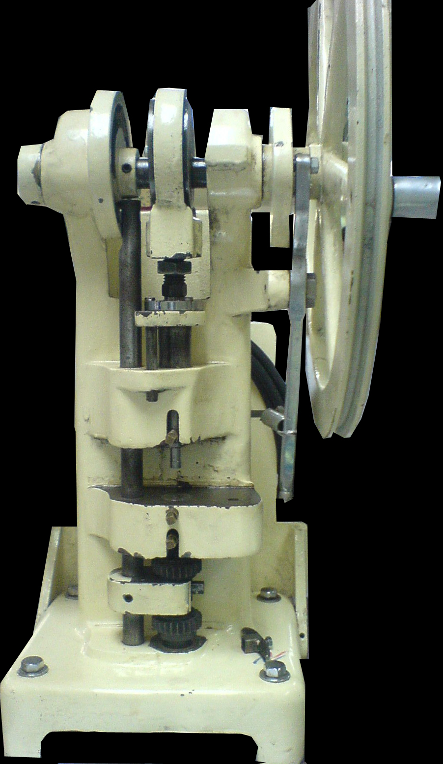
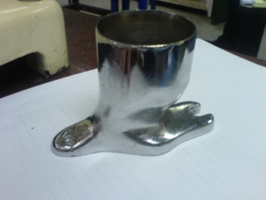
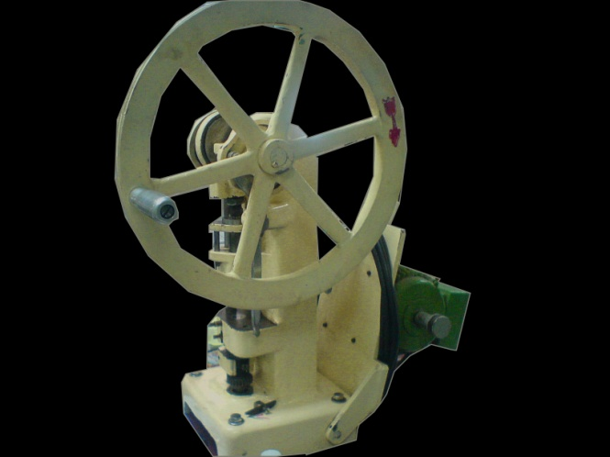
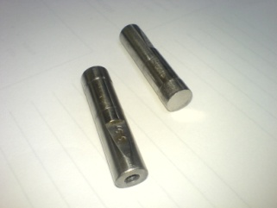
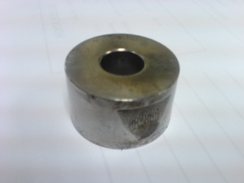
Single Punch Machine (Tablets)
Upper and
Lower Collar
Collar locker

Slide 11
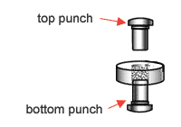

Slide 12
Tablet production methods
Dry methods
Direct compression
Dry granulation
Wet methods
Wet granulation

Slide 13
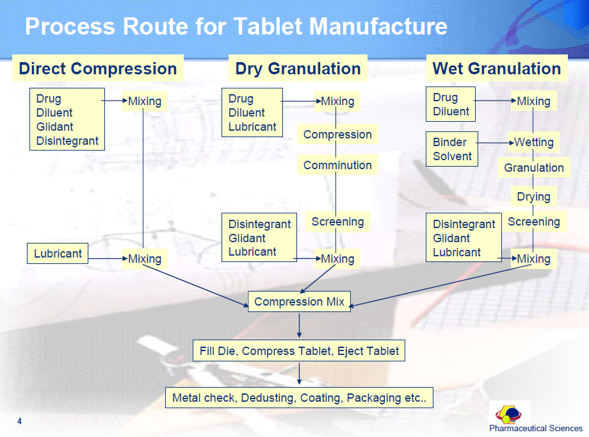

Slide 14
For more information please follow these links
https://www.youtube.com/watch?v=4xggZRckfTE
https://www.youtube.com/watch?v=0zcC72P7pwo
https://www.youtube.com/watch?v=yCwqABwoVUA
https://www.youtube.com/watch?v=42wg9_zuWh0

Slide 15


